Slide 1

ANATOMY
THE UPPER LIMB
DPT
1ST SEMESTER
DR DANISH

Slide 2
Muscles of the Arm
The arm is divided into:
  Anterior compartment (flexor group)
  Posterior compartment (extensor group)
Muscles act mainly on the elbow joint

Slide 3
Muscles of Anterior Compartment
Biceps Brachii
Brachialis
Coracobrachialis
Nerve Supply: Musculocutaneous nerve

Slide 4
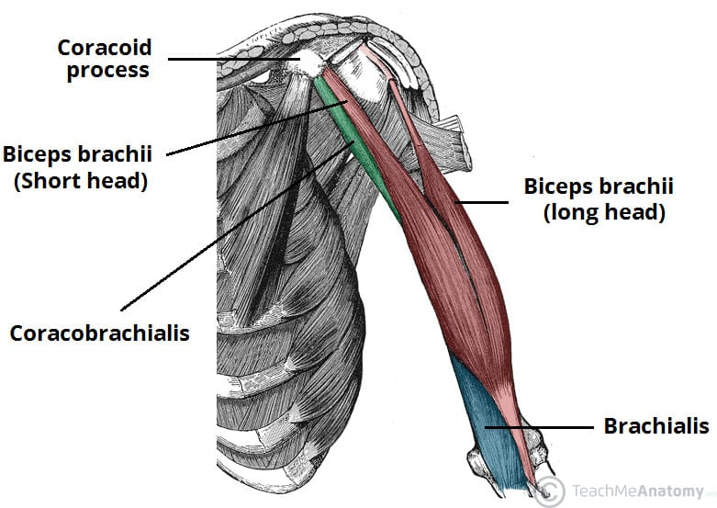

Slide 5
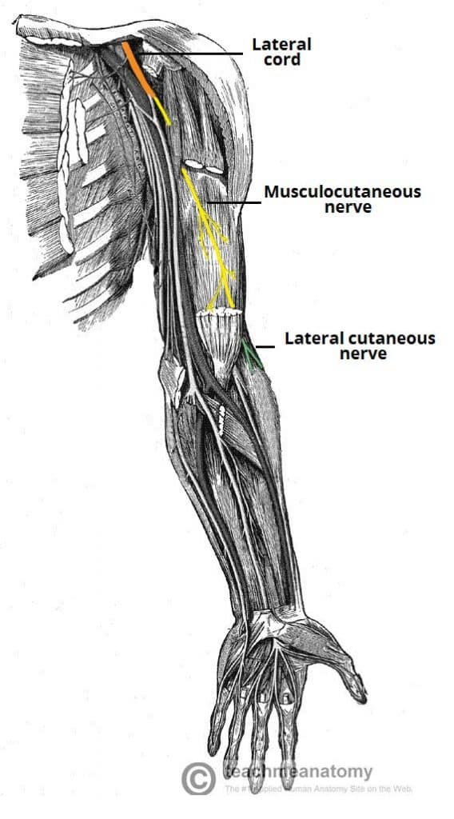

Slide 6
Biceps Brachii
Origin:
Long head: Supraglenoid tubercle of scapula
Short head: Coracoid process of scapula
Insertion:
Radial tuberosity
Bicipital aponeurosis

Slide 7
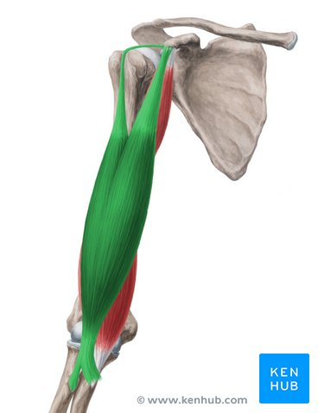

Slide 8
Continued
Nerve Supply:
Musculocutaneous nerve
Nerve Root:
C5–C6
Functions:
Supination of forearm
Flexion of elbow
Assists in shoulder flexion

Slide 9
Brachialis
Origin:
Lower half of anterior surface of humerus
Insertion:
Coronoid process and tuberosity of ulna
Nerve Supply:
Musculocutaneous nerve
Small contribution from radial nerve

Slide 10
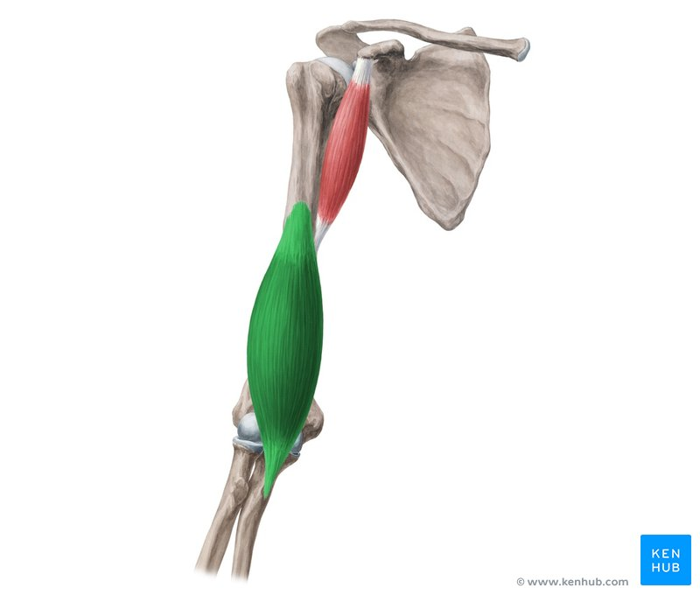

Slide 11
Continued
Nerve Root:
C5–C6
Functions:
Chief flexor of elbow (in all positions)

Slide 12
Coracobrachialis
Origin:
Coracoid process of scapula
Insertion:
Middle third of medial surface of humerus
Nerve Supply:
Musculocutaneous nerve

Slide 13
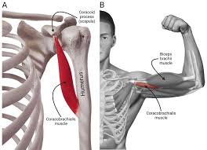

Slide 14
Continued
Nerve Root:
C5–C7
Functions:
Flexion and adduction of shoulder
Stabilizes shoulder joint

Slide 15
POSTERIOR COMPARTMENT OF ARM
Triceps Brachii
Anconeus
Nerve Supply: Radial nerve

Slide 16
Triceps Brachii
Origin:
Long head: Infraglenoid tubercle of scapula
Lateral head: Posterior surface of humerus (above radial groove)
Medial head: Posterior surface of humerus (below radial groove)
Insertion:
Olecranon process of ulna

Slide 17
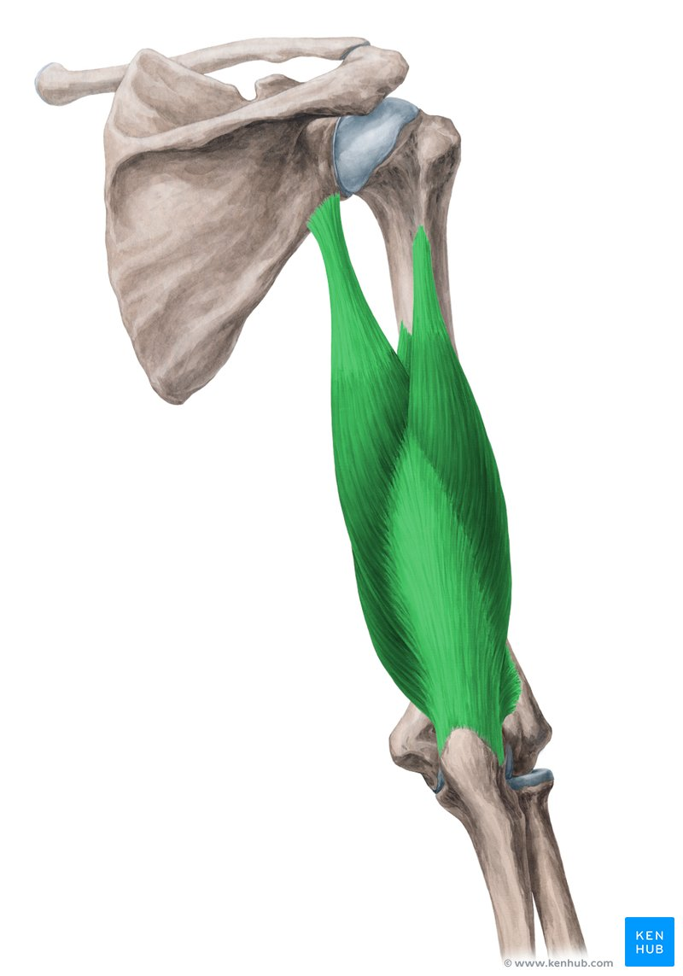

Slide 18
Continued
Nerve Supply:
Radial nerve
Nerve Root:
C6–C8
Functions:
Extension of elbow
Long head assists in shoulder extension and adduction

Slide 19


Slide 20


