Slide 1

HUMAN ANATOMY
BS RIT,OTT,MLT
1ST SEMESTER
DR DANISH

Slide 2
Male Reproductive System
OVERVIEW
System concerned with:
  Production of male gametes (spermatozoa)
  Secretion of male sex hormones (androgens)
Also responsible for:
  Storage
  Maturation
  Transportation of sperm

Slide 3
Components of Male Reproductive System
Primary sex organ
  Testes
Accessory ducts
  Epididymis
  Vas deferens
  Ejaculatory ducts
  Urethra

Slide 4
CONTINUED
Accessory glands
  Seminal vesicles
  Prostate gland
  Bulbourethral (Cowper’s) glands
External genitalia
  Penis
  Scrotum

Slide 5
Testes
Situation & Shape
Paired organs
Located in the scrotum
Oval in shape
Each testis:
  Length: ~4–5 cm
  Width: ~2.5 cm

Slide 6
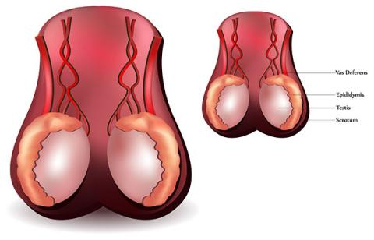

Slide 7
Epididymis
Crescent-shaped structure
Lies on posterior border of testis
Divided into:
  Head
  Body
  Tail
Functions:
  Storage of sperm
  Maturation of sperm

Slide 8
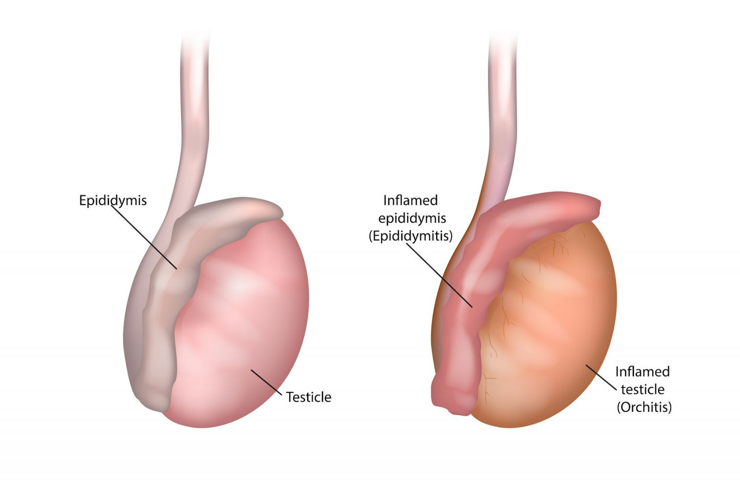

Slide 9
Vas Deferens
Thick-walled muscular tube
Length: ~45 cm
Extends from:
  Tail of epididymis → ejaculatory duct
Function:
  Conduction of sperm during ejaculation

Slide 10
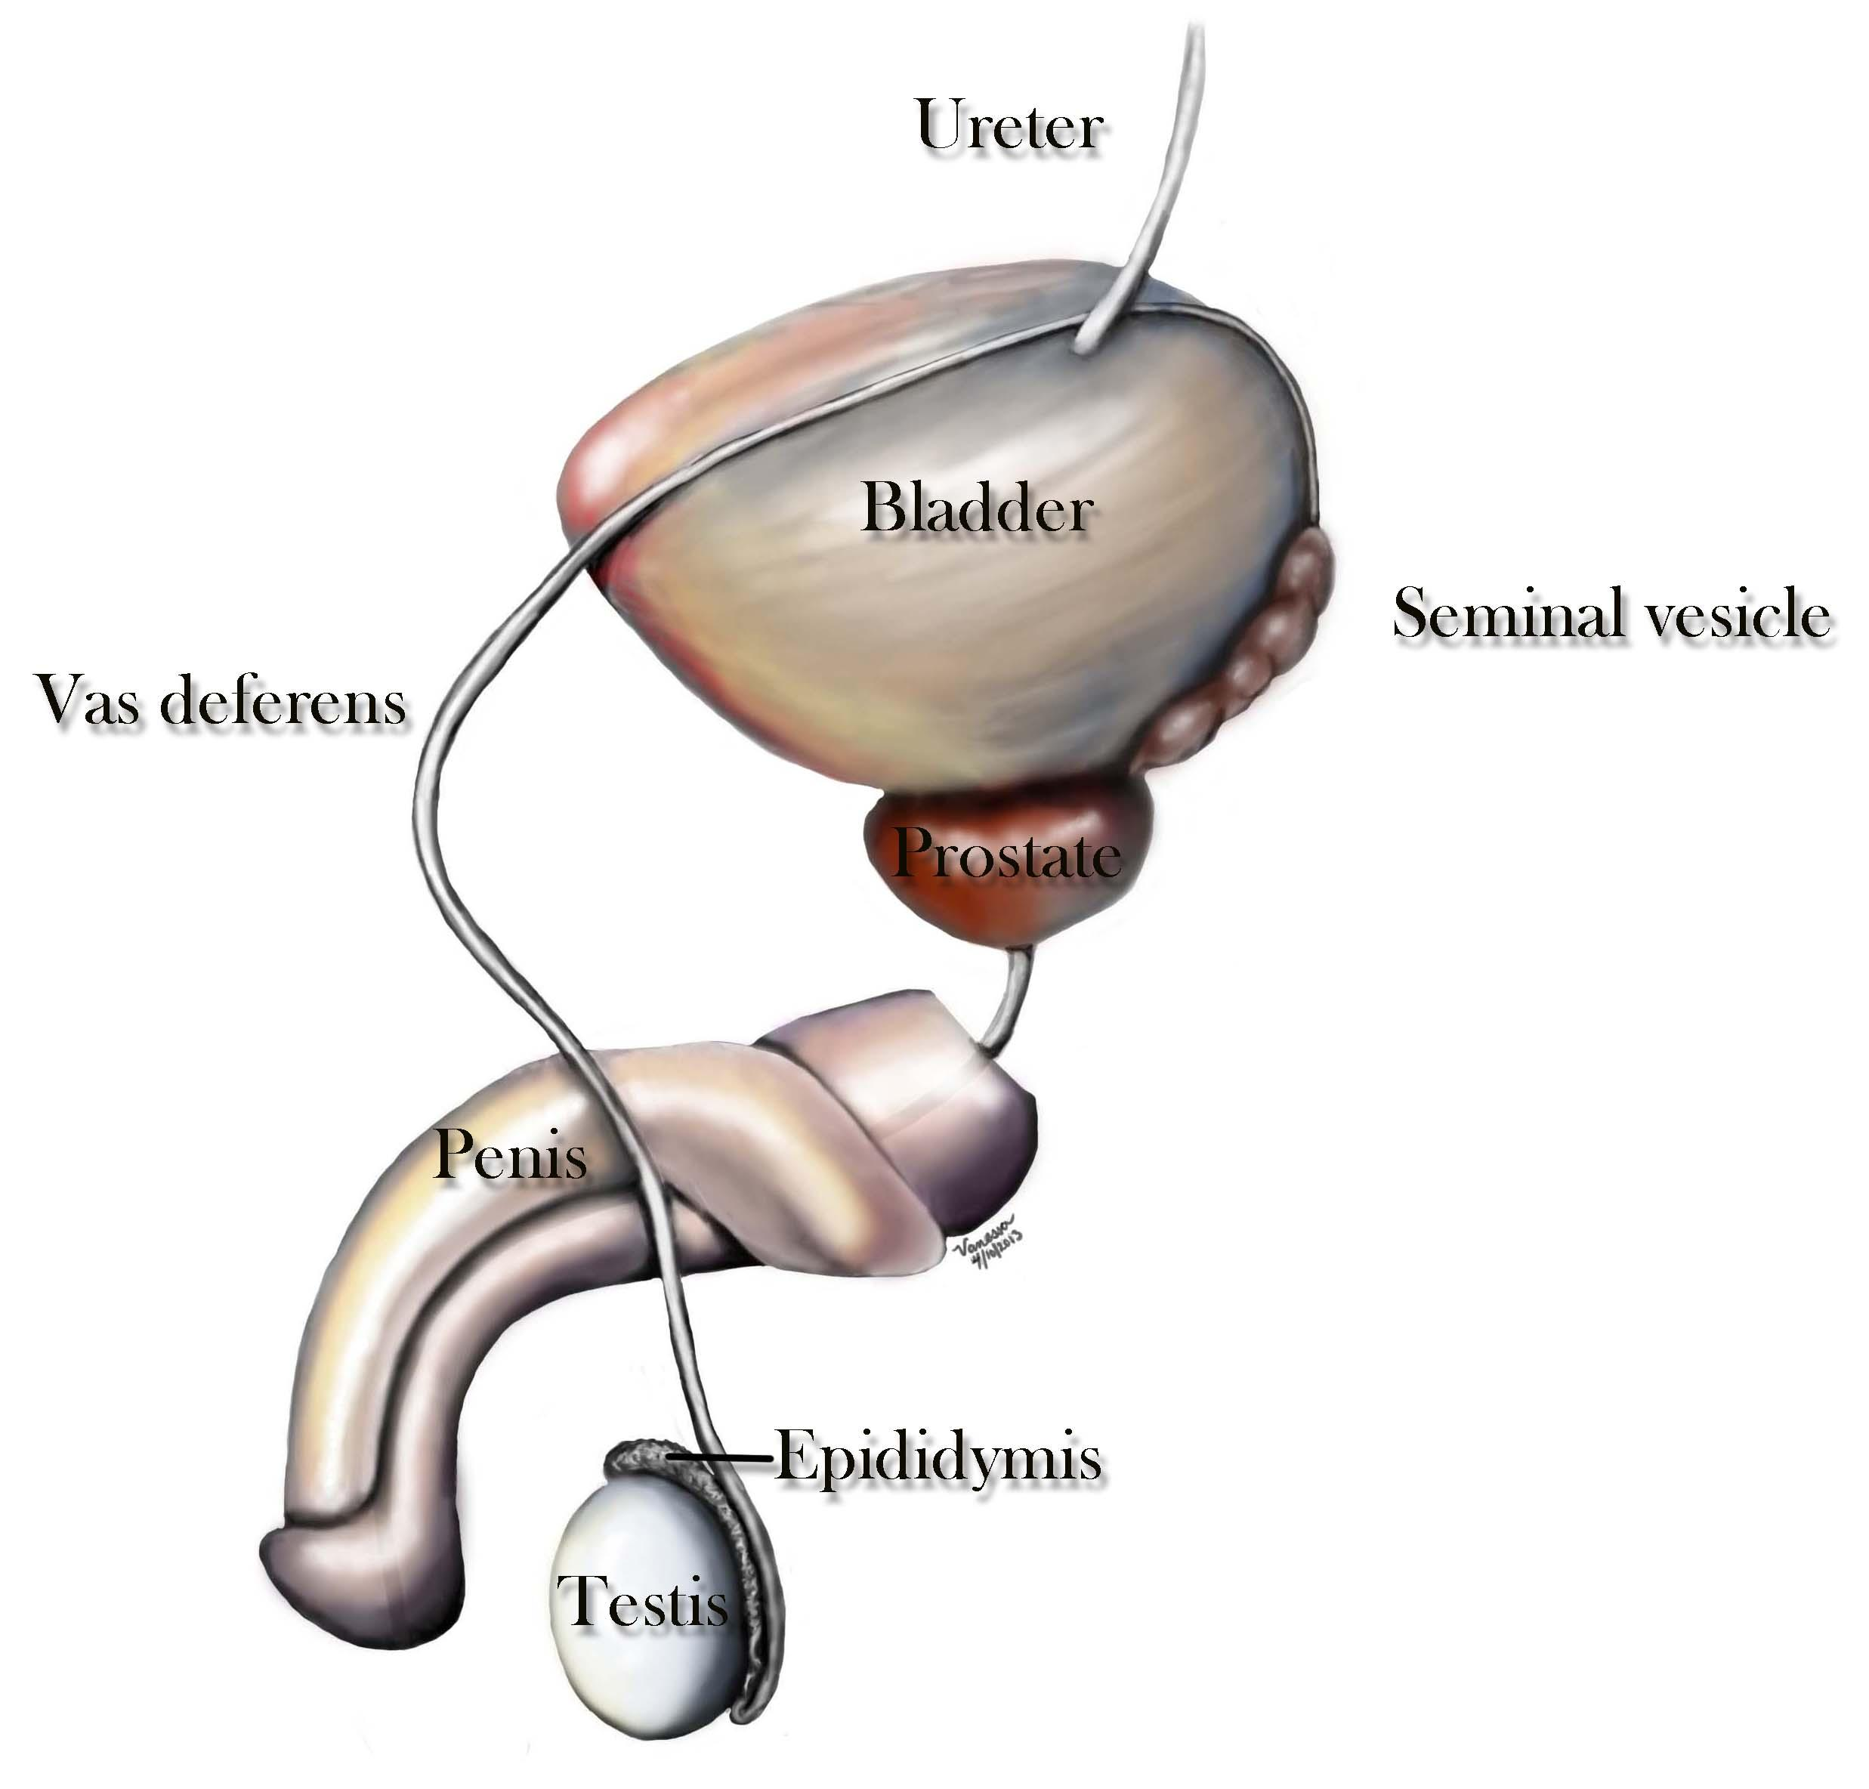

Slide 11
Ejaculatory Ducts
Formed by union of:
  Vas deferens
  Duct of seminal vesicle
Open into:
  Prostatic urethra

Slide 12
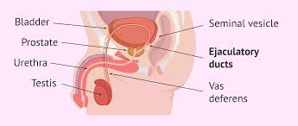

Slide 13
Accessory Glands
Seminal Vesicles
Paired glands
Posterior to urinary bladder
Secrete:
  Fructose-rich alkaline fluid
Forms major volume of semen

Slide 14
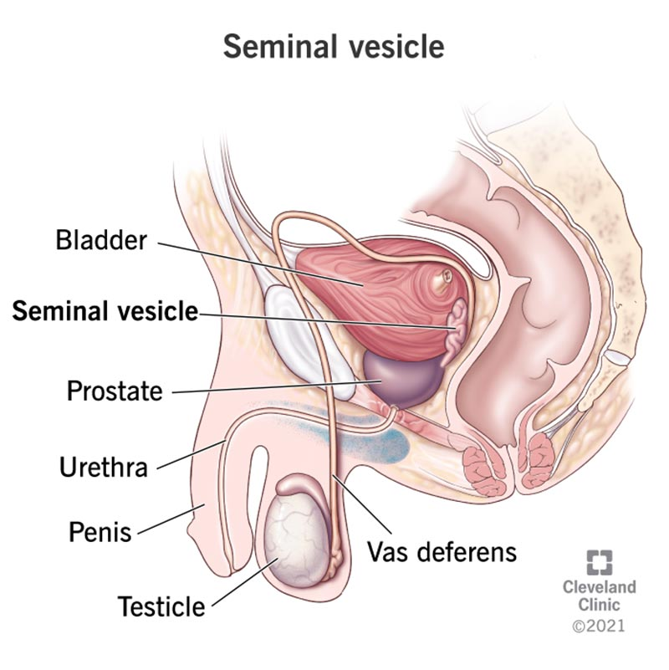

Slide 15
Prostate Gland
Single gland
Below urinary bladder
Surrounds prostatic urethra
Secretes:
  Milky fluid
Helps in sperm motility

Slide 16
Bulbourethral (Cowper’s) Glands
Pea-sized glands
Open into spongy urethra
Secrete:
  Mucus for lubrication

Slide 17
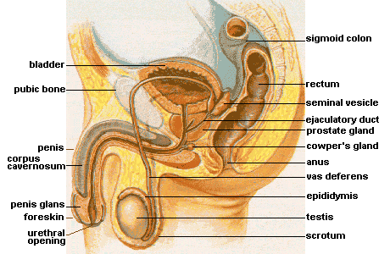

Slide 18


Slide 19


