Slide 1

ANATOMY
THE UPPER LIMB
DPT
1ST SEMESTER
DR DANISH

Slide 2
SUPERFICIAL BACK MUSCLES
OVERVIEW:
Also called extrinsic back muscles
Connect upper limb to axial skeleton
Mainly involved in movement of shoulder and upper limb

Slide 3
1. TRAPEZIUS
Origin:
Medial third of superior nuchal line
External occipital protuberance
Ligamentum nuchae
Spinous processes of C7–T12
Insertion:
Lateral third of clavicle
Acromion
Spine of scapula

Slide 4
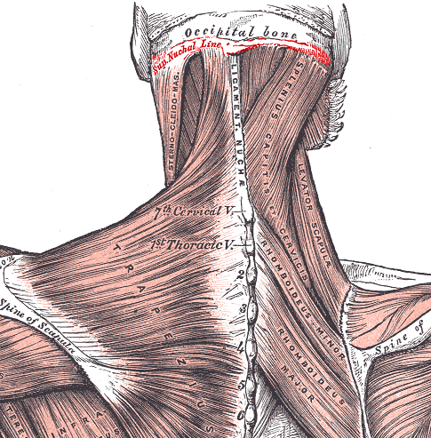

Slide 5
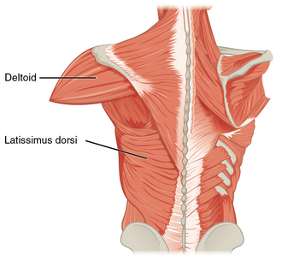

Slide 6
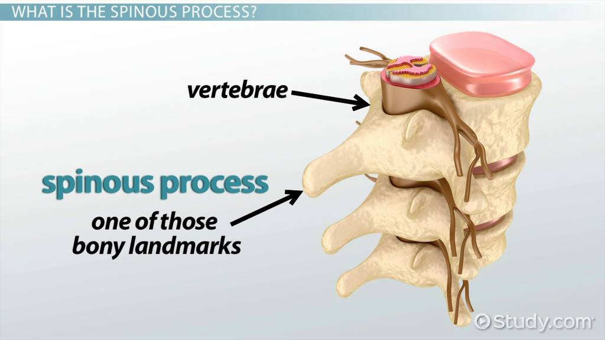

Slide 7
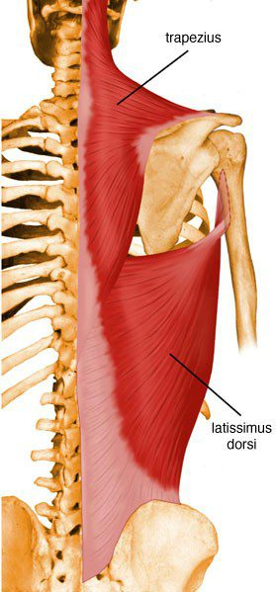

Slide 8
Continued
Nerve Supply
Spinal Accessory Nerve (CN XI) – motor
C3–C4 ventral rami – proprioception
Nerve Root
C3, C4 (sensory)

Slide 9
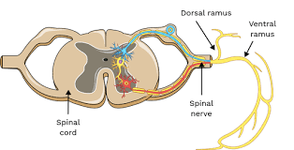

Slide 10
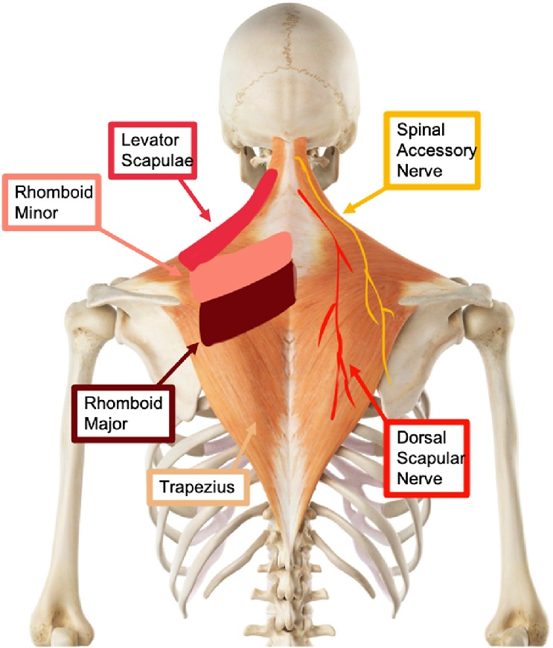

Slide 11
Function
Elevates scapula
Retracts scapula
Depresses scapula
Rotates scapula upward
Extends head and neck

Slide 12
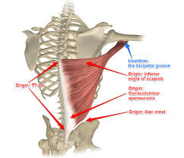
2. LATISSIMUS DORSI

Slide 13
Continued
Origin
Spinous processes of T6–T12
Thoracolumbar fascia
Iliac crest
Lower 3–4 ribs
Insertion
Floor of intertubercular sulcus of humerus

Slide 15
Continued
Nerve Supply
Thoracodorsal nerve
Nerve Root
C6, C7, C8

Slide 16
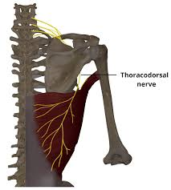

Slide 17
Function
Extension of arm
Adduction of arm
Medial rotation of arm
Raises body during climbing

Slide 18
3. LEVATOR SCAPULAE
Origin
Transverse processes of C1–C4
Insertion
Medial border of scapula above spine
Function
Elevates scapula
Downward rotation of scapula
Assists neck side flexion

Slide 19
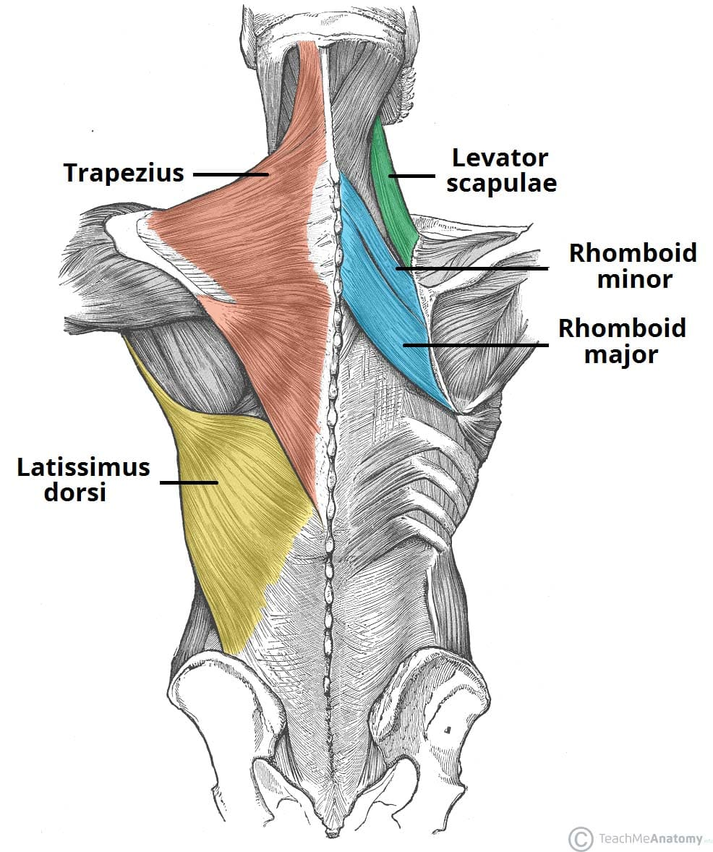

Slide 20
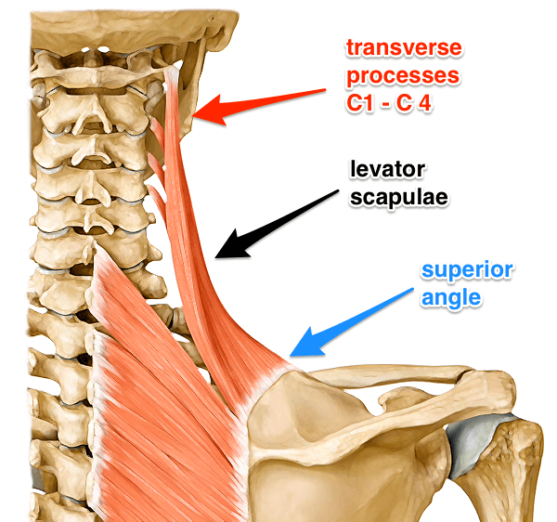

Slide 21
Continued
Nerve Supply
Dorsal scapular nerve
Cervical nerves
Nerve Root
C3, C4, C5

Slide 22
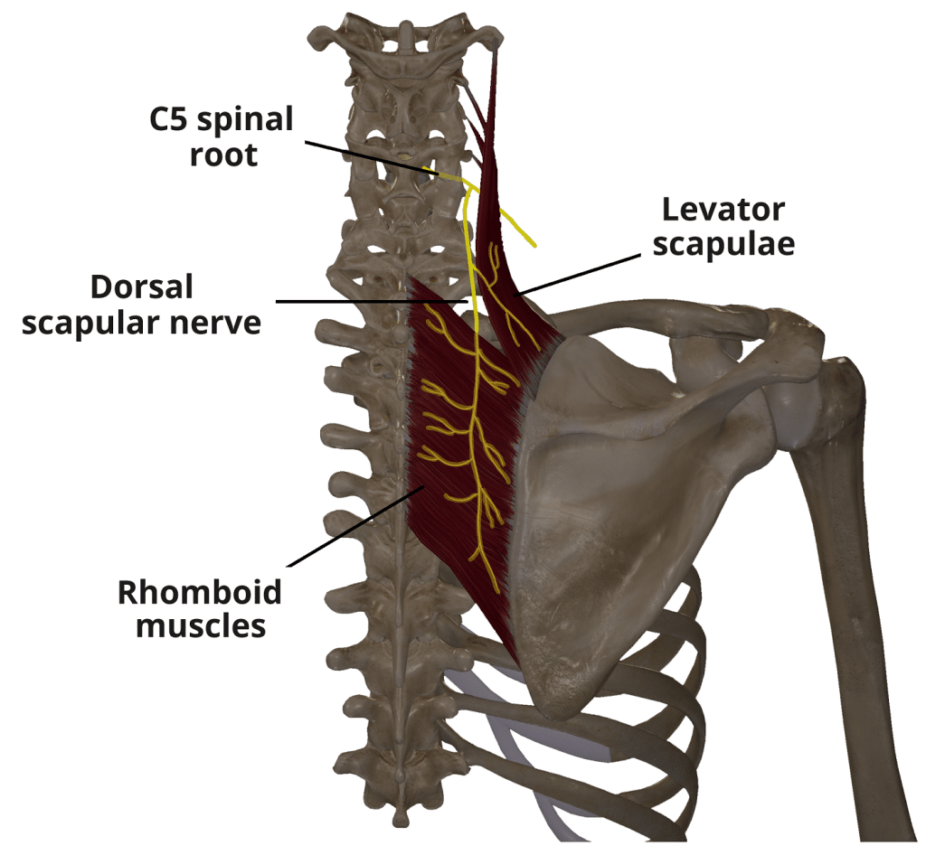

Slide 23
4. RHOMBOID MINOR
Origin
Ligamentum nuchae
Spinous processes of C7–T1
Insertion
Medial end of scapular spine
Function
Retracts scapula
Fixes scapula to thoracic wall
Downward rotation of scapula

Slide 25
Continued
Nerve Supply
Dorsal scapular nerve
Nerve Root
C4, C5

Slide 27
5. RHOMBOID MAJOR
Origin
Spinous processes of T2–T5
Insertion
Medial border of scapula (below spine)
Function
Retracts scapula
Stabilizes scapula
Downward rotation of scapula

Slide 29
Continued
Nerve Supply
Dorsal scapular nerve
Nerve Root
C4, C5

Slide 31
SUMMARY TABLE
Trapezius – CN XI – Scapular movements
Latissimus dorsi – Thoracodorsal nerve – Arm extension & adduction
Levator scapulae – Dorsal scapular nerve – Scapular elevation
Rhomboids – Dorsal scapular nerve – Scapular retraction

Slide 32


Slide 33


