Slide 1

HUMAN ANATOMY
BS RIT,OTT,MLT
1ST SEMESTER
DR DANISH

Slide 2
URINARY SYSTEM
The urinary system maintains body homeostasis
Regulates:
  Water balance
  Electrolytes
  Acid–base balance
Removes metabolic waste products

Slide 3
Components of Urinary System
Kidneys (2)
Ureters (2)
Urinary bladder
Urethra

Slide 4
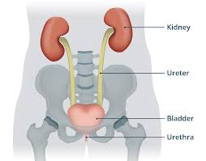

Slide 5
Kidneys
Paired, bean-shaped organs
Located retroperitoneally
On either side of vertebral column (T12–L3)
Right kidney slightly lower than left

Slide 6
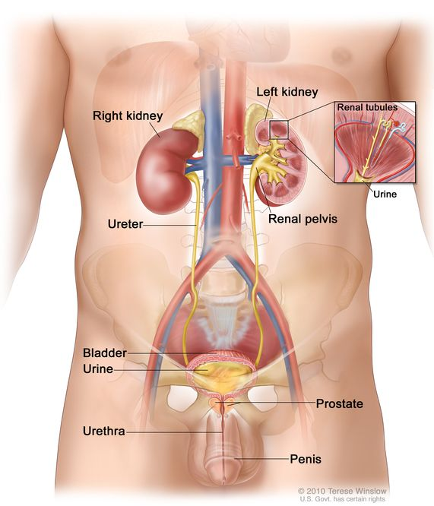

Slide 7
External Features of Kidney
Upper pole and lower pole
Medial border (concave, hilum present)
Lateral border (convex)
Anterior and posterior surfaces

Slide 9
Internal Structure of Kidney
Renal cortex
Renal medulla
Renal pyramids
Renal papilla
Minor and major calyces
Renal pelvis

Slide 10
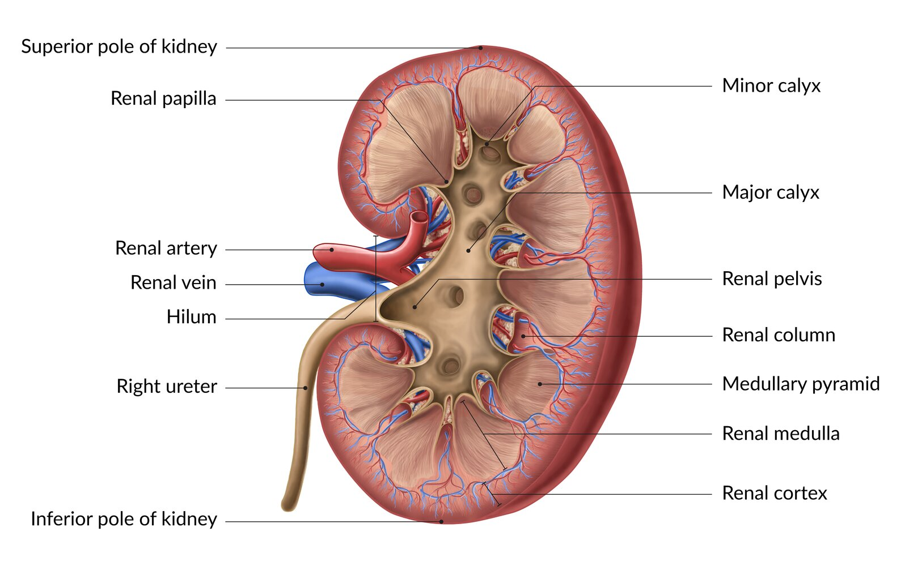

Slide 11
Nephron
Structural and functional unit of kidney
About 1 million nephrons per kidney

Slide 12
Functions of Kidney
Formation of urine
Regulation of blood pressure
Regulation of electrolytes
Acid–base balance
Secretion of hormones (erythropoietin)

Slide 13
Ureters
Muscular tubes ~25–30 cm long
Convey urine from kidneys to bladder
Lined by transitional epithelium

Slide 14
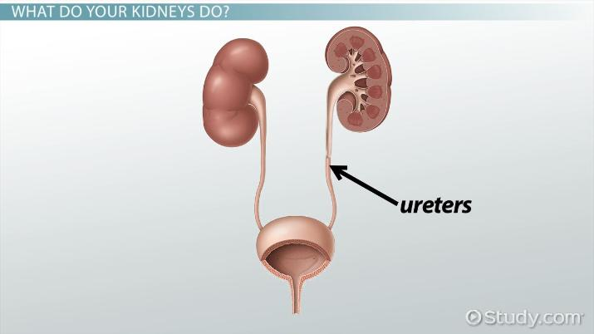

Slide 15
Urinary Bladder
Muscular reservoir for urine
Located in pelvic cavity
Capacity: 300–500 ml
Parts:
  Apex
  Body
  Fundus
  Neck

Slide 16
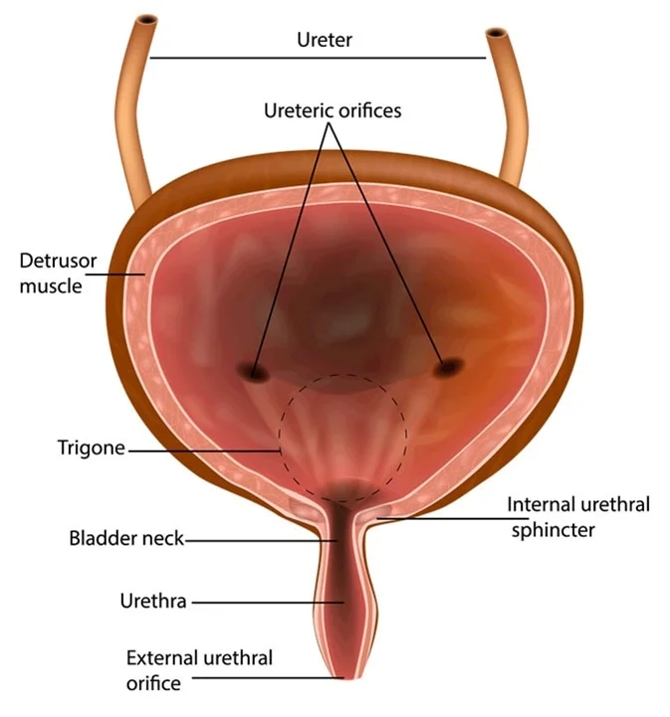

Slide 17
Urethra
Conducts urine to exterior
Length:
  Male: ~18–20 cm
  Female: ~4 cm

Slide 18


