Slide 1
VISION
Presented by: Haiqa Tanveer
Assigned by: Mam Shehwar Saeed

Slide 2
INTRODUCTION
Vision is the most complex , highly developed and important sense for humans and most other mobile creatures.

Slide 3
Stimulus for vision
Is a wave form of radiant energy that is light radiates from its source in waves, which we can call light waves.
Characteristics
Wave amplitude
Wave length
Wave purity

Slide 4
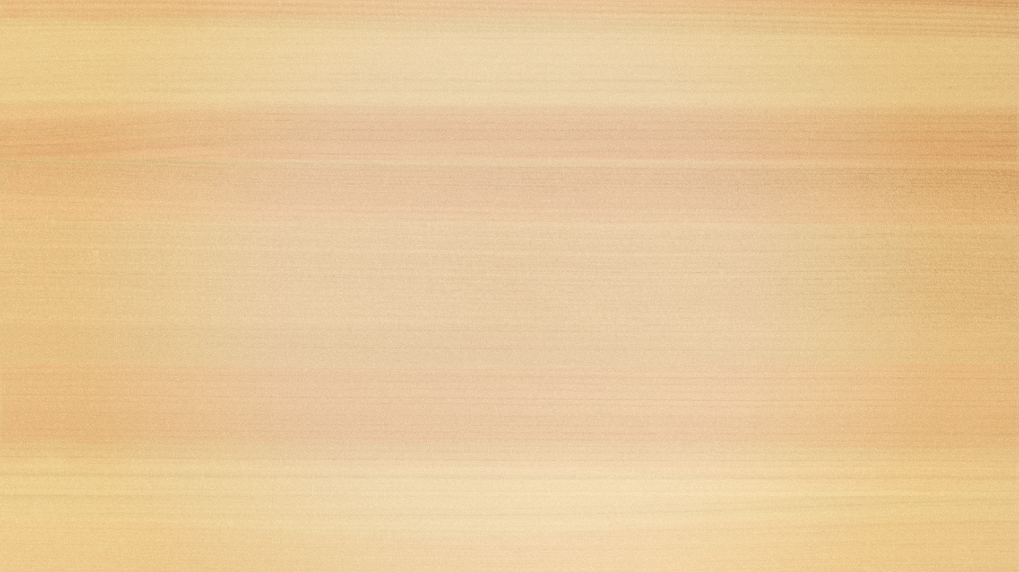

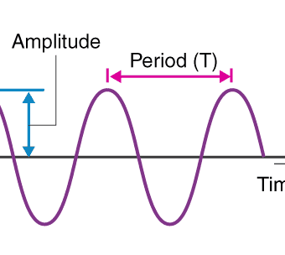

WAVE AMPLITUDE
Indicates its intensity.
Represented by its height.
Our psychological experience of wave amplitude or intensity is brightness.
Difference between a dim light and a bright light is due to difference in wave amplitude.

Slide 5
WAVE LENGTH
It is the distance between two same points on consecutive waves (like crest to crest.)
Unit of measurement of light wave is nanometer (nm), equal to one billion of a meter.
Human eye respond only to radiant energy in waveform that has a wave length b/w 380 and 760 nm.

Slide 6
WAVE PURITY
When the wave length has exactly the same nm wavelength, it would appear pure rich color.
We call such colors as monochromatic, because it is made up of light waves all of one length or colour.

Slide 7
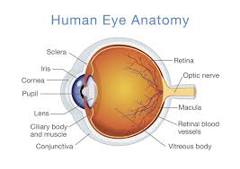
STRUCTURE OF EYE

Slide 8
LAYERS OF EYES
Human eye consists of three concentric layers.
The outer most layer it is fibrous tunic which protects the eyeball.
Middle layer it is vascular tunic which nourishes the eyeball.
Retina it detects light and initiate neural messages bound for the brain.

Slide 9
OUTERMOST LAYER
The sclera is the outermost layer of the eye. It is a strong, tough, white covering that surrounds most of the eyeball.
The sclera protects the inner delicate parts of the eye from injury.
It helps maintain the shape of the eyeball.
It provides attachment for the eye muscles, which help in eye movement.
The front transparent part of the sclera is called the cornea, which allows light to enter the eye.

Slide 10
MIDDLE LAYER
The middle layer of the eye is called the choroid. It lies between the sclera (outer layer) and the retina (inner layer).
The choroid is a thin, dark, and highly vascular layer (rich in blood vessels).
It supplies oxygen and nutrients to the retina.
It contains pigment that absorbs excess light and prevents reflection inside the eye.

Slide 11
CHAMBERS
Besides these three layers eye is partitioned in to two chambers, a small Interior chamber and a large vitreous chamber.

Slide 12
ANTERIOR CHAMBER
The anterior chamber of the eye is the fluid-filled space between the cornea (in front) and the iris (behind).
It is filled with a clear fluid called aqueous humor.
The aqueous humor is produced by the ciliary body.
This chamber helps maintain the shape and pressure of the eye.

Slide 13
IRIS
The iris is the colored, circular part of the eye located between the cornea and the lens, surrounding the pupil.
It is made of muscle fibers.
The color of the eye (black, brown, blue, etc.) depends on the iris.
The iris has a central opening called the pupil.

Slide 14
PUPIL
The pupil is the small, round opening in the center of the iris
.It appears black because light entering it is absorbed inside the eye.
The size of the pupil changes according to light conditions.
It is not a structure, but an opening.

Slide 15
VITREOUS CHAMBER
It is the large space behind the lens of the eye, filled with a jelly-like substance called vitreous humor, which helps maintain the eye’s shape and supports the retina.

Slide 16
RETINA
The retina is the thin, delicate layer of tissue lining the inner surface of the eye.
It acts like the film in a camera, detecting light and sending visual information to the brain via the optic nerve.

Slide 17
LAYERS OF RETINA
Retina can be divided into three layers,
Photoreceptors
Bipolar cells
Ganglion cells

Slide 18
PHOTORECEPTORS
Photoreceptors are specialized cells in the retina that detect light and convert it into electrical signals, a process called phototransduction. They are the first step in vision.
There are two types of photoreceptors that are discussed here,

Slide 19
RODS
Contains a single light sensative chemical called rhodospin.
One of the rhodospin is vitamin A
Rods are light sensative receptors cells concentrated in the outer part of the retina.
They are more than 115 million, handling low illumination vision.

Slide 20
CONES
Cones are packed in to the center of retina as they are about 6 million.
They are responsible for our experiencing a world of coloured objects.
It contains three different chemicals iodopsins, which will prove to be the basis for color vision.

Slide 21
FOVEA
In the very center of the retina is a small region called fovea, which contains densely packed cones.
It is rod-free
It is the area of our sharpest vision
Color and spatial details are most accurately detected here.

Slide 22
BIPOLAR CELLS
These are nerve cells that combine impulses from many receptors and send the result to ganglion cells.
They have single dendrites with branched endings and one axon and terminal button.
Each ganglion cell, then, integrates the impulses from many bipolar cells into a single firing rate.

Slide 23
HORIZONTAL CELLS | AMACRINE CELLS
HORIZONTAL CELLS MAKE LATERAL CONNECTIONS AT A LEVEL NEAR THE RECEPTORS. | AMACRINE CELLS MAKE LATERAL CONNECTIONS AT A LEVEL NEAR THE GANGLION CELLS.

Slide 24
OPTIC NERVE
The direct connections from the photoreceptors cells to the brain go first to bipolar cells and then to ganglion cells.
The axon of ganglion cells from the optic nerve, which extends out of the eye and go to the brain.

Slide 25


Slide 26


