Slide 1

HUMAN ANATOMY
BS RIT,MLT,OTT
1ST SEMESTER
DR DANISH

Slide 2
Major Digestive Glands
Secretions of digestive glands are released into the alimentary canal
Help in digestion of food
Include:
  Major salivary glands
  Pancreas
  Liver

Slide 3
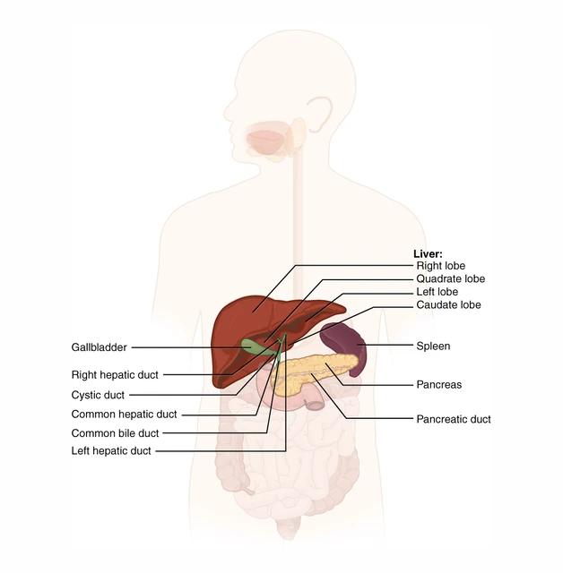

Slide 4
Major Salivary Glands
Three pairs of major salivary glands located in and around the oral cavity:
  Parotid glands
  Submandibular glands
  Sublingual glands
Saliva is delivered into the oral cavity through ducts

Slide 5
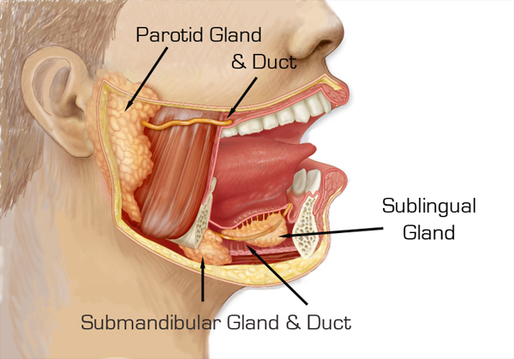

Slide 6
Functions of Saliva
Moistens food to make swallowing easier
Contains enzyme amylase which mixes with food
Helps in digestion of starch
Plays an important role in maintaining the health of teeth and other oral tissues

Slide 7
Pancreas
A long, flat gland
Located behind the stomach in the upper left abdomen
Produces:
  Endocrine secretions (hormones)
  Exocrine secretions (digestive enzymes)

Slide 8
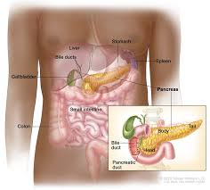

Slide 9
Continued
Exocrine secretions:
  Passed into the duodenum through the pancreatic duct
Endocrine secretions:
  Released directly into the bloodstream through capillaries in the pancreas

Slide 10
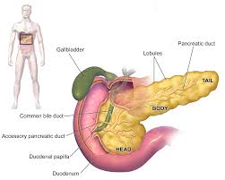

Slide 11
Liver
Largest solid organ of the body
Located in the upper right region of the abdomen
Performs a wide variety of important functions

Slide 13
Major functions include:
Detoxification (removal of toxins from blood)
Maintenance of blood sugar level
Regulation of blood clotting

Slide 15
Continued
Produces bile
Stored in the gall bladder
Periodically released into the small intestine
Helps in digestion and absorption of fats

Slide 16
Respiratory System
Responsible for breathing
Supplies oxygen to the body
Removes carbon dioxide
Divided into:
  Upper respiratory tract
  Lower respiratory tract

Slide 17
Upper Respiratory Tract
Consists of:
  Nose and nasal cavities
  Oral cavity
  Pharynx
  Larynx

Slide 18
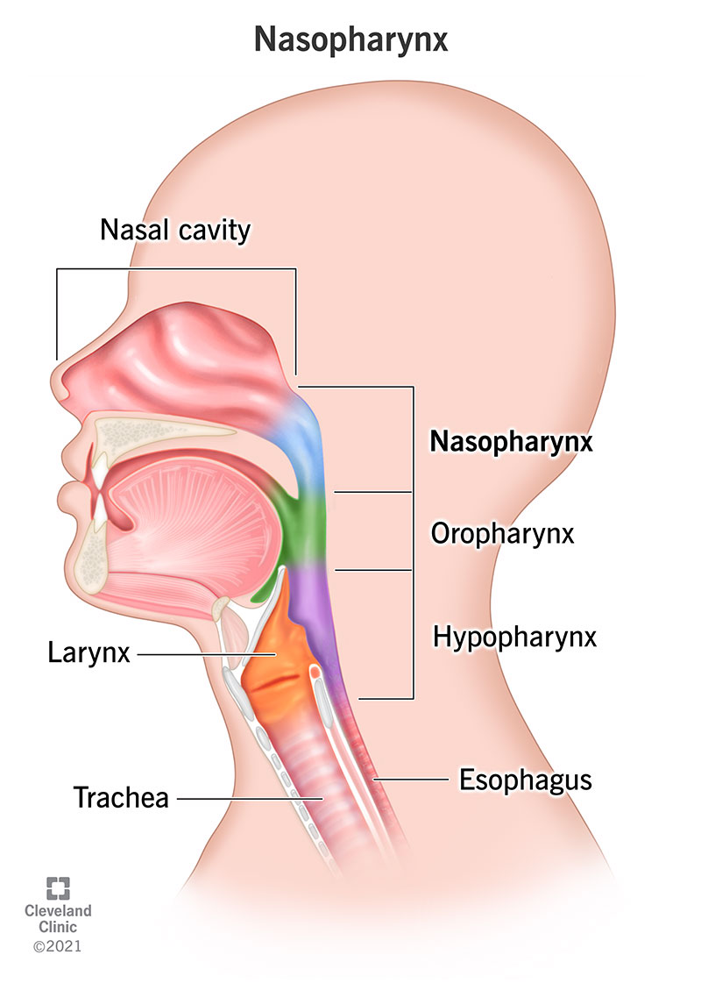

Slide 19
Lower Respiratory Tract
Consists of:
  Trachea
  Right and left principal bronchi
  Right and left lungs

Slide 20
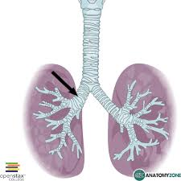

Slide 21


Slide 22


