Slide 1

ANATOMY
THE UPPER LIMB
DPT
1ST SEMESTER
DR DANISH

Slide 2
Muscles of the Anterior Aspect of Forearm
Located on the palmar (anterior) side of the forearm
Primarily responsible for:
  Flexion of wrist and fingers
  Pronation of forearm
Mostly supplied by Median nerve
Divided into 3 layers:
  Superficial
  Intermediate
  Deep

Slide 3
Superficial Group
Pronator Teres
Flexor Carpi Radialis
Palmaris Longus
Flexor Carpi Ulnaris
All originate from medial epicondyle of humerus – common flexor origin

Slide 4
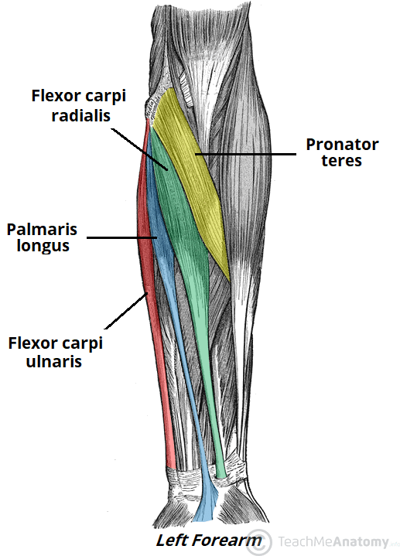

Slide 5
Pronator Teres
Origin
  Humeral head: Medial epicondyle
  Ulnar head: Coronoid process of ulna
Insertion
  Lateral surface of radius (mid-shaft)

Slide 6
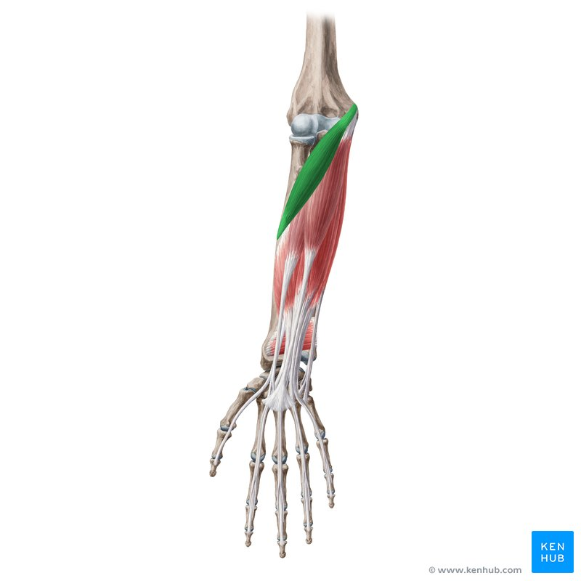

Slide 7
Continued
Nerve Supply
  Median nerve
Nerve Root
  C6–C7
Function
  Pronation of forearm
  Weak flexion of elbow

Slide 8
Flexor Carpi Radialis
Origin
  Medial epicondyle of humerus
Insertion
  Base of 2nd (± 3rd) metacarpal

Slide 10
Continued
Nerve Supply
  Median nerve
Nerve Root
  C6–C7
Function
  Flexion of wrist
  Abduction (radial deviation) of wrist

Slide 11
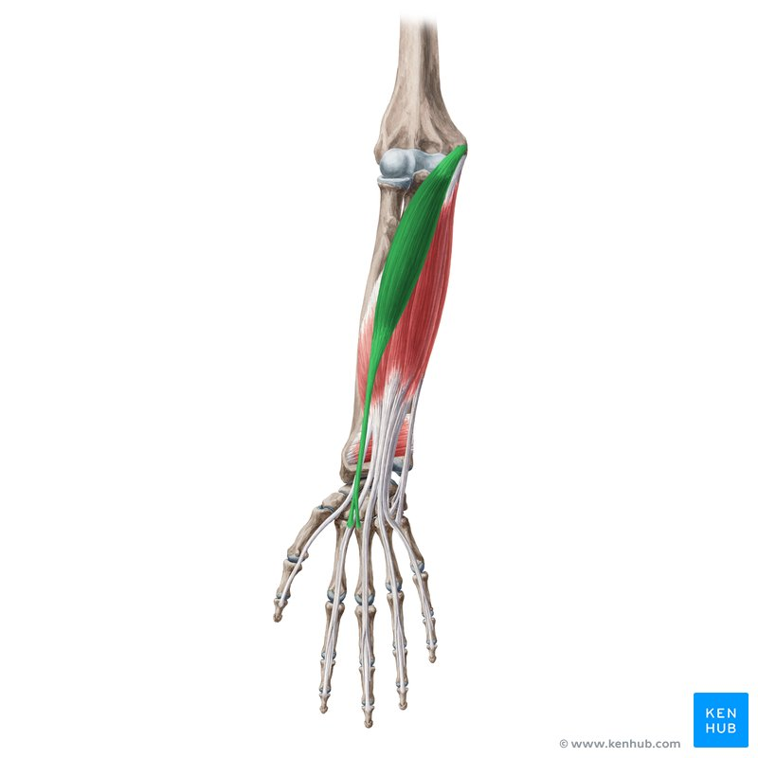

Slide 12
Palmaris Longus
Origin
  Medial epicondyle of humerus
Insertion
  Palmar aponeurosis & flexor retinaculum

Slide 13
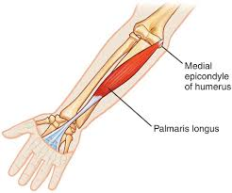

Slide 14
Continued
Nerve Supply
  Median nerve
Nerve Root
  C7–C8
Function
  Tenses palmar aponeurosis
  Weak wrist flexion

Slide 15
Flexor Carpi Ulnaris
Origin
  Humeral head: Medial epicondyle
  Ulnar head: Olecranon & posterior border of ulna
Insertion
  Pisiform, hook of hamate, base of 5th metacarpal

Slide 16
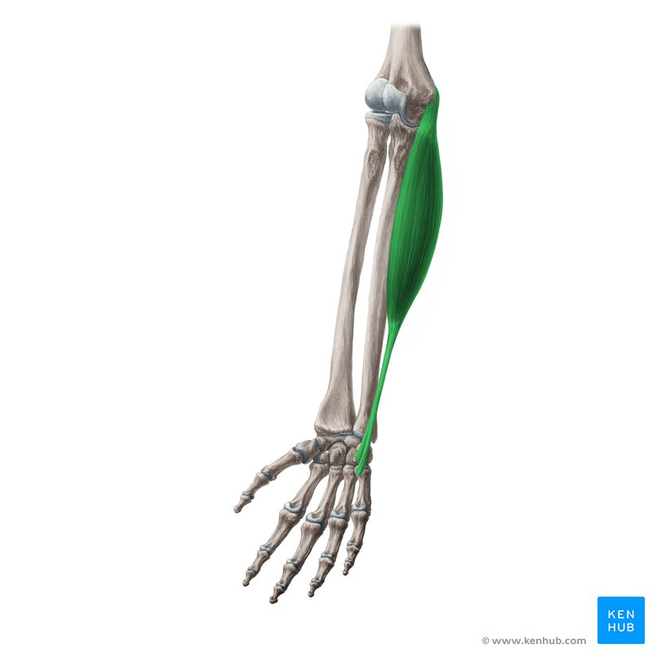

Slide 17
Continued
Nerve Supply
  Ulnar nerve
Nerve Root
  C7–T1
Function
  Flexion of wrist
  Adduction (ulnar deviation) of wrist

Slide 18
Intermediate Group
Flexor Digitorum Superficialis (FDS)

Slide 19
Flexor Digitorum Superficialis
Origin
  Medial epicondyle
  Coronoid process
  Upper half of radius
Insertion
  Sides of middle phalanges of digits 2–5

Slide 20
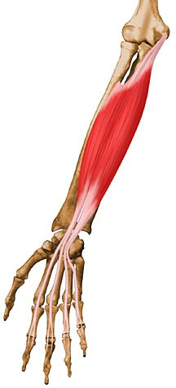

Slide 21
Continued
Nerve Supply
  Median nerve
Nerve Root
  C7–T1
Function
  Flexion of PIP joints
  Assists MCP & wrist flexion

Slide 22
Deep Group
Flexor Digitorum Profundus
Flexor Pollicis Longus
Pronator Quadratus

Slide 23
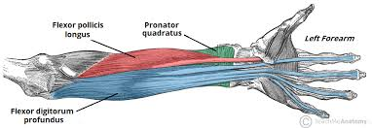

Slide 24
Flexor Digitorum Profundus (FDP)
Flexor Digitorum Profundus (FDP)
Origin
  Upper ¾ of ulna & interosseous membrane
Insertion
  Base of distal phalanges of digits 2–5

Slide 25
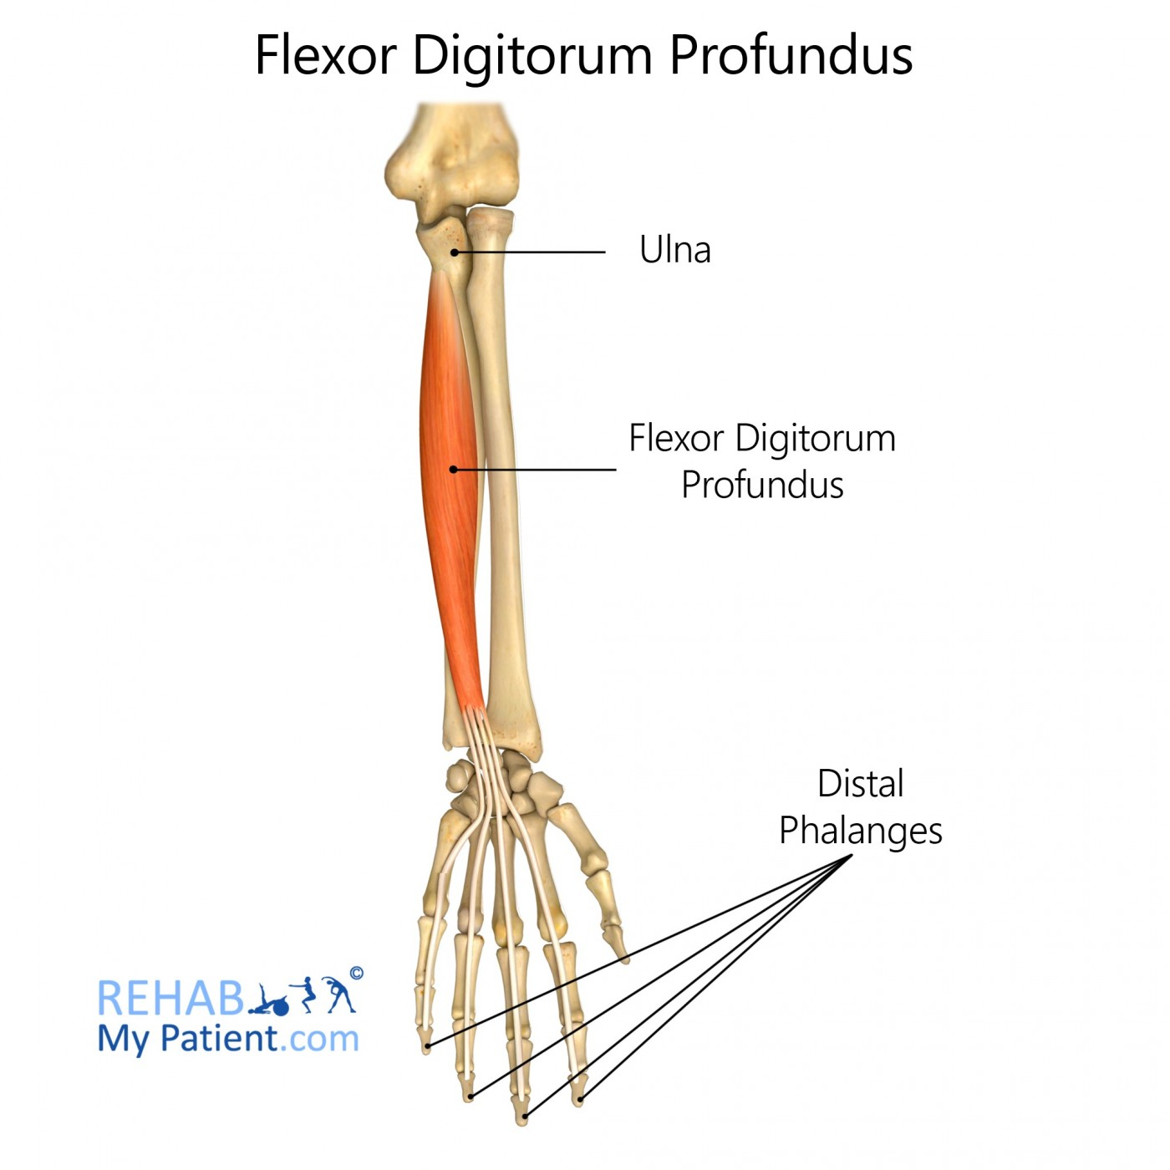

Slide 26
Continued
Nerve Supply
  Lateral half (digits 2–3): Anterior interosseous nerve (Median)
  Medial half (digits 4–5): Ulnar nerve
Nerve Root
  C8–T1
Function
  Flexion of DIP joints
  Assists wrist & MCP flexion

Slide 27
Flexor Pollicis Longus
Origin
  Anterior surface of radius & interosseous membrane
Insertion
  Base of distal phalanx of thumb

Slide 28
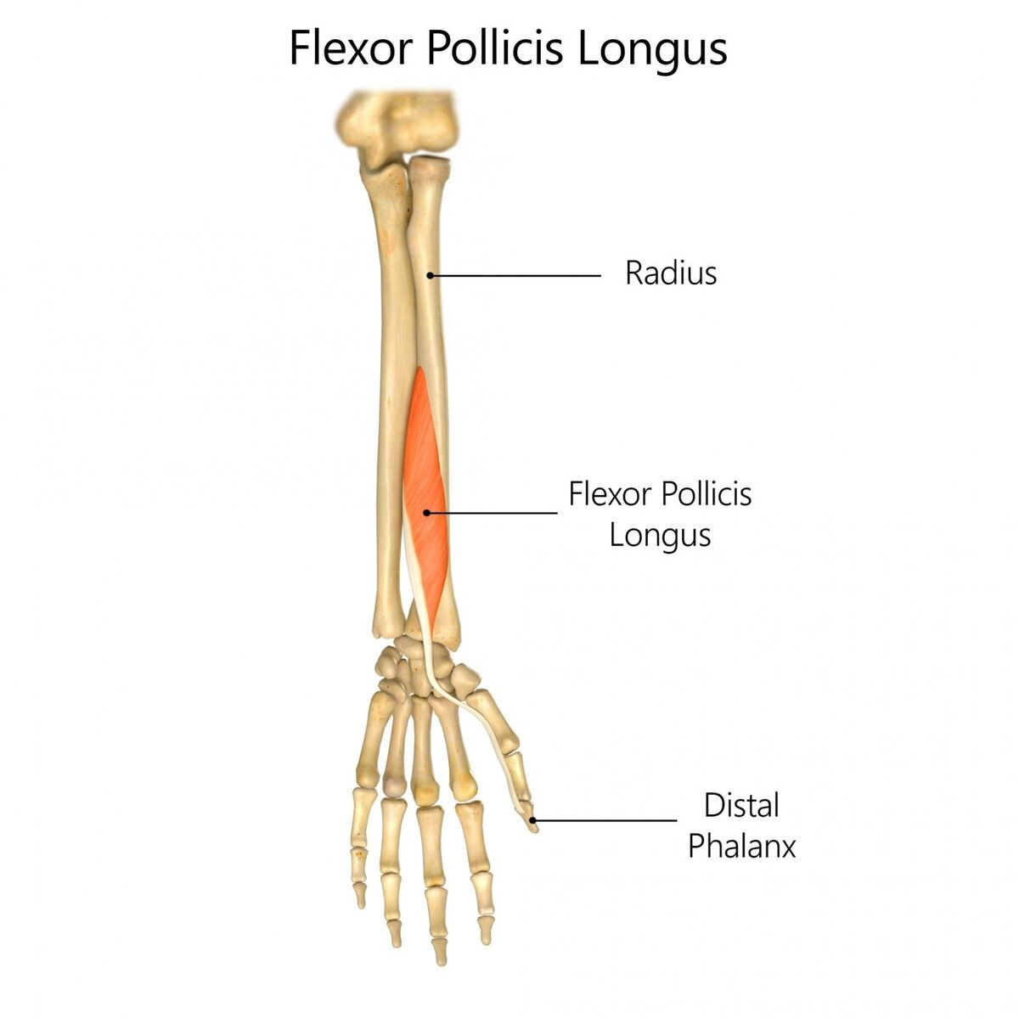

Slide 29
Continued
Nerve Supply
  Anterior interosseous nerve (branch of median nerve)
Nerve Root
  C8–T1
Function
  Flexion of thumb (IP joint)

Slide 30
Pronator Quadratus
Origin
  Distal ¼ of ulna (anterior surface)
Insertion
  Distal ¼ of radius (anterior surface)
Nerve Supply
  Anterior interosseous nerve
Nerve Root
  C8–T1
Function
  Primary pronator of forearm
  Stabilizes distal radioulnar joint

Slide 31
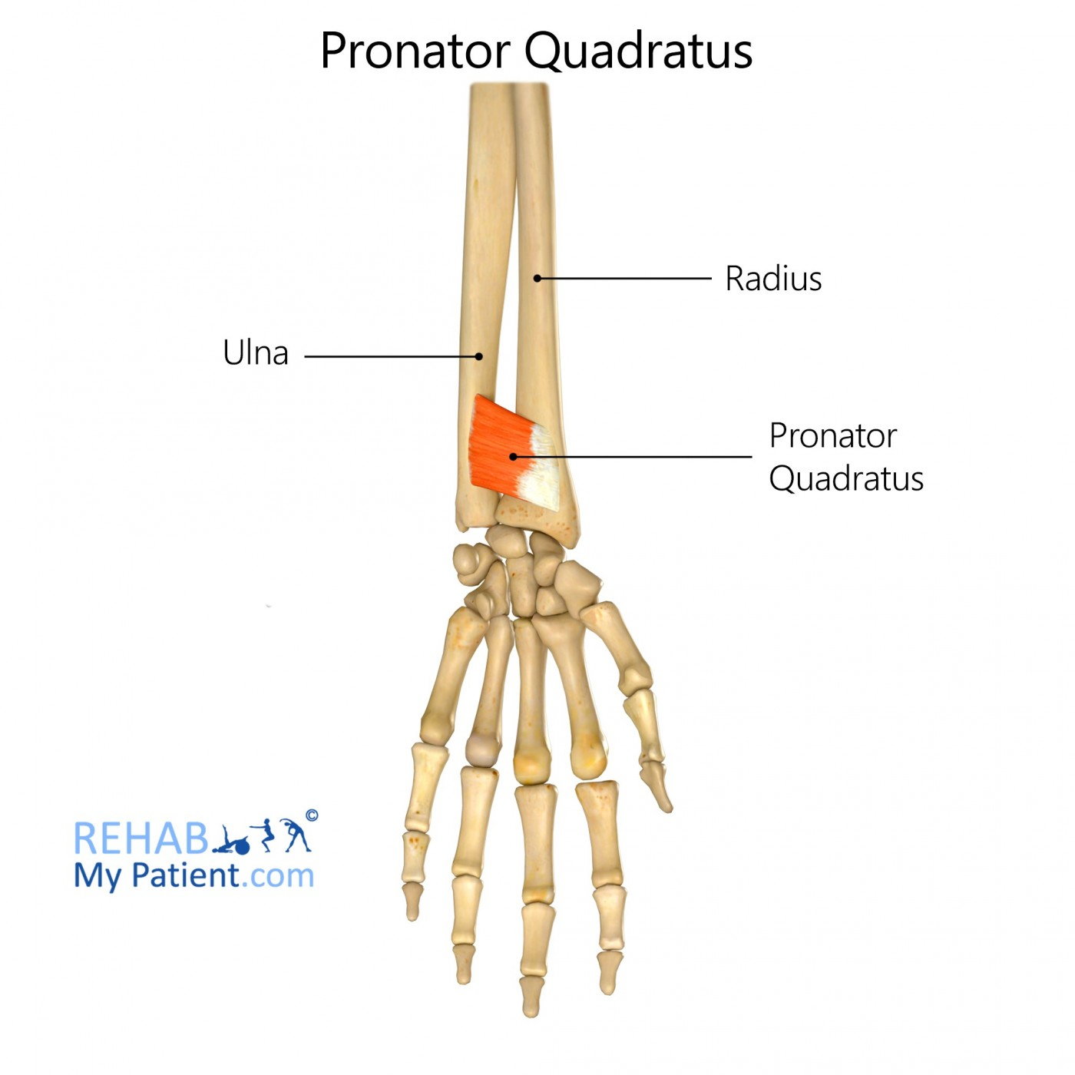

Slide 32


Slide 33


