Slide 1

BASIC MEDICAL SCIENCE
FSC MEDICAL TECHNOLOGIES I
1ST SEMESTER
DR DANISH

Slide 2
Thoracic Aorta
The thoracic aorta is a major portion of the aorta located within the thoracic cavity
It is the continuation of the ascending aorta after the aortic arch
Runs posterior to the heart and slightly to the left of the midline
Descends along the vertebral column
Supplies oxygenated blood to thoracic organs and structures
Continues downward to become the abdominal aorta at the diaphragm

Slide 3
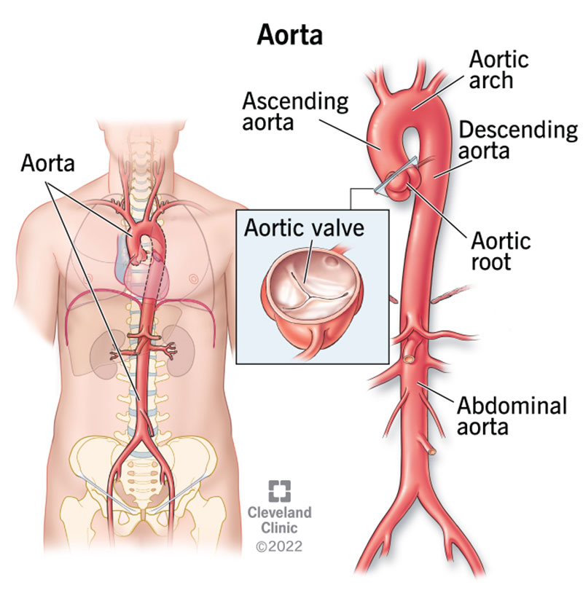

Slide 4
1. Location
Lies in the thoracic cavity
Positioned posterior to the heart
Slightly left of the midline
Descends along the vertebral column
Runs behind the heart and lungs

Slide 6
2. Segments
Ascending Aorta
Arises from the left ventricle
Ascends upward
Gives rise to the coronary arteries
Supplies blood to the heart muscle

Slide 7
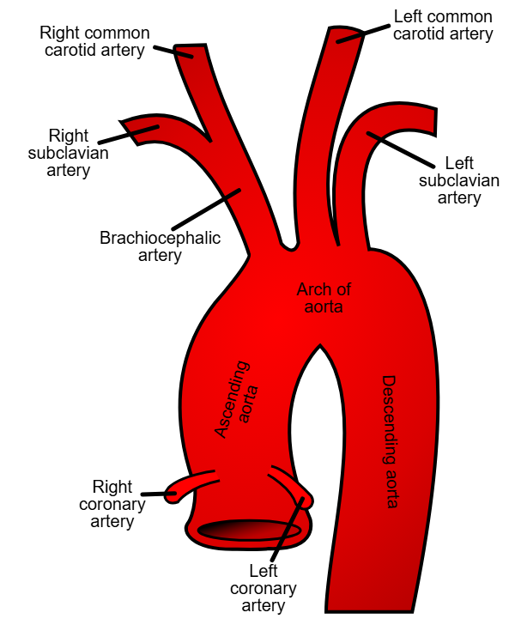

Slide 8
Continued
Aortic Arch
Curved portion between ascending and descending aorta
Gives rise to:
  Brachiocephalic artery
  Left common carotid artery
  Left subclavian artery

Slide 10
Continued
Descending Thoracic Aorta
Extends from the aortic arch to the diaphragm
Passes through the thoracic cavity
Supplies blood to:
  Chest wall
  Esophagus
  Lungs
  Other thoracic structures

Slide 11
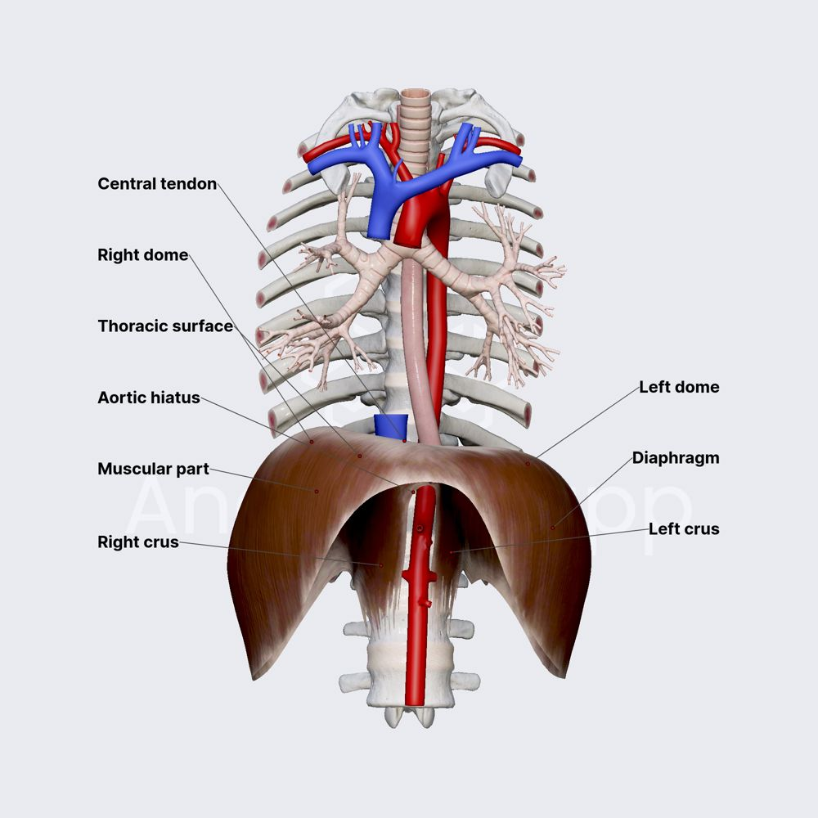

Slide 12
3. Branches
Bronchial Arteries
  Supply oxygenated blood to bronchi and lung structures
Esophageal Arteries
  Supply blood to the esophagus
Intercostal Arteries
  Supply intercostal spaces, muscles, and vertebrae

Slide 13
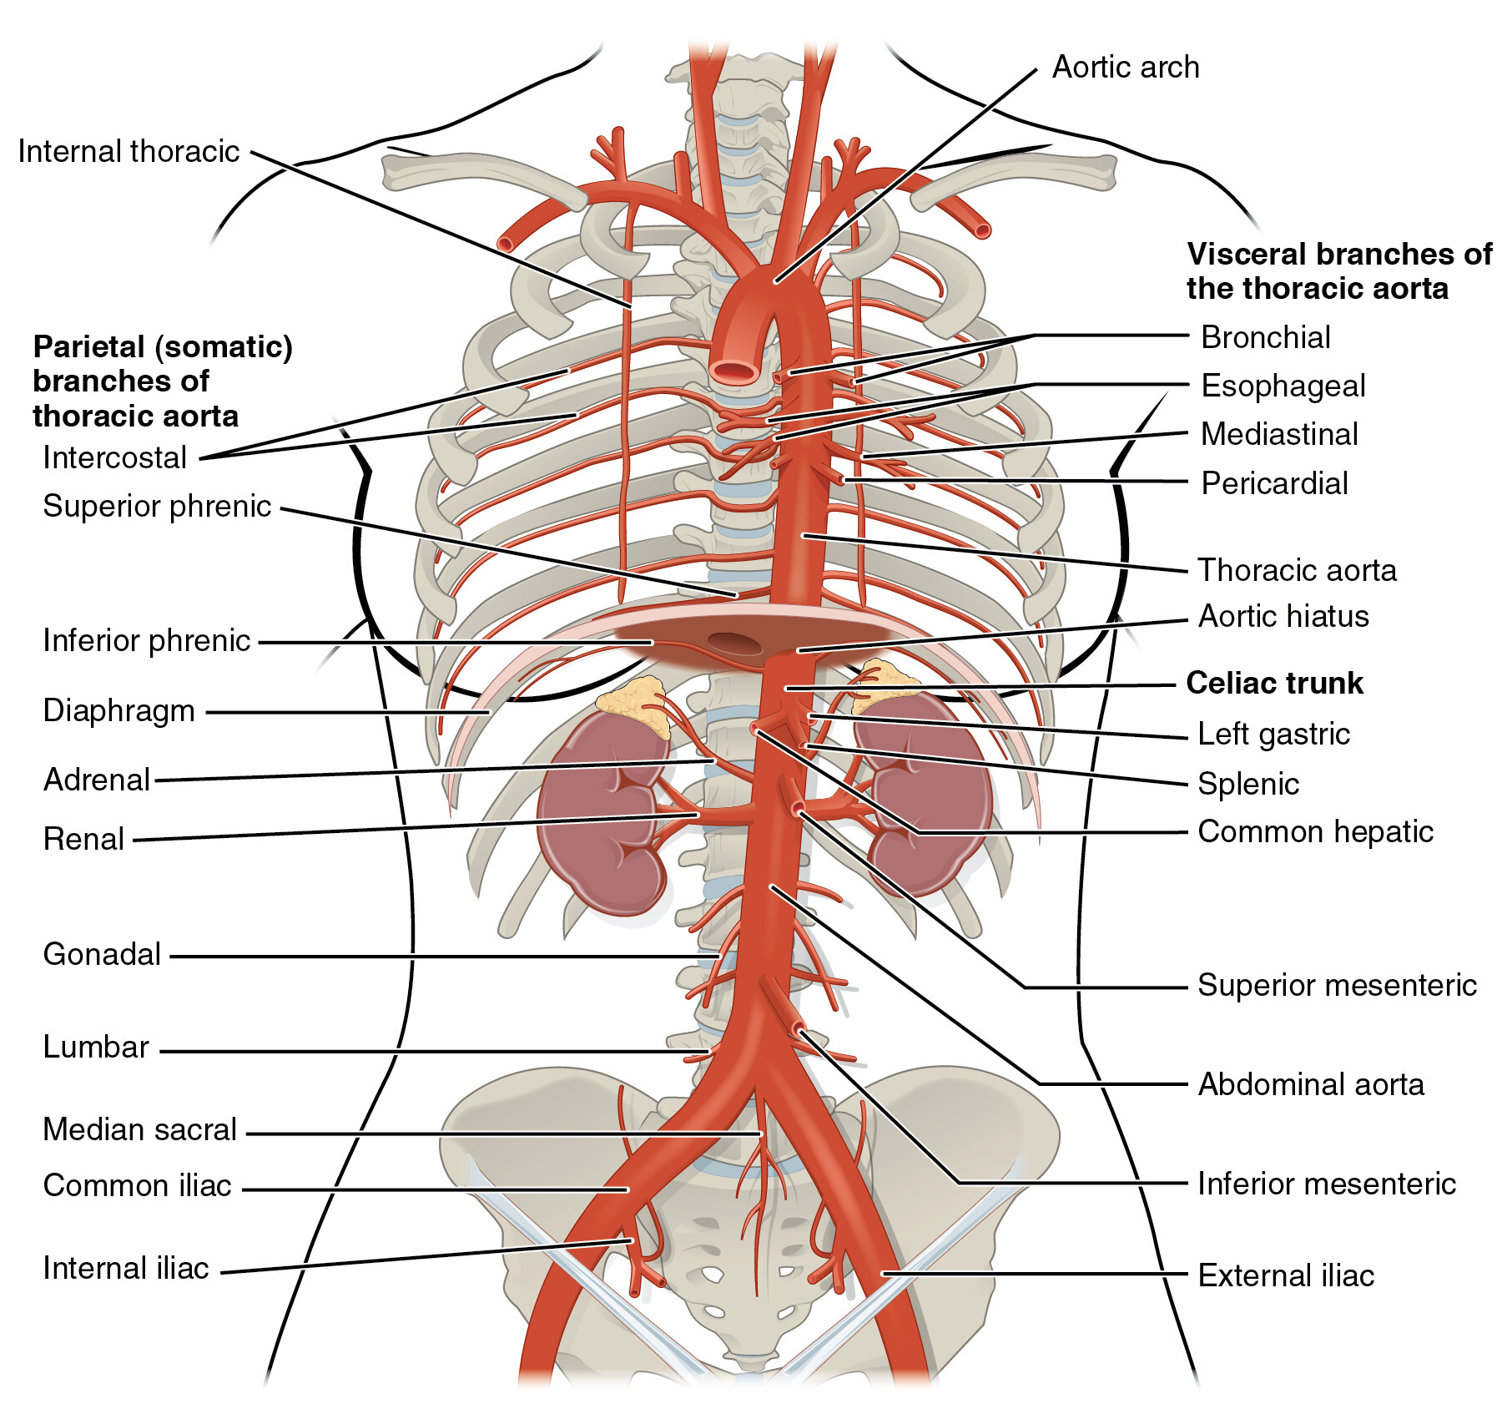

Slide 14
Continued
Superior Phrenic Arteries
  Supply blood to the diaphragm
Mediastinal Arteries
  Supply the mediastinum
  Includes heart, great vessels, thymus, and related structures
Pericardial Arteries
  Supply the pericardium (sac around the heart)

Slide 16
4. Pathologies
Aortic aneurysm
Aortic dissection
Atherosclerosis
Can lead to serious complications
Often require medical intervention

Slide 17
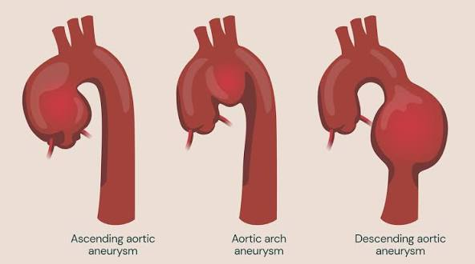

Slide 18
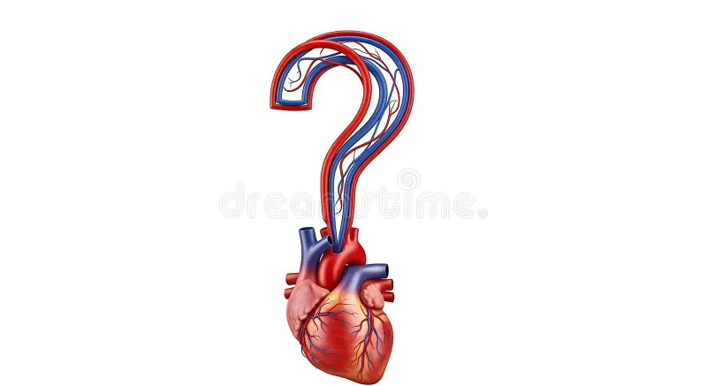

Slide 19


