Slide 1

BASIC MEDICAL SCIENCE
FSC MEDICAL TECHNOLOGIES I
DR DANISH

Slide 2
BRANCHES OF ARCH OF AORTA
The aorta is the largest artery in the human body, originating from the left ventricle of the heart.
It ascends upward from the top of the heart before descending down through the chest and abdomen.
The arch of the aorta is the curved portion of the aorta between the ascending and descending parts.
It gives rise to several branches that supply blood to ascending parts of the body.

Slide 3
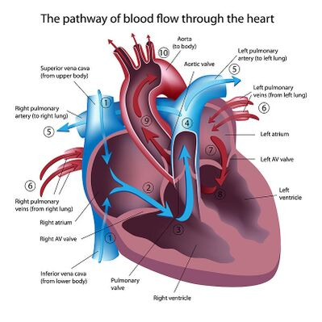

Slide 4
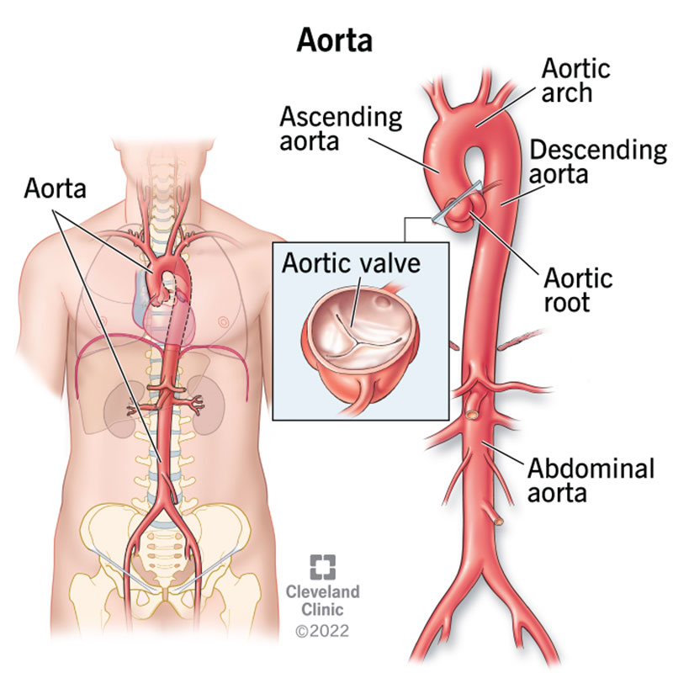

Slide 5
1.Brachiocephalic Artery
The brachiocephalic artery is the first branch of the arch of the aorta.
It quickly bifurcates into the right subclavian artery and the right common carotid artery.
The right subclavian artery supplies blood to the right arm and the right side of the head and neck.
The right common carotid artery supplies blood to the right side of the head and neck.

Slide 6
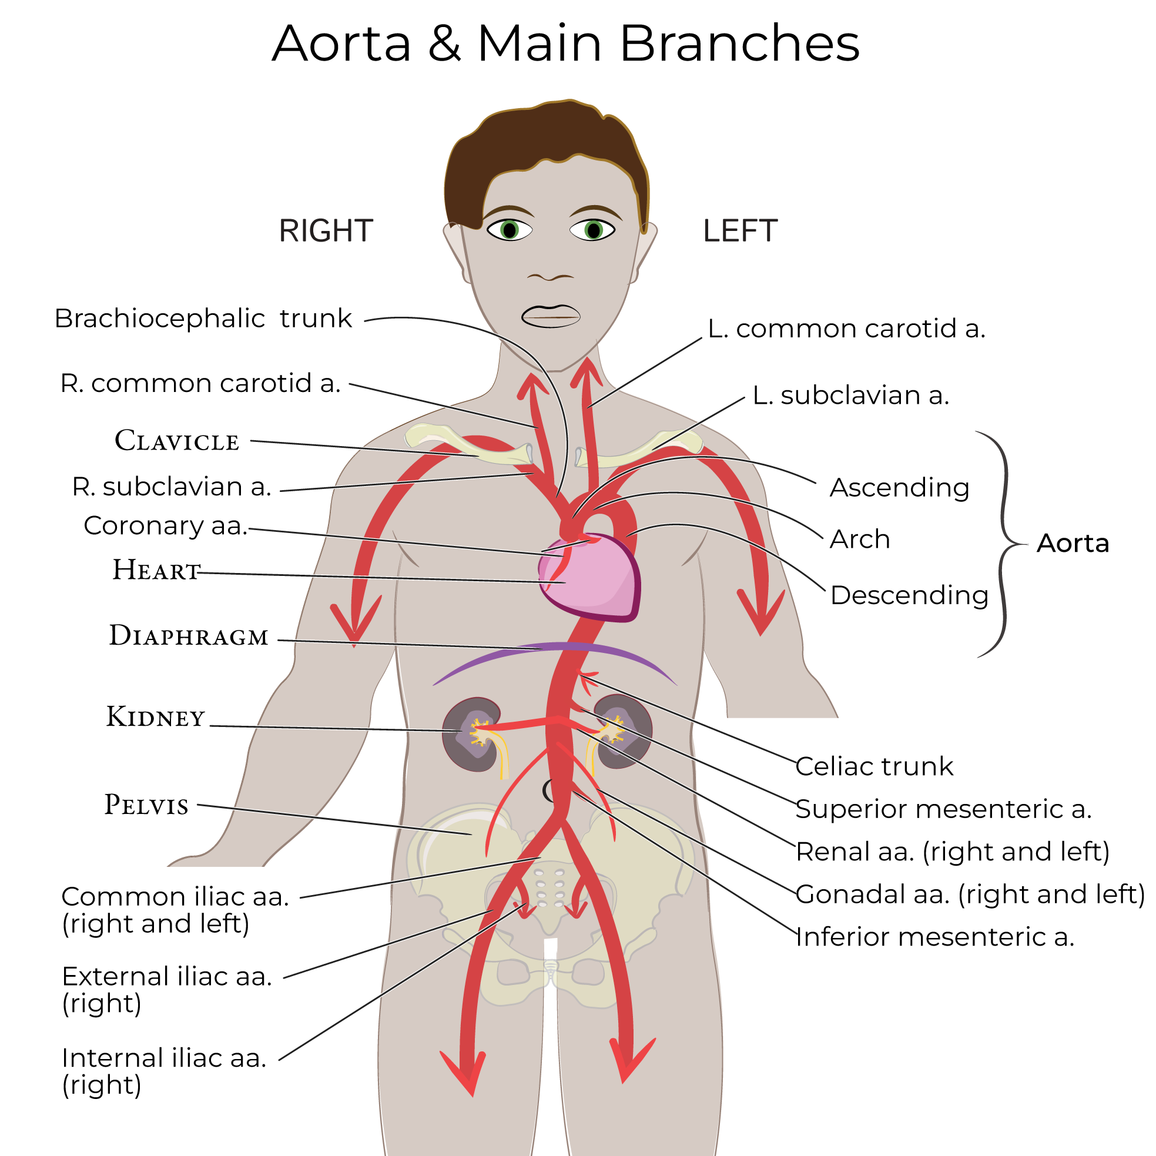

Slide 7
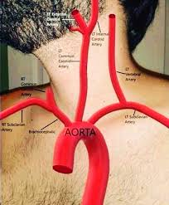

Slide 8
2. Left Common Carotid Artery
The left common carotid artery arises directly from the arch of aorta.
It supplies blood to the left side of the head and neck.

Slide 9
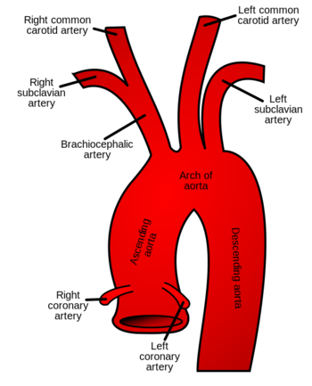

Slide 10
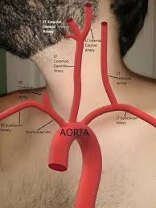

Slide 11
3. Left Subclavian Artery
The left subclavian artery is the third branch of the arch of aorta.
It supplies blood to the left arm and portions of the chest and back.

Slide 12
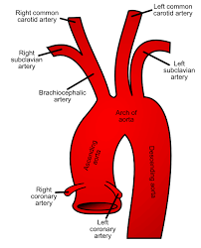

Slide 13
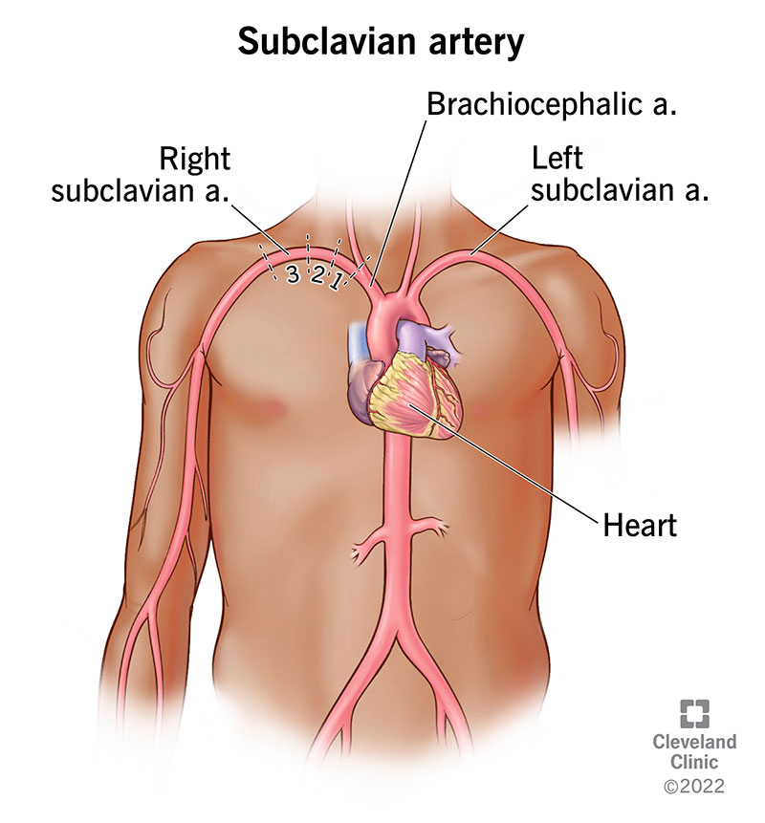

Slide 14


Slide 15


