Slide 1

ANATOMY
THE UPPER LIMB
DPT
1ST SEMESTER
DR DANISH

Slide 2
THE MYALOGY
Study of the muscles their structure,origin,insertion,nerve root,nerve supply including their function is called Myalogy

Slide 3
Pectoral Region Muscles
Pectoralis Major
Pectoralis Minor
Subclavius
Serratus Anterior

Slide 4
Pectoralis Major
Origin
Medial half of clavicle
Sternum
Costal cartilages of ribs 1–6
Aponeurosis of external oblique muscle

Slide 5
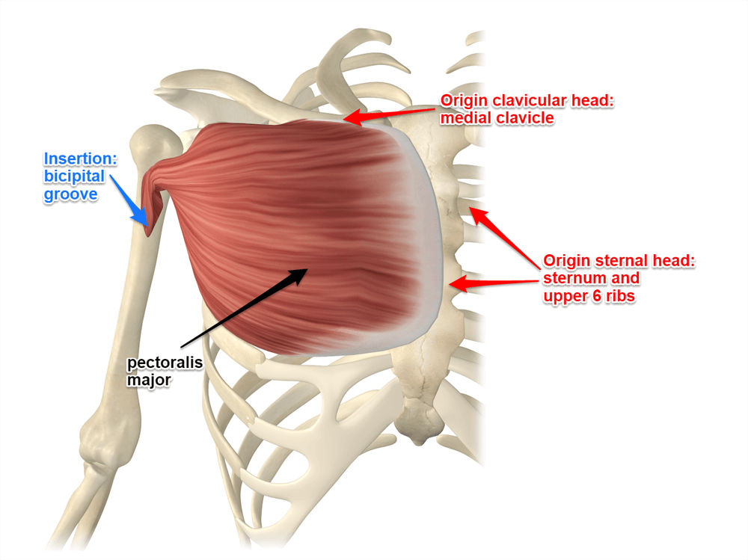

Slide 6
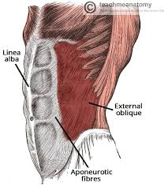

Slide 7
Insertion
Insertion
Lateral lip of bicipital (intertubercular) groove of humerus

Slide 8
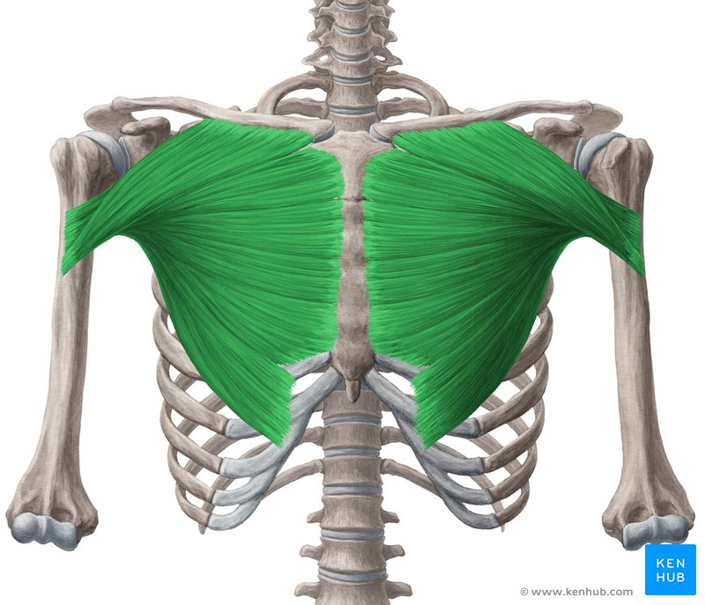

Slide 9
Nerve Root & Nerve Supply
Nerve Root
C5–T1
Nerve Supply
Medial pectoral nerve
Lateral pectoral nerve

Slide 10
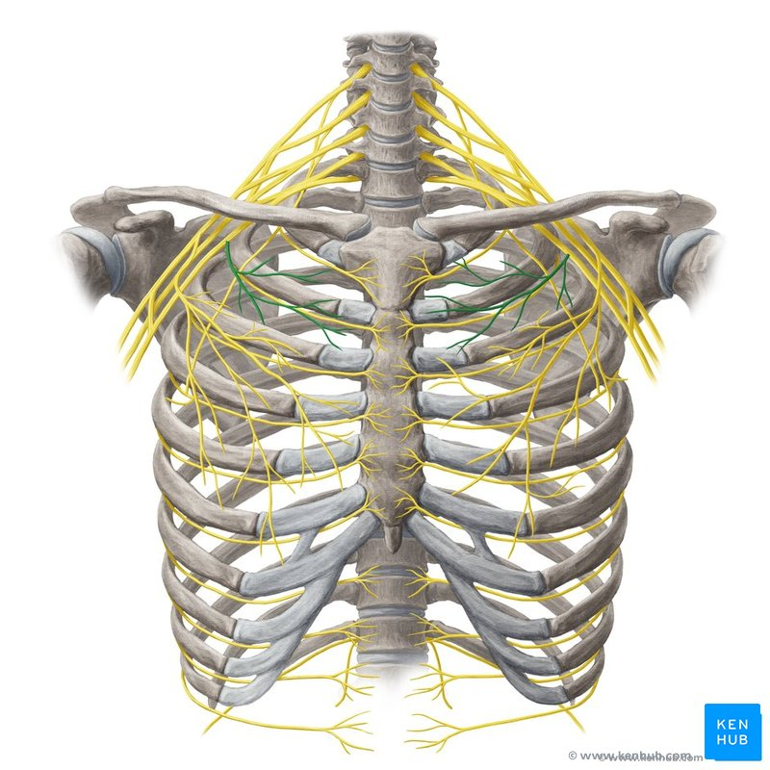

Slide 11
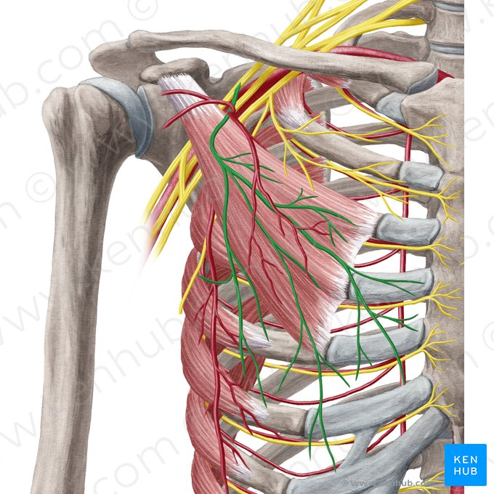

Slide 12
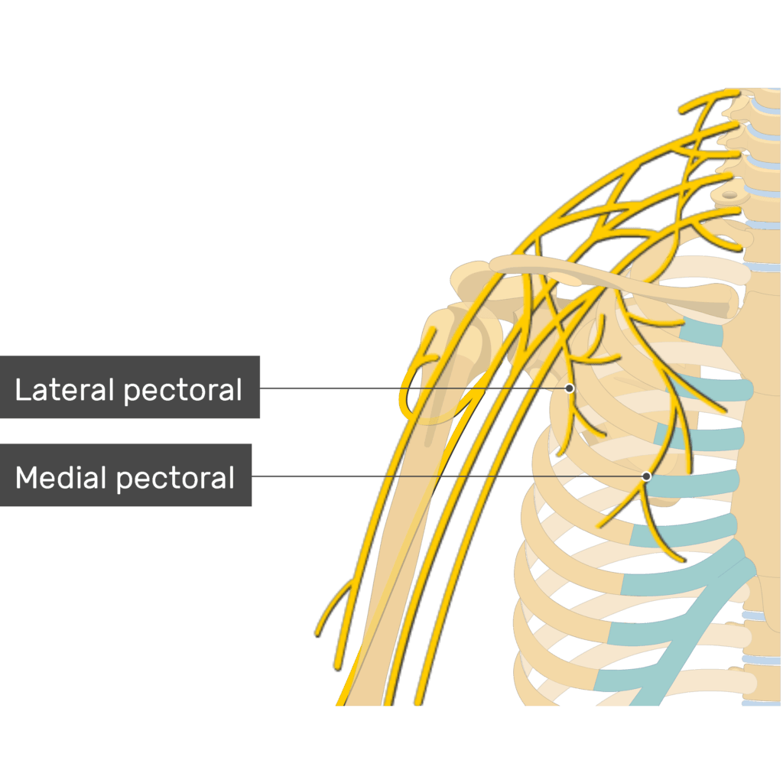

Slide 13
Function
Adducts and medially rotates arm
Flexes arm (clavicular head)
Extends flexed arm (sternocostal head)
Powerful muscle for pushing and climbing

Slide 14
Pectoralis Minor
Origin
Anterior surfaces of ribs 3–5 near costal cartilages
Insertion
Medial border and superior surface of coracoid process of scapula

Slide 15
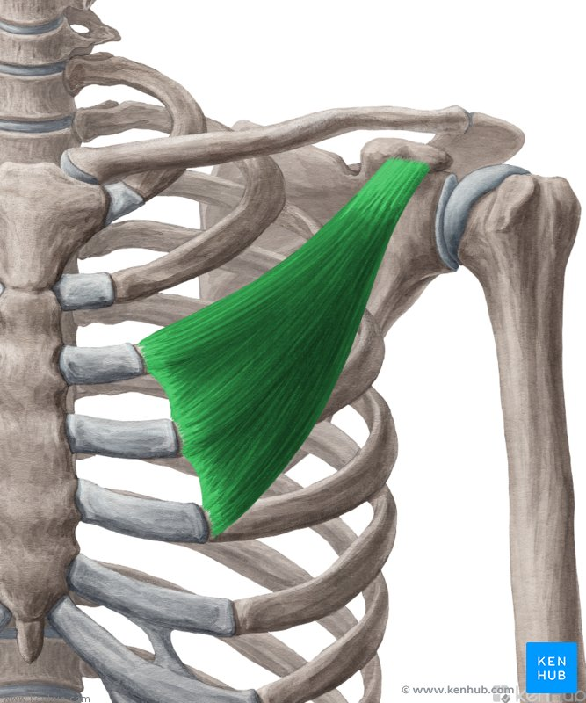

Slide 16
Nerve Root & Nerve Supply
Nerve Root
C6–T1
Nerve Supply
Medial pectoral nerve

Slide 19
Function
Stabilizes scapula by drawing it anteriorly and inferiorly
Assists in forced inspiration by elevating ribs when scapula is fixed

Slide 20
Subclavius
Origin
Junction of 1st rib and its costal cartilage
Insertion
Inferior surface of middle third of clavicle
Nerve Root
C5–C6
Nerve Supply
Nerve to subclavius

Slide 21
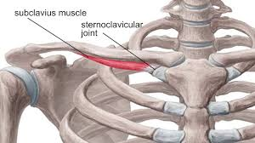

Slide 23
Function
Anchors and depresses clavicle
Stabilizes sternoclavicular joint

Slide 24
Serratus Anterior
Origin
External surfaces of ribs 1–8
Insertion
Anterior surface of medial border of scapula
Nerve Root
C5–C7
Nerve Supply
Long thoracic nerve

Slide 25
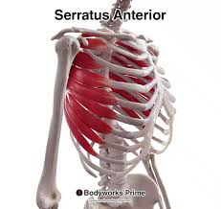

Slide 26
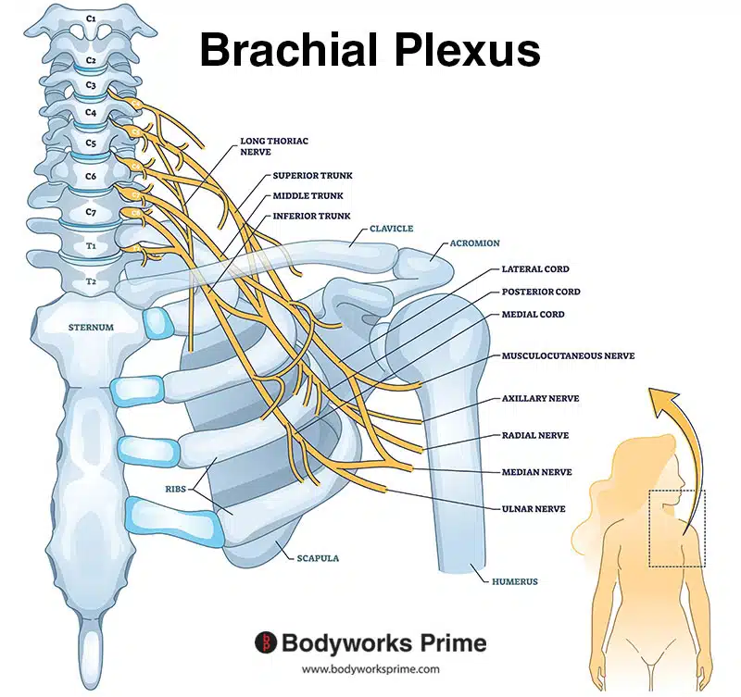

Slide 27
Function
Protracts scapula
Holds scapula against thoracic wall
Assists in upward rotation of scapula for overhead abduction

Slide 28


Slide 29


