Slide 1

ANATOMY
THE UPPER LIMB
DPT
1ST SEMESTER
DR DANISH

Slide 2
Wrist Joint (Radiocarpal Joint)
Articulation:
This joint is between the distal end of the radius and the articular disc proximally and the scaphoid, lunate, and triquetral bones distally.
The proximal articular surface forms an ellipsoid concave surface, which is adapted to the distal ellipsoid convex surface.

Slide 3
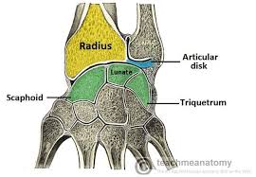

Slide 4
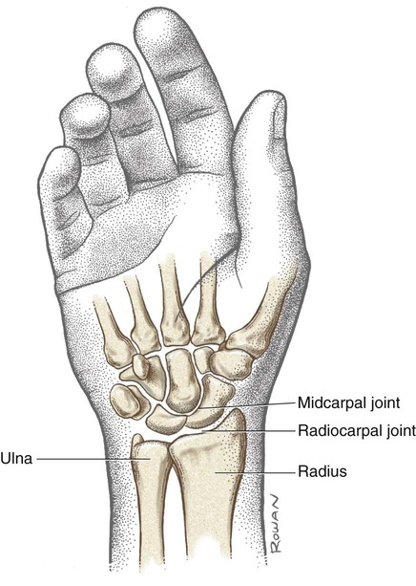

Slide 5
Type
Synovial ellipsoid joint.
Biaxial synovial joint where an oval-shaped bone end fits into an elliptical cavity, allowing movement in two planes (flexion/extension, abduction/adduction), but limited rotation, seen in the wrist and knuckles (metacarpophalangeal joints).

Slide 6
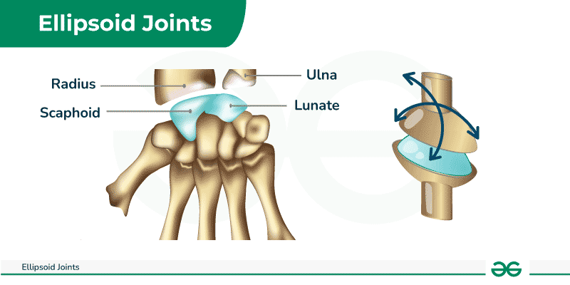

Slide 7
Capsule
Encloses the joint and is attached above to the distal ends of the radius and ulna and below to the proximal row of carpal bones.

Slide 8
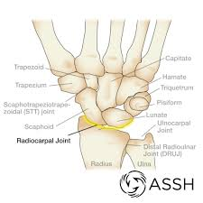

Slide 9
Ligaments
Anterior and posterior ligaments strengthen the capsule.
The medial ligament is attached to the styloid process of the ulna and to the triquetral bone.
The lateral ligament is attached to the styloid process of the radius and to the scaphoid bone.

Slide 10
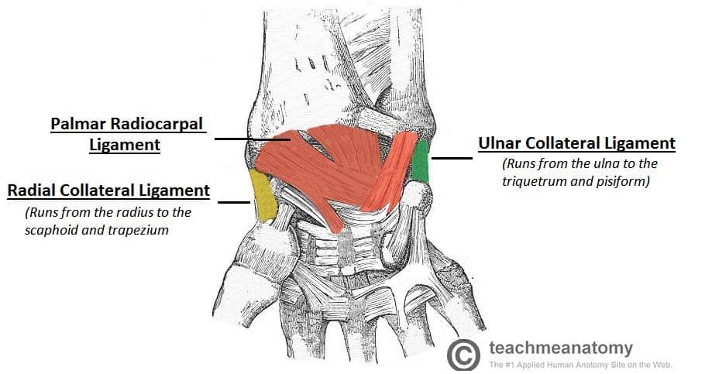

Slide 11
Synovial membrane
This lines the capsule and is attached to the margins of the articular surfaces.
The joint cavity does not communicate with that of the distal radioulnar joint or with the joint cavities of the intercarpal joints.

Slide 12
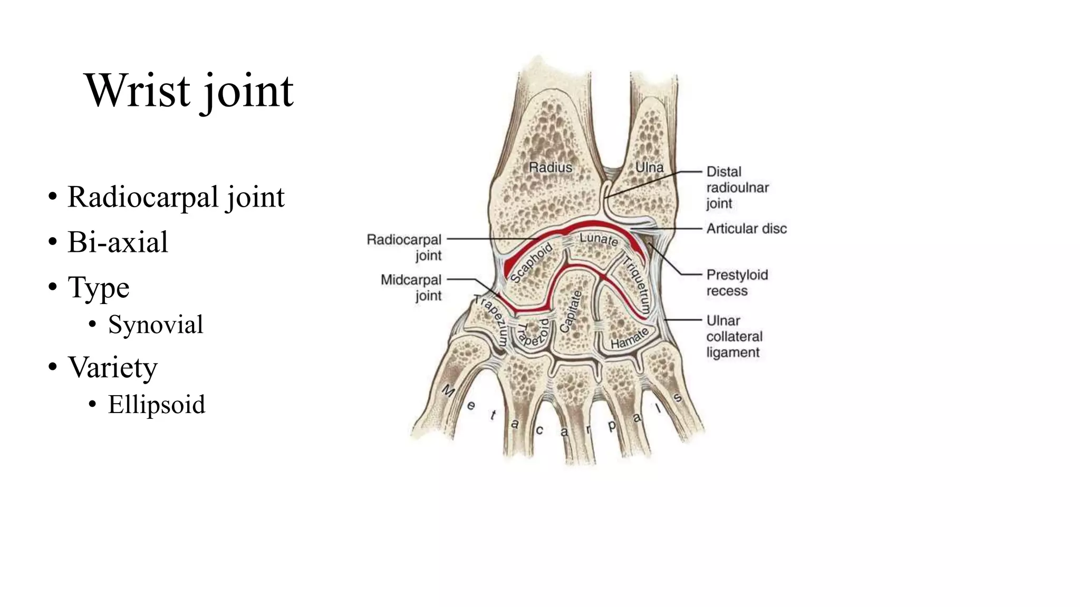

Slide 13
Nerve supply
Anterior interosseous nerve and the deep branch of the radial nerve.

Slide 14
Movements
The following movements are possible:
  Flexion
  Extension
  Abduction
  Adduction
  Circumduction
Rotation is not possible because the articular surfaces are ellipsoid shaped.
The movements of pronation and supination of the forearm compensate for the lack of rotation.

Slide 15
Flexion
Performed by the flexor carpi radialis, flexor carpi ulnaris, and palmaris longus.
Assisted by the flexor digitorum superficialis, flexor digitorum profundus, and flexor pollicis longus.

Slide 16
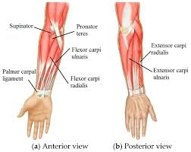

Slide 17
Extension
Performed by the extensor carpi radialis longus, extensor carpi radialis brevis, and extensor carpi ulnaris.
Assisted by the extensor digitorum, extensor indicis, extensor digiti minimi, and extensor pollicis longus.

Slide 19
Abduction & Adduction
Abduction:
Performed by the flexor carpi radialis and the extensor carpi radialis longus and brevis.
Assisted by the abductor pollicis longus and extensor pollicis longus and brevis.
Adduction:
Performed by the flexor and extensor carpi ulnaris.

Slide 20
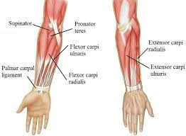

Slide 21
Clinical Notes
The wrist joint is essentially a synovial joint between the distal end of the radius and the proximal row of carpal bones.
The head of the ulna is separated from the carpal bones by the strong triangular fibrocartilaginous disc, which separates the wrist joint from the distal radioulnar joint.
The strong medial and lateral ligaments stabilize the joint.
Because the styloid process of the radius is longer than that of the ulna, abduction of the wrist joint is less extensive than adduction.
In flexion–extension movements, the hand can be flexed about 80° but extended to only about 45°.
Movement at the midcarpal joint (between the proximal and distal rows of carpal bones) increases the range of flexion.
A fall on an outstretched hand can strain the anterior ligament of the wrist joint, producing synovial effusion, joint pain, and limitation of movement.

Slide 22
Important Relations
Anteriorly:
Tendons of the flexor digitorum profundus and superficialis
Flexor pollicis longus
Flexor carpi radialis
Flexor carpi ulnaris
Median and ulnar nerves

Slide 23
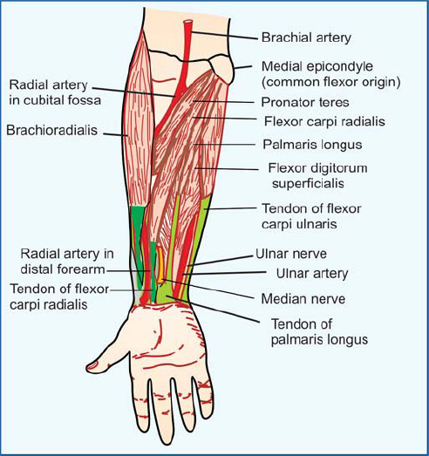

Slide 24
Continued
Posteriorly:
Tendons of the extensor carpi ulnaris
Extensor digiti minimi
Extensor digitorum
Extensor indicis
Extensor carpi radialis longus and brevis
Extensor pollicis longus and brevis
Abductor pollicis longus

Slide 25
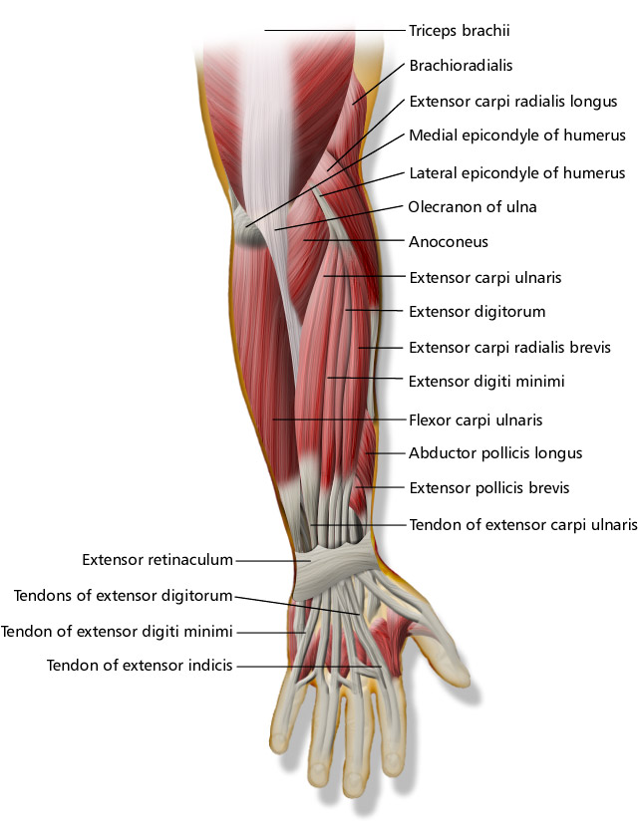

Slide 26
Continued
Medially:
Posterior cutaneous branch of the ulnar nerve
Laterally:
Radial artery

Slide 27
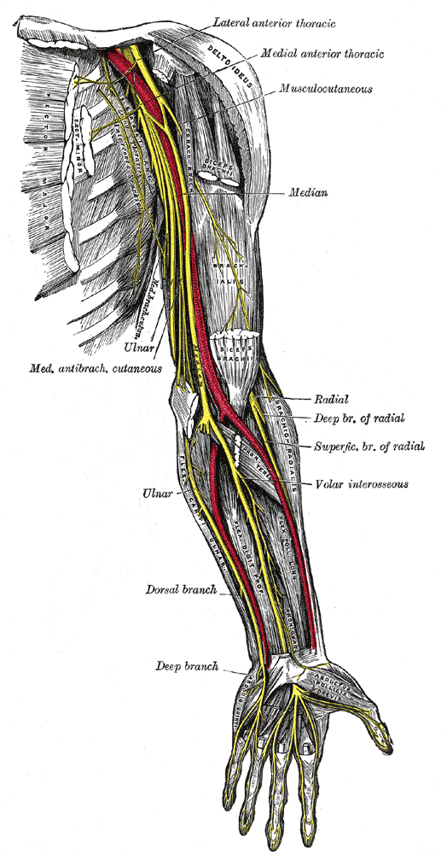

Slide 28


Slide 29


