Slide 1

Reading Strategies
Functional English | BS & DPT
Hafsa Rasheed

Slide 2
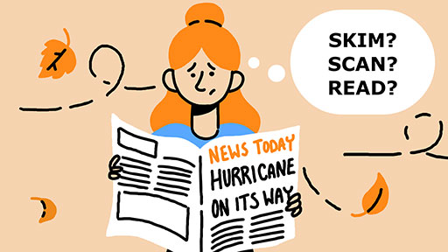
What are Reading Strategies?
Reading strategies are conscious, goal-oriented techniques
Are used to understand, interpret, remember, and evaluate written texts
These strategies help in achieving reading purpose

Slide 3
Skimming
Skimming is a rapid reading technique used to grasp the overall meaning, theme, or structure of a text without focusing on details.
Coined / Popularised By
Evelyn Wood, American educator and businessperson
1959
Reading Dynamics

Slide 4
Types of Skimming
1. Preview Skimming: The reader looks at the title, headings, and subheadings to predict the content of the text.
2. Structural Skimming: The reader focuses on introductory and concluding paragraphs to understand the main argument.
3. Superficial Skimming: The eyes move quickly over the text to gain a general sense of ideas.
4. Survey Skimming: This type is used before detailed study to understand the organisation of a book or chapter.

Slide 5
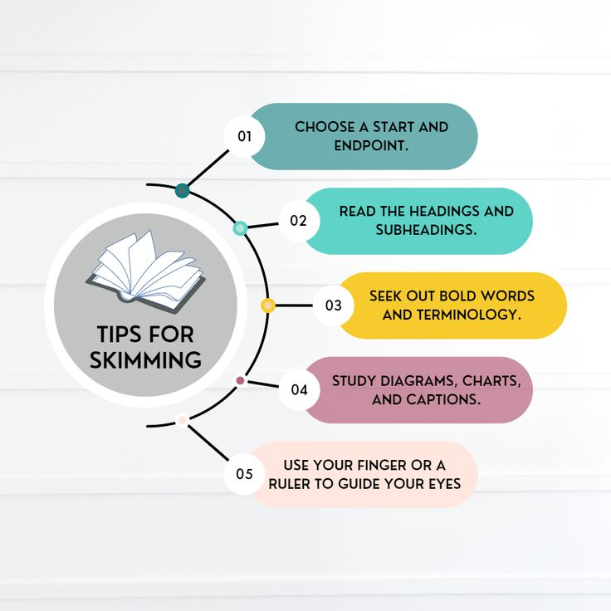
Uses of Skimming
Skimming is commonly used while reading newspapers, previewing academic texts, and managing time in examinations.

Slide 6
Scanning
Scanning is a selective reading technique used to locate specific information such as names, dates, figures, or keywords without reading the entire text.
Development
Scanning developed through 20th-century reading and study-skills research and is widely taught in academic reading courses.

Slide 7
Scanning Strategies
1. Keyword spotting: The reader searches for a particular word or phrase relevant to their need.
2. Numerical scanning: This strategy is used to locate dates, prices, or statistics.
3. Capital-letter scanning: Proper nouns or headings are identified through visual cues.
4. Pattern recognition: Tables, graphs, and bullet points help the reader quickly find information.
5. Index and contents scanning: The reader uses reference tools to reach the required section efficiently.

Slide 8
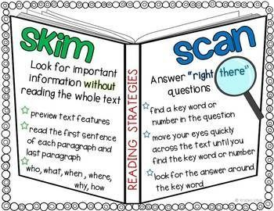
Uses
Scanning is useful for dictionaries, timetables, research references, and objective-type exams.

Slide 9
SQ3R Method
Survey – Question – Read – Recite – Review
SQ3R is a structured academic reading method designed to improve comprehension, concentration, and long-term memory.
Coined By
Francis P. Robinson, an educational psychologist
1946| Effective Study

Slide 10
Continued
Survey: The reader previews the text by examining headings, summaries, and visuals to get an overview.
Question: The reader forms questions based on headings to set a purpose for reading.
Read: The text is read carefully to find answers to the questions.
Recite: The reader recalls and restates key ideas in their own words to reinforce learning.
Review: The material is revised periodically to strengthen retention.

Slide 11
SQ4R Method
Survey – Question – Read – Reflect – Recite – Review
SQ4R is an advanced version of SQ3R that adds reflection to encourage deeper understanding and critical thinking.
Coined By
Edwin L. Thomas and H. Alan Robinson
1972| Improving Reading in Every Class: A Sourcebook for Teachers

Slide 12
Reflection
Reflection requires the reader to connect new ideas with prior knowledge, personal experience, or real-world contexts.

Slide 13


