Slide 1
Anesthesia Machine
FSC ( OTT)
ADNAN RAMZAN

Slide 2
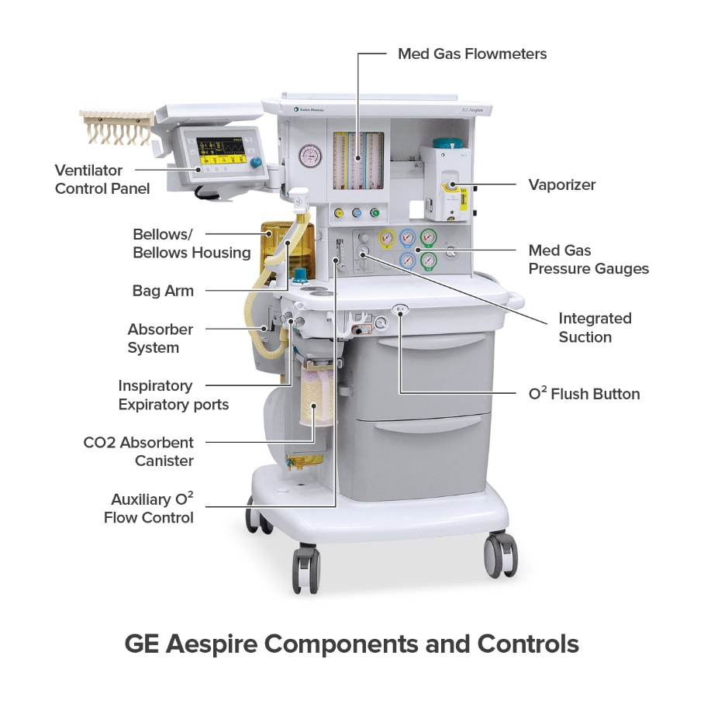

Slide 3
Anesthesia Machine
An anesthesia machine is used in operation theaters
It helps doctors give anesthesia to patients
The machine keeps the patient unconscious during surgery
It supplies oxygen and anesthetic gases
Proper anesthesia is important for safe surgery
The machine controls pressure and gas flow
It is handled by an anesthetist

Slide 4
Boyle’s Anesthesia Machine
Boyle’s machine is the most commonly used anesthesia machine
It was developed in the early 20th century
It works on a continuous flow system
It delivers oxygen mixed with anesthetic vapors
Gases are given at controlled pressure and flow
It provides a constant gas supply to the patient
Mechanical ventilation can be used if needed
It is widely used in hospitals

Slide 5
Problems with Early Anesthesia Machines
Early machines caused high wastage of gases
Anesthetic agents were not used efficiently
Machines were completely mechanical
Fresh gas flow was very high
Control over gas delivery was poor
Monitoring systems were not available
ccuracy of treatment was low

Slide 6
Connection and System Issues
Early machines had many connections
Disconnection was very common
Wrong connections could occur easily
Tubes could bend or kink
Gas leakage was a serious problem
Flow meters were not accurate
Gas delivery was unreliable

Slide 7
Lack of Safety Features
There were no alarm systems
Anesthetists had to monitor everything manually
Mechanical ventilation increased workload
Critical patients were difficult to manage
Gas delivery was not accurate
System efficiency was very low
Patient safety was compromised

Slide 8
Need for Improvement
Many patient lives were at risk
Accurate control of anesthesia was necessary
Proper oxygen supply was very important
Lung ventilation had to be maintained
Oxygen-enriched gas was required
Old machines were not reliable
Continuous flow was not always accurate

Slide 9
Development of Modern Anesthesia Machines
Modern machines focus on patient safety
Efficiency of anesthesia delivery has improved
New components were added to machines
Gas mixture accuracy is much better
Advanced monitoring systems are included
Fail-safe systems are now available
Hypoxic guard systems were introduced
Overall performance has improved

Slide 10
Hypoxic Guard and Fail-Safe System
Hypoxic guard prevents low oxygen delivery
It ensures oxygen concentration stays above 21%
If oxygen decreases, nitrous oxide also decreases
This prevents hypoxic gas mixture
Fail-safe system protects the patient
Gas flow is controlled automatically
Anesthesia delivery becomes safer
Risk of complications is reduced

Slide 11
Safety Systems in Anesthesia Machines
Pin Index Safety System is used
Gas cylinders are color coded
Gas-specific connectors are used
Wrong gas connection is prevented
Scavenging systems remove waste gases
Operating room pollution is reduced
Medical staff and patients remain safe

Slide 12
Comparison (Old vs Modern)
Old Anesthesia machines | Modern Anesthesia machines
Old machines were separate units | Modern machines are integrated
Old used manual controls | Modern use electronic controls
Old had limited monitoring | Modern have multi-parameter monitoring
Old wasted gases | Modern save gases

Slide 13
What is Anesthesia Workstation
It is an integrated anesthesia unit
Combines gas delivery system
Includes ventilator system
Has patient monitoring system
Works with electronic controls
Used in surgeries
Improves safety and efficiency

Slide 14
Main Components
Gas delivery system
Electronic flow meters
Vaporizers for anesthetic agents
Breathing circuit
Advanced ventilator
Patient monitoring system
Scavenging system

Slide 15
Electronic Flow Meters
More accurate than mechanical meters
Use electronic sensors
No glass flow tubes
Flow shown on digital display
Reduces leakage risk
Easy visualization of gas flow
Saves anesthetic gases

Slide 16
Advantages of Electronic Flow Meters
High accuracy in gas delivery
Less mechanical failure
Better control of oxygen flow
Digital display is clear
Improves economy of gases
Safer for patient

Slide 17
Breathing Circuit (Circle System)
Modern machines use circle system
Designed for low flow anesthesia
Reuses oxygen and anesthetic gases
Reduces wastage of gases
Has CO₂ absorber

Slide 18
CO₂ Absorber System
Removes carbon dioxide
Uses soda lime or disposable absorber
Helps in rebreathing
Maintains proper gas composition
Bypass valve present
Easy replacement
No interruption of anesthesia
Reduces resistance

Slide 19
Ventilator System
Very important component
Uses electronic piston or turbine
Provides controlled ventilation
Accurate tidal volume delivery
Supports critical patients
Has advanced ventilation modes
Reduces manual ventilation
Improves safety

Slide 20
Patient Monitoring System
Continuous patient monitoring
Heart rate monitoring
ECG monitoring
Blood pressure monitoring
Oxygen saturation (SpO₂)
Improves patient safety

Slide 21
Advantages of Integrated Workstation
All systems work together
Accurate tidal volume delivery
Reduces low pressure hazards
Improves anesthesia safety
Better monitoring
Less human error
Saves time
Cost effective

Slide 22
Training Requirement
Modern machines are complex
Staff needs proper training
Electronic systems need understanding
Software-based controls
Wrong use can cause errors
Training improves safety
Reduces accidents
Improves confidence

Slide 23
Conclusion
Anesthesia machines are essential in surgery
Early machines had many limitations
Patient safety was a major concern
Modern machines are more reliable
Safety features have greatly improved
Gas delivery is accurate and controlled
Monitoring systems help anesthetists
Overall patient care has improved

Slide 24


