Slide 1

ANATOMY
THE UPPER LIMB
DPT
1ST SEMESTER
DR DANISH

Slide 2
Proximal Radioulnar Joint
Articulation
  Between the circumference of the head of the radius and the annular ligament and the radial notch on the ulna
  Constitutes the third joint in the elbow
Type
  Synovial pivot joint

Slide 3
CONTINUED
Capsule
  Encloses the joint
  Continuous with that of the elbow joint

Slide 4
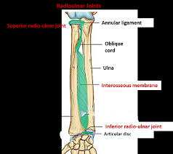

Slide 5
Ligament
Annular ligament
Attached to the anterior and posterior margins of the radial notch on the ulna
Forms a collar around the head of the radius
Continuous above with the capsule of the elbow joint
Not attached to the radius

Slide 6
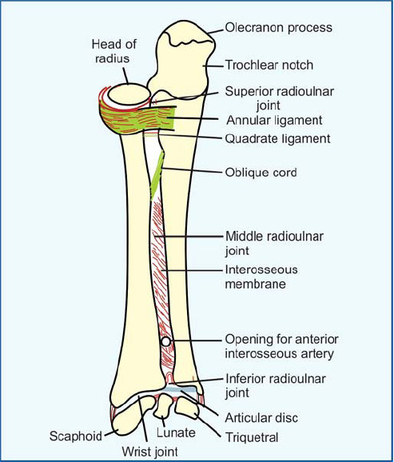

Slide 7
Synovial Membrane
Continuous above with that of the elbow joint
Below, attached to the inferior margin of the annular ligament
Extends downwards to the lower margin of the radial notch of the ulna

Slide 8
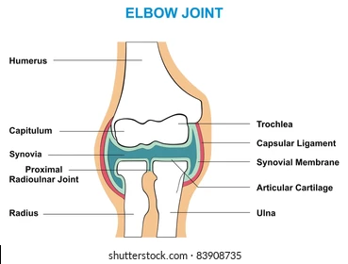

Slide 9
Continued
Nerve Supply
  Branches of the median, ulnar, musculocutaneous, and radial nerves
Movements
  Produces pronation and supination of the forearm

Slide 10
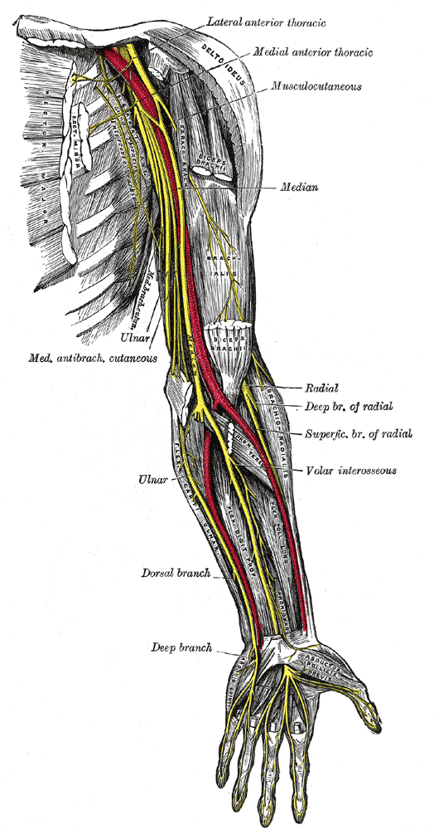

Slide 11
Interosseous Membrane
Strong ligament
Attaches to the interosseous borders of the radius and ulna
Unites the shafts of the two bones
Fibers run obliquely downward and medially
Assists proximal displacement of the radius

Slide 13
Continued
Force applied to the radius (e.g., from an outstretched hand) is transmitted:
  From radius → ulna → humerus → scapula
Fibers become taut in pronation
Provides attachment for neighboring muscles

Slide 14
Distal Radioulnar Joint
Articulation
  Between the rounded head of the ulna and the ulnar notch of the radius
Type
  Synovial pivot joint
Capsule
  Encloses the joint
  Deficient superiorly
Ligaments
  Weak anterior and posterior ligaments strengthen the capsule

Slide 15
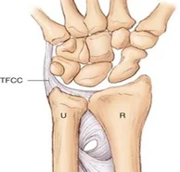

Slide 16
Articular Disc
Triangular in shape
Composed of fibrocartilage
Attached by its apex to the lateral side of the base of the ulnar styloid process
Base attached to the lower border of the ulnar notch of the radius
Separates the distal radioulnar joint from the wrist joint
Strongly unites the radius to the ulna

Slide 17
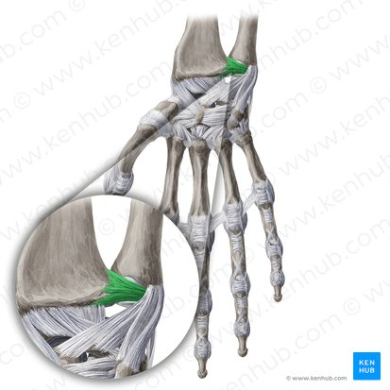

Slide 18
Nerve Supply
Anterior interosseous nerve
Deep branch of the radial nerve

Slide 19
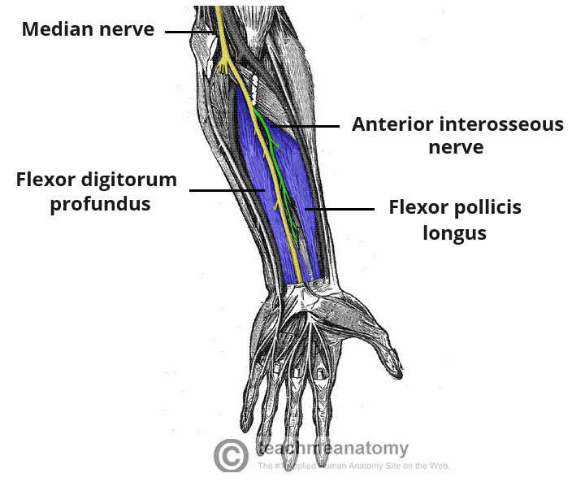

Slide 20
Movements of Pronation and Supination
Occur at both proximal and distal radioulnar joints
Axis passes:
  Through the head of the radius above
  Through the attachment of the articular disc to the ulna below

Slide 22
Pronation
Radius rotates at the capitulum
Head of radius rotates within the annular ligament
Hand moves bodily forward
Ulnar notch of radius moves around the circumference of the distal end of the ulna
Hand remains in line with the upper limb
Ulna is not displaced medially
Palm faces posteriorly
Thumb lies on the medial side

Slide 23
Supination
Reverse of pronation
Hand returns to anatomical position
Palm faces anteriorly
More powerful movement due to strength of biceps brachii

Slide 24
Muscles
Pronation: Pronator teres, Pronator quadratus
Supination: Biceps brachii, Supinator

Slide 25
Important Relations
Anteriorly
  Tendons of flexor digitorum profundus
Posteriorly
  Tendon of extensor digiti minimi

Slide 26
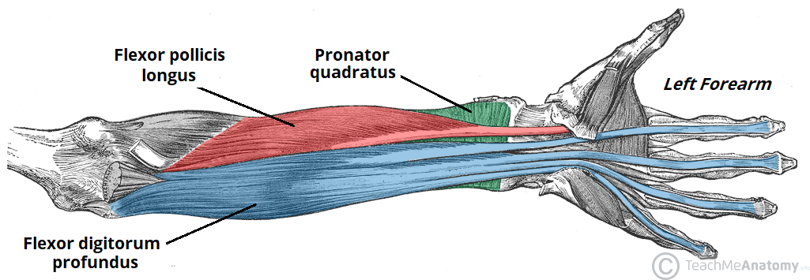

Slide 27


Slide 28


