Slide 1

BASIC MEDICAL SCIENCE
FSC MEDICAL TECHNOLOGIES I
DR DANISH

Slide 2
Blood Vessels
Definition
Blood vessels are tubular structures that carry blood throughout the body.
They form a closed circulatory system.
Help in transport of oxygen, nutrients, hormones, and removal of waste products.

Slide 3
Types of Blood Vessels
There are three main types:
Arteries
Veins
Capillaries

Slide 4
1. Arteries
Carry blood away from the heart.
Mostly carry oxygenated blood
(Exception: pulmonary artery carries deoxygenated blood).
Have thick, elastic, and muscular walls.
Blood flows under high pressure.
No valves (except at the heart).

Slide 5
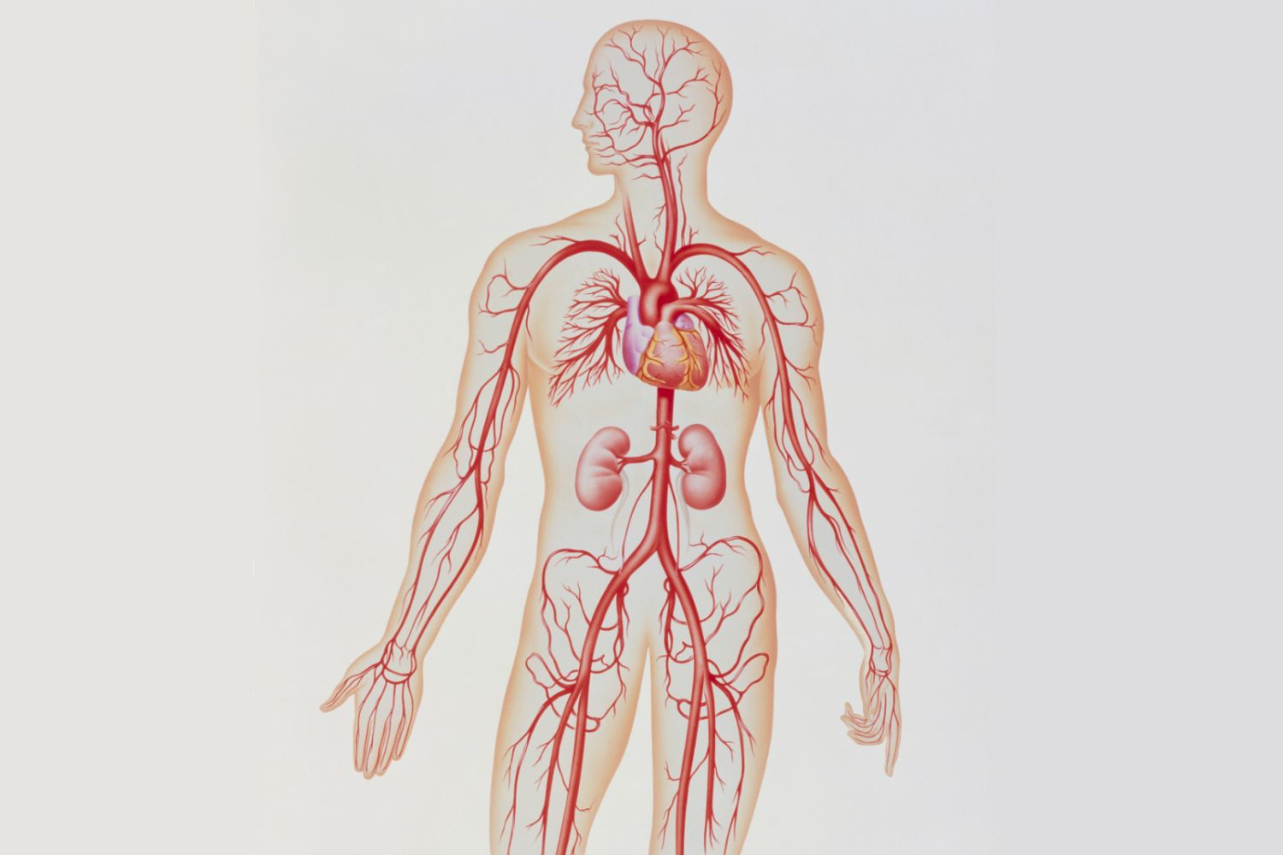

Slide 6
Structure of Arteries
Tunica intima: Inner smooth lining.
Tunica media: Thick muscular layer (controls blood pressure).
Tunica externa: Outer protective layer.

Slide 7
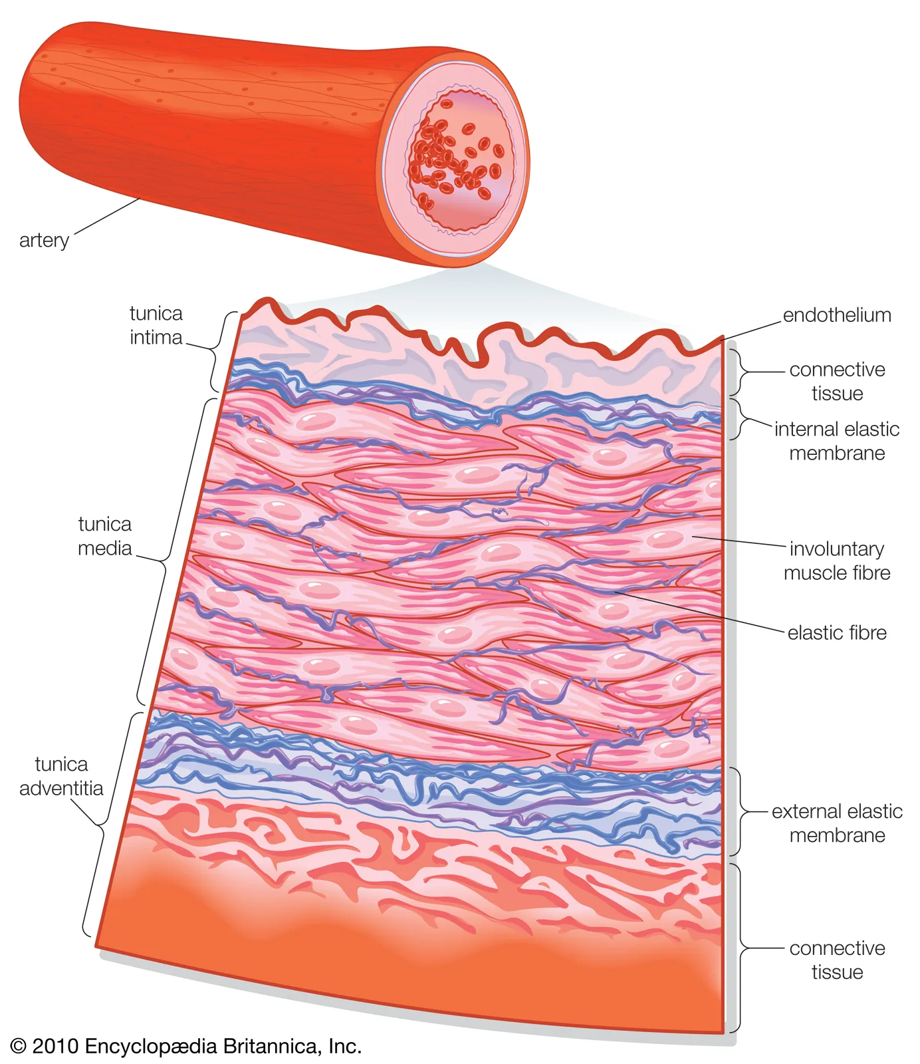

Slide 8
Functions of Arteries
Distribute oxygen-rich blood to body tissues.
Maintain blood pressure.
Help regulate body temperature.

Slide 9
Examples
Aorta
Coronary arteries
Pulmonary artery

Slide 10
2. Veins
Carry blood towards the heart.
Mostly carry deoxygenated blood
(Exception: pulmonary vein carries oxygenated blood).
Walls are thin and less elastic.
Blood flows under low pressure.
Contain valves to prevent backflow of blood.

Slide 11
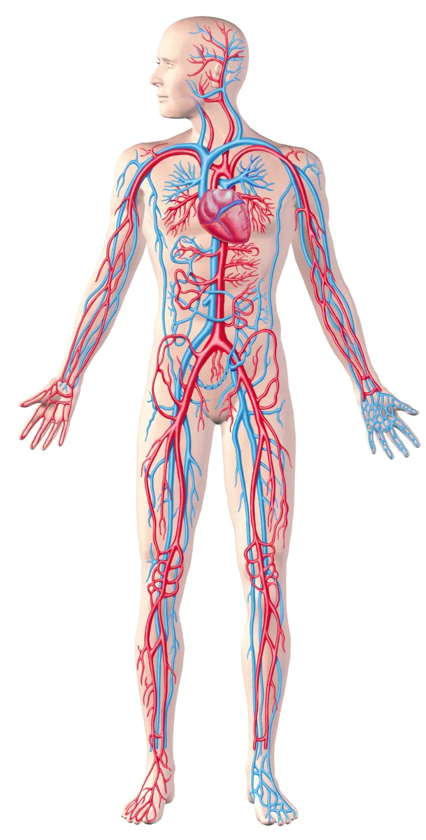

Slide 12
Structure of Veins
Same three layers as arteries but thinner.
Larger lumen than arteries.

Slide 13
Functions of Veins
Return blood to the heart.
Act as blood reservoirs.
Valves ensure one-way flow of blood.

Slide 14
Examples
Superior vena cava
Inferior vena cava
Pulmonary veins

Slide 15
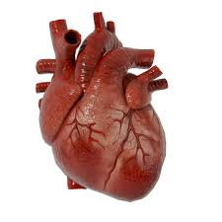

Slide 16
3. Capillaries
Smallest and most numerous blood vessels.
Connect arterioles to venules.
Walls are one cell thick.
Blood flows very slowly.

Slide 17
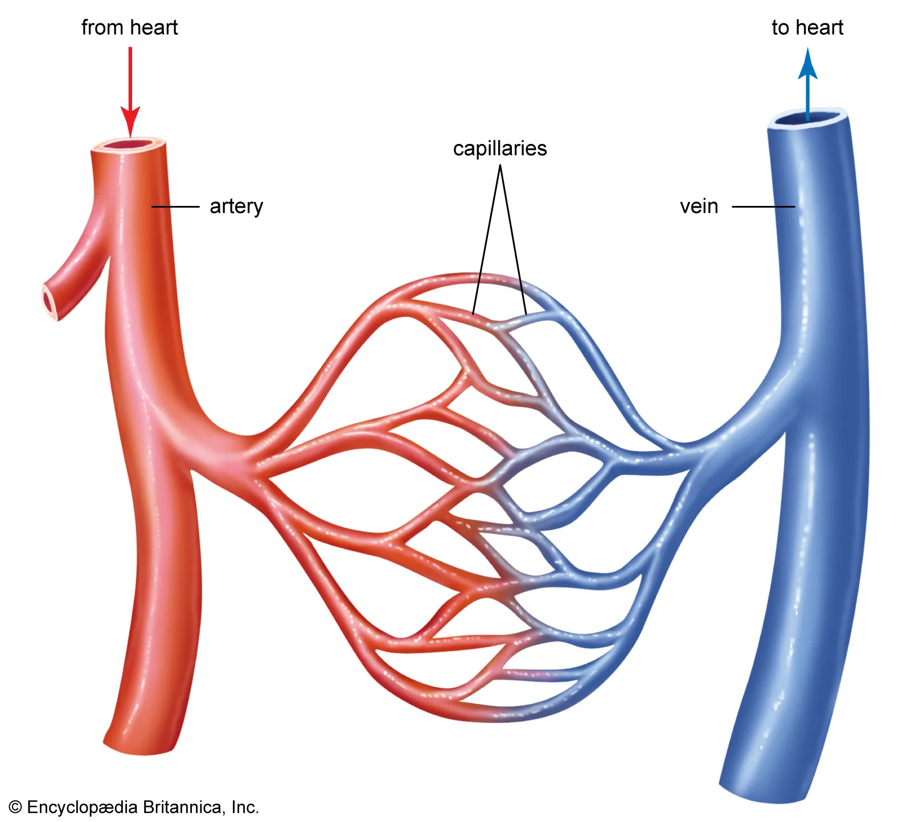

Slide 18
Functions of Capillaries
Exchange of:
  Oxygen and carbon dioxide
  Nutrients and waste products
Provide direct contact between blood and tissues.

Slide 19
Types of Capillaries
Continuous capillaries (muscles, brain)
Fenestrated capillaries (kidneys, intestines)
Sinusoidal capillaries (liver, spleen)

Slide 20
Comparison of Blood Vessels
Feature | Arteries | Veins | Capillaries
Direction of flow | Away from heart | Towards heart | Between arteries & veins
Wall thickness | Thick | Thin | One cell thick
Pressure | High | Low | Very low
Valves | Absent | Present | Absent
Main function | Distribution | Return | Exchange

Slide 21
Difference Between Arteries and Veins
Feature | Arteries | Veins
Direction of blood flow | Carry blood away from the heart | Carry blood towards the heart
Type of blood | Mostly oxygenated blood | Mostly deoxygenated blood
Exceptions | Pulmonary artery carries deoxygenated blood | Pulmonary vein carries oxygenated blood
Wall thickness | Thick, muscular, and elastic walls | Thin and less elastic walls
Lumen size | Narrow lumen | Wide lumen
Blood pressure | High pressure | Low pressure
Valves | Absent | Present (prevent backflow)
Pulse | Pulse is present | No pulse
Position in body | Mostly deep seated | Often superficial
Speed of blood flow | Fast | Slow
Function | Distribute blood to tissues | Return blood to the heart
Risk if damaged | Severe bleeding | Slow bleeding

Slide 22


Slide 23


