Slide 1

HUMAN ANATOMY
BS RIT,OTT,MLT
1ST SEMESTER
DR DANISH

Slide 2
Somatic Nervous System &
Visceral (Autonomic) Nervous System
PNS is functionally divided into:
Somatic Nervous System
Visceral (Autonomic) Nervous System

Slide 3
Somatic Nervous System (SNS)
Definition
Part of peripheral nervous system
Concerned with voluntary activities
Supplies:
  Skin
  Skeletal muscles
  Joints

Slide 4
Components of Somatic Nervous System
Sensory (Afferent) nerves
  Carry sensations from body to CNS
Motor (Efferent) nerves
  Carry impulses from CNS to skeletal muscles

Slide 5
Functions of Somatic Nervous System
Conscious perception of sensations:
  Pain
  Touch
  Temperature
  Proprioception
Voluntary control of skeletal muscles
Responsible for reflex actions involving skeletal muscles

Slide 6
Characteristics of Somatic Nervous System
Single motor neuron between CNS and muscle
Neurotransmitter: Acetylcholine
Effect on muscles is always excitatory
Actions are under conscious control

Slide 7
Visceral Nervous System (Autonomic NS)
Part of peripheral nervous system
Controls involuntary activities
Regulates internal environment of body

Slide 8
Structures Supplied by Visceral Nervous System
Smooth muscles
Cardiac muscle
Glands
Blood vessels
Viscera (internal organs)

Slide 9
Divisions of Visceral Nervous System
Sympathetic nervous system
Parasympathetic nervous system

Slide 10
Sympathetic Nervous System
Prepares body for stress and emergency
Known as “Fight or Flight” system
Effects:
  Increases heart rate
  Dilates pupils
  Inhibits digestion

Slide 11
Parasympathetic Nervous System
Conserves and restores energy
Known as “Rest and Digest” system
Effects:
  Decreases heart rate
  Constricts pupils
  Stimulates digestion

Slide 12
Characteristics of Visceral Nervous System
Two-neuron chain:
  Preganglionic neuron
  Postganglionic neuron
Neurotransmitters:
  Acetylcholine
  Noradrenaline
Effects may be:
  Excitatory
  Inhibitory
Not under conscious control

Slide 13
Preganglionic neuron starting in the CNS (brain/spinal cord) and synapsing in a ganglion, releasing acetylcholine
Postganglionic neuron starts at the ganglion (often short) and travels to the target organ (like muscle or gland), usually releasing norepinephrine (sympathetic) or acetylcholine (parasympathetic).

Slide 14
DIFF B/W SOMATIC AND VISCERAL NERVOUS SYTEM
Feature | Somatic NS | Visceral NS
Control | Voluntary | Involuntary
Effectors | Skeletal muscles | Smooth, cardiac, glands
Neurons | Single neuron | Two neurons
Consciousness | Conscious | Unconscious

Slide 15
Clinical Importance
Damage to somatic nerves → paralysis, loss of sensation
Damage to visceral nerves → autonomic dysfunction
Important in understanding:
Shock
Hypertension
Digestive disorders

Slide 16
Summary
Somatic NS controls voluntary actions
Visceral NS controls involuntary functions
Both systems are essential for survival and coordination
Maintain balance between internal and external environment

Slide 17
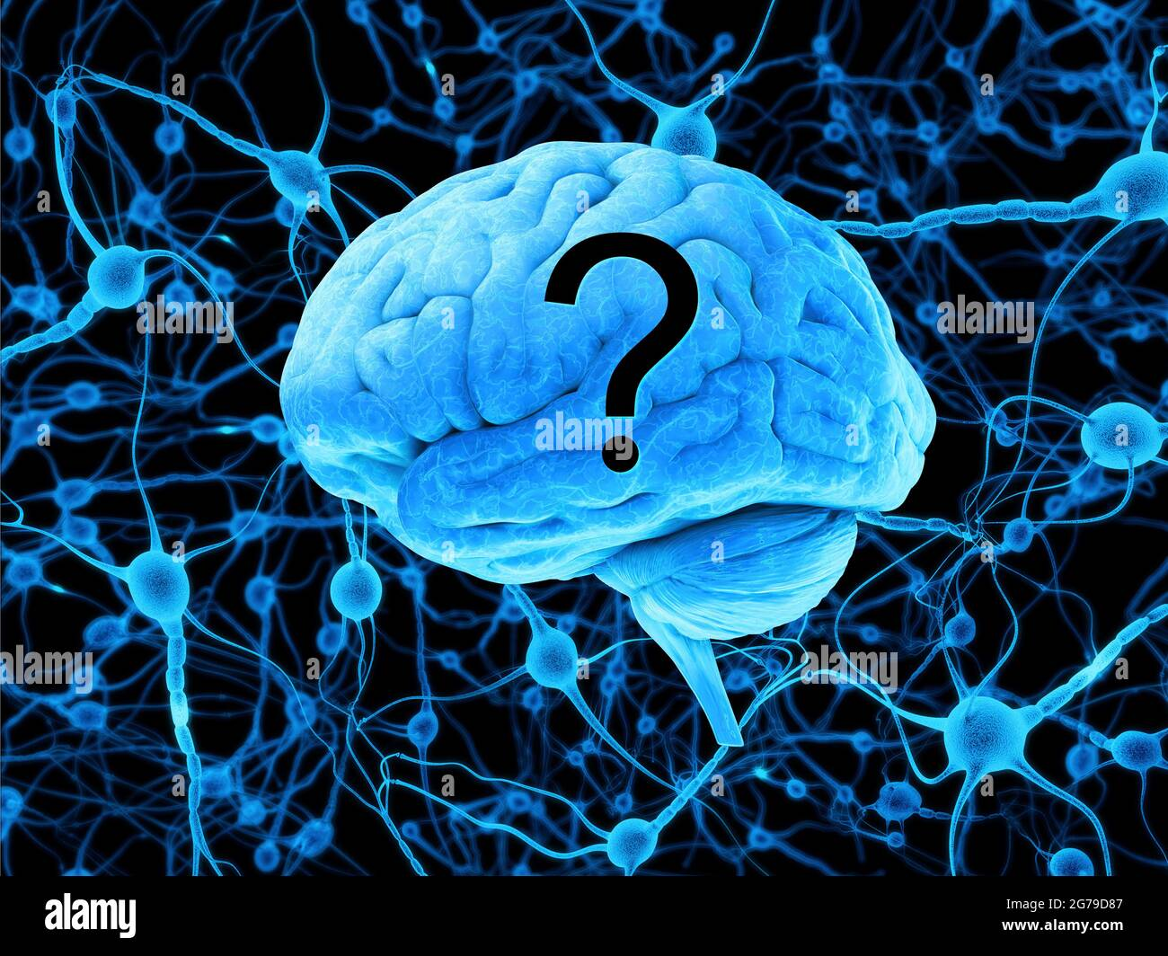

Slide 18


