Slide 1

ANATOMY
THE UPPER LIMB
DPT
1ST SEMESTER
DR DANISH

Slide 2
ELBOW JOINT
Overview
The elbow joint is a complex joint made up of three individual articulating joints
These joints share a common synovial cavity
The articular surfaces are:
  Humeroulnar
  Humeroradial
  Proximal radioulnar
All articular surfaces are covered by hyaline cartilage

Slide 3
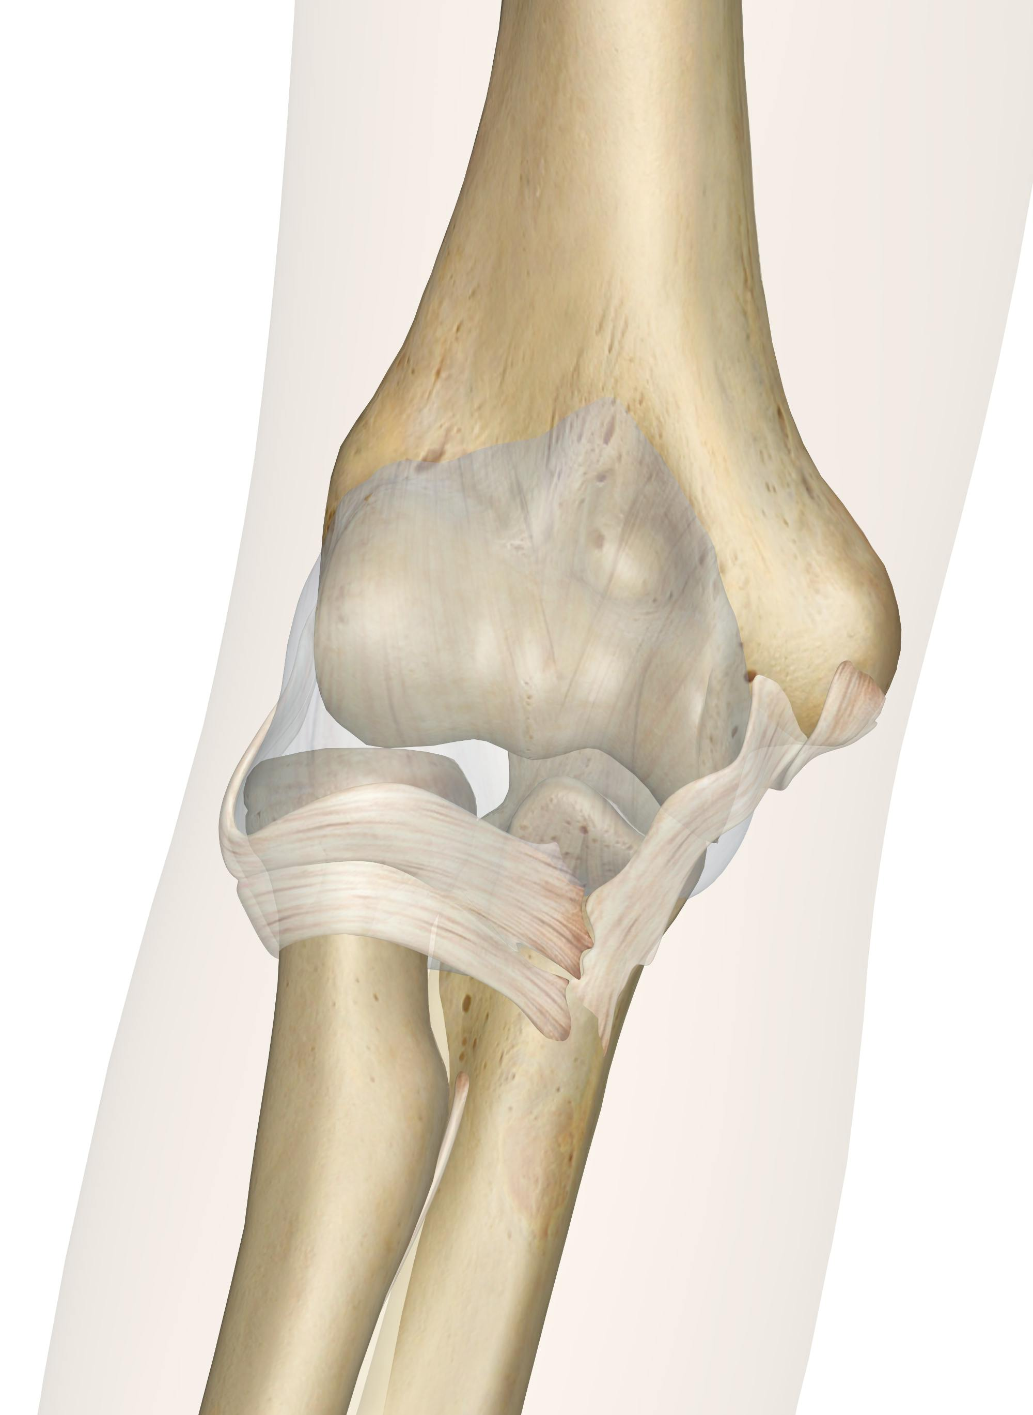

Slide 4
ARTICULATION
Humeroulnar joint:
Occurs between:
  Trochlea of the humerus
  Trochlear notch of the ulna

Slide 6
Continued
Humeroradial joint:
Occurs between:
  Capitulum of the humerus
  Head of the radius

Slide 8
Continued
Proximal radioulnar joint:
Occurs between:
  Head of the radius
  Radial notch of the ulna
  The humeroulnar joint provides stability and hinge movement, while the humeroradial and radioulnar joints allow rotational movements of the forearm.

Slide 10
TYPE OF JOINT
Humeroulnar joint
  Uniaxial hinge joint
Humeroradial joint
  Biaxial condyloid joint
Overall elbow joint
  Functionally acts as a hinge joint
  Flexion and extension occur mainly at the humeroulnar joint, while forearm rotation involves the humeroradial and radioulnar joints.

Slide 11
CAPSULE
Encloses all three joints
Anteriorly
  Attached above to:
    Margins of coronoid and radial fossae
  Attached below to:
    Margins of coronoid process and annular ligament

Slide 12
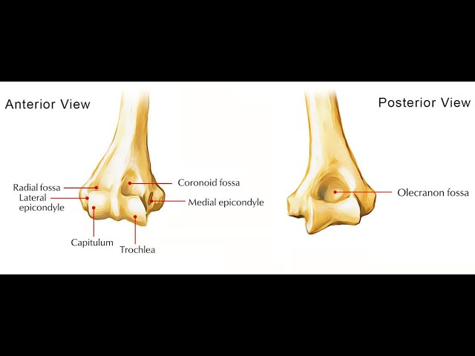

Slide 13
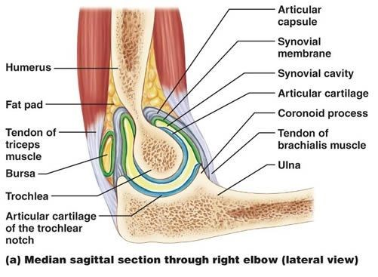

Slide 14
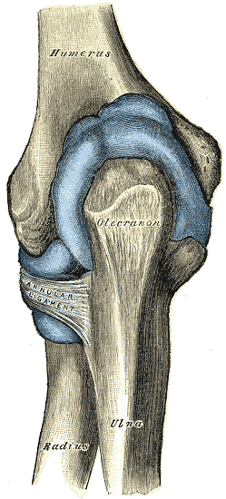

Slide 15
Continued
Posteriorly
  Attached above to:
    Margins of olecranon fossa
  Attached below to:
    Margins of olecranon process of ulna
    The capsule is thin and lax to allow free movement but strengthened by ligaments on the sides.

Slide 17
LIGAMENTS
1. Ulnar (Medial) Collateral Ligament:
Triangular in shape
Consists of:
  Anterior band
    From medial epicondyle → coronoid process
  Posterior band
    From medial epicondyle → medial margin of olecranon
  Transverse band
    Between coronoid and olecranon processes

Slide 18
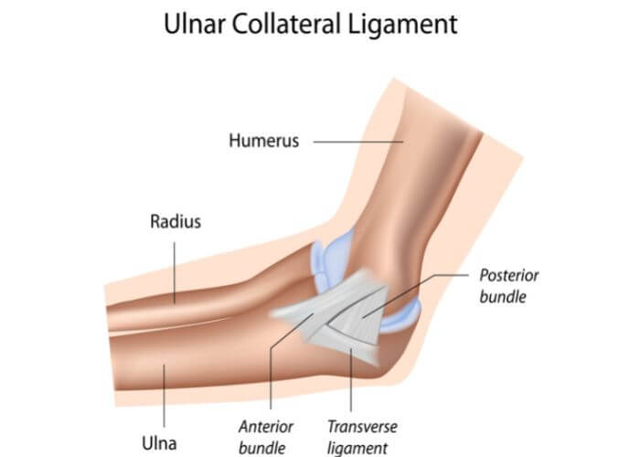

Slide 19
Continued
2. Radial (Lateral) Collateral Ligament:
Triangular
Attached by its apex to:
  Lateral epicondyle of humerus
Blends with:
  Annular ligament of radius

Slide 20
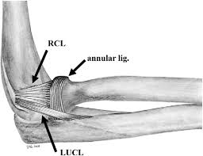

Slide 21
Continued
3. Annular Ligament
Surrounds the head of the radius
Attached to:
  Anterior and posterior margins of radial notch of ulna
  Keeps the radial head in place during pronation and supination.

Slide 23
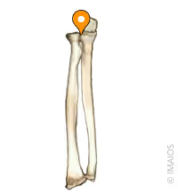

Slide 24
MOVEMENTS
Flexion
Muscles involved:
  Brachialis
  Biceps brachii
  Brachioradialis

Slide 25
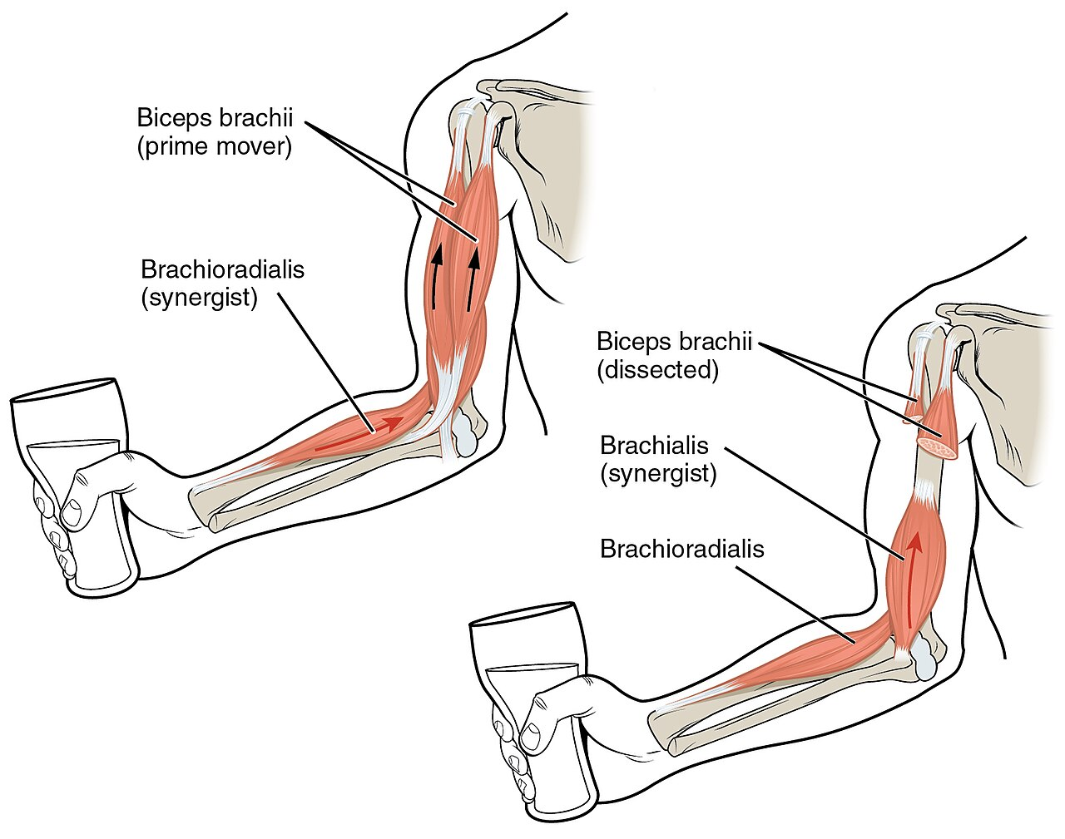

Slide 26
Continued
Extension
Muscle involved:
  Triceps brachii

Slide 27
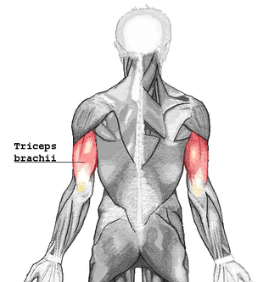

Slide 28
Continued
Pronation
Muscles involved:
  Pronator teres
  Pronator quadratus
Supination
Muscles involved:
  Biceps brachii
  Supinator
  Flexion–extension occurs at the humeroulnar joint, while pronation–supination occurs at the radioulnar joint.

Slide 29
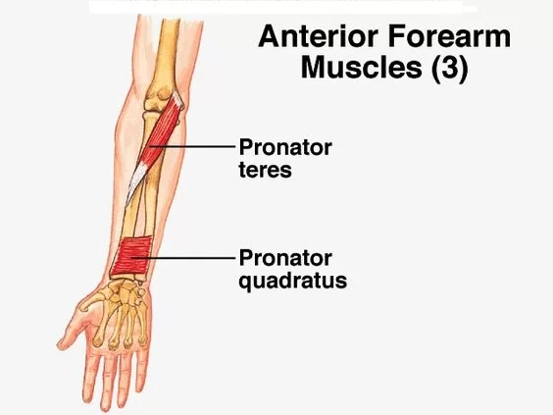

Slide 30
BLOOD SUPPLY
Anastomosis around elbow formed by:
Brachial artery branches
Radial artery
Ulnar artery
This rich anastomosis ensures blood supply during elbow flexion when vessels may be compressed.

Slide 31
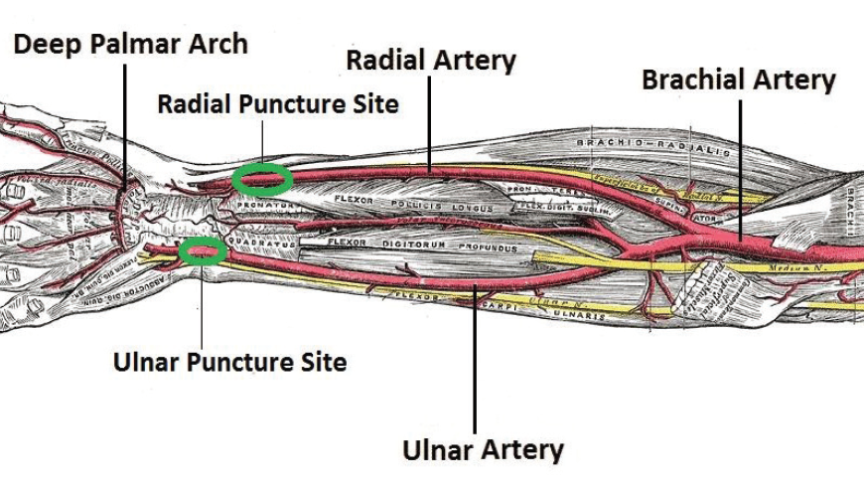

Slide 32
NERVE SUPPLY
Musculocutaneous nerve
Median nerve
Radial nerve
Ulnar nerve

Slide 33
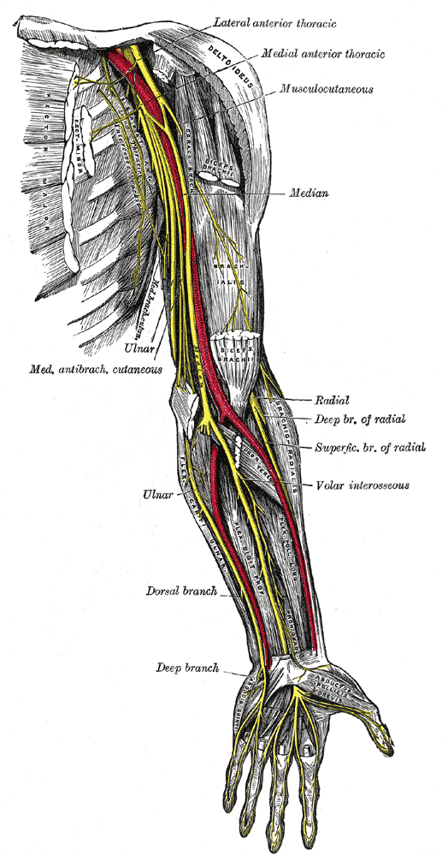

Slide 34
CLINICAL NOTES
Elbow Joint Stability
Stability provided by:
  Shape of articulating surfaces
  Strong collateral ligaments
  Muscles crossing the joint
Dislocation
More common in children
Usually posterior dislocation

Slide 35
Continued
Ulnar Nerve Injury
Ulnar nerve passes behind medial epicondyle
Vulnerable in elbow injuries (“funny bone”)
Tennis Elbow
Inflammation of common extensor origin
Pain over lateral epicondyle

Slide 36
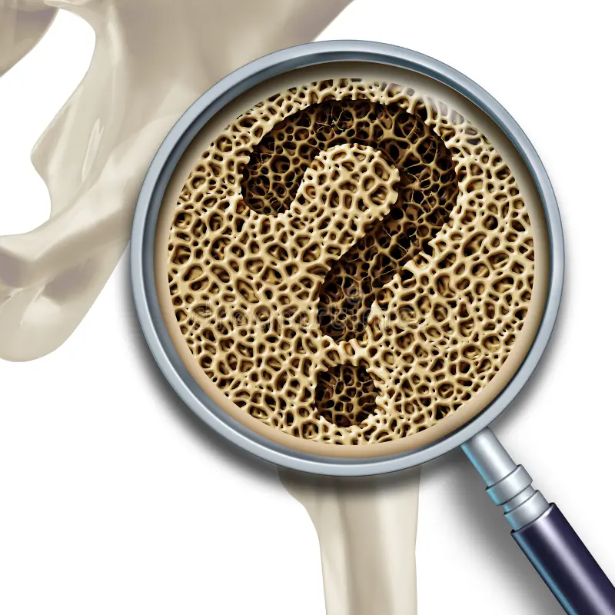

Slide 37


