Slide 1

BASIC MEDICAL SCIENCE
FSC MEDICAL TECHNOLOGIES I
DR DANISH

Slide 2
Conducting System of the Heart
Definition
The conducting system of the heart is a network of specialized cardiac muscle cells
It generates and transmits electrical impulses
These impulses cause rhythmic contraction of the heart

Slide 3
Main Parts of the Conducting System
1. Sinoatrial (SA) Node
Located in the right atrium
Known as the pacemaker of the heart
Produces electrical impulses automatically
Initiates heart beat

Slide 4
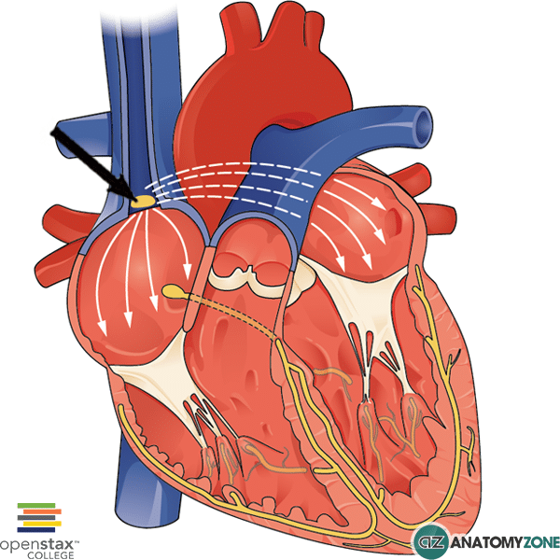

Slide 5
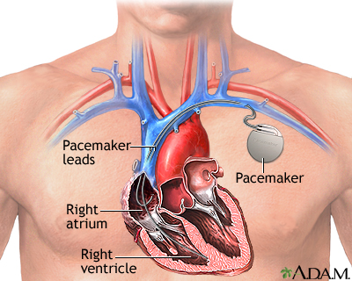

Slide 6
CONTINUED
2. Atrioventricular (AV) Node
Located between atria and ventricles
Receives impulse from SA node
Delays impulse briefly
Allows atria to empty blood into ventricles

Slide 7
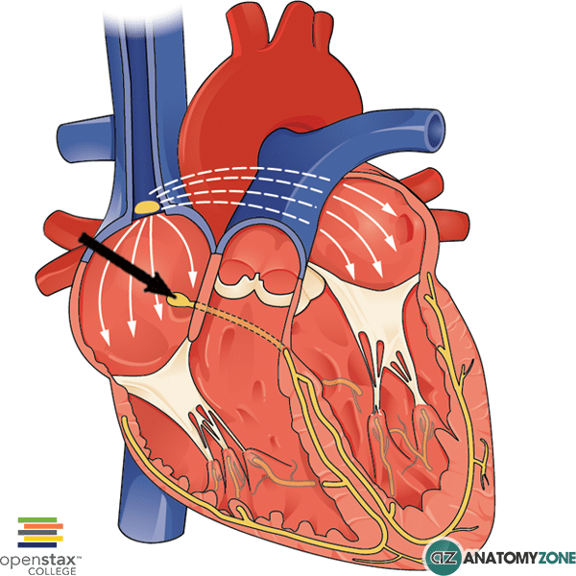

Slide 8
CONTINUED
3. Bundle of His (AV Bundle)
Located in interventricular septum
Carries impulse from AV node to ventricles
Divides into right and left bundle branches

Slide 9
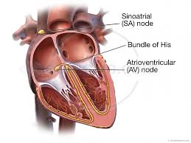

Slide 10
CONTINUED
4. Bundle Branches
Present in right and left ventricles
Carry impulse toward ventricular walls

Slide 12
CONTINUED
5. Purkinje Fibers
Spread throughout ventricular muscles
Cause strong and coordinated ventricular contraction
Help pump blood efficiently

Slide 13
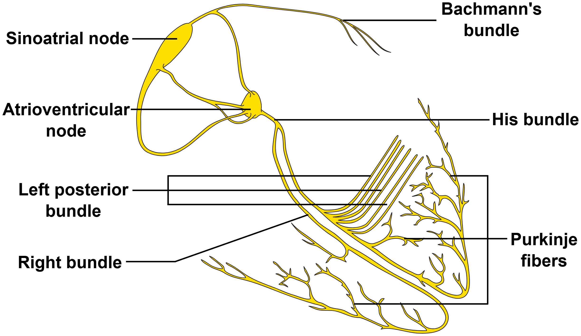

Slide 15
Importance of Conducting System
Maintains regular heart rhythm
Ensures proper blood circulation
Coordinates atrial and ventricular contraction

Slide 16
Summary
SA node starts heartbeat
AV node delays impulse
Bundle of His and Purkinje fibers spread impulse
Result: Effective heart pumping

Slide 17
Mediastinum
Definition
The mediastinum is the space between the two pleural cavities in the thorax
It contains the heart and other vital organs

Slide 18
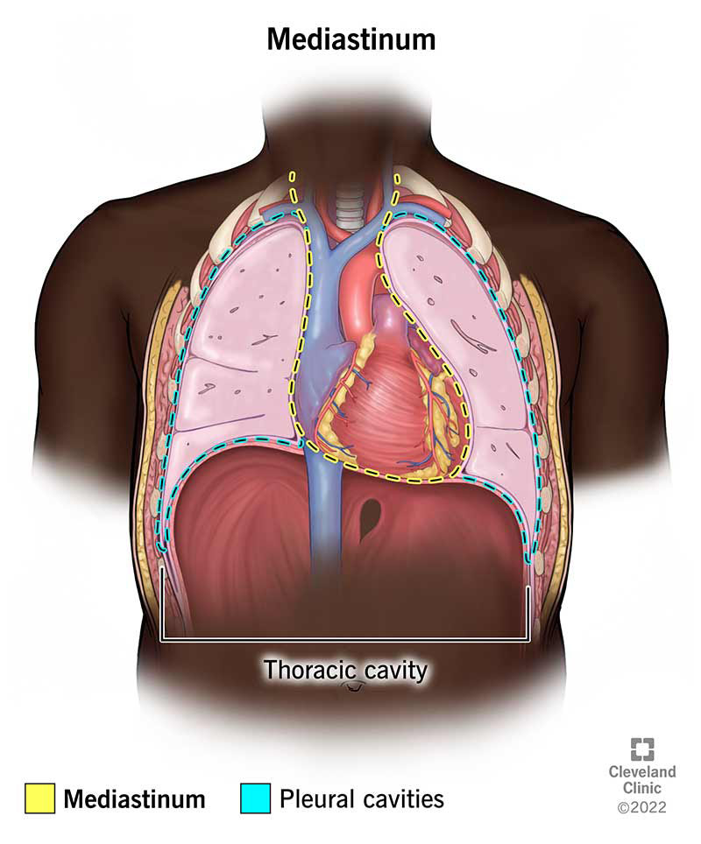

Slide 19
Boundaries of Mediastinum
Laterally: Pleural cavities
Anteriorly: Sternum
Posteriorly: Vertebral column

Slide 21
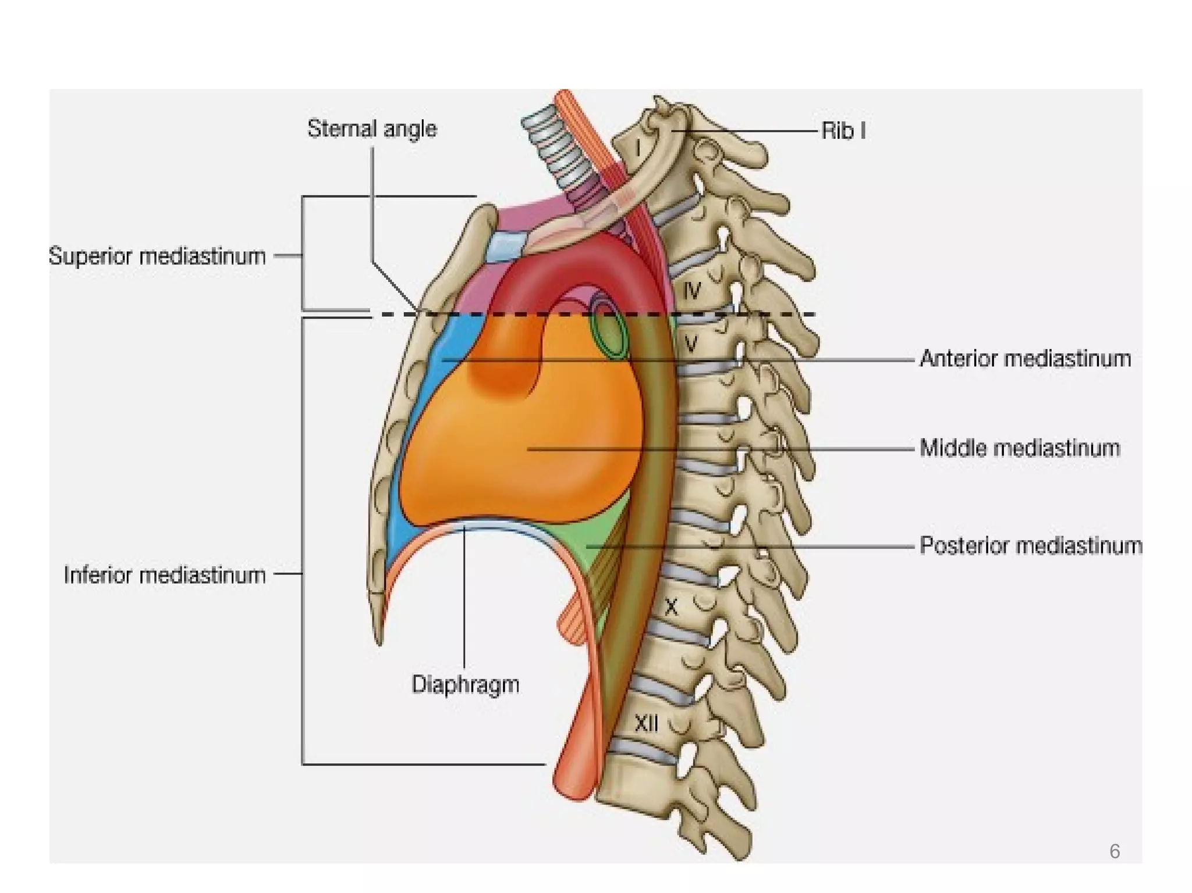

Slide 22
Divisions of Mediastinum
Superior Mediastinum
Inferior Mediastinum, further divided into:
  Anterior mediastinum
  Middle mediastinum
  Posterior mediastinum

Slide 23
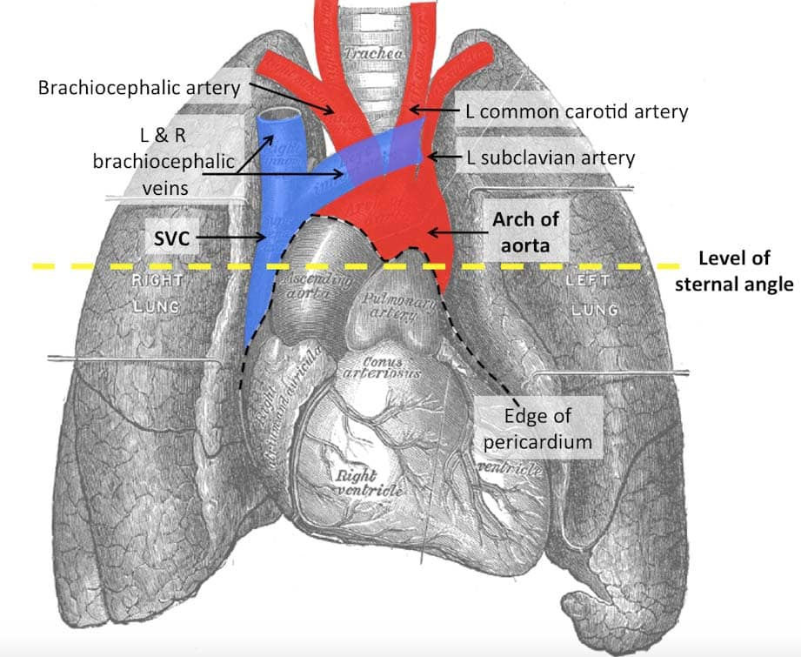

Slide 24
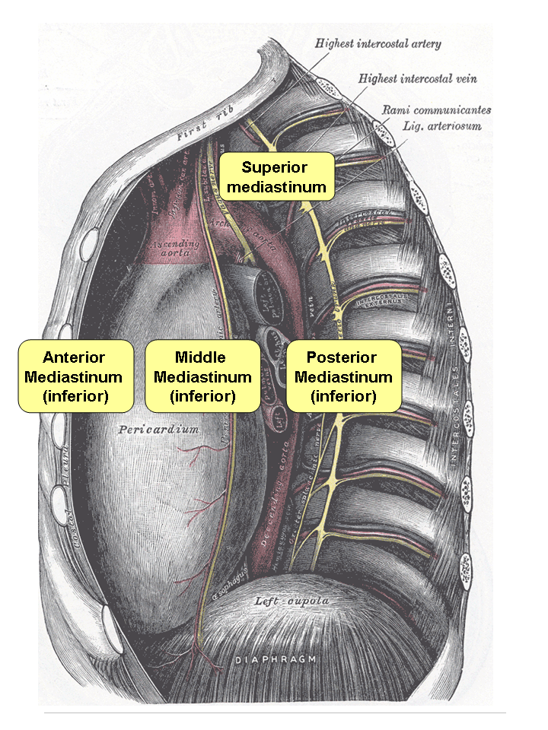

Slide 25
Superior Mediastinum – Contents
Trachea
Esophagus
Thymus
Aortic arch
Superior vena cava (SVC)
Azygos vein
Phrenic nerves
Thoracic duct
Brachiocephalic artery and veins
Left common carotid artery
Left subclavian artery

Slide 26
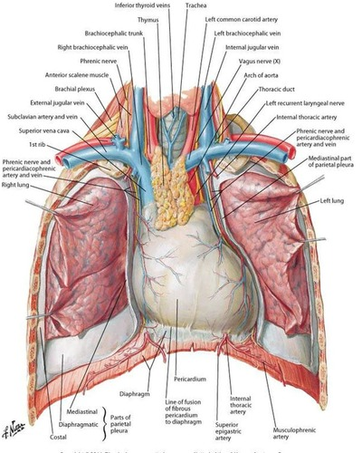

Slide 28
Anterior Mediastinum – Contents
Thymus
Lymph nodes
Connective tissue

Slide 29
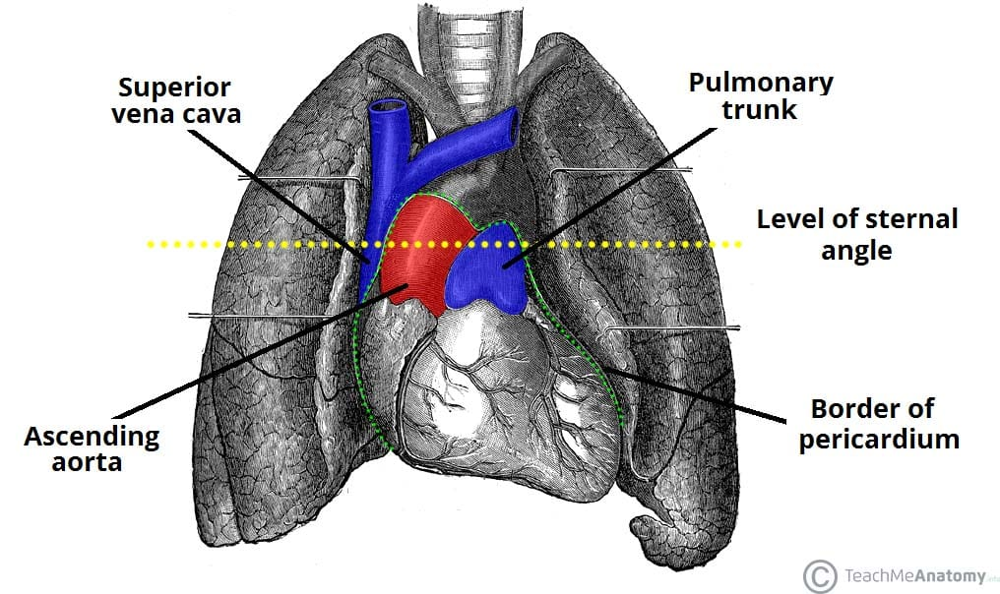

Slide 30
Middle Mediastinum – Contents
Heart
Pericardium
Ascending aorta
Superior vena cava
Phrenic nerves
Coronary arteries and veins

Slide 32
Posterior Mediastinum – Contents
Descending aorta
Esophagus
Thoracic duct
Azygos vein
Vagus nerves (Cranial nerve X)
Splanchnic nerves

Slide 33
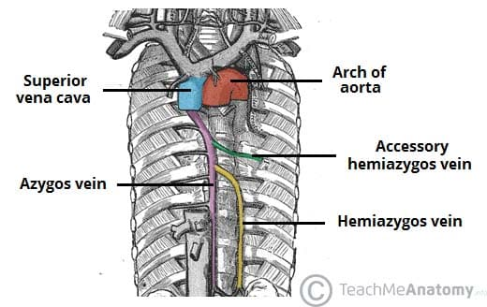

Slide 34
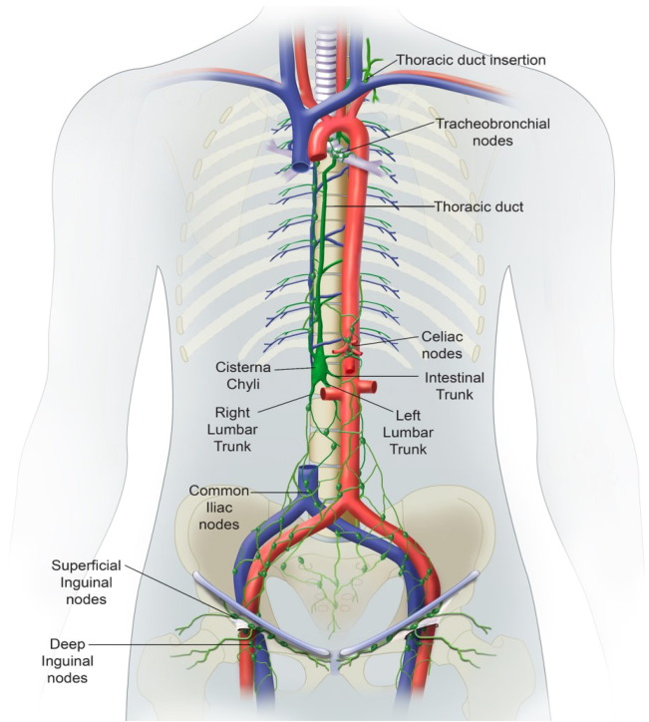

Slide 35


Slide 36


