Slide 1

HUMAN ANATOMY
BS RIT,OTT,MLT
1ST SEMESTER
DR DANISH

Slide 2
SPINAL NERVES
Spinal nerves are mixed nerves
Each spinal nerve is formed by:
  Anterior (ventral) root – motor
  Posterior (dorsal) root – sensory
Posterior root has a spinal (dorsal root) ganglion

Slide 3
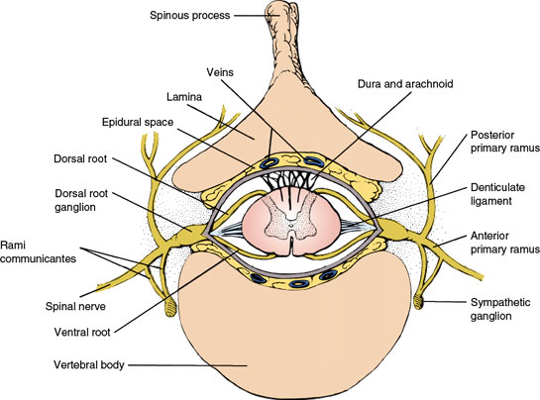

Slide 4
Number of Spinal Nerves
Total 31 pairs
8 Cervical (C1–C8)
12 Thoracic (T1–T12)
5 Lumbar (L1–L5)
5 Sacral (S1–S5)
1 Coccygeal (Co1)

Slide 5
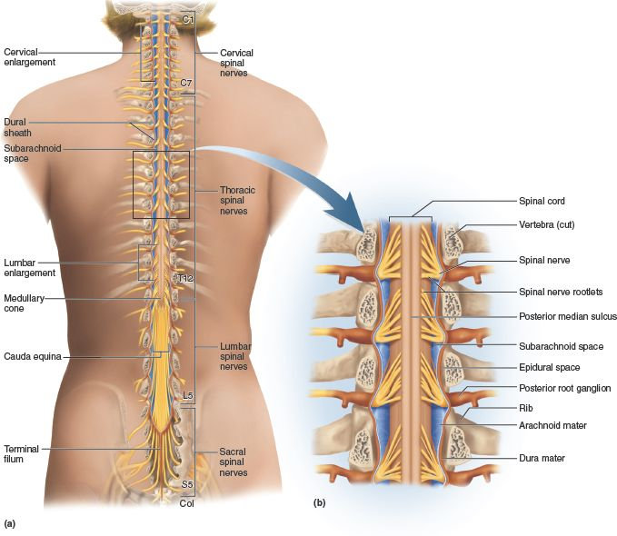

Slide 6
Formation of a Typical Spinal Nerve
Union of:
  Anterior root (motor fibers)
  Posterior root (sensory fibers)
Occurs in the intervertebral foramen

Slide 8
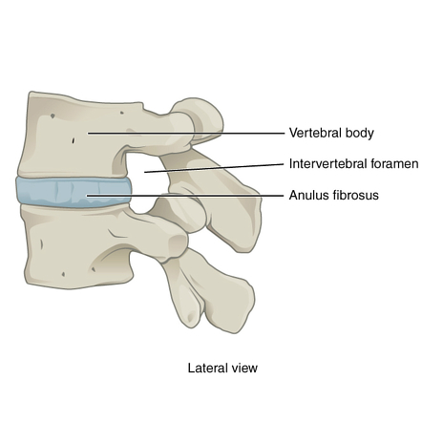

Slide 9
Roots of Spinal Nerves
Posterior (Dorsal) Root
Sensory (afferent)
Contains spinal ganglion
Cell bodies are pseudounipolar neurons
Anterior (Ventral) Root
Motor (efferent)
Fibers arise from anterior horn of spinal cord

Slide 10
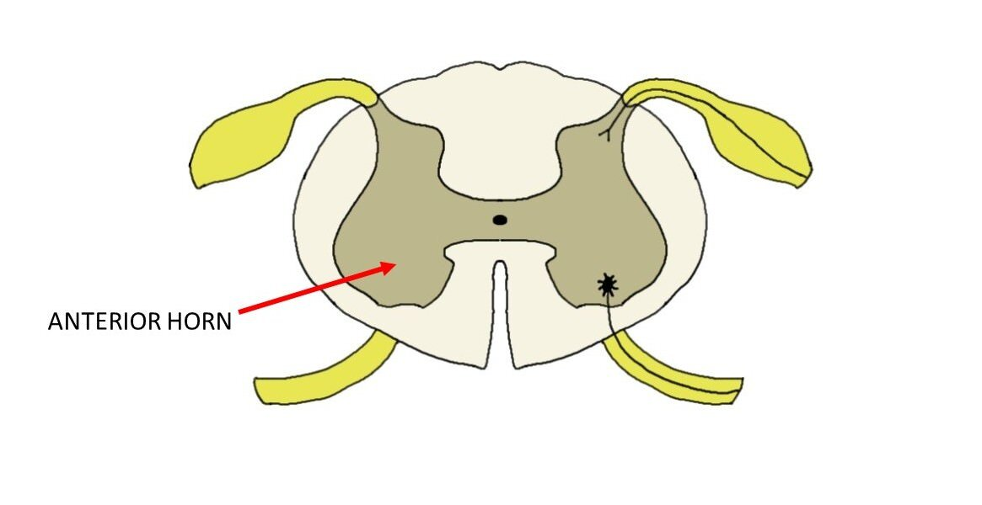

Slide 11
Branches of a Typical Spinal Nerve
After formation, spinal nerve divides into:
Anterior (ventral) ramus
Posterior (dorsal) ramus
Meningeal branch
Rami communicantes

Slide 12
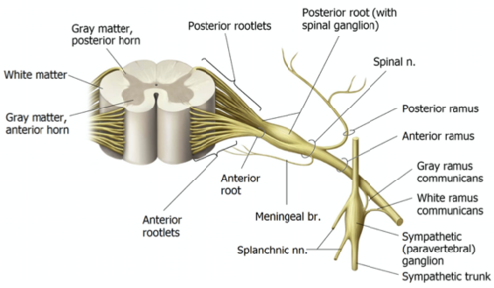

Slide 13
Anterior Ramus
Supplies:
  Limbs
  Anterolateral trunk
Forms nerve plexuses(except thoracic region)

Slide 15
Posterior Ramus
Supplies:
  Deep muscles of back
  Skin of back
Does not form plexuses

Slide 17
Rami Communicantes
Connect spinal nerve to sympathetic trunk
Two types:
  White rami communicantes (T1–L2)
  Grey rami communicantes (all spinal nerves)

Slide 19
Dermatome
Area of skin supplied by one spinal nerve
Clinically important for:
  Nerve root lesions
  Spinal injuries

Slide 20
SPECIALIZED SUPPORTING CELLS OF PERIPHERAL NERVOUS SYSTEM
Main types:
Schwann cells
Satellite cells

Slide 21
Summary Table
Feature | Schwann Cell | Satellite Cell
Location | Around axons | Around neuron cell bodies
Function | Myelination & regeneration | Support & protection
Found in | Peripheral nerves | Peripheral ganglia

Slide 23


Slide 24


