Slide 1
VISION
Assigned By: Ms. Shehwar Saeed

Slide 2
INTRODUCTION
Vision is the ability to see and interpret light.
It is one of the five senses.
Helps us understand shape, color, distance, and movement.

Slide 3
IMPORTANCE OF VISION
Helps in learning and reading.
Essential for daily activities.
Protects us from danger.
Supports communication and social interaction.

Slide 4
HUMAN EYE ( Overview )
The eye is the organ of vision.
It works like a camera.
Captures light and sends signals to the brain.

Slide 5
MAIN PARTS OF EYES
Cornea
Iris
Pupil
Lens
Retina
Optic nerve

Slide 6
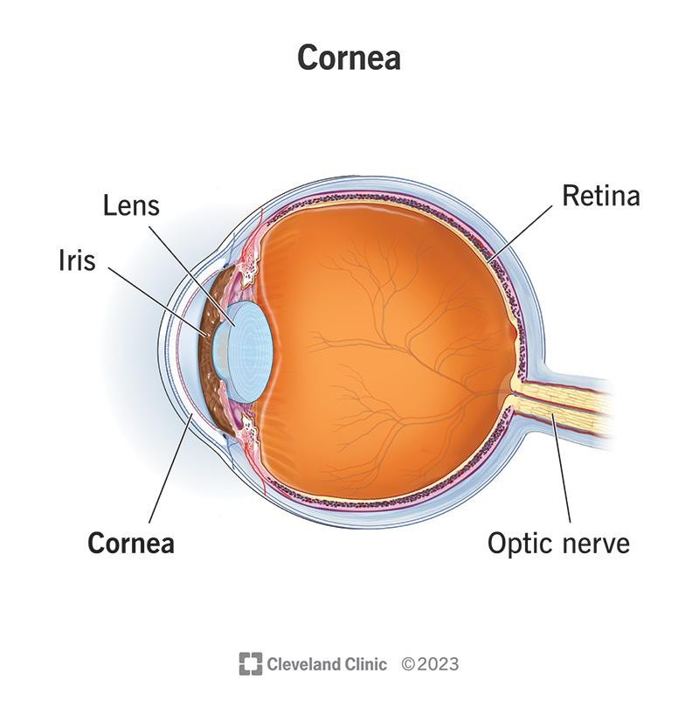

Slide 7
FUNTIONS OF EYE PARTS
Cornea: Bends incoming light.
Iris: Controls amount of light.
Pupil: Opening for light entry.
Lens: Focuses light.
Retina: Forms image.
Optic Nerve: Sends signals to brain.

Slide 8
HOW VISION WORKS
Light enters through cornea.
Passes through pupil and lens.
Image forms on retina.
Retina converts light into nerve signals.
Brain interprets the image.

Slide 9
COMMON VISION PROBLEMS
Myopia (Short sightedness).
Hypermetropia (Long sightedness).
Astigmatism.
Color blindness.

Slide 10
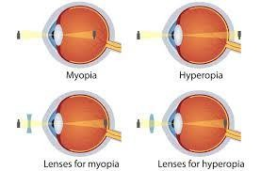

Slide 11
CARES OF EYES
Eat healthy food (vitamin A).
Avoid excessive screen time.
Read in proper light.
Get regular eye checkups.

Slide 12
CONCLUSION
Vision is a vital sense
Eyes help us understand the world
Proper care ensures healthy vision

Slide 13



Slide 14

ThePhoto by PhotoAuthor is licensed under CCYYSA.

