Slide 1

Fourteen
Presented by: Anila Khalid

Slide 2
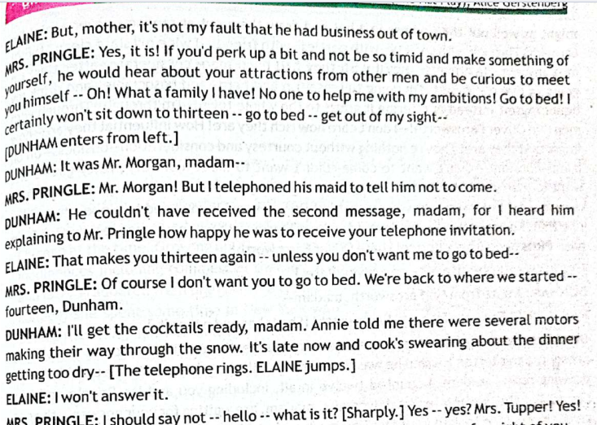

Slide 4
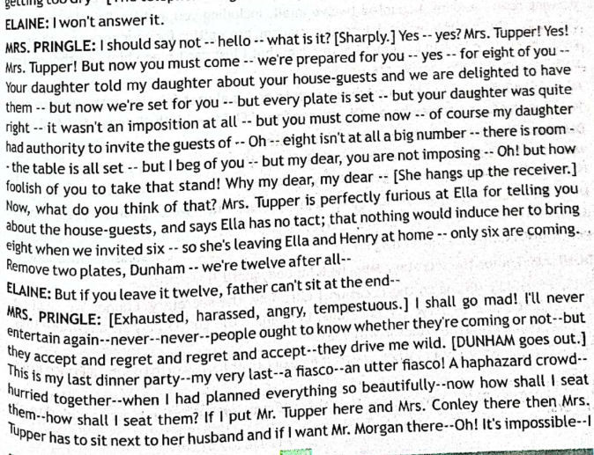

Slide 6
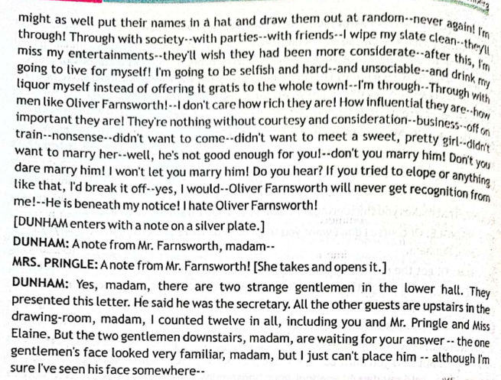

Slide 8
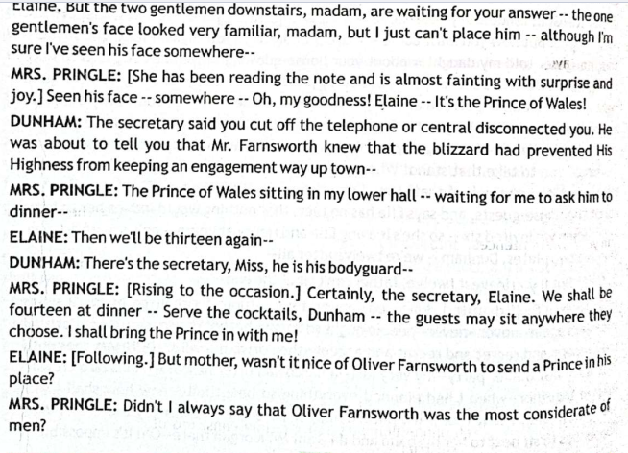

Slide 10
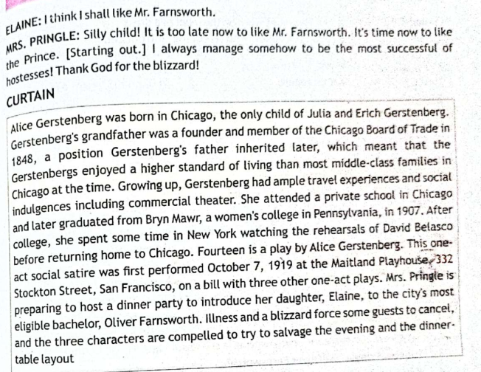

Slide 12
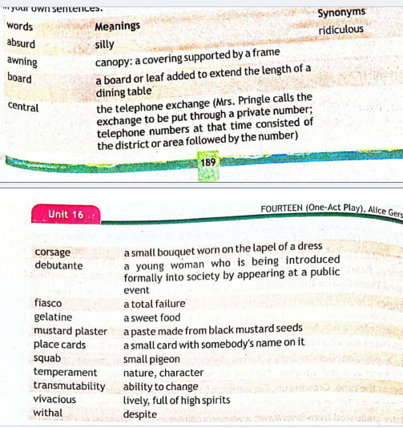

Slide 14
QEUSTION
Explain Climax and Anti-Climax with the reference to any narrative work of literature you have read.

Slide 15


