Slide 1

Fourteen
Presented by: Anila Khalid

Slide 2


Slide 4


Slide 6


Slide 8
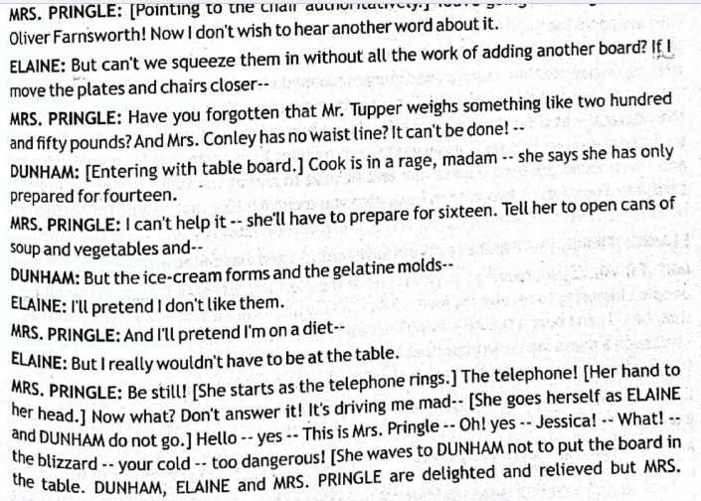

Slide 10


Slide 12


Slide 14
QUESTION
‘Characterization, like many elements of storytelling technique, is an invisible tool which helps build and portray strong, flawed/flawless, and realistic depiction of characters’. Explain the above statement in the context of any work of fiction you have read and discuss how a character undergoes different phases of development.

Slide 15


