Slide 1

ANATOMY
THE UPPER LIMB
DPT
1ST SEMESTER
DR DANISH

Slide 2
GLENOHUMERAL (SHOULDER) JOINT
Synovial joint
Ball-and-socket type
Multiaxial → allows movement in all directions

Slide 3
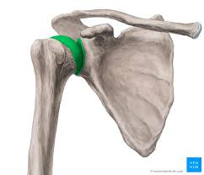

Slide 4
Articulation
Head of humerus (large, spherical)
Glenoid cavity of scapula (small, shallow)

Slide 6
Continued
Glenoid Labrum:
Fibrocartilaginous rim attached to the margin of the glenoid cavity
Functions:
  Deepens the socket
  Increases stability
  Provides attachment to the capsule

Slide 7
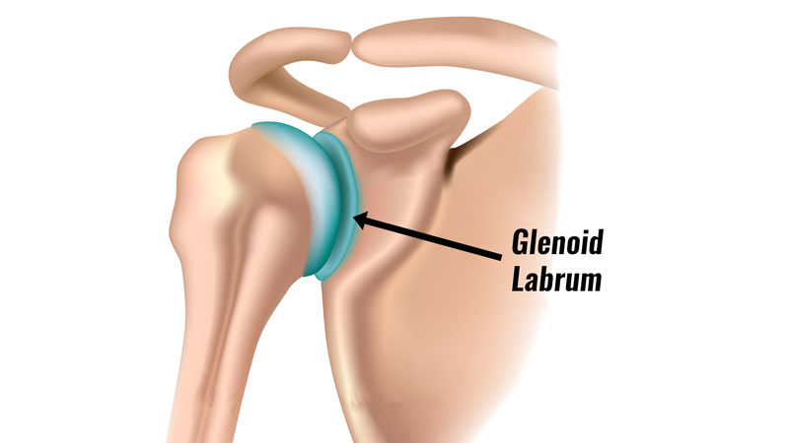

Slide 8
Joint Capsule
Thin and loose to allow free movement
Attachments:
  Medially: margin of the glenoid cavity (outside the labrum)
  Laterally: anatomical neck of the humerus
Capsule is weakest inferiorly → common site of shoulder dislocation

Slide 9
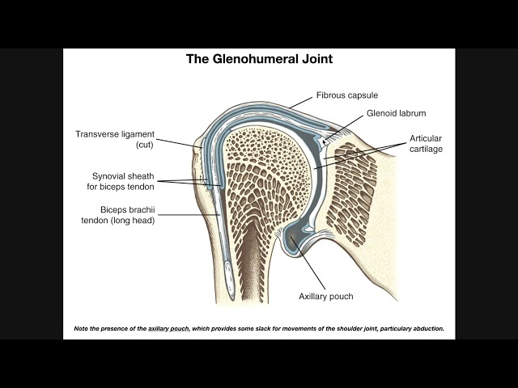

Slide 10
Synovial Membrane
Lines the capsule
Covers:
  Inner surface of capsule
  Tendon of long head of biceps brachii
Produces synovial fluid for lubrication

Slide 11
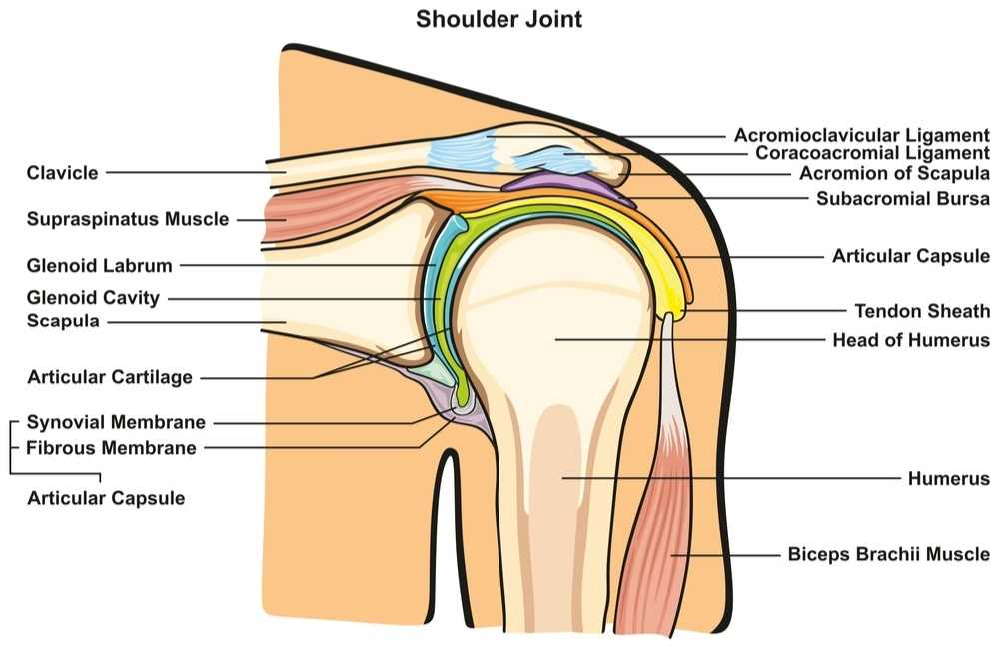

Slide 12
Ligaments of the Shoulder Joint
1. Glenohumeral Ligaments (3)
Superior
Middle
Inferior
Thickenings of the anterior capsule
Strengthen the joint anteriorly

Slide 13
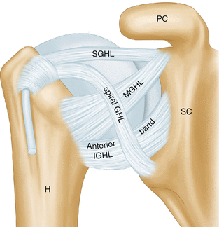

Slide 14
Continued
2. Coracohumeral Ligament
From coracoid process → greater tubercle of humerus
Strengthens the capsule superiorly
Prevents downward displacement of humerus

Slide 15
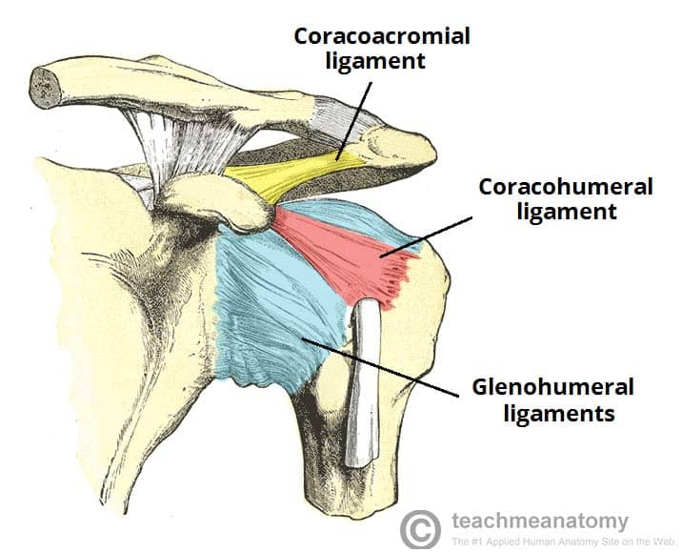

Slide 16
Continued
3. Transverse Humeral Ligament
Bridges the intertubercular (bicipital) groove
Holds the tendon of long head of biceps brachii in place

Slide 17
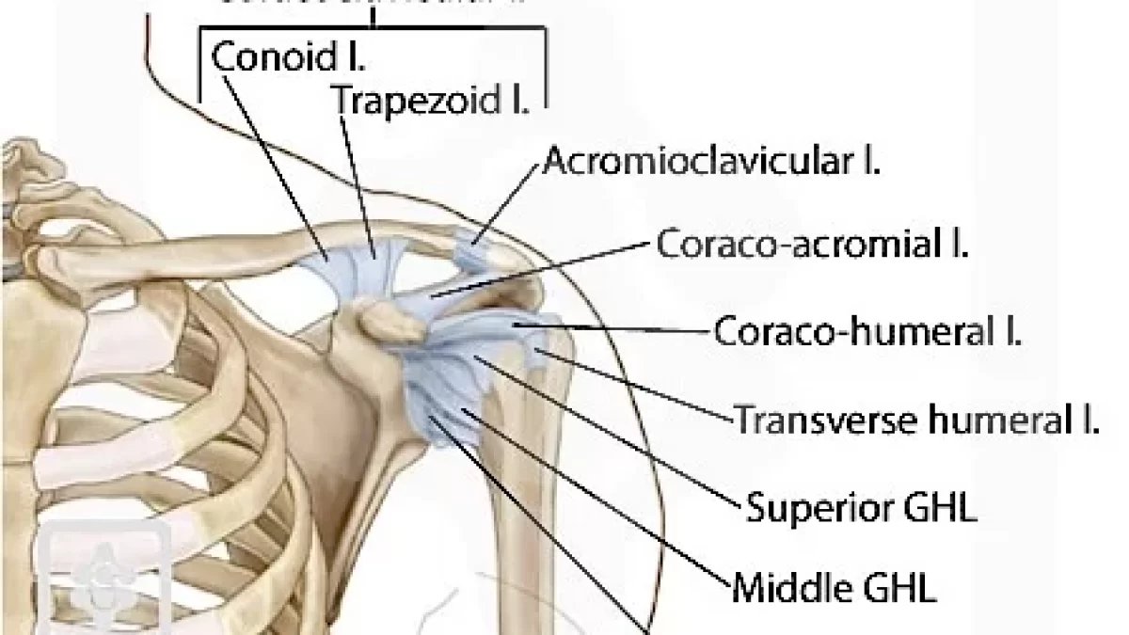

Slide 18
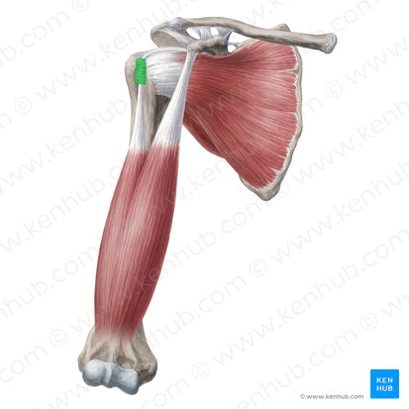

Slide 19
Continued
4. Coracoacromial Ligament
Extends between coracoid process and acromion
Forms the coracoacromial arch
Protects the humeral head from superior displacement

Slide 20
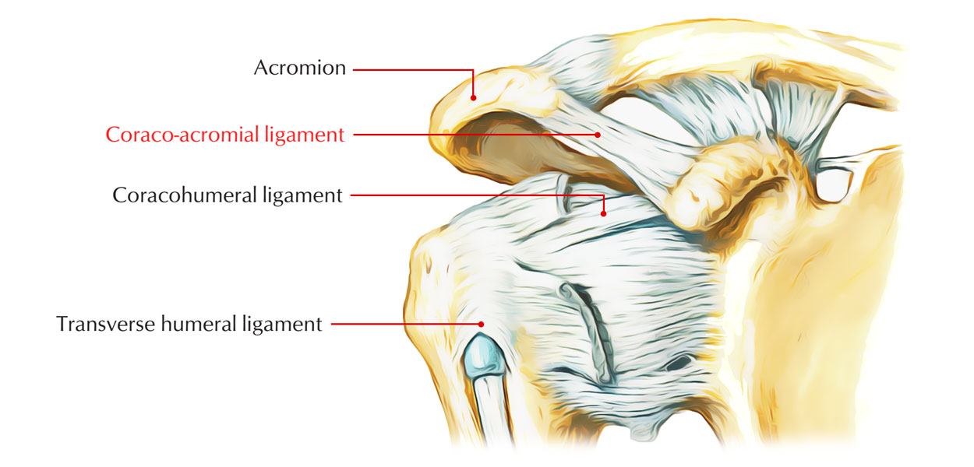

Slide 21
Bursae Related to Shoulder Joint
Subacromial (subdeltoid) bursa
  Lies between supraspinatus tendon and acromion
  Reduces friction during abduction

Slide 22
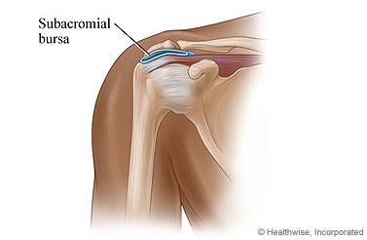

Slide 23
Muscles Related to the Shoulder Joint
Rotator Cuff Muscles (SITS)
These muscles:
Blend with the capsule
Stabilize the joint
Hold the humeral head in the glenoid cavity

Slide 24
Continued
Supraspinatus
  Superior
Infraspinatus
  Posterior
Teres minor
  Posterior
Subscapularis
  Anterior
Inferior aspect has no rotator cuff support → weakest part

Slide 25
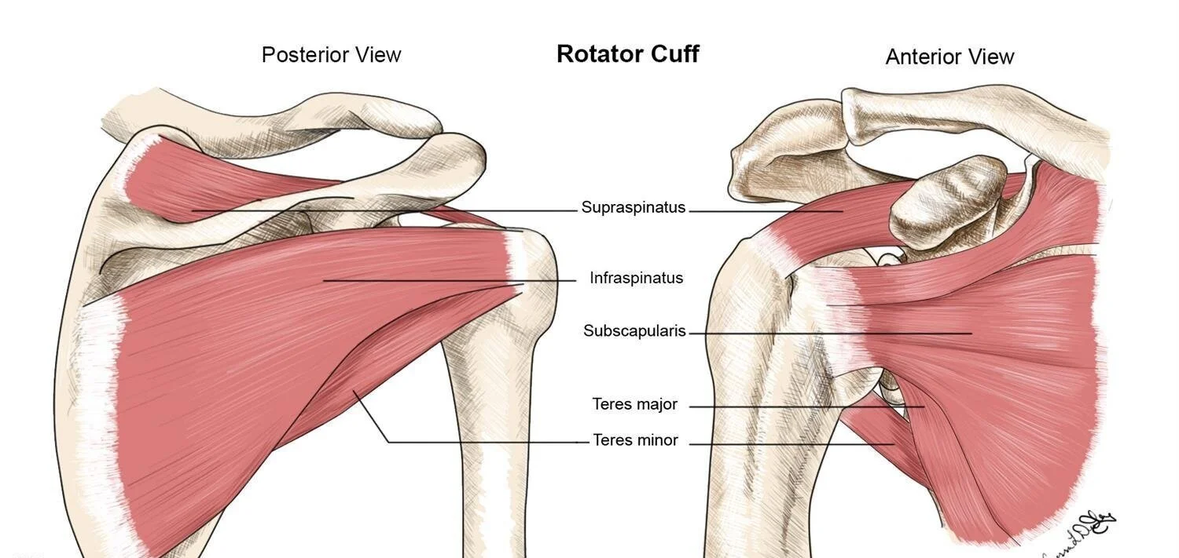

Slide 26
Movements at the Shoulder Joint
Flexion
Extension
Abduction
Adduction
Medial rotation
Lateral rotation
Circumduction

Slide 27
Abduction of the Shoulder (VERY IMPORTANT)
Phases of Abduction:
1. First 0–15°
Done by supraspinatus
Initiates abduction
2. 15–90°
Done mainly by deltoid muscle

Slide 29
Continued
2. 15–90°
Done mainly by deltoid muscle
3. Beyond 90°
Requires rotation of scapula
Glenohumeral joint alone cannot perform this
Scapular rotation is done by:
  Trapezius
  Serratus anterior
  Pure glenohumeral abduction is possible only up to ~120°

Slide 30
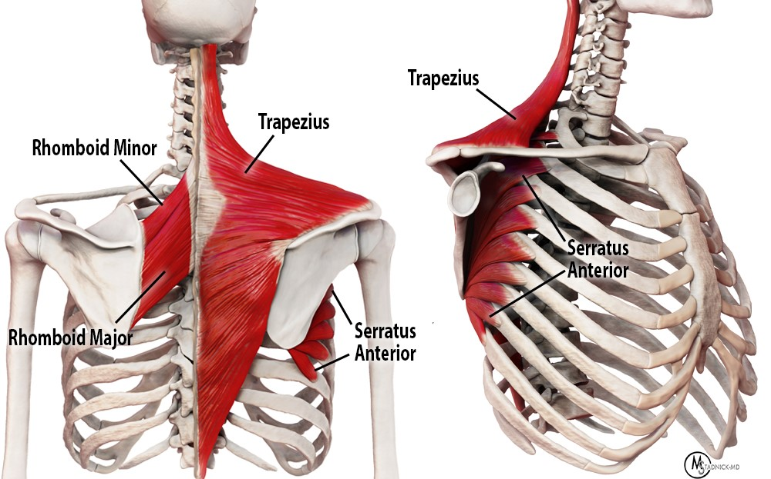

Slide 31
Adduction
Movement of arm toward the body
Muscles involved:
  Pectoralis major
  Latissimus dorsi
  Teres major

Slide 32
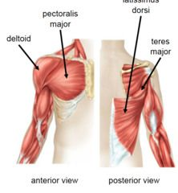

Slide 33
Flexion
Range: about 90°
Muscles:
  Anterior fibers of deltoid
  Pectoralis major
  Coracobrachialis
  Biceps brachii

Slide 34
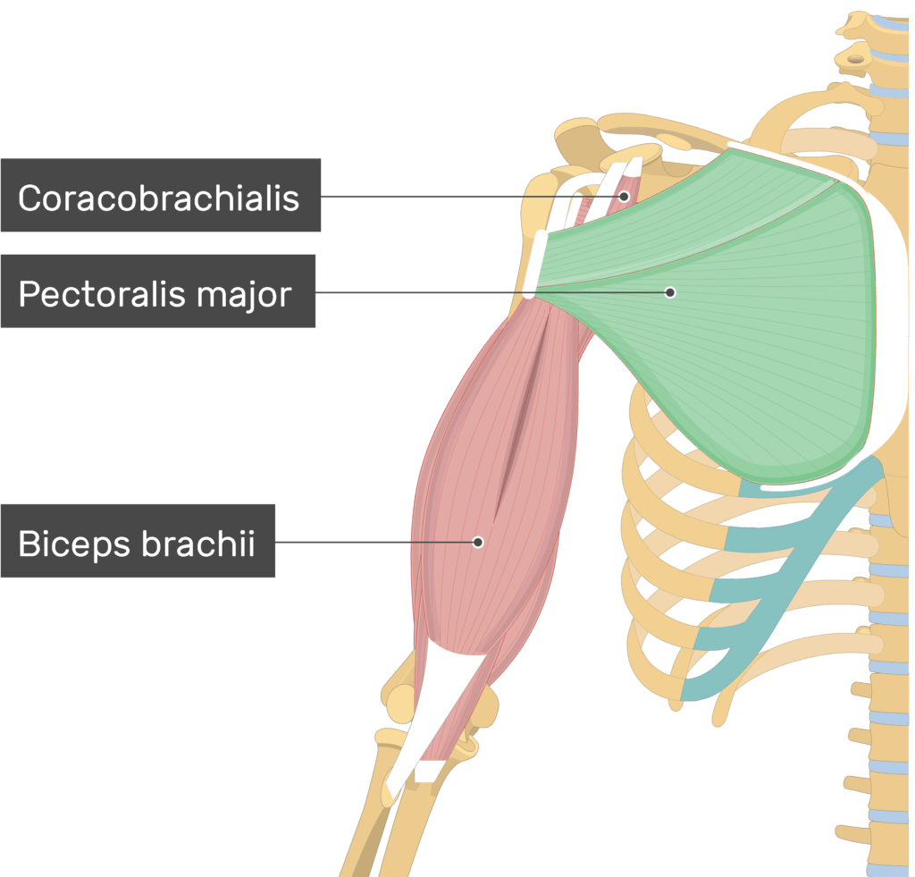

Slide 35
Extension
Posterior movement of arm
Muscles:
  Latissimus dorsi
  Teres major
  Posterior fibers of deltoid

Slide 36
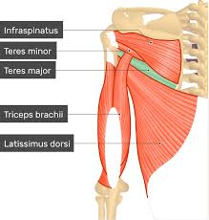

Slide 37
Rotation of Shoulder
Lateral (External) Rotation
Range: ~40–45°
Muscles:
  Infraspinatus
  Teres minor

Slide 39
Medial (Internal) Rotation
Range: ~55°
Muscles:
  Subscapularis
  Latissimus dorsi
  Teres major
  Pectoralis major

Slide 41
Circumduction
Combination of:
  Flexion
  Extension
  Abduction
  Adduction
Results in a cone-shaped movement

Slide 42
Relations of the Shoulder Joint
Anterior
Subscapularis muscle
Posterior
Infraspinatus
Teres minor
Superior
Supraspinatus tendon
Subacromial bursa
Coracoacromial arch
Inferior
Weak capsule
Close relation to axillary nerve

Slide 44
Nerve Supply
Axillary nerve
Suprascapular nerve

Slide 45
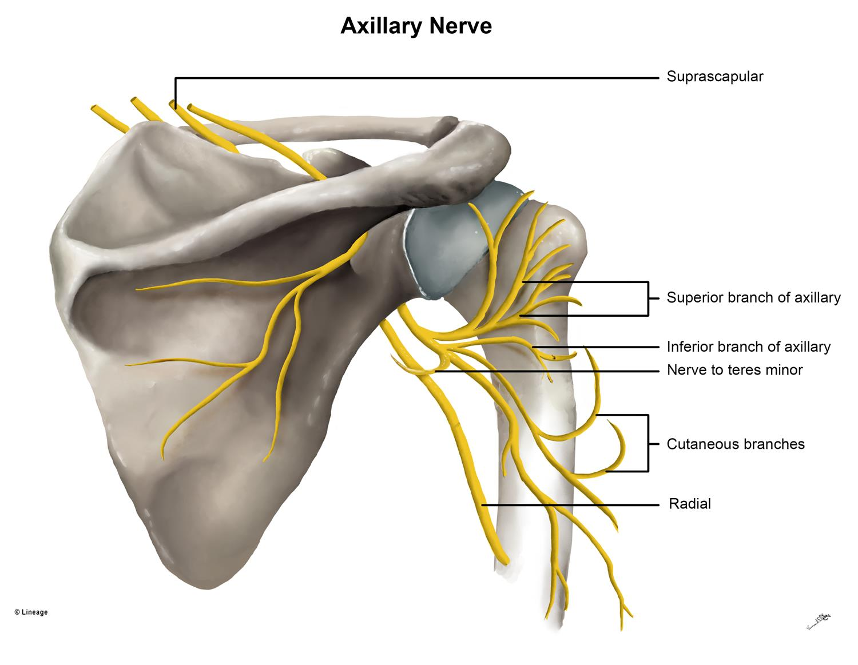

Slide 46
Blood Supply
Anterior circumflex humeral artery
Posterior circumflex humeral artery

Slide 47
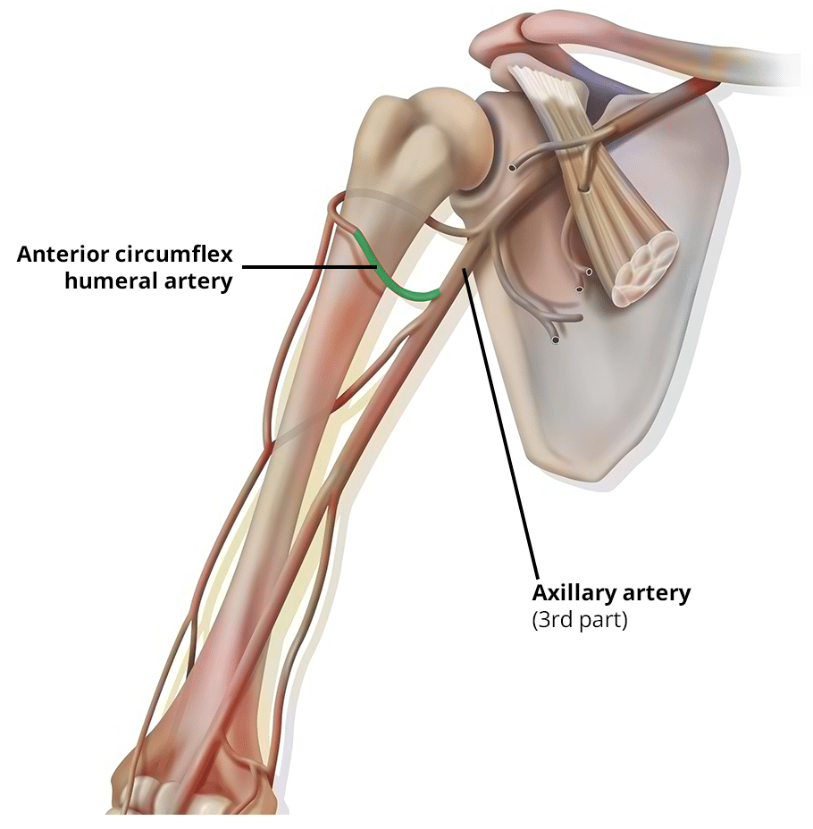

Slide 48
Clinical Importance
Shoulder is the most mobile joint
Stability is sacrificed for mobility
Inferior dislocation is common
Injury to axillary nerve → deltoid paralysis

Slide 49
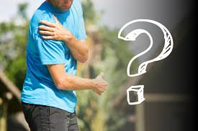

Slide 50
