Slide 1
The Nervous System
Awais Hamza
BS Hons Medical Technologies

Slide 2
The Nervous System
Nervous system Together with the endocrine system it controls important aspects of body function and maintains homeostasis. Nervous system stimulation provides an immediate response while endocrine activity is, in the main, slower and more prolonged.
The nervous system consists of the brain, the spinal cord and peripheral nerves.
Response to changes in the internal environment maintains homeostasis and regulates involuntary functions, e.g. blood pressure and digestive activity. Response to changes in the external environment maintains posture and other voluntary activities.

Slide 3
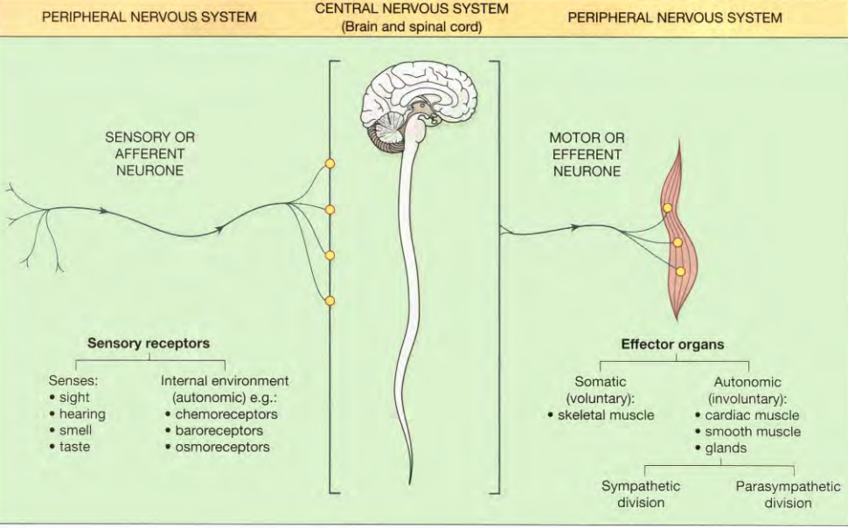

Slide 4
Divisions of the Nervous System
Central Nervous System (CNS): Brain and spinal cord
Peripheral Nervous System (PNS): Cranial nerves, spinal nerves, ganglia
Functional divisions:
Somatic nervous system
Autonomic nervous system (sympathetic & parasympathetic)

Slide 5
Brain: Gross Functional Anatomy
Divided into:
Cerebrum
Diencephalon
Brainstem
Cerebellum
Protected by skull, meninges, and CSF

Slide 6
Cerebrum: Structure
Largest part of brain
Two cerebral hemispheres connected by corpus callosum
Outer gray matter (cerebral cortex)
Inner white matter with basal nuclei
Highly developed in humans

Slide 7
Cerebral Cortex: Functional Areas
Motor cortex (frontal lobe): voluntary movements
Sensory cortex (parietal lobe): perception of sensations
Visual cortex (occipital lobe)
Auditory cortex (temporal lobe)
Association areas: integration, interpretation, memory

Slide 8
Functions of the Cerebrum
Conscious perception of sensations
Voluntary motor activity
Higher mental functions: intelligence, learning, memory
Language, behavior, emotions, personality

Slide 9
Basal Nuclei (Basal Ganglia)
Deep gray matter masses within cerebrum
Includes caudate nucleus, putamen, globus pallidus
Regulate muscle tone and posture
Smooth and coordinate voluntary movements

Slide 10
Diencephalon: Components
Located between cerebrum and midbrain
Includes:
Thalamus
Hypothalamus
Epithalamus
Forms walls of third ventricle

Slide 11
Thalamus: Functions
Major sensory relay station (except olfactory)
Receives sensory impulses and transmits to cortex
Plays role in motor integration
Regulates consciousness and alertness

Slide 12
Hypothalamus: Functions
Control center for autonomic nervous system
Regulates body temperature, hunger, thirst
Controls pituitary gland (endocrine regulation)
Emotional behavior and circadian rhythms

Slide 13
Brainstem
Connects brain with spinal cord
Consists of:
Midbrain
Pons
Medulla oblongata
Contains vital centers and cranial nerve nuclei

Slide 14
Spinal Cord: Functions
Extends from medulla to L1–L2 level
Conduction pathway between brain and body
Center for spinal reflexes
Controls posture, muscle tone, and basic motor patterns

Slide 15
Cranial nerves
There are 12 pairs of cranial nerves originating from nuclei in the inferior surface of the brain, some sensory, some motor and some mixed

Slide 16
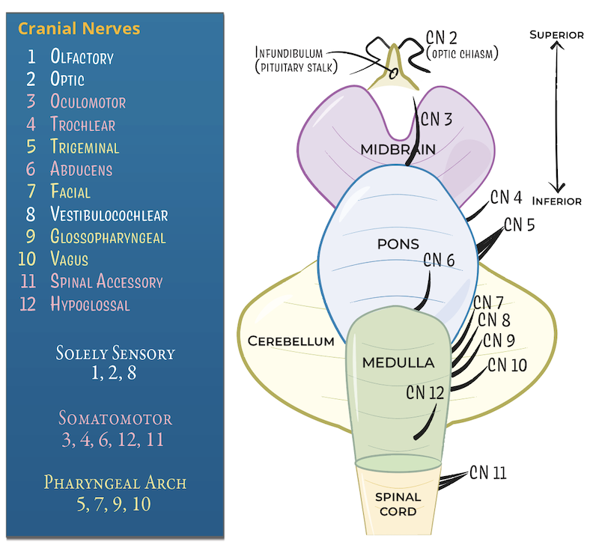
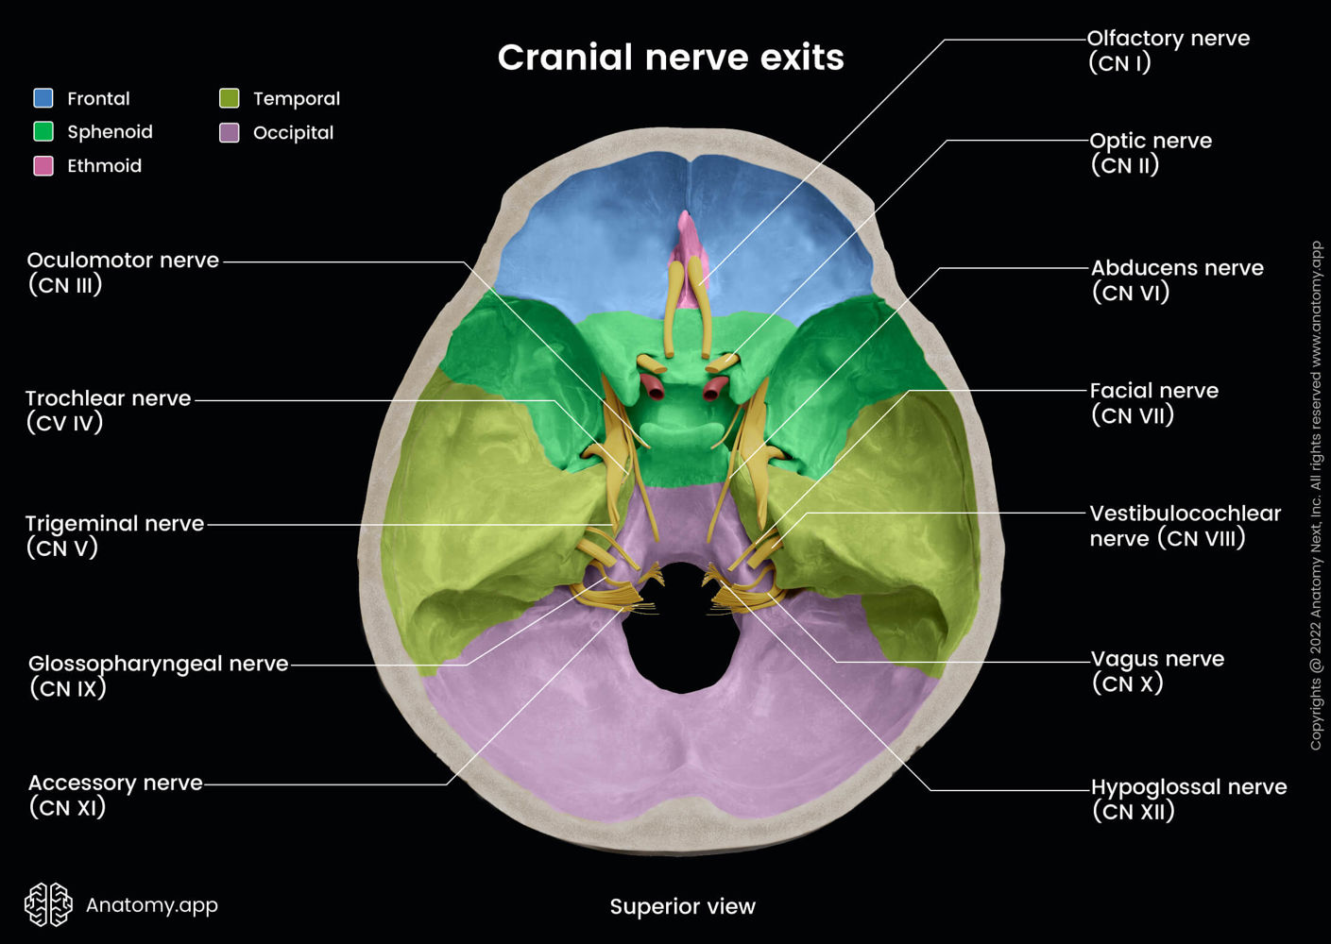

Slide 17
Olfactory nerves (sensory)
These are the nerves of the sense of smell.
Their nerve endings and fibres originate in the upper part of the mucous membrane of the nasal cavity, pass upwards through the cribriform plate of the ethmoid bone and then go to the olfactory bulb
The nerves then proceed backwards as the olfactory tract, to the area for the perception of smell in the temporal lobe of the cerebrum.

Slide 18
II. Optic nerves (sensory)
These are the nerves of the sense of sight.
The fibres originate in the retinae of the eyes and they combine to form the optic nerves
They are directed backwards and medially through the posterior part of the orbital cavity.
The central retinal artery and vein enter the eye enveloped by the fibres of the optic nerve.

Slide 19
III. Oculomotor nerves (motor)
These nerves arise from nerve cells near the cerebral aqueduct.
They supply:
• four extraocular muscles, which move the eyeball, i.e. the superior, medial and inferior recti and the inferior oblique muscle
• intraocular muscles: — ciliary muscles which alter the shape of the lens, changing its refractive power — circular muscles of the iris which constrict the pupil
• the levator palpebrae muscle which raises the upper eyelid.

Slide 20
IV. Trochlear nerves (motor)
These nerves arise from nerve cells near the cerebral aqueduct. They supply the superior oblique muscles of the eyes.

Slide 21
V. Trigeminal nerves (mixed)
These nerves contain motor and sensory fibres and are among the largest of the cranial nerves.
They are the chief sensory nerves for the face and head (including the oral and nasal cavities and teeth), receiving impulses of pain, temperature and touch.
The motor fibres stimulate the muscles of mastication.

Slide 22
V. Trigeminal nerves (mixed)
The trigeminal nerve (Cranial Nerve V) has three main branches: the Ophthalmic (V1), the Maxillary (V2), and the Mandibular (V3), which provide sensory innervation to different facial areas and carry motor control for chewing muscles. V1 supplies the forehead/eye area, V2 the middle face/upper jaw, and V3 the lower jaw, with V3 being the only branch with both sensory and motor fibers

Slide 23
VI. Abducent nerves (motor)
These nerves arise from a group of nerve cells lying under the floor of the fourth ventricle.
They supply the lateral rectus muscles of the eyeballs.

Slide 24
VII. Facial nerves (mixed)
These nerves are composed of both motor and sensory nerve fibres, arising from nerve cells in the lower part of the pons.
The motor fibres supply the muscles of facial expression.
The sensory fibres convey impulses from the taste buds in the anterior two-thirds of the tongue to the taste perception area in the cerebral cortex.

Slide 25
VIM. Vestibulocochlear (auditory) nerves (sensory)
These nerves are composed of two distinct sets of fibres, vestibular nerves and cochlear nerves.
The vestibular nerves arise from the semicircular canals of the inner ear and convey impulses to the cerebellum.
They are associated with the maintenance of posture and balance.
The cochlear nerves originate in the organ of Corti in the inner ear and convey impulses to the hearing areas in the cerebral cortex where sound is perceived.

Slide 26
IX. Glossopharyngeal nerves (mixed)
These nerves arise from nuclei in the medulla oblongata.
The motor fibres stimulate the muscles of the tongue and pharynx and the secretory cells of the parotid (salivary) glands.
The sensory fibres convey impulses to the cerebral cortex from the posterior third of the tongue, the tonsils and pharynx and from taste buds in the tongue and pharynx.
These nerves are essential for the swallowing and gag reflexes.

Slide 27
X. Vagus nerves (mixed)
These nerves have a more extensive distribution than any other cranial nerves.
They arise from nerve cells in the medulla oblongata and other nuclei, and pass down through the neck into the thorax and the abdomen.
The motor fibres supply the smooth muscles and secretory glands of the pharynx, larynx, trachea, heart, oesophagus, stomach, intestines, pancreas, gall bladder, bile ducts, spleen, kidneys, ureter and blood vessels in the thoracic and abdominal cavities.

Slide 28
XI. Accessory nerves (motor)
These nerves arise from cell bodies in the medulla oblongata and in the spinal cord.
The fibres supply the sternodeidomastoid and trapezius muscles. Branches join the vagus nerves and supply the phanyngeal and laryngeal muscles.

Slide 29
XII. Hypoglossal nerves (motor)
These nerves arise from cells in the medulla oblongata. They supply the muscles of the tongue and muscles surrounding the hyoid bone and contribute to swallowing and speech.

Slide 30
Resting Membrane Potential & Action Potential
CNS neurons communicate using electrical signals
Electrical signals allow:
Rapid communication
Long-distance transmission
Precise timing
Two fundamental properties:
Resting membrane potential (RMP)
Action potential (AP)

Slide 31
Basic Electrical Terms
Membrane potential: Voltage difference across cell membrane
Measured in millivolts (mV)
Inside of neuron is normally negative relative to outside
Electrical potential arises due to ion distribution and permeability

Slide 32
Neuronal Membrane as an Electrical Structure
Neuronal membrane behaves like:
Capacitor → lipid bilayer
Resistors → ion channels
Separates charges across membrane
Selectively permeable to ions

Slide 33
Major Ions Involved in CNS Electrical Activity
Sodium (Na⁺)
Potassium (K⁺)
Chloride (Cl⁻)
Calcium (Ca²⁺)

Slide 34
Ionic Distribution Across Neuronal Membrane
Intracellular:
High K⁺
High negatively charged proteins (A⁻)
Extracellular:
High Na⁺
High Cl⁻
High Ca²⁺

Slide 35
Selective Permeability of Neuronal Membrane
Membrane permeability is unequal for ions
At rest:
High permeability to K⁺
Low permeability to Na⁺
This selective permeability is key to RMP

Slide 36
Definition of Resting Membrane Potential
Electrical potential difference across neuronal membrane
Present when neuron is not conducting impulse
Value in CNS neurons: –65 to –70 mV

Slide 37
Mechanism of RMP: Role of Potassium
K⁺ diffuses out of neuron via leak channels
Leaves behind negatively charged proteins
Results in negative intracellular environment
Major contributor to RMP

Slide 38
Role of Sodium in RMP
Na⁺ tends to diffuse into neuron
But membrane is poorly permeable to Na⁺ at rest
Minimal contribution compared to K⁺

Slide 39
Role of Na⁺/K⁺ ATPase Pump
Actively transports:
3 Na⁺ out
2 K⁺ in
Maintains ionic gradients
Contributes ~ –5 mV to RMP
Electrogenic pump

Slide 40
Definition of Action Potential
Rapid, transient, reversible change in membrane potential
Propagates without decrement
Follows all-or-none law
Phases:
Resting phase
Depolarization
Repolarization
Hyperpolarization

Slide 41
Depolarization and Repolarization Phase
Opening of voltage-gated Na⁺ channels
Rapid influx of Na⁺
Membrane potential becomes positive (+30 to +40 mV)
Repolarization Phase:
Inactivation of Na⁺ channels
Opening of voltage-gated K⁺ channels
Efflux of K⁺ restores negativity

Slide 42
Hyperpolarization and Refractory Periods
K⁺ channels remain open longer
Membrane becomes more negative than RMP.Gradual return to resting level. Absolute refractory period:
No AP possible
Na⁺ channels inactivated
Relative refractory period:
Strong stimulus required
Occurs during hyperpolarization

Slide 43
Neurons and Neuroglia
The nervous system consists of a vast number of cells called neurones, supported by a special type of connective tissue, neuroglia.
Each neurone consists of a cell body and its processes, one axon and many dendrites. Neurones are commonly referred to simply as nerve cells. Bundles of axons bound together are called nerves.
Neurones cannot divide and for survival they need a continuous supply of oxygen and glucose. Unlike many other cells, neurones can synthesise chemical energy (ATP) only from glucose.

Slide 44
Neurons and Neuroglia
The physiological 'units' of the nervous system are nerve impulses, or action potentials, which are akin to tiny electrical charges.
However, unlike ordinary electrical wires, the neurones are actively involved in conducting nerve impulses.
In effect the strength of the impulse is maintained throughout the length of the neurone.
Some neurones initiate nerve impulses while others act as 'relay stations' where impulses are passed on and sometimes redirected.

Slide 45
Properties of neurones
Neurones have the characteristics of irritability and conductivity. Irritability is the ability to initiate nerve impulses in response to stimuli from:
• outside the body, e.g. touch, light waves
• inside the body, e.g. a change in the concentration of carbon dioxide in the blood alters respiration; a thought may result in voluntary movement.

Slide 46
Cell bodies
Nerve cells vary considerably in size and shape but they are all too small to be seen by the naked eye.
Cell bodies form the grey matter of the nervous system and are found at the periphery of the brain and in the centre of the spinal cord.
Groups of cell bodies are called nuclei in the central nervous system and ganglia in the peripheral nervous system.

Slide 47
Axons and dendrites
Axons and dendrites are extensions of cell bodies and form the white matter of the nervous system.
Axons are found deep in the brain and in groups, called tracts, at the periphery of the spinal cord.
They are referred to as nerves or nerve fibres outside the brain and spinal cord.

Slide 48
Structure of an axon
Axon Hillock
Cone-shaped region at junction of cell body and axon
Lacks Nissl substance
Contains high density of voltage-gated Na⁺ channels
Site where action potential is initiated

Slide 49
Structure of an axon
Initial Segment
First part of the axon beyond axon hillock
Most excitable part of neuron
Lowest threshold for depolarization
Critical for determining frequency of nerve impulses

Slide 50
Axolemma & Axoplasm
Axolemma
Plasma membrane of the axon, Contains:Voltage-gated Na⁺ and K⁺ channels, Ligand-gated channels (in terminals), Na⁺/K⁺ ATPase pump- Responsible for electrical conduction of nerve impulses
Axoplasm
Cytoplasm of the axon
Contains:Mitochondria (energy supply), Neurofilaments (structural support), Microtubules (axonal transport)

Slide 51
Myelin Sheath
Lipoprotein covering around axon
Formed by:
Schwann cells (PNS)
Oligodendrocytes (CNS)
Acts as an electrical insulator
Increases speed of nerve conduction

Slide 52
Axon Terminals
Terminal branches (telodendria)
End in synaptic boutons
Contain synaptic vesicles with neurotransmitters
Responsible for chemical transmission at synapse

Slide 53
Dendrites
The dendrites are the many short processes that receive and carry incoming impulses towards cell bodies.
They have the same structure as axons but they are usually shorter and branching.
In motor neurones they form part of synapses and in sensory neurones they form the sensory receptors that respond to stimuli.

Slide 54
Types of nerves
Sensory or afferent nerves: When action potentials are generated by sensory receptors on the dendrites of these neurones, they are transmitted to the spinal cord by the sensory nerve fibres. The impulses may then pass to the brain or to connector neurones of reflex arcs in the spinal cord.
Sensory receptors: Specialised endings of sensory neurones respond to different stimuli (changes) inside and outside the body.

Slide 55
Somatic, cutaneous or common senses
These originate in the skin. They are: pain, touch, heat and cold.
Sensory nerve endings in the skin are fine branching filaments without myelin sheaths.
When stimulated, an impulse is generated and transmitted by the sensory nerves to the brain where the sensation is perceived

Slide 56
Sensory receptors
Proprioceptor senses.
These originate in muscles and joints and contribute to the maintenance of balance and posture.
Special senses. These are sight, hearing, smell, touch and taste.
Autonomic afferent nerves. These originate in internal organs, glands and tissues, e.g. baroreceptors, chemoreceptors, and are associated with reflex regulation of involuntary activity and visceral pain

Slide 57
Motor or efferent nerves
Motor nerves originate in the brain, spinal cord and autonomic ganglia. They transmit impulses to the effector organs: muscles and glands.
There are two types:
• somatic nerves — involved in voluntary and reflex skeletal muscle contraction
• autonomic nerves (sympathetic and parasympathetic) — involved in cardiac and smooth muscle contraction and glandular secretion.

Slide 58
Mixed nerves
In the spinal cord, sensory and motor nerves are arranged in separate groups, or tracts.
Outside the spinal cord, when sensory and motor nerves are enclosed within the same sheath of connective tissue they are called mixed nerves.

Slide 59
The synapse and neurotransmitters
There is always more than one neurone involved in the transmission of a nerve impulse from its origin to its destination, whether it is sensory or motor. There is no physical contact between these neurones.
The point at which the nerve impulse passes from one to another is the synapse. At its free end the axon of the presynaptic neurone breaks up into minute branches which terminate in small swellings called synaptic knobs, or terminal boutons.

Slide 60
The synapse and neurotransmitters
These are in close proximity to the dendrites and the cell body of the postsynaptic neurone.
The space between them is the synaptic cleft.
In the ends of synaptic knobs there are spherical synaptic vesicles, containing a chemical, the neurotransmitter, which is released into synaptic clefts. Neurotransmitters are synthesised by nerve cells, actively transported along the axons and stored in the synaptic vesicles. They are released by exocytosis in response to the action potential and diffuse across the synaptic cleft.

Slide 61
The synapse and neurotransmitters
They act on specific receptor sites on the postsynaptic membranes.
Their action is short lived as immediately they have stimulated the postsynaptic neurone or effector organ, such as a muscle fibre, they are either inactivated by enzymes or taken back into the synaptic knob.
A knowledge of the action of different neurotransmitters is important because some drugs neutralise or prolong their effect.
Usually neurotransmitters have an excitatory effect at the synapse but they are sometimes inhibitory.

Slide 62
The synapse and neurotransmitters
The neurotransmitters in the brain and spinal cord and their modes of action are not yet fully understood.
It is believed however that noradrenaline, gamma ammobutyric acid (GABA) and acetylcholine act as neurotransmitters.
Other substances, such as dopamine, serotonin (5-hydroxytryptamine), enkephalins, endorphins and substance P, have similar functions. Somatic nerves carry impulses directly to the synapses at skeletal muscles: the neuromuscular junctions.

Slide 63
Effects of autonomic stimulation
Cardiovascular system : Sympathetic stimulation
• Exerts an accelerating effect upon the sinoatrial node in the heart, increasing the rate and force of the heartbeat.
• Causes dilatation of the coronary arteries, increasing the blood supply to cardiac muscle.
• Causes dilatation of the blood vessels supplying skeletal muscle, increasing the supply of oxygen and nutritional materials and the removal of metabolic waste products, thus increasing the capacity of the muscle to work.

Slide 64
Parasympathetic stimulation
Cardiovascular system : •
Decreases the rate and force of the heartbeat.
• Causes constriction of the coronary arteries reducing the blood supply to cardiac muscle.
The parasympathetic nervous system exerts little or no effect on blood vessels except the coronary arteries.

Slide 65
Respiratory system
Sympathetic stimulation This causes dilatation of the airways, especially the bronchioles, allowing a greater amount of air to enter the lungs at each inspiration and increases the respiratory rate.
In conjunction with the increased heart rate, the oxygen intake and carbon dioxide output of the body are increased.
Parasympathetic stimulation Produces constriction of the bronchi.

Slide 66
Digestive and urinary systems: Sympathetic system
The liver converts an increased amount of glycogen to glucose, making more carbohydrate immediately available to provide energy.
• The adrenal (suprarenal) glands are stimulated to secrete adrenaline and noradrenaline which potentiate and sustain the effects of sympathetic stimulation.
• Smooth muscle contraction and secretion of digestive juices are inhibited, delaying digestion,
• Urethral and anal sphincters. The muscle tone of the sphincters is increased, inhibiting micturition and defecation. • The bladder wall relaxes

Slide 67
Digestive/urinary systems: Para-Sympathetic system
The stomach and small intestine. The rate of digestion and absorption of food is increased.
• The pancreas. There is an increase in the secretion of pancreatic juice and the hormone insulin.
• Urethral and anal sphincters. Relaxation of the internal urethral sphincter is accompanied by contraction of the muscle of the bladder wall and micturition occurs.

Slide 68
Eye
Sympathetic stimulation This causes contraction of the radiating muscle fibres of the iris, dilating the pupil.
Retraction of the levator palpebral muscles occurs, opening the eyes wide and giving the appearance of alertness and excitement. The ciliary muscle that adjusts the thickness of the lens is slightly relaxed.
Parasympathetic stimulation This causes contraction of the circular muscle fibres of the iris, constricting the pupil. The eyelids tend to close, giving the appearance of sleepiness.

Slide 69
Skin: Sympathetic and Parasympathetic system
Sympathetic stimulation
• Causes increased secretion of sweat, leading to increased heat loss from the body.
• Produces contraction of the arrectores pilorum (the muscles in the hair follicles of the skin), giving the appearance of 'goose flesh'.
• Causes constriction of the blood vessels preventing heat loss. There is no parasympathetic nerve supply to the skin. Some sympathetic fibres are adrenergic, causing vasoconstriction, and some are cholinergic, causing vasodilatation

Slide 70
Somatic vs Autonomic Nervous System
PNS: Connects CNS to the body
Two functional divisions:
Somatic Nervous System (SNS)
Autonomic Nervous System (ANS)
SNS: voluntary control, skeletal muscles
ANS: involuntary control, smooth muscle, cardiac muscle, glands

Slide 71
Basic Definitions
Somatic Nervous System: Controls voluntary movements and conveys
sensory info from skin, muscles, joints to CNS
Autonomic Nervous System: Regulates involuntary activities, maintains homeostasis,
controls visceral functions

Slide 72
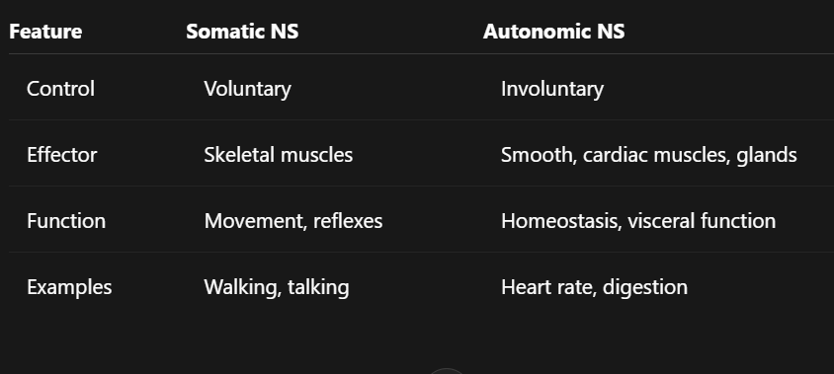
Functional Difference

Slide 73
Efferent Pathway Differences
SNS:
Single neuron from CNS → effector
Myelinated axon → fast conduction
ANS:
Two-neuron chain: preganglionic → ganglion → postganglionic → effector
Thinly myelinated/unmyelinated → slower conduction

Slide 74
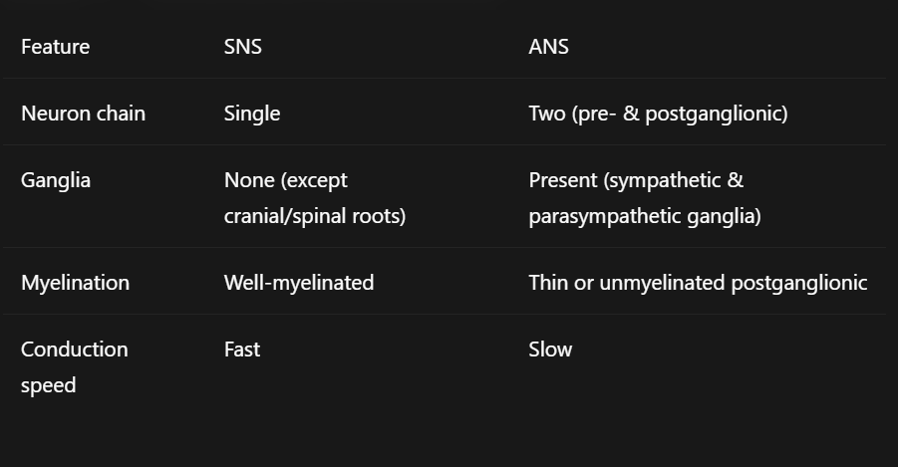
Structural Differences

Slide 75
Sympathetic vs Parasympathetic (Subdivision of ANS)
Sympathetic: fight or flight, thoracolumbar origin (T1-L2)
Increases heart rate, dilates pupils, inhibits digestion
Parasympathetic: rest and digest, craniosacral origin (CN III, VII, IX, X; S2–S4)
Decreases heart rate, stimulates digestion, constricts pupils

Slide 76
Types of Synapses
Electrical Synapse
Gap junctions allow direct ion flow
Very fast, bidirectional
Found in: cardiac muscle, some CNS neurons
Chemical Synapse
Uses neurotransmitters to transmit impulse
Unidirectional
Slower, allows integration and modulation

Slide 77
Structure of a Chemical Synapse
Presynaptic neuron: synaptic vesicles with neurotransmitter
Synaptic cleft: 20–30 nm gap
Postsynaptic neuron: neurotransmitter receptors on dendrites or cell body
Synaptic transmission: action potential → Ca²⁺ influx →
neurotransmitter release → receptor binding → postsynaptic response

Slide 78
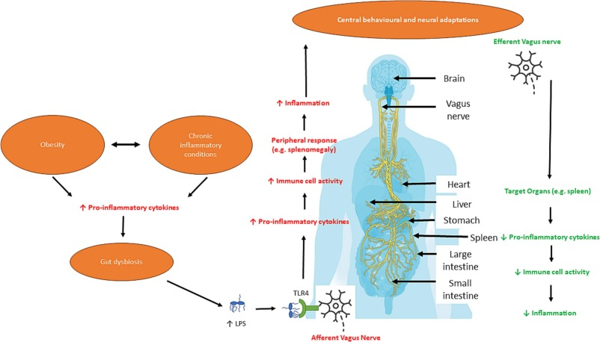
Reflex Arc

Slide 79
Reflex Arc:
Neural pathway mediating a reflex action
Reflex: rapid, involuntary, predictable response to a stimulus. Ensures protection and homeostasis
Components of Reflex Arc
Receptor – detects stimulus
Sensory (afferent) neuron – transmits signal to CNS
Integration center – spinal cord or brain; may involve interneurons
Motor (efferent) neuron – conducts impulse to effector
Effector – muscle or gland that responds

Slide 80
Types
Monosynaptic reflex
Single synapse between sensory and motor neuron
Example: Patellar reflex
Very fast
Polysynaptic reflex
Involves one or more interneurons
Example: Withdrawal reflex
Slower, allows integration and modulation

Slide 81
Clinical Relevance
Hyperreflexia or hyporeflexia indicates neurological disorders
Damage to afferent or efferent limb affects reflex
Synapse malfunction: myasthenia gravis neurotransmitter imbalance (Parkinson’s, depression)
Understanding reflex arc crucial for neurological examination and localization of lesions

Slide 82
Nervous System Diseases
Nervous system disorders affect CNS or PNS
Can be structural, functional, or degenerative
Symptoms: paralysis, tremors, memory loss, sensory deficits

Slide 83
Alzheimer’s Disease
CNS degenerative disorder
Affects memory and cognition
Characterized by: beta-amyloid plaques, neurofibrillary tangles
Common in elderly

Slide 84
Parkinson’s Disease
CNS disorder affecting basal ganglia
Symptoms: tremor, rigidity, bradykinesia, postural instability
Caused by dopamine deficiency in substantia nigra

Slide 85
Multiple Sclerosis (MS)
Autoimmune demyelinating disease of CNS
Symptoms: weakness, visual disturbances, coordination problems
Demyelination slows nerve conduction

Slide 86
Epilepsy
Chronic CNS disorder with recurrent seizures
Caused by abnormal neuronal discharges
Symptoms: convulsions, loss of consciousness, sensory disturbances

Slide 87
Amyotrophic Lateral Sclerosis (ALS)
Motor neuron disease affecting CNS and PNS
Progressive muscle weakness and atrophy
No sensory loss

Slide 88
Peripheral Neuropathy
PNS disorder affecting peripheral nerves
Causes: diabetes, toxins, infections
Symptoms: numbness, tingling, weakness in limbs

Slide 89
Stroke (Cerebrovascular Accident)
Sudden CNS dysfunction due to ischemia or hemorrhage
Symptoms: hemiplegia, speech difficulty, visual deficits
Emergency condition

