Slide 1
Measures of Dispersion
Statistics
DPT
Awais Hamza

Slide 2
Measures of Dispersion
Dispersion refers to the degree to which data values in a dataset are spread out or scattered around an average (such as the mean or median). It helps us understand the variability or consistency within the data — whether the values are closely grouped or widely spread.
In statistics, measures of dispersion are numerical values that describe the extent of variation among data points. They provide insight into how the data is distributed and help compare the reliability or uniformity of different datasets.

Slide 3
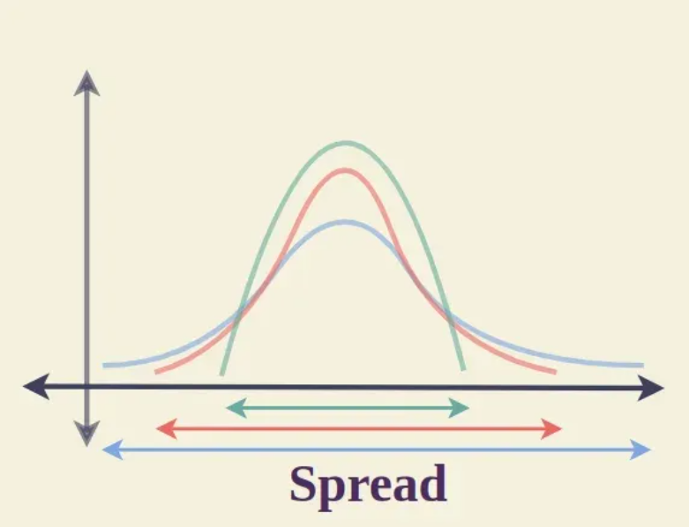
Measures of Dispersion

Slide 4
Common measures of dispersion
The most common measures of dispersion include:
Range – the difference between the maximum and minimum values.
Variance – the average of the squared deviations from the mean.
Standard Deviation – the square root of the variance, showing dispersion in the same units as the data.

Slide 5
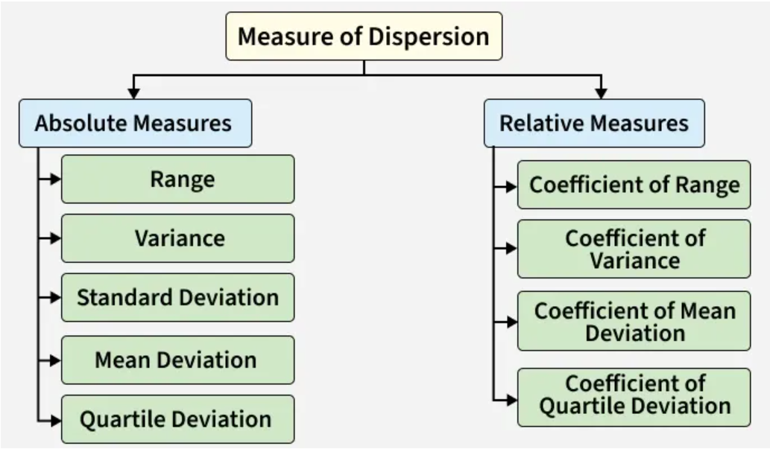
Measures of dispersion

Slide 6
Absolute Measure of Dispersion
Range: It is defined as the difference between the largest and the smallest value in the distribution. The measure of dispersion is used to variability of the data.
Mean deviation: It is the arithmetic mean of the differences between the values and their mean.
Standard Deviation: It is the square root of the arithmetic average of the squares of the deviations measured from the mean.
Variance: It is defined as the average of the square deviation from the mean of the given data set.

Slide 7
Absolute Measure of Dispersion
Quartile Deviation: It is defined as half of the difference between the third quartile and the first quartile in a given data set.
Interquartile Range: The difference between the upper(Q₃) and lower(Q₁) quartiles is called the Interquartile Range. Its formula is given as Q₃ - Q_{1.}

Slide 8
Relative Measure of Dispersion
Coefficient of Range: It is defined as the ratio of the difference between the highest and lowest value in a data set to the sum of the highest and lowest value.
Coefficient of Variation: It is defined as the ratio of the standard deviation to the mean of the data set. We use percentages to express the coefficient of variation.
Coefficient of Mean Deviation: It is defined as the ratio of the mean deviation to the value of the central point of the data set.
Coefficient of Quartile Deviation: It is defined as the ratio of the difference between the third quartile and the first quartile to the sum of the third and first quartiles.

Slide 9
Range of Data Set
The range is the difference between the largest and the smallest values in the distribution.
Thus, it can be written as
R = L – S
where,
L is the largest value in the Distribution
S is the smallest value in the Distribution

Slide 10
Examples on Range
Example 1: You are given a dataset of the ages of students in a classroom: 18, 19, 20, 21, 22, 35, 18, 23?
Example 2: You are given a dataset of the heights of students in a classroom(in cm): 150, 155, 160, 165, 170, 175. Find Range.
Example 3: Consider a dataset of exam scores for a class: Scores: 85, 92, 78, 96, 64, 89, 75, find the range?
Example 4: Consider a dataset of daily temperature of a city( in °F): 68°F, 72°F, 75°F, 70°F, 74°F. Find temperature range.

Slide 11
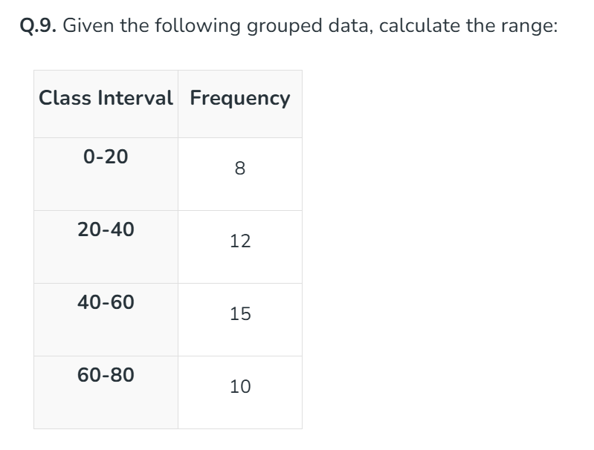
Grouped Data Example 1

Slide 12
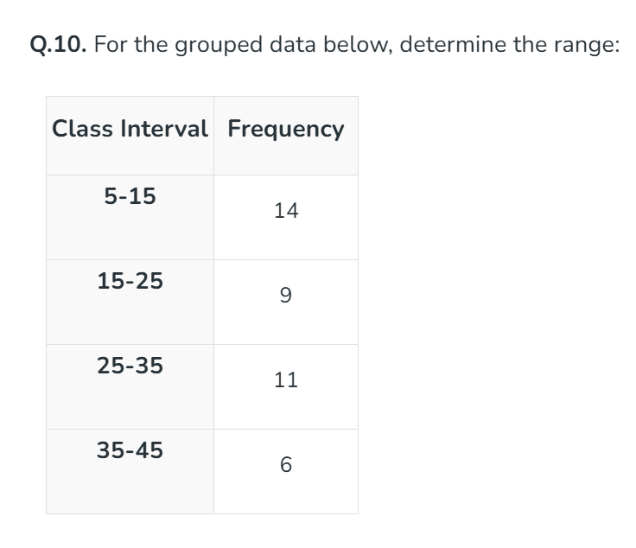
Grouped Data Example 2

Slide 13
Inter Quartile Range
The Interquartile Range (IQR) tells us how spread out the middle 50% of the data is. It is less affected by extreme values and gives a better idea of how tightly or loosely the central data points are grouped. It is calculated using the first quartile (Q1) and third quartile (Q3).

Slide 14
Inter Quartile Range
Focuses only on the central portion of the data.
Not affected much by outliers, unlike the full range.
Gives a clear view of how values are arranged around the median.

Slide 15
Quartiles
Quartiles divide the dataset into four equal parts:
Q1 (First Quartile): Separates the lowest 25% of the data
Q2 (Second Quartile / Median): Middle value of the dataset
Q3 (Third Quartile): Separates the highest 25% of the data
The IQR captures the range between Q1 and Q3, representing the middle 50% of the distribution.

Slide 16
Formula of IQR
The data is sorted in ascending order and split into 4 equal parts: Q1, Q2, Q3, called first, second, and third quartiles, respectively, in the given data.
The IQR is simply the difference between the third quartile (Q3) and the first quartile (Q1), which is calculated as:
Interquartile Range = Upper Quartile (Q3)– Lower Quartile(Q1)
It tells us how spread out the central 50% of the data is, which helps to gauge the data's variability without being influenced by outliers.

Slide 17
How to Calculate the Interquartile Range
Step 1: Sort the data in ascending order
Step 2: Find the median (Q2)
Step 3: Split the dataset into two halves
Q1 = median of lower half
Q3 = median of upper half
Step 4: Calculate IQR
IQR = Q3 - Q1

Slide 18
Example
Dataset: 77, 85, 92, 64, 78, 95, 82
Sort the data: 64, 77, 78, 82, 85, 92, 95
Median (Q2) = 82
Lower half = 64, 77, 78
Q1 is the median of the lower half (64, 77, 78) which is 77.
Upper half = 85, 92, 95
Q3 is the median of the upper half (85, 92, 95) which is 92.

Slide 19
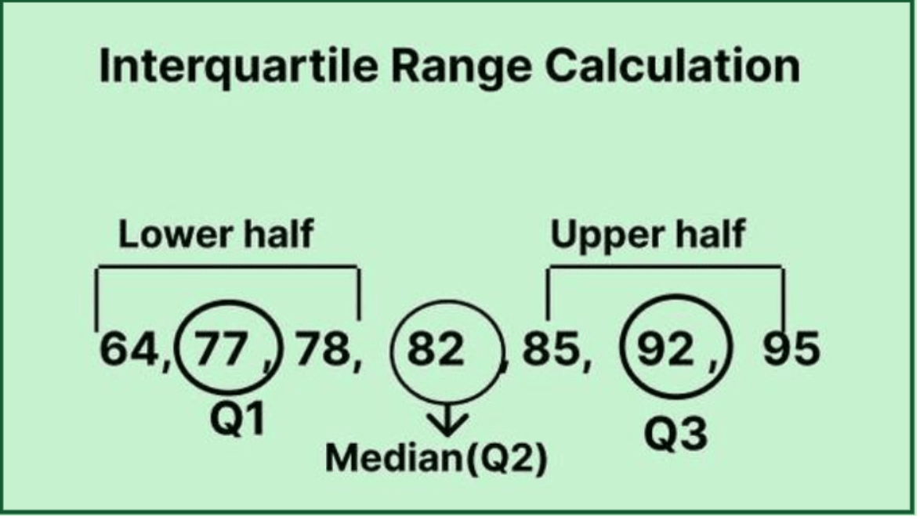
Example

Slide 20
Answer
IQR = 92 - 77 = 15
So the IQR for this dataset is 15.

Slide 21
Understanding Semi Interquartile Range (SIQR)
Semi interquartile range is also known as the Quartile deviation is a measure of how spread out the middle 50% of the data is. It is useful for datasets with skewed distributions and is not affected much by extreme values or outliers.
SIQR is half of the Interquartile Range (IQR).
It provides insight into how data is distributed around a central point (the median).
Extreme values have little impact on the SIQR helps in making it ideal for datasets with outliers.

Slide 22
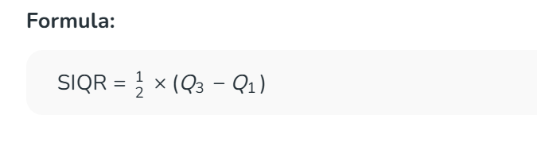
How to Find Semi Interquartile Range
The semi interquartile range is calculated by the following steps:-
1. Find Q1: Identify the first quartile (Q1) from the data.
2. Find Q3: Identify the third quartile (Q3) from the data.
3. Subtract Q1 from Q3: IQR=Q3−Q1
4. Divide by 2: SIQR is half of the IQR:

Slide 23
Interquartile Range Median (IQR Median)
The IQR Median is the median of the interquartile range which provides a measure of the central tendency for the middle 50% of our data. It minimizes the impact of extreme values helps in providing a more accurate reflection of the data's central distribution.

Slide 24
Relationship between Median and IQR
The Median (Q2) is the middle value of the dataset helps in splitting it into two equal parts.
The IQR represents the range of values that lie between Q1 (25th percentile) and Q3 (75th percentile) capturing the middle 50% of the data.
When dealing with skewed distributions it’s better to use the median (Q2) for central tendency and IQR for variability as these are less affected by extreme outliers.

Slide 25
Solved Examples on IQR
Example 1: You are given a dataset of the ages of students in a classroom: 18, 19, 20, 21, 22, 35, 13, 23,find the Interquartile Range ?

Slide 26
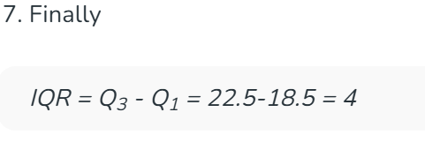
Solution
Arrange in ascending order: 13, 18, 19, 20, 21, 22, 23, 35
Count the given values i.e is 8 so median is average of two numbers median =20+21/2 = 20.5
Lower half is 13, 18, 19, 20
Median of the lower half (Q₁)= (18+ 19) / 2 = 18.5
Upper half is 21, 22, 23, 35, Median of the Upper half (Q₃)= (22+ 23) / 2 = 22.5

Slide 27
Practice Questions IQR
Question 1: The age of a group of young gymnasts are 4, 5, 6, 3, 12, 14, 15, 13 Find the interquartile range and the semi-interquartile range?
Question 2: Calculate the Interquartile Range for the following dataset: 12, 15, 20, 25, 30, 35, 40, 45?
Question 3: A dataset of temperatures in degrees Celsius for a week is given as follows: 18, 22, 20, 25, 19, 28, 17. Find the Interquartile Range?
Question 4: You have a dataset of the heights (in inches) of a group of individuals: 62, 67, 71, 68, 70, 75, 61, 66, 69, 70. Determine the Interquartile Range of heights?

Slide 28
Mean Deviation
The mean deviation (also known as Mean Absolute Deviation, or MAD) of the data set is the value that tells us how far each data point is from the center point of the data set.
The center point of the data set can be the Mean, Median, or Mode.
Thus, the mean of the deviation is the average of the absolute deviations of all data points from the chosen central value.

Slide 29
Example of Mean Deviation
Suppose we have to find the mean deviation of the given data set: {4, 5, 6, 7, 8}.
Calculate mean by diving 4+5+6+7+8/5=6
Now we subtract the mean from each data set to obtain the deviation from the mean.

Slide 30
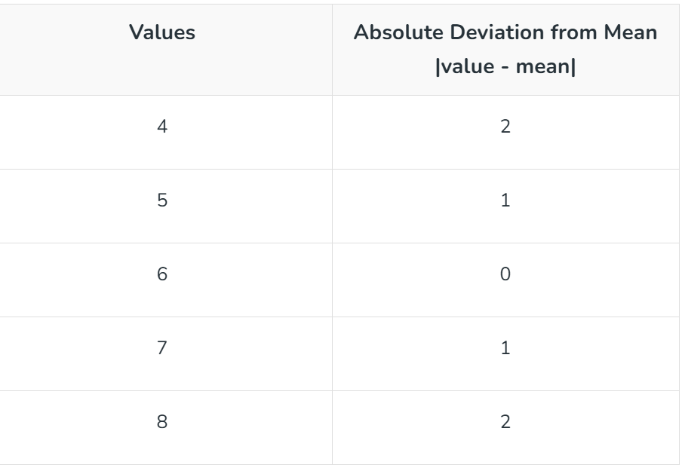
Next Step

Slide 31
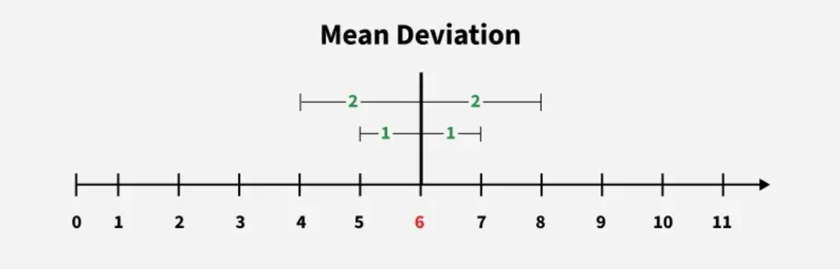
The above table can be depicted on a number line

Slide 32
Final Step
Sum of Absolute Deviations: 2 + 1 + 0 + 1 + 2 = 6
Mean Deviation: Mean Deviation = 6/5 = 1.2
This gives the mean deviation of the given data set.

Slide 33
Key Concepts of Mean Deviation
1) Central Tendency
The central point of a dataset can be represented by the Mean, Median, or Mode.
Mean Deviation measures how far the data points are spread out from the central value.
2) Absolute Deviation:
The absolute deviation of a data point is the absolute difference between the data point and the central value (∣xi−central value∣∣xi​−central value∣).
Using absolute values ensures that deviations are always positive, regardless of direction.

Slide 34
Key Concepts of Mean Deviation
3) Mean of Deviations:
The Mean Deviation is the average of all absolute deviations in the dataset.
Mean Deviation Formulas
There are various types of mean deviation formulas used depending upon the types of data given and the central point chosen for the given data set.

Slide 35
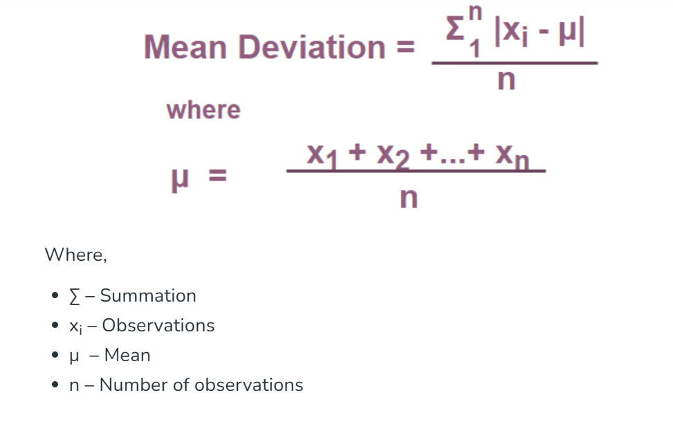
Key Concepts of Mean Deviation

Slide 36
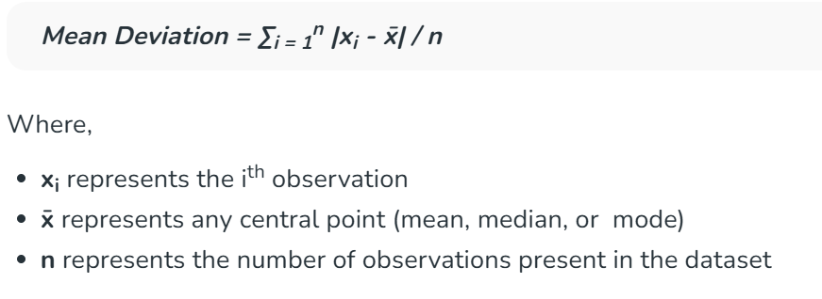
Mean Deviation Formula for Ungrouped Data
For ungrouped data or data that is not properly arranged, that is, the given data is in raw form, the mean deviation is calculated using the formula

Slide 37
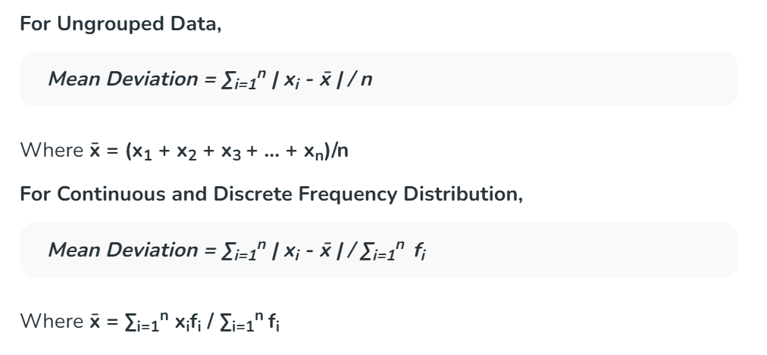
Formula used to calculate the mean deviation about the mean of the data

Slide 38
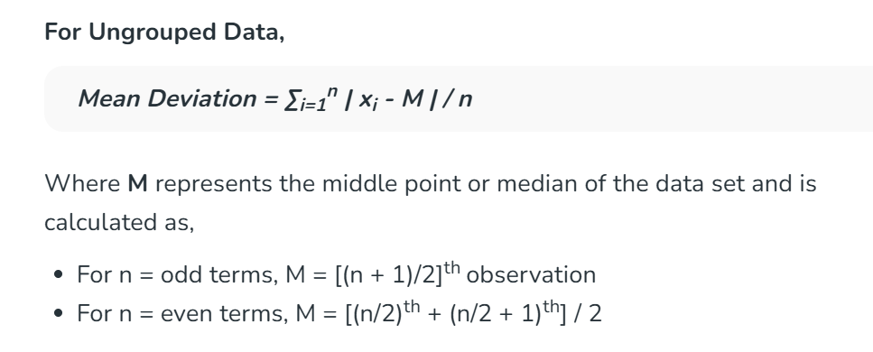
Mean Deviation about Median
The middle point of the data set, when arranged in ascending or descending order, is called the median of the data set. It is the middle value of the data set that divides the data set into two equal halves.

Slide 39
How to Calculate Mean Deviation?
Step 1: Calculate the value of the mean, median, or mode of the series.
Step 2: Calculate the absolute deviations about the mean, median, or mode.
Step 3: Multiply the deviations of the given data set with their respective frequency. It is required if the frequency of the data is given.
Step 4: Find the sum of all the deviations and divide it by the number of observations to get the mean deviation.

Slide 40
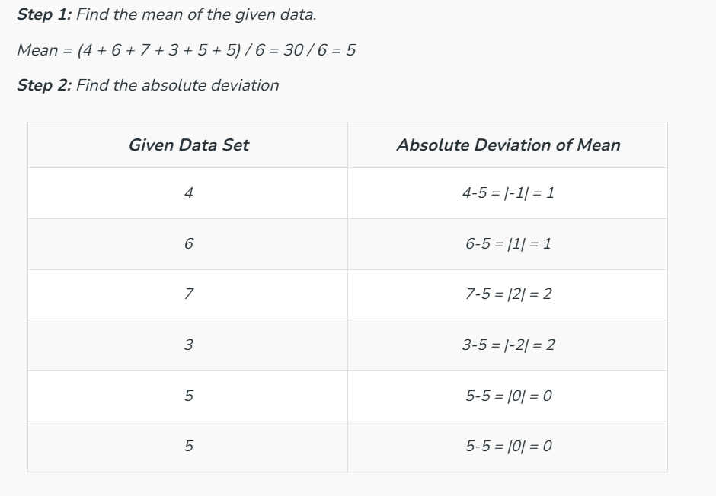
Find the mean deviation of the given data about their mean, {4, 6, 7, 3, 5, 5}.

Slide 41
Step 3
Step 3: Find the mean deviation of the absolute value so obtained.
Mean Deviation = (1 + 1 + 2 + 2 + 0 + 0)/6 = 6/6 = 1
Thus, the mean deviation from the mean of the given data set is 1.

Slide 42
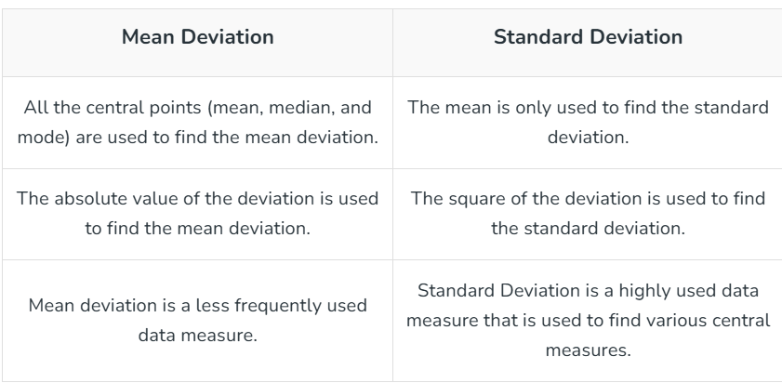
Mean Deviation vs Standard Deviation

Slide 43
Practice Questions
Find the mean deviation of the following data: 7, 5, 1, 3, 6, 4, 10.
Find the mean deviation of the following data: 11, 9, 7, 3, 2, 8, 10, 12, 15, 13.

Slide 44
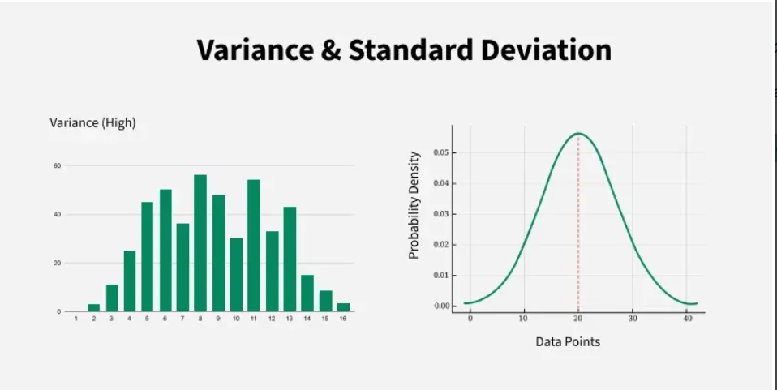
Variance and Standard Deviation
Variance is the measure of how the data points vary according to the mean, while standard deviation is the measure of the central tendency of the distribution of the data.

Slide 45
Variance and Standard Deviation
The major difference between variance and standard deviation is in their units of measurement. Standard deviation is measured in a unit similar to the units of the mean of data, whereas the variance is measured in squared units.

Slide 46
Variance
The measure of how far the set of data is dispersed from their mean value". Variance is represented with the symbol σ2.
Properties of Variance
As each term in the variance formula is firstly squared and then their mean is found, it is always a non-negative value, i.e. mean can be either positive or can be zero, but it can never be negative.
Variance is always measured in squared units. For example, if we have to find the variance of the height of the students in a class and if the height of the student is given in cm, then the variance is calculated in cm².

Slide 47
Variance Formula
There are two formulas for Variance, that are:
Population Variance
Sample Variance

Slide 48
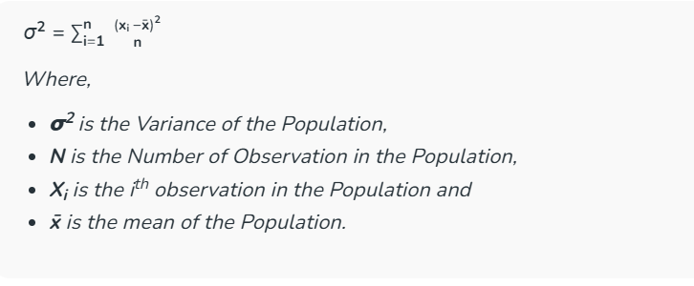
Formula for Population Variance

Slide 49
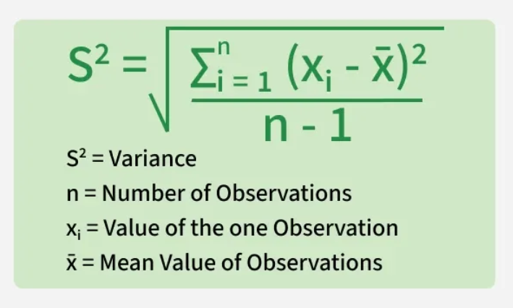
Formula for Sample Variance

Slide 50
Standard Deviation
The "spread of the statistical data from the mean or average position". We denote the standard deviation of the data using the symbol σ.
We can also define the standard deviation as the square root of the variance.

Slide 51
Properties of Standard Deviation
Standard Deviation is the square root of the variance of the given data set. It is also called root mean square deviation.
Standard Deviation is a non-negative quantity i.e., it always has positive values or zero values.
If all the values in a data set are similar then the Standard Deviation has a value close to zero. Whereas if the values in a data set are very different from each other,, then standard deviation has a high positive value.

Slide 52
Standard Deviation Formula
There are two formulas for the standard deviation listed as follows:
Population Standard Deviation
Sample Standard Deviation

Slide 53
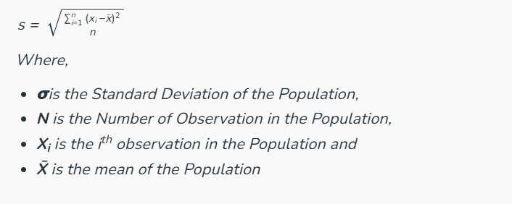
Formula for Population Standard Deviation

Slide 54
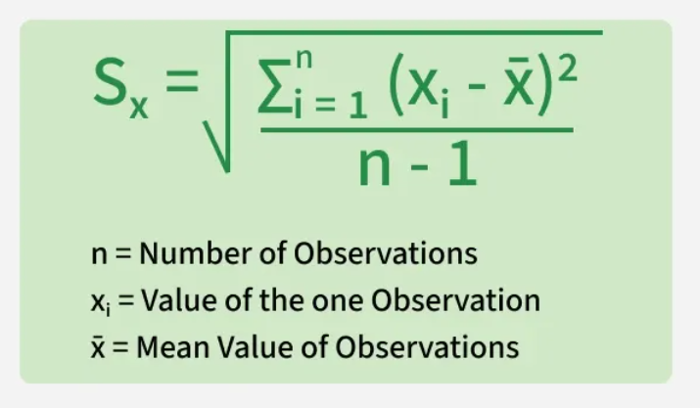
Formula for Sample Standard Deviation

Slide 55
Relation between Standard Deviation and Variance
Variance and Standard deviation are the most common measure of the given set of data. They are used to find the deviation of the values from their mean value or the spread of all the values of the data set.
Variance is defined as the average degree through which all the values of a given data set deviate from the mean value.
Standard Deviation is the degree to which the values in a data set are spread out concerning, the mean value.

Slide 56
Relationship between Variance and Standard Deviation
Variance = (Standard Deviation)²
OR
√(Variance) = Standard Deviation

Slide 57
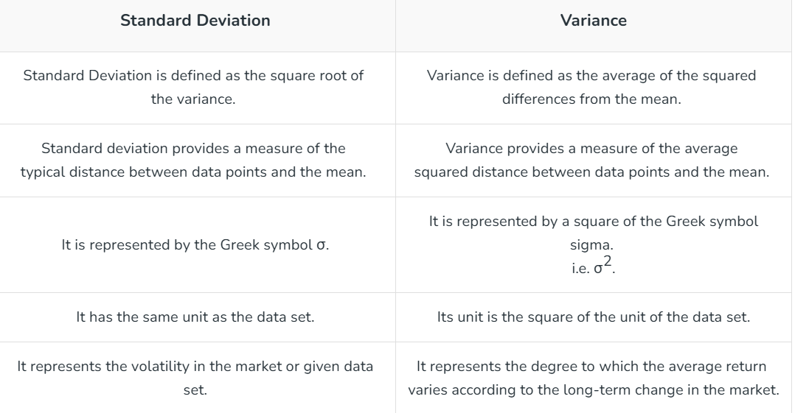
Variance vs Standard deviation

Slide 58
Change of Origin and Scale
In statistics, sometimes raw data is transformed to:
simplify calculations
reduce large numbers
make interpretation easier
Two common transformations are:
Change of Origin
Change of Scale
These transformations do not change the nature of the data, only its numerical representation.

Slide 59
Change of Origin
Definition
Change of origin means shifting the reference point of data by adding or subtracting a constant value.

Slide 60
Mathematical Representation
If
Original variable = X
New variable = u
Then:
u=X−a
Where a is a constant (new origin).

Slide 61
Interpretation
Every data value is shifted by the same amount.
The shape of the data distribution remains unchanged.
Only the location of data changes, not the spread.

Slide 62
Effect on Statistical Measures
Mean → changes
Median → changes
Mode → changes
Variance → unchanged
Standard Deviation → unchanged

Slide 63
Example
If original data values are large:
X = 102, 105, 108
Choose new origin a = 100
Then:
u = 2, 5, 8
Calculations become easier without affecting variability.

Slide 64
Change of Scale
Change of scale means rescaling data by multiplying or dividing by a constant.
Mathematical Representation
u=X/b
Where b is the scaling factor.

Slide 65
Interpretation
Data values are stretched or compressed.
Both location and spread change.
Distribution shape remains the same.

Slide 66
Effect on Statistical Measures
Mean → divided by b
Median → divided by b
Mode → divided by b
Variance → divided by b²
Standard Deviation → divided by b

Slide 67
Example
If:
X = 50, 60, 70
Choose scale b = 10
Then:
u = 5, 6, 7
This makes units smaller and easier to analyze.

Slide 68
Change of Origin and Scale Together
ombined Transformation
u=X−a/ b
Where:
a = change of origin
b = change of scale

Slide 69
Key Takeaway Slide
Change of origin shifts data
Change of scale resizes data
Both are mathematical tools to simplify statistical analysis
Widely used in grouped frequency distributions

Slide 70
Coefficient of Variation
The Coefficient of Variation (CV) in statistics measures relative variability, calculated as the ratio of the standard deviation to the mean, often expressed as a percentage (CV = SD/Mean * 100%).
It's a unitless measure, making it ideal for comparing dispersion between datasets with different scales or units (e.g., comparing test scores vs. heights).
A lower CV indicates less variability and greater precision/consistency, while a higher CV signifies more relative spread.

Slide 71
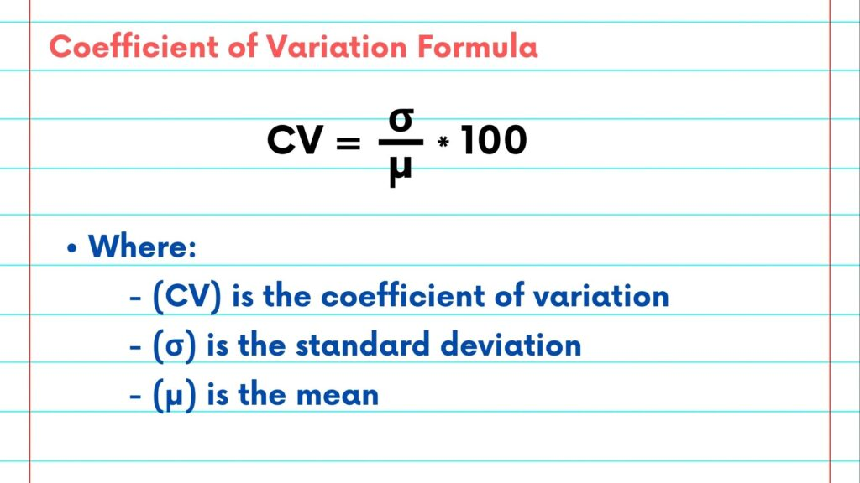
Coefficient of Variation Formula

Slide 72
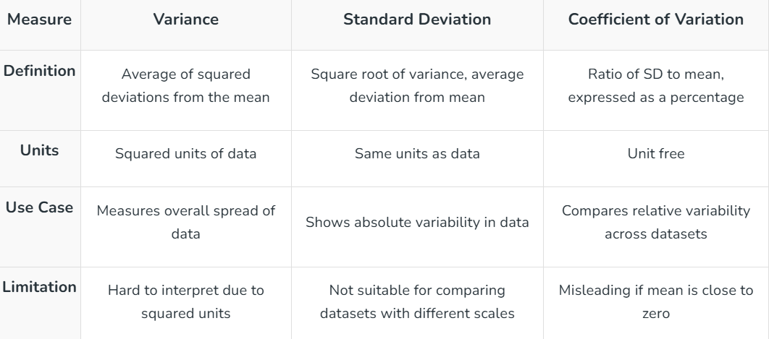

Slide 73
Key Properties of Variance
Non-Negative: Variance is always zero or positive because it's the average of squared deviations from the mean.
Squared Units: Its units are the square of the data's units (e.g., cm² for height in cm), making direct comparison difficult, which is why the standard deviation (square root of variance) is often used.
Zero Variance: If variance is zero, all data points are identical (no spread).
Spread Measurement: A large variance means data is widely spread; a small variance means data is clustered near the mean.

Slide 74
6 Important Properties of Standard Deviation
1. It cannot be negative.
2. It is only used to measure spread or dispersion around the mean of a data set.
3. It shows how much variation or dispersion exists from the average value.
4. It is sensitive to outliers. A single outlier can raise σ and, in turn, distort the picture of the spread.
5. For data with almost the same mean, the greater the spread, the greater the standard deviation.
6. Standard deviation can be used in conjunction with the mean in order to calculate data intervals when analyzing normally distributed data.

Slide 75
Key Properties of Standardized variables
Mean: 0 (The distribution is centered at zero).
Standard Deviation: 1 (The spread of the data is scaled to one unit).
Variance: 1 (The square of the standard deviation).
Scale-Independent: Allows direct comparison of values from different original scales (e.g., height vs. test scores).
Preserves Relationships: Correlation and covariance structures between variables remain unchanged after standardization.

