Slide 1

Introduction to Operation Theater Equipment
FSC(OT)
ADNAN RAMZAN

Slide 2
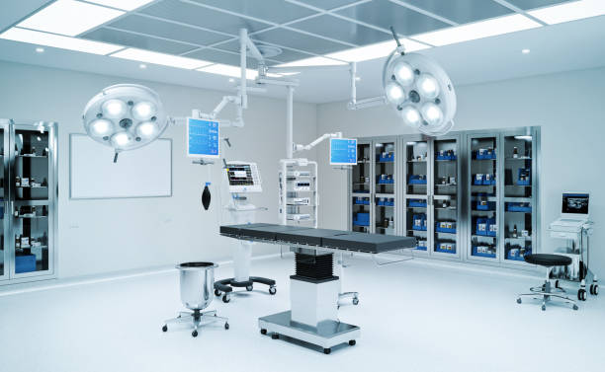

Slide 3
Introduction to Operation Theater Equipment
Operation theater equipment is essential for safe surgeries
All equipment supports surgeons and medical staff
Proper equipment improves patient outcomes
Modern OTs use advanced technology
Equipment must meet safety standards
Regular maintenance is very important

Slide 4
General Equipment Maintenance
Maintenance ensures equipment works properly
Reduces chances of sudden equipment failure
Improves safety of patients and staff
Regular checks increase equipment life
Preventive maintenance is recommended
Maintenance should be planned in advance
biomedical team performs maintenance
Documentation of maintenance is required

Slide 5
Importance of Maintenance in OT
Ensures uninterrupted surgical procedures
Helps identify faults early
Prevents electrical and mechanical hazards
Reduces repair costs
Improves efficiency of OT staff
Supports infection control practices

Slide 6
Surgical Lights – Overview
Surgical lights provide illumination of surgical site
Essential for performing precise procedures
Designed to eliminate shadows
Provide bright and focused light
Mounted on ceiling or wall
Can be adjusted easily
Modern lights use LED technology
Recommended maintenance is twice per year

Slide 7
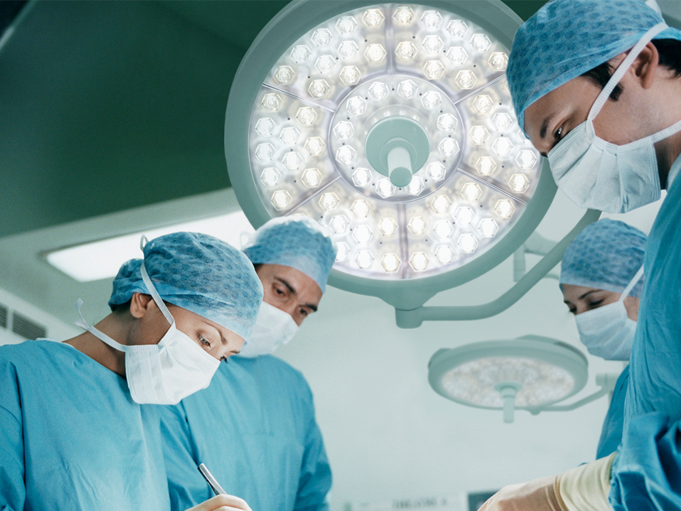

Slide 8
Types of Surgical Lights
Ceiling-mounted surgical lights
Wall-mounted surgical lights
Mobile surgical lights
Single dome lights
Double dome lights
LED surgical lights
Halogen surgical lights
Shadow-free lights

Slide 9
Advantages of Surgical Lights
Clear visualization of surgical field
Improves surgical accuracy
Reduces eye strain for surgeons
Produces less heat with LED lights
Better color rendition
Longer lifespan
Easy to clean and maintain

Slide 10
Operating Tables – Overview
Operating tables support patient positioning
Essential during surgical procedures
Allow movement of patient body parts
Compatible with surgical accessories
Designed for patient safety
Adjustable height and tilt
Different tables for different surgeries
Maintenance recommended twice per year

Slide 11
Types of Operating Tables
General operating tables
Orthopedic tables
Neurosurgical tables
Gynecological tables
Electro-mechanical tables
Hydraulic operating tables
Radiolucent tables
Special procedure tables

Slide 12
Surgical Booms – Overview
Also called equipment management systems
Reduce clutter in operating room
Manage electrical and gas connections
Improve working space in OT
Enhance safety by reducing trip hazards
Allow easy positioning of equipment
Can be ceiling mounted
Maintenance required twice per year
Notes:
Clutter (ے ترتیبی، افراتفری، یا گڑبڑ،)

Slide 13
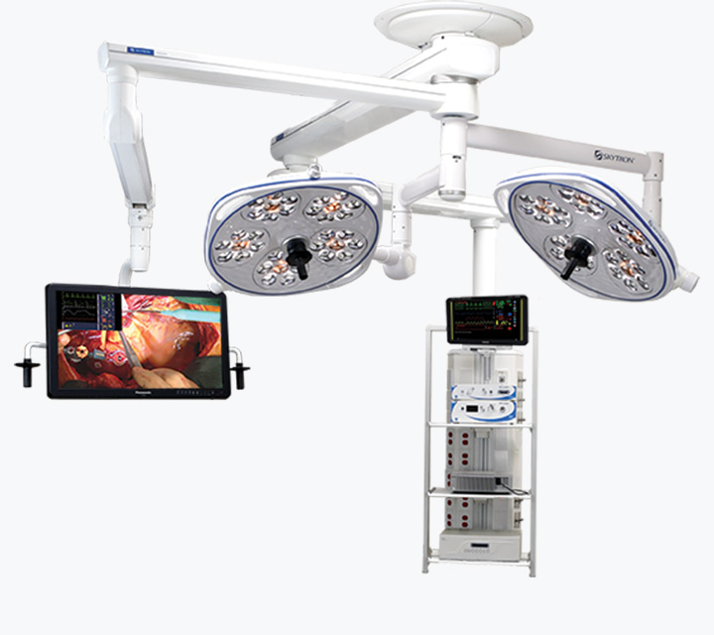

Slide 14
Advantages of Surgical Booms
Improves OT organization
Keeps floor free from cables
Increases sterility in OT
Easy access to equipment
Supports multiple devices
Flexible positioning
Enhances workflow efficiency
Improves staff safety

Slide 15
Surgical Displays – Overview
specialized, high-resolution monitors used in operating rooms
Used in minimally invasive surgeries
Provide visualization of anatomy
Display surgical procedure clearly
Mounted on walls or arms
Some support 4K visualization
Helps entire team view procedure
Maintenance recommended twice per year

Slide 16
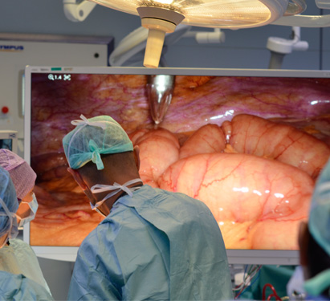

Slide 17
Benefits of Surgical Displays
Clear and magnified view
Improves surgical precision
Supports advanced surgeries
High-resolution images
Reduced surgeon fatigue
Easy integration with cameras
Reliable performance with maintenance

Slide 18
Operating Room Integration Systems
Connects all OT equipment digitally
Improves workflow efficiency
Allows real-time communication
Supports remote viewing
Reduces traffic in OT
Decreases infection risk
Maintenance required twice per year

Slide 19
Blanket Warmers – Overview
Also called warming cabinets
Used to warm blankets and fluids
Prevents patient hypothermia
Maintains normal body temperature
Improves patient comfort
May have multiple chambers
Maintenance recommended twice per year

Slide 20
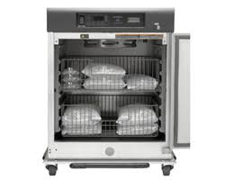

Slide 21
Conclusion and Additional Points
OT equipment plays a vital role in surgery
Proper use improves patient safety
Regular maintenance is essential
Training staff is equally important
Clean equipment reduces infection risk
Advanced technology improves outcomes
Good planning saves time and cost

Slide 22


