Slide 1

PHYSIOTHERAPY TECHNIQUES
FSC PT I
DR DANISH

Slide 2
Fracture
Definition:
A fracture is defined as a break or crack in a bone
It may be complete or incomplete

Slide 3
Causes of Fracture
Trauma (falls, road traffic accidents)
Sports injuries
Osteoporosis
Pathological conditions (tumors, infections)
Stress or repetitive strain
Birth injury (in newborns)

Slide 4
Types of Fracture
Simple (Closed) fracture – no open wound
Compound (Open) fracture – bone pierces skin

Slide 5
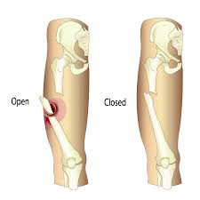

Slide 6
Continued
Greenstick fracture – incomplete fracture (common in children)
Comminuted fracture – bone breaks into multiple fragments
Impacted fracture – one fragment driven into another
Stress fracture – due to repeated stress
Pathological fracture – due to disease

Slide 7
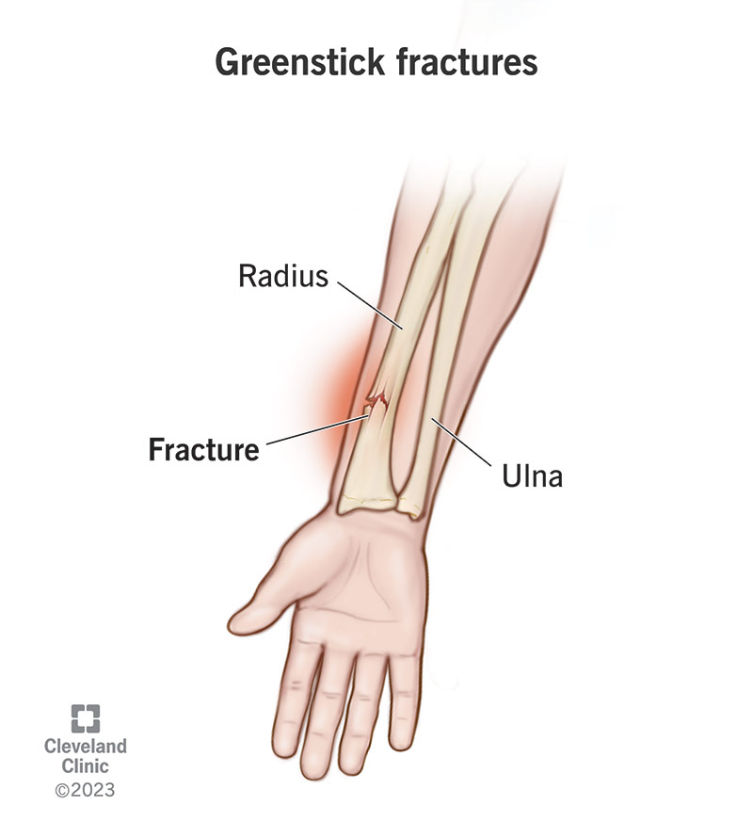
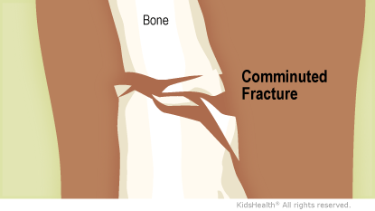

Slide 8
Continued
Spiral fracture
Oblique fracture
Transverse fracture

Slide 9
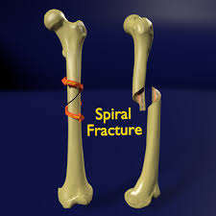
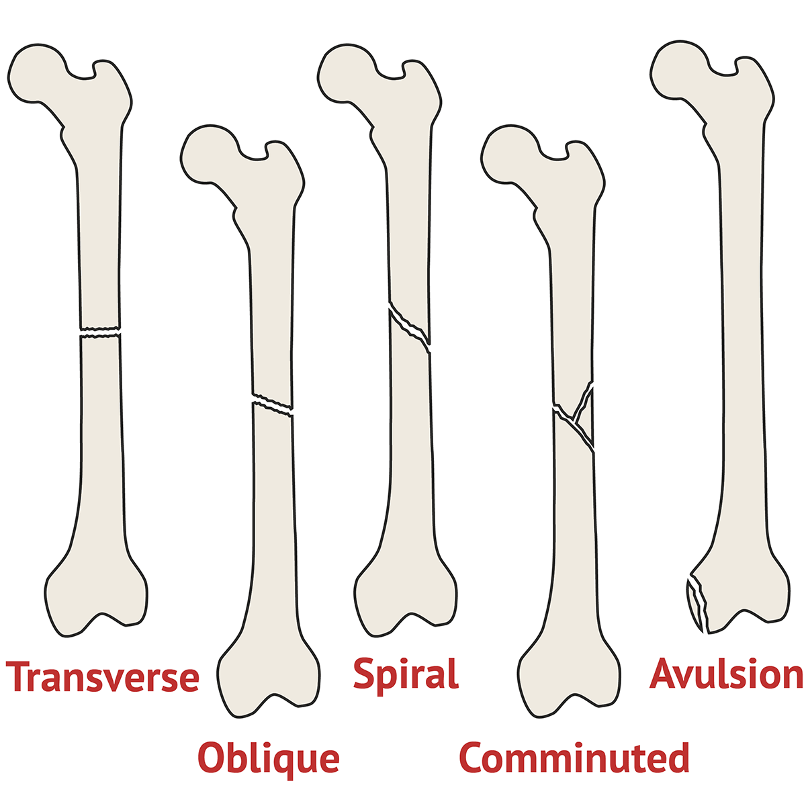

Slide 10
Clinical Features of Fracture
Pain
Swelling
Deformity
Tenderness
Loss of function
Abnormal mobility
Crepitus
Bruising or bleeding

Slide 11
Classification of Fracture
Based on:
  Site
  Severity
  Direction of fracture line
  Presence or absence of skin wound

Slide 12
Treatment of Bone Fracture
Objectives
Restore anatomical alignment
Promote bone healing
Restore maximum function

Slide 13
Methods
Reduction
  Closed reduction
  Open reduction
Immobilization
  Plaster cast
  Splints
  Traction

Slide 14
Continued
Internal fixation
  Plates
  Screws
  Intramedullary nails
External fixation
Physiotherapy rehabilitation

Slide 15
Complications of Fracture
Early Complications
Shock
Infection
Damage to blood vessels
Nerve injury
Compartment syndrome

Slide 16
Late Complications
Malunion
  Healing with angulation, rotation, or shortening
Non-union
  Failure of fracture to unite
Cross-union
  Fragments of different bones unite
Joint stiffness and contractures
Myositis ossificans
Volkmann’s ischemic contracture

Slide 17
Myositis Ossificans
Definition
Formation of new bone in soft tissues around a joint following trauma
Causes
Severe contusion
Repeated trauma
Improper massage after injury

Slide 18
Features
Pain
Swelling
Reduced range of motion
Hard mass in muscle

Slide 19
Treatment
Rest
Reduction of inflammation
Immobilization
Anti-inflammatory drugs
Physiotherapy management
Surgical removal (rare cases)

Slide 20
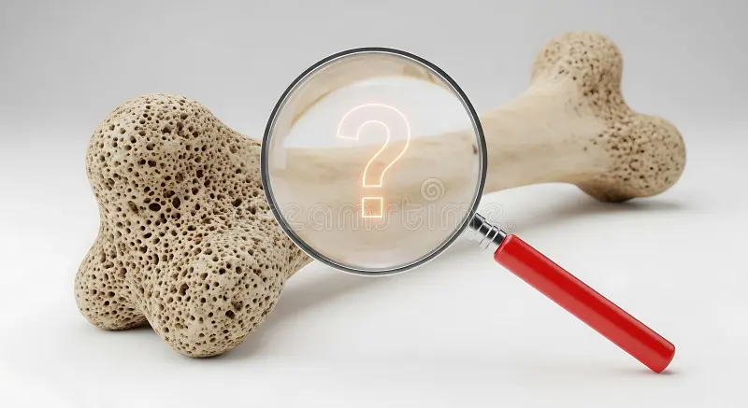

Slide 21


