Slide 1

Phrases
Functional English | BS & DPT
Hafsa Rasheed

Slide 2
Dangling Phrase
Definition: A phrase with no logical noun to modify.
Wrong: Walking down the road, the trees looked beautiful.
Correct: Walking down the road, I saw beautiful trees.
📌 Rule: If the “doer” is missing → dangling

Slide 3
Misplaced Phrase
Definition: Phrase placed too far from the word it modifies.
Wrong: She saw a man with a telescope.
Correct: With a telescope, she saw a man.

Slide 4
Squinting Phrase
Definition: Phrase that can modify two meanings, causing ambiguity.
Example : Students who study regularly pass exams.
Fix: Students who study regularly pass exams.

Slide 5
Reduced Phrase
Clause shortened into phrase.
Clause: When he was walking home, he met Ali.
Reduced: Walking home, he met Ali.
Used for conciseness and style

Slide 6
Appositive Phrase
Definition: Renames a noun.
Example:
Ali, a brilliant student, topped the class.

Slide 7
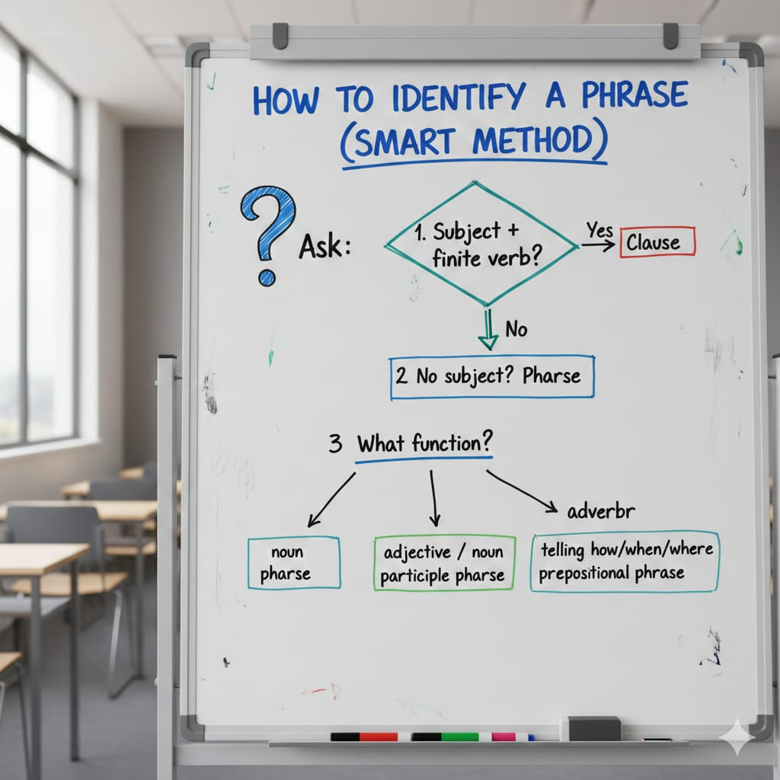
Adjective Phrase
Definition: Describes a noun.
Structure: (Adverb) + Adjective
Examples:
very happy
extremely difficult
Sentence: She is very intelligent.

Slide 8


