Slide 1

HUMAN ANATOMY
BS RIT,MLT,OTT
1ST SEMESTER
DR DANISH

Slide 2
Central Nervous System
The Central Nervous System consists of:
  Brain
  Spinal cord
It is responsible for:
  Receiving sensory information
  Processing and integrating data
  Sending motor responses

Slide 3
BRAIN
The brain is the chief controlling organ of the body.
Located in the cranial cavity of the skull.
Weight:
  Adult male: ~1400 g
  Adult female: ~1300 g

Slide 4
Parts of Brain
The brain is divided into:
Forebrain
Midbrain
Hindbrain

Slide 5
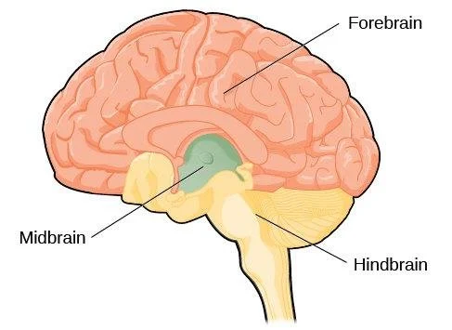

Slide 6
Forebrain
Forebrain includes:
  Cerebrum
  Diencephalon

Slide 7
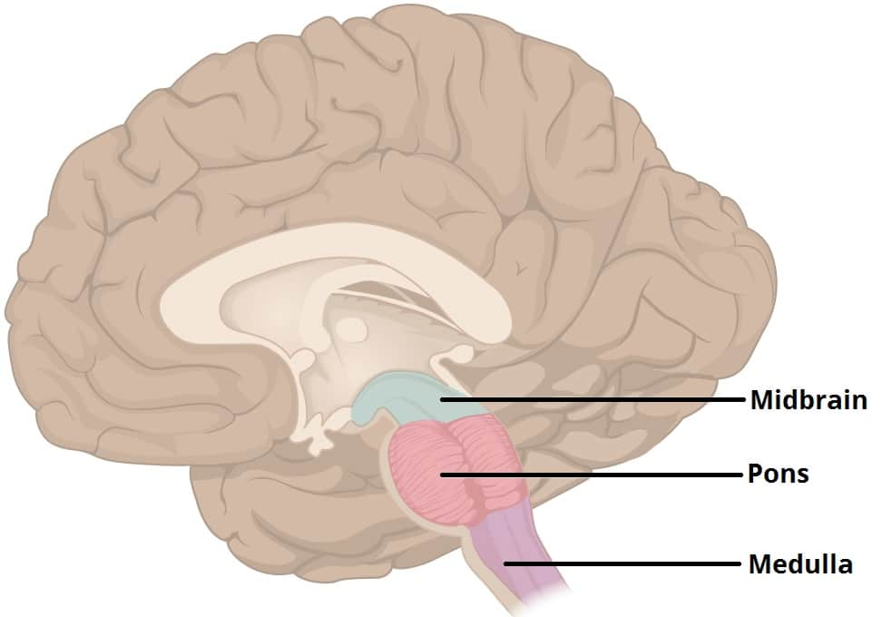

Slide 8
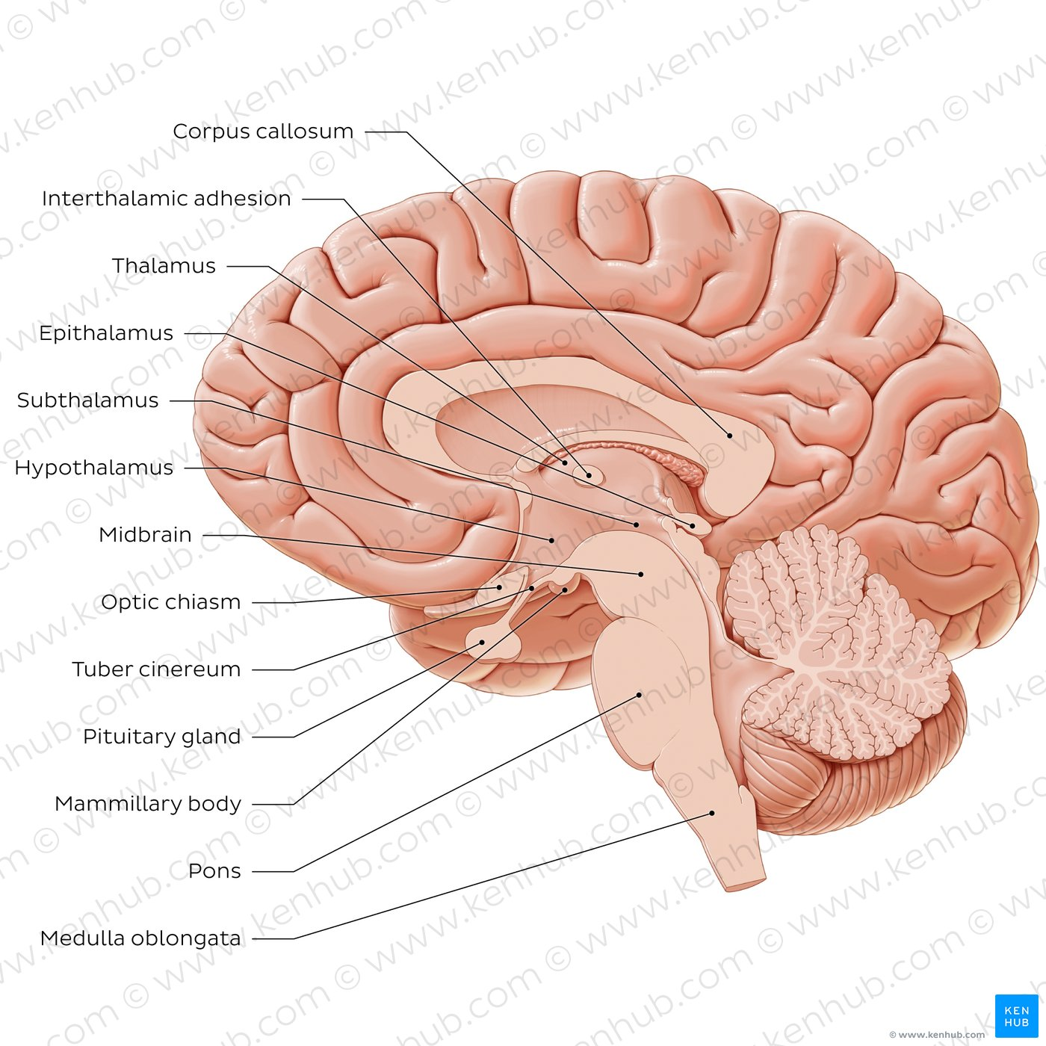

Slide 9
Cerebrum
Largest part of the brain
Divided into two cerebral hemispheres
Functions:
  Consciousness
  Memory
  Intelligence
  Voluntary movements
  Sensory perception

Slide 10
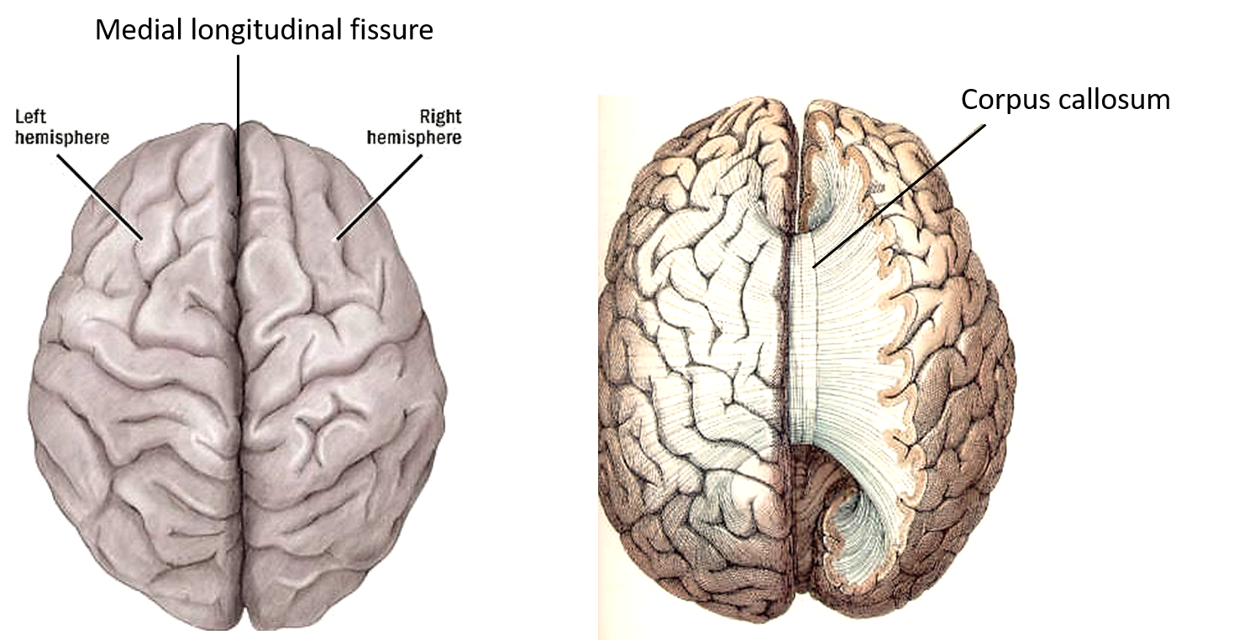

Slide 11
Diencephalon
Includes:
  Thalamus
  Hypothalamus
Thalamus:
  Relay station for sensory impulses
Hypothalamus:
  Controls temperature
  Hunger and thirst
  Emotional behavior
  Autonomic nervous system

Slide 13
Midbrain
Connects forebrain and hindbrain
Acts as a pathway for nerve impulses
Functions:
  Visual reflexes
  Auditory reflexes
  Motor coordination

Slide 15
Hindbrain
Includes:
Cerebellum
Pons
Medulla oblongata

Slide 16
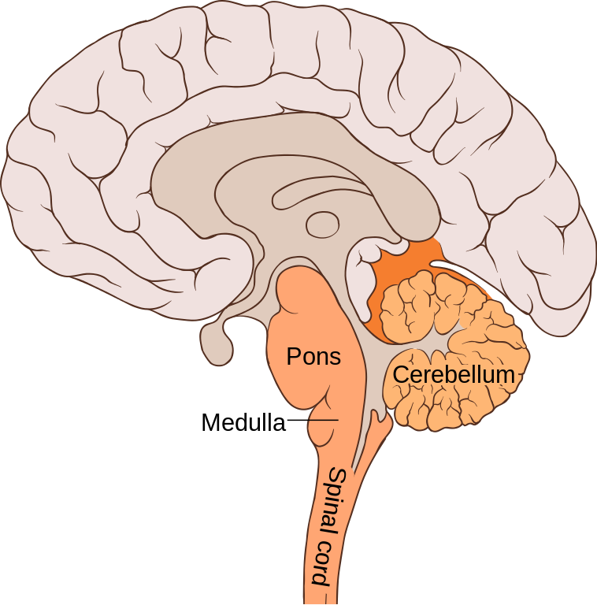

Slide 17
Cerebellum
Second largest part of brain
Located posteriorly
Functions:
  Maintenance of posture
  Balance
  Coordination of voluntary movements

Slide 19
Pons
Bridge between different parts of brain
Helps in:
  Regulation of breathing
  Transmission of nerve signals

Slide 21
Medulla Oblongata
Lowest part of brain
Continuous with spinal cord
Controls vital centers:
  Heart rate
  Respiration
  Blood pressure

Slide 23
SPINAL CORD
Long cylindrical structure
Located in vertebral canal
Extends from:
  Medulla oblongata
  Up to L1–L2 vertebral level in adults

Slide 24
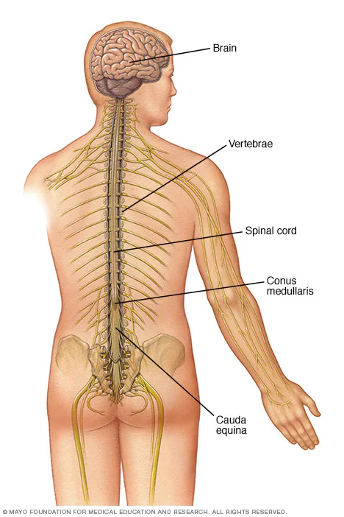

Slide 25
Structure of Spinal Cord
Divided into segments:
  Cervical
  Thoracic
  Lumbar
  Sacral
Each segment gives rise to:
  A pair of spinal nerves

Slide 26
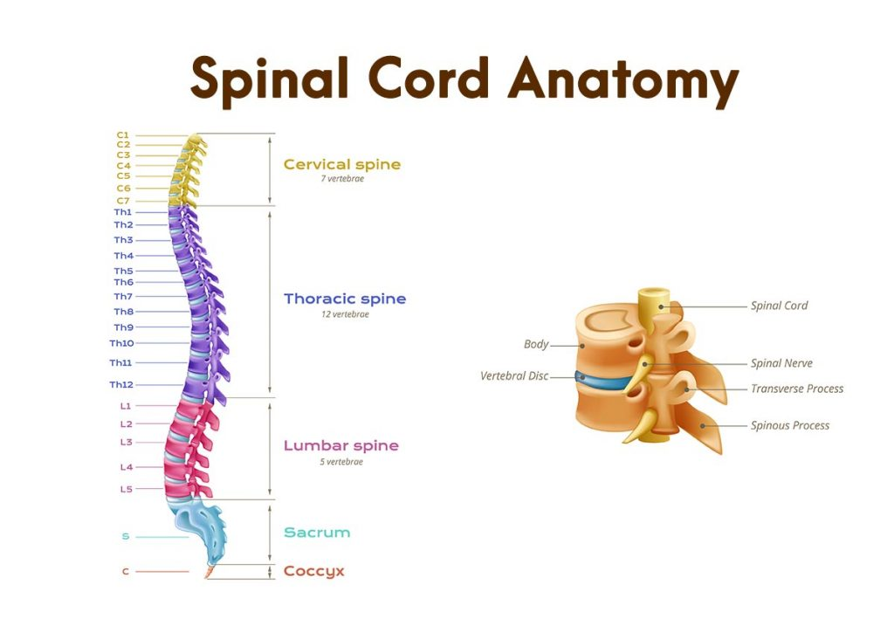

Slide 27
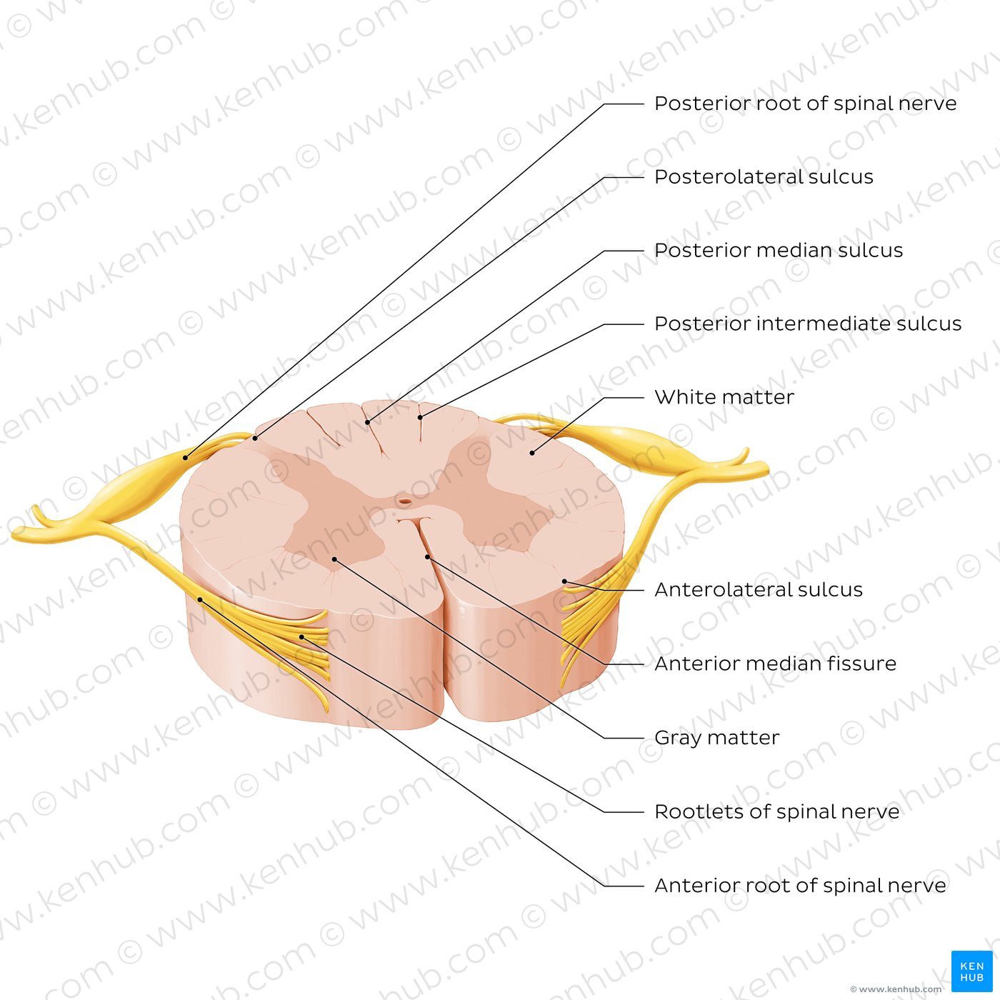

Slide 28
Functions of Spinal Cord
Acts as:
  Conduction pathway between brain and body
  Reflex center
Functions include:
  Carrying sensory impulses to brain
  Carrying motor impulses from brain
  Controlling spinal reflexes

Slide 29
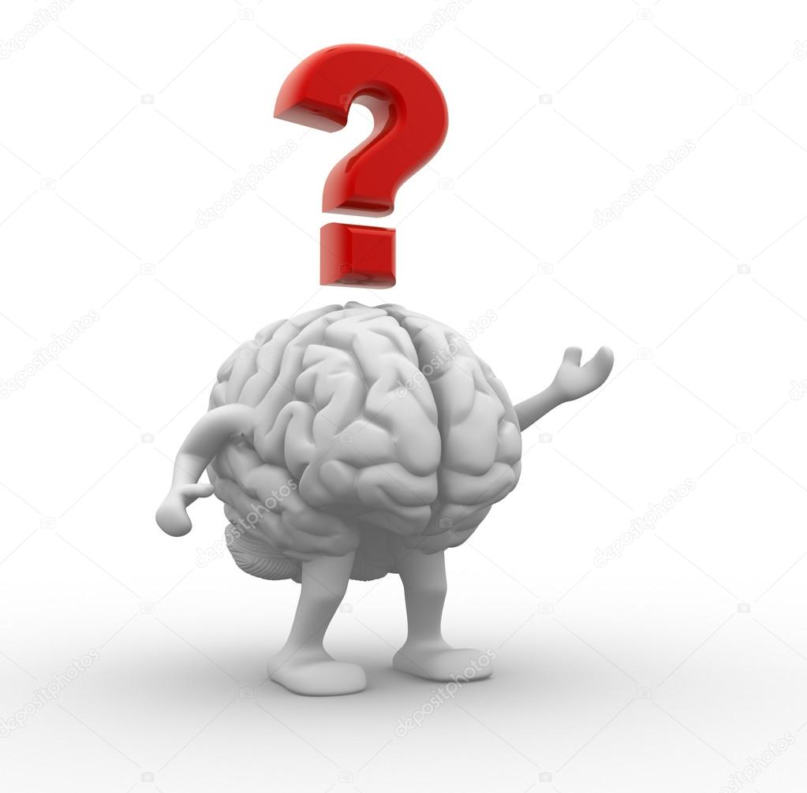

Slide 30


