Slide 1

BASIC MEDICAL SCIENCE
FSC MEDICAL TECHNOLOGIES I
DR DANISH

Slide 2
Internal features of heart
Chambers of heart:
Right atrium(receiving chamber)
Right ventricle(pumping chamber)
Left atrium(receiving chamber)
Left ventricle(pumping chamber)

Slide 3
Heart – Regional Anatomy
The heart is divided into four chambers:
  Right Atrium
  Right Ventricle
  Left Atrium
  Left Ventricle
Each chamber has a specific role in receiving or pumping blood
Blood flow through the heart is one-directional, controlled by valves

Slide 4
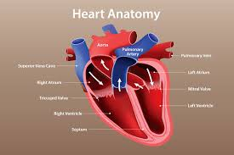

Slide 5
Right Atrium
Receives deoxygenated blood from the body
Blood enters through:
  Superior vena cava (from upper body)
  Inferior vena cava (from lower body)
  Coronary sinus (from heart muscle)

Slide 6
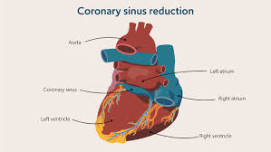

Slide 7
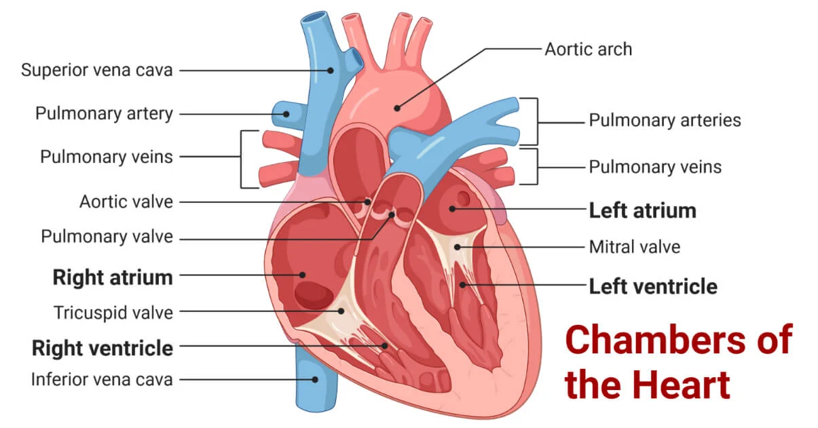

Slide 8
Continued
Internal features:
  Pectinate muscles (ridge-like muscles)
  Interatrial septum separates it from the left atrium
Blood passes to the right ventricle through the tricuspid valve

Slide 9
Right Ventricle
Pumps deoxygenated blood to the lungs
Blood exits through the pulmonary artery
Internal structures:
  Trabeculae carneae (irregular muscular ridges)
  Papillary muscles
  Chordae tendineae (prevent valve inversion)
Outflow valve:
  Pulmonary semilunar valve

Slide 10
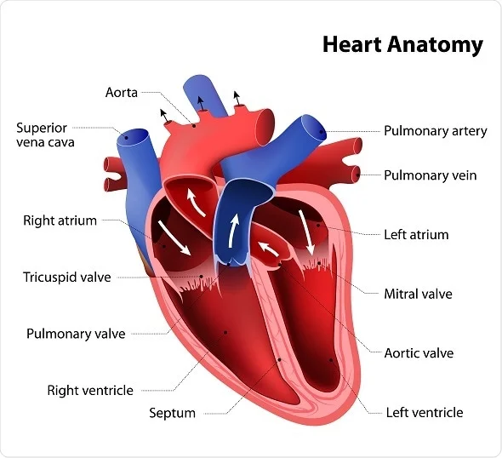

Slide 11
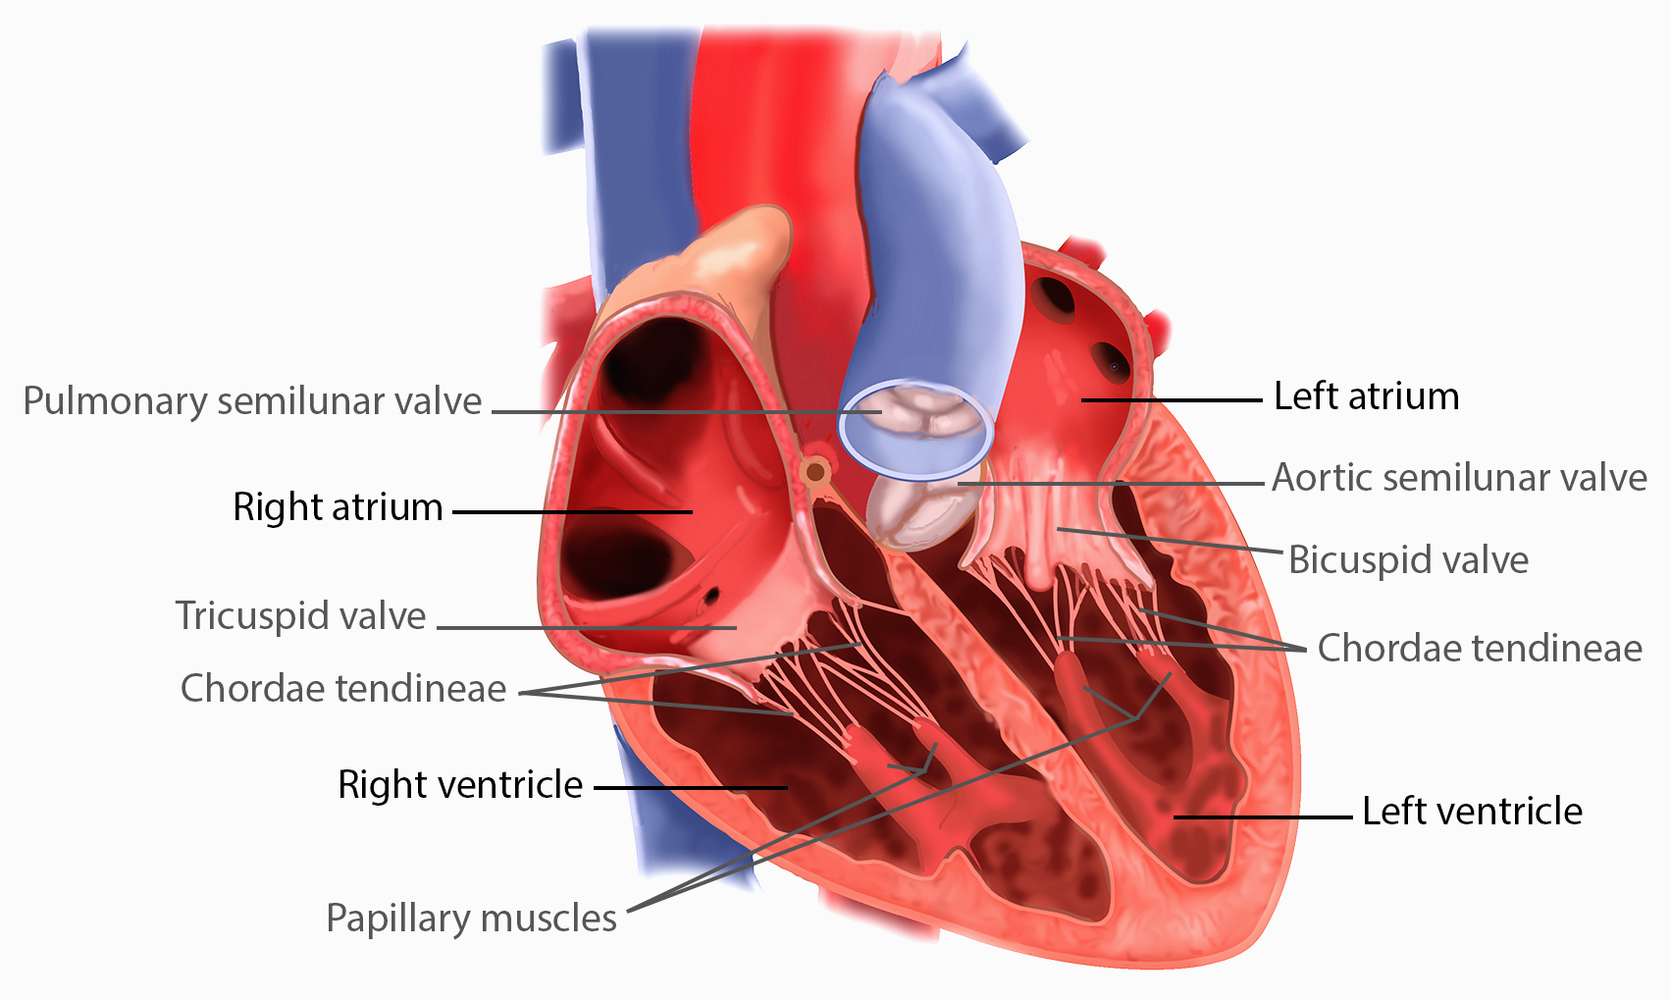

Slide 12
Left Atrium
Receives oxygenated blood from the lungs
Blood enters through four pulmonary veins
Has a smooth internal surface
Blood flows into the left ventricle via the bicuspid (mitral) valve

Slide 14
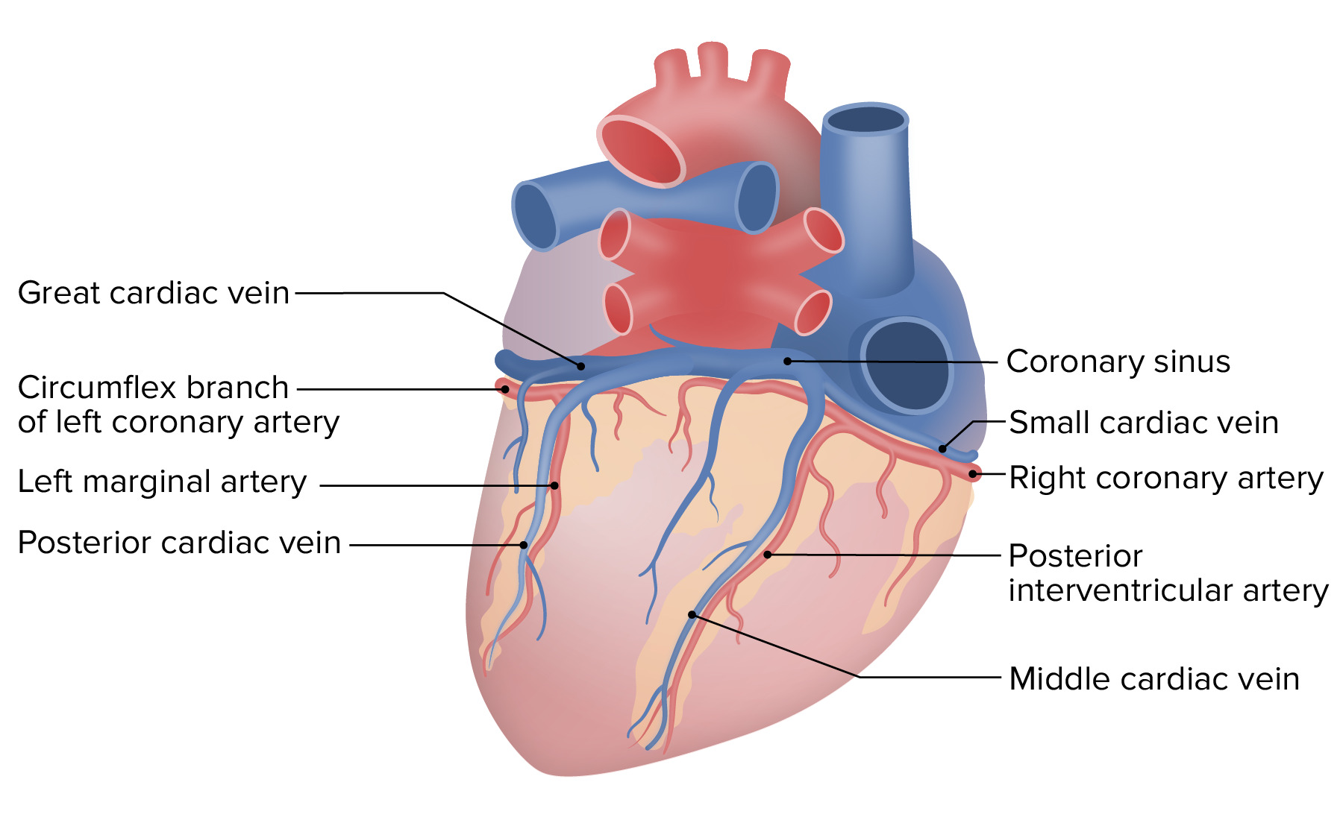

Slide 15
Left Ventricle
Pumps oxygenated blood to the entire body
Has the thickest muscular wall (needs high pressure)
Internal features:
  Trabeculae carneae
  Papillary muscles
Blood exits through the aortic valve into the aorta

Slide 17
Major Blood Vessels of the Heart
Aorta – carries oxygenated blood to the body
Pulmonary artery – carries deoxygenated blood to lungs
Pulmonary veins – bring oxygenated blood from lungs
Superior & Inferior vena cava – bring deoxygenated blood from body

Slide 19
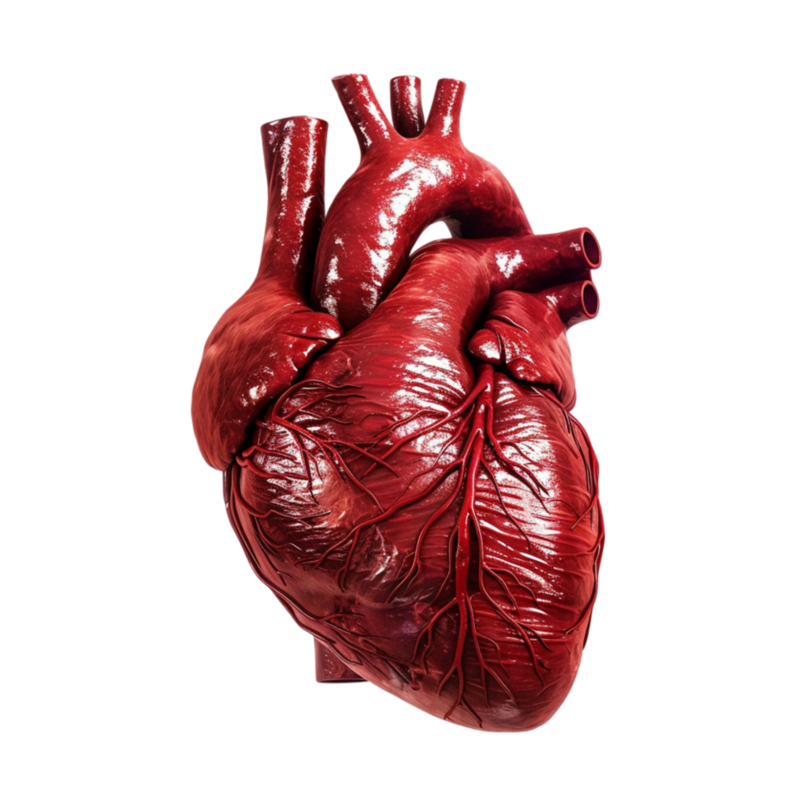

Slide 20
Valves of the Heart
Valves prevent backflow of blood
Two types:
  Atrioventricular (AV) valves
  Semilunar valves

Slide 22
Bicuspid (Mitral) Valve
Located between:
  Left atrium and left ventricle
Has two cusps (anterior & posterior)
Allows blood to flow only from atrium to ventricle
Supported by chordae tendineae and papillary muscles

Slide 24
Tricuspid Valve
Located between:
  Right atrium and right ventricle
Has three cusps (anterior, posterior, septal)
Prevents backflow into the right atrium during ventricular contraction

Slide 26
Pulmonary Semilunar Valve
Located at the opening of the pulmonary artery
Has three cusps
Prevents blood from flowing back into the right ventricle

Slide 28
Aortic Semilunar Valve
Located at the opening of the aorta
Has three cusps (right, left, posterior)
Prevents backflow of blood into the left ventricle

Slide 30
Blood Flow Summary
Body → Right Atrium → Right Ventricle → Lungs
Lungs → Left Atrium → Left Ventricle → Body
Ensures:
  Deoxygenated blood goes to lungs
  Oxygenated blood goes to body

Slide 31
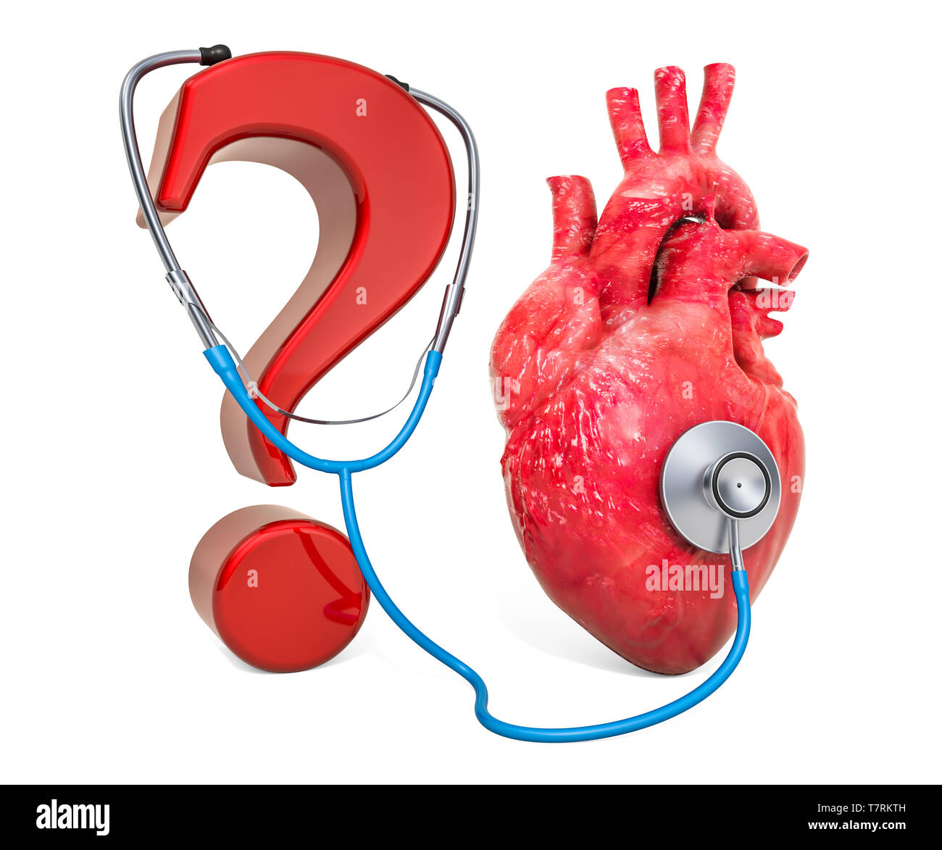

Slide 32
