Slide 1

ANATOMY
THE UPPER LIMB
DPT
1ST SEMESTER
DR DANISH

Slide 2
Ulna
General Overview:
The ulna is the medial bone of the forearm (little-finger side) in anatomical position
Longer than the radius
Plays a major role in elbow joint stability

Slide 3
CONTINUED
Participates in:
  Elbow joint (with humerus)
  Proximal and distal radioulnar joints (with radius)
Does not directly articulate with carpal bones
Provides attachment for multiple muscles of:
  Arm
  Forearm
Easily palpable along its posterior border

Slide 4
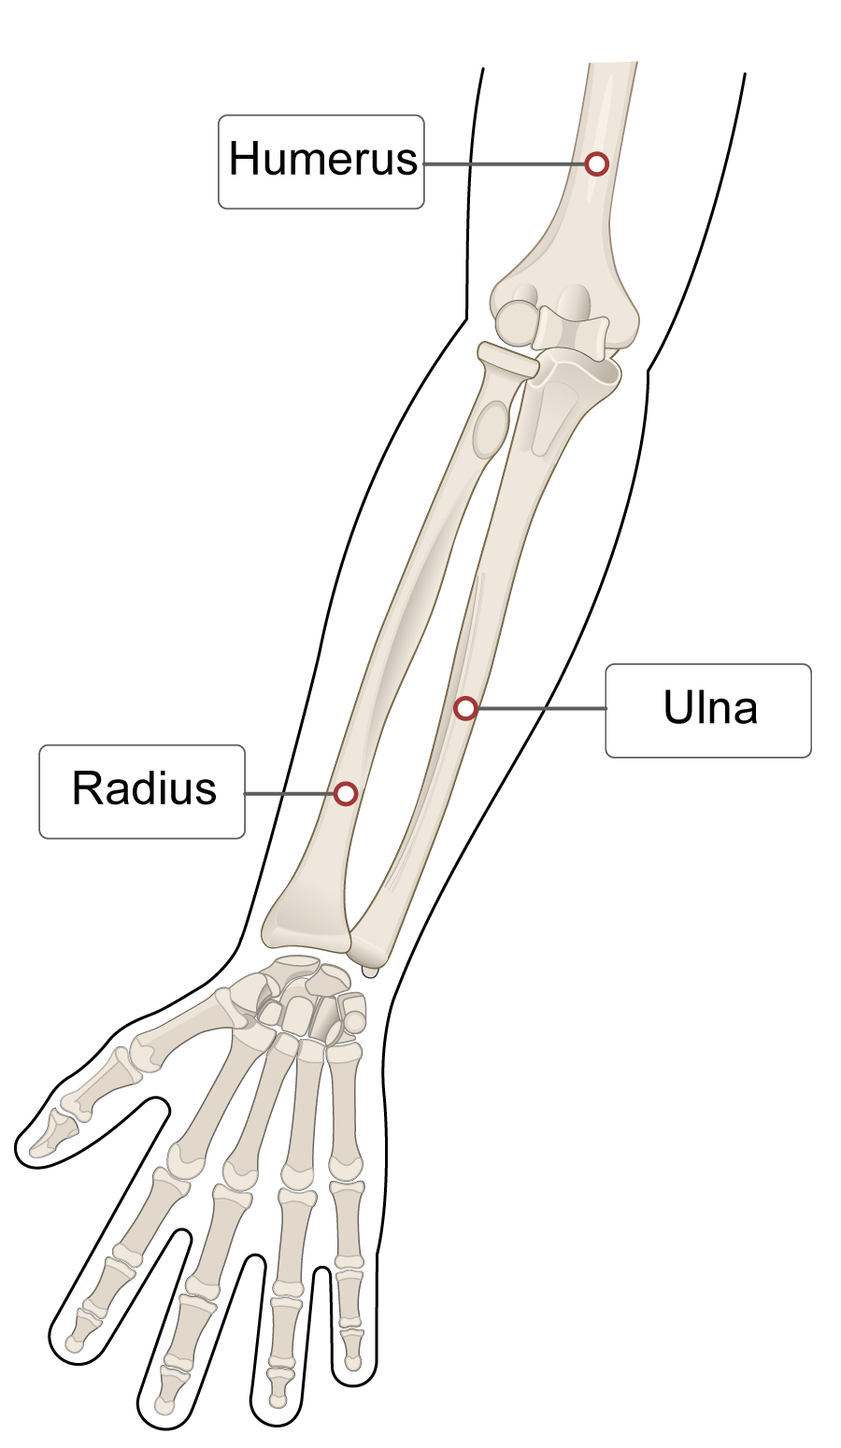

Slide 5
ANATOMICAL FEATURES
Proximal End of Ulna
Body (Shaft) of Ulna
Distal End of Ulna

Slide 6
Proximal End of Ulna
Olecranon
Greek word meaning “elbow”
Forms the point of the elbow
Easily palpable
Insertion site of triceps brachii muscle
Fits into the olecranon fossa of humerus during elbow extension

Slide 7
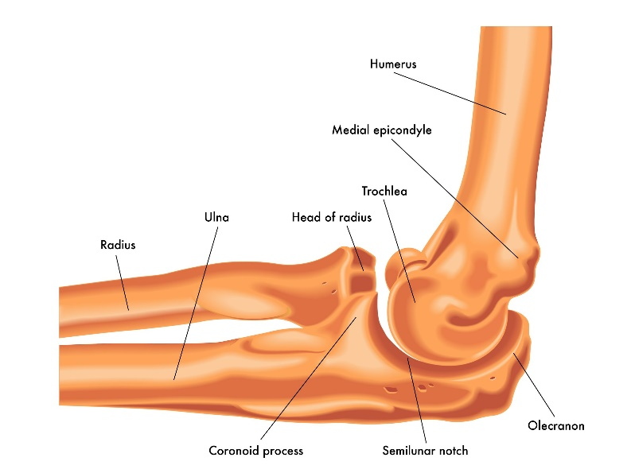

Slide 8
CONTINUED
Coronoid Process
Greek word meaning “resembling a crow”
Anterior projection of proximal ulna
Forms the lower part of the trochlear notch
Important for elbow joint stability

Slide 9
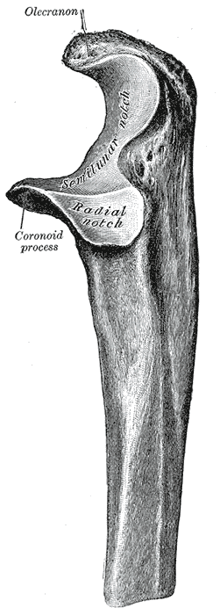

Slide 10
Trochlear Notch
Large, crescent-shaped notch
Located on anterior aspect of proximal ulna
Formed by:
  Olecranon
  Coronoid process
Articulates with the trochlea of the humerus

Slide 11
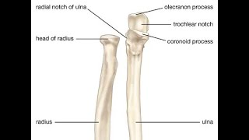

Slide 13
Radial Notch
Shallow, smooth notch
Located on lateral side of coronoid process
Articulates with the head of the radius

Slide 14
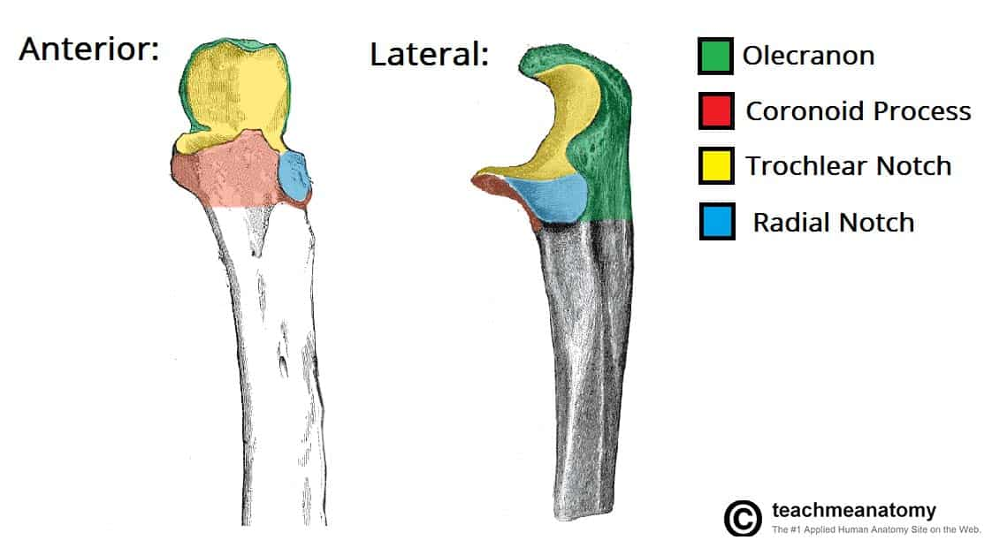

Slide 15
Ulnar Tuberosity
Roughened area distal to coronoid process
Insertion of brachialis muscle

Slide 16
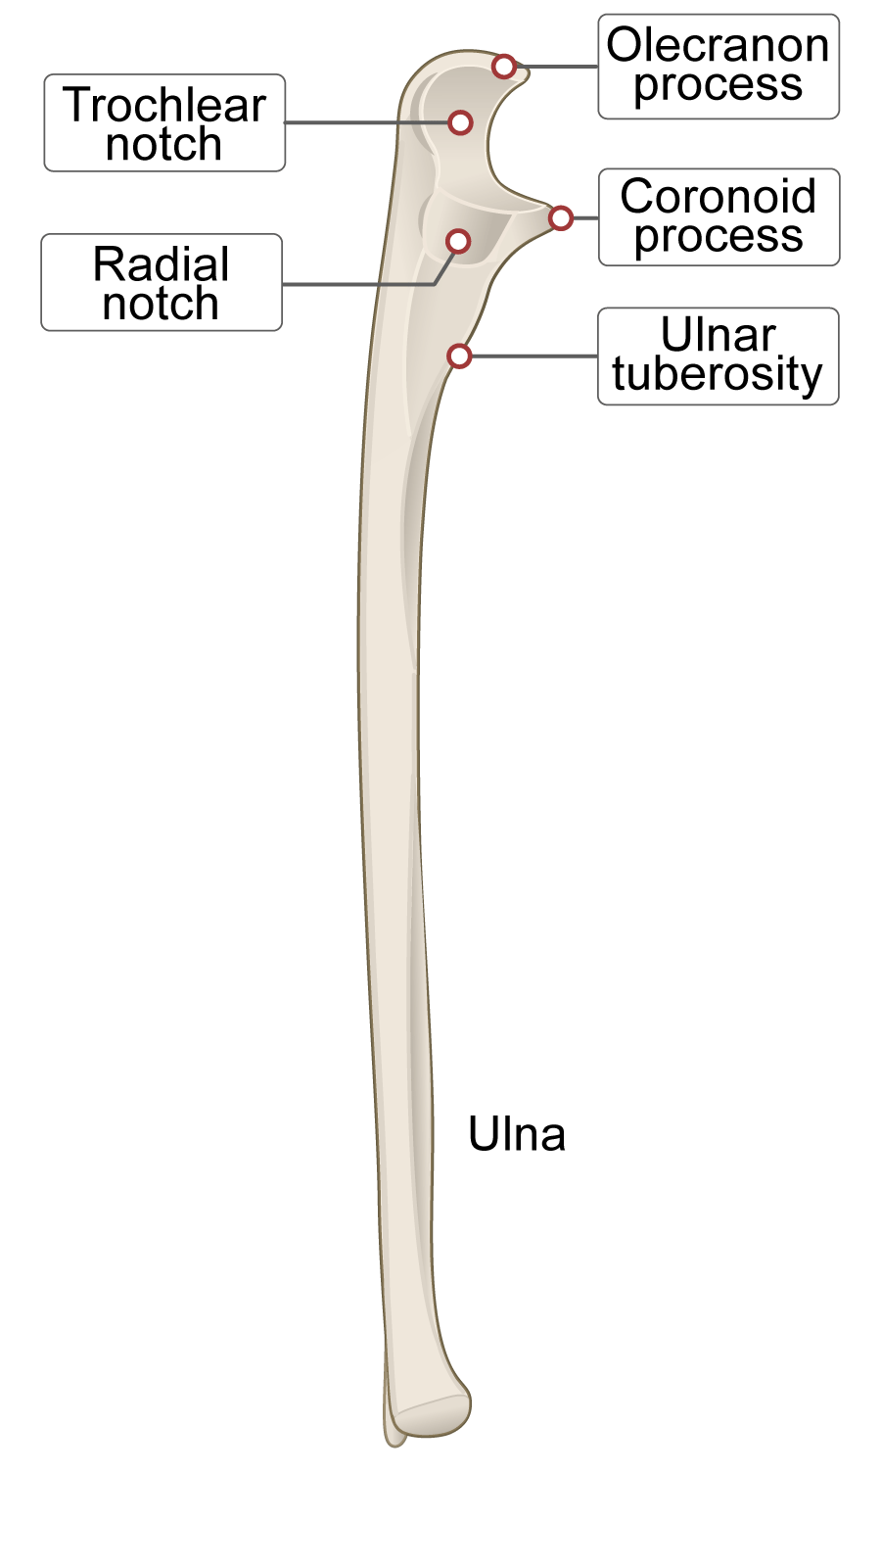

Slide 17
Body (Shaft) of Ulna
Elongated middle part of the bone
Tapers from proximal to distal end
Posterior border
  Rounded
  Subcutaneous
  Easily palpable along its length
Interosseous border
  Sharp lateral crest
  Attachment for interosseous membrane

Slide 18
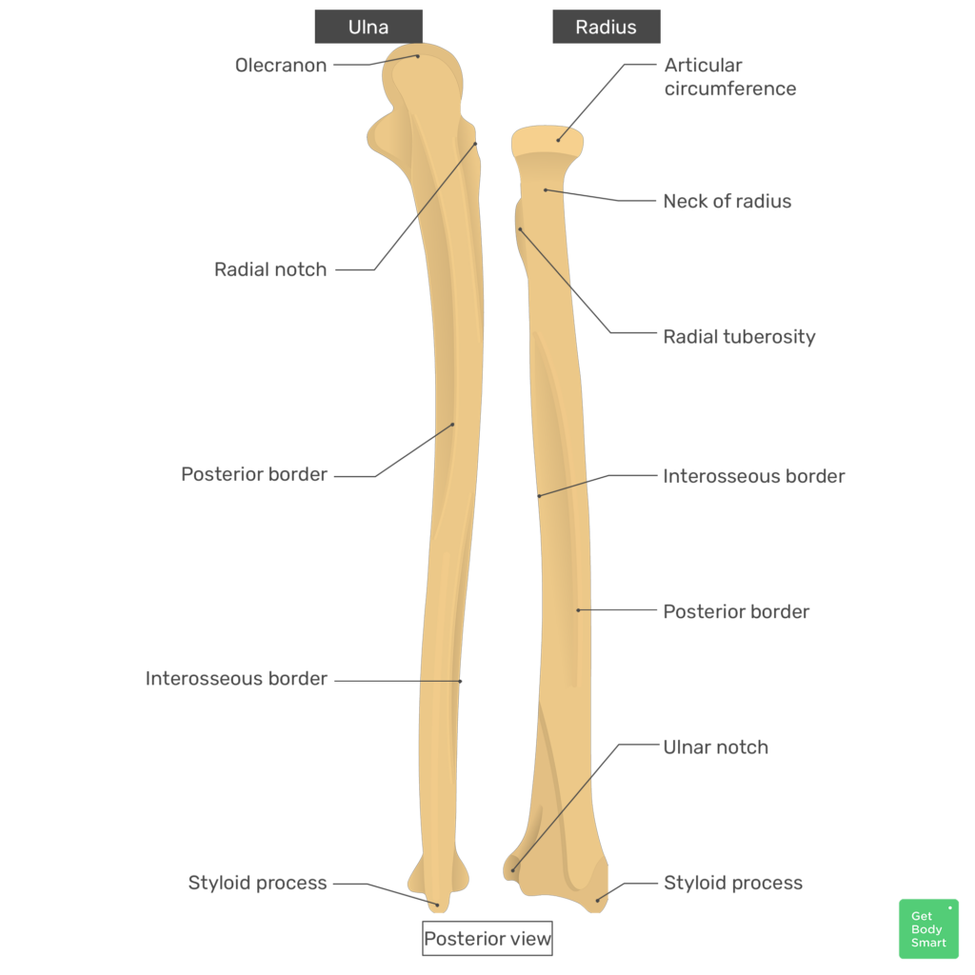

Slide 19
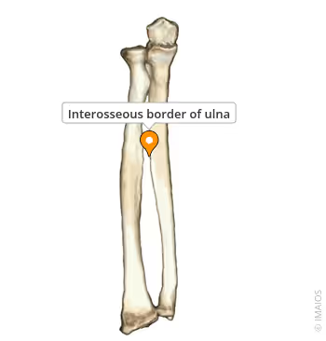

Slide 20
Distal End of Ulna
Head of Ulna
Small, rounded distal end
Articulates with ulnar notch of radius
Separated from wrist joint by an articular disc

Slide 21
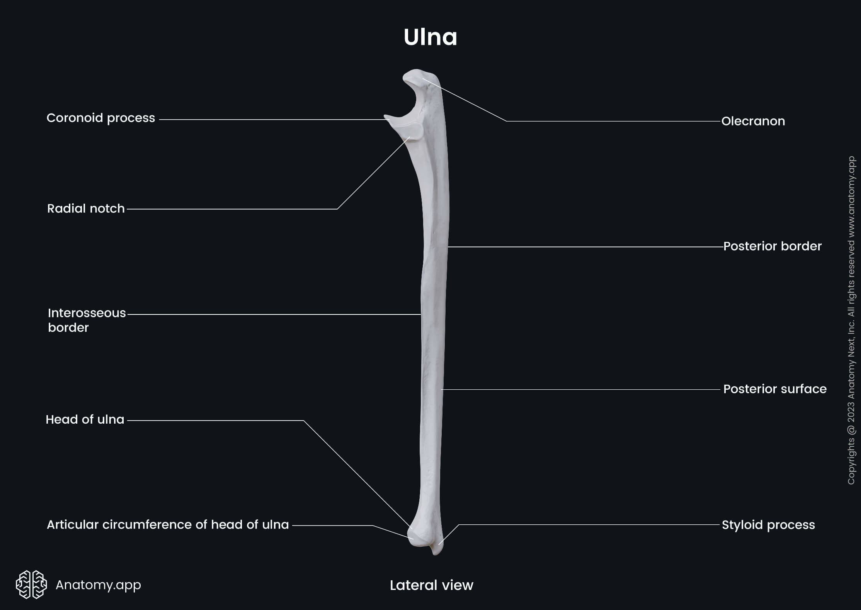

Slide 22
CONTINUED
Styloid Process
Small projection
Located on posteromedial side
Important ligament attachment

Slide 24


Slide 25


