Slide 1

HUMAN ANATOMY
BS RIT,OTT,MLT
1ST SEMESTER
DR DANISH

Slide 2
NEURONS (NERVE CELLS)
Neurons are structural and functional units of the nervous system
They are specialized for:
  Receiving stimuli
  Conducting nerve impulses
  Transmitting information
Example:
When you touch a hot object, neurons carry the pain signal to the brain.

Slide 3
Structure of a Neuron
A neuron has three main parts:
1. Cell Body (Soma / Perikaryon)
Contains:
  Nucleus
  Cytoplasm
  Nissl bodies (protein synthesis)
Responsible for metabolic activities
Example:
Like the control center of a mobile phone.

Slide 4
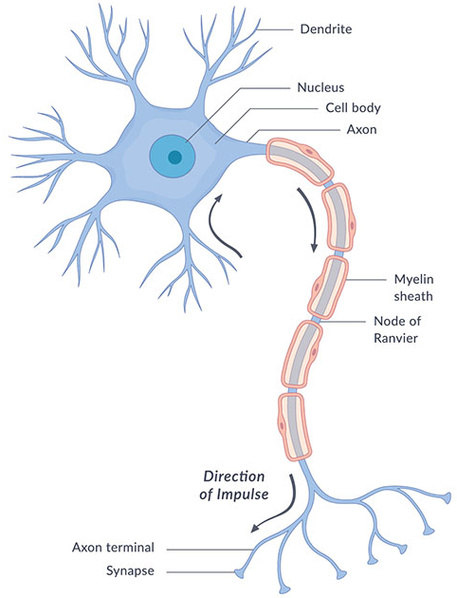

Slide 5
Continued
2. Dendrites
Short, branched processes
Carry impulses towards the cell body
Example:
Act like antennae receiving signals from other neurons.

Slide 7
Continued
3. Axon
Long, single process
Conducts impulses away from the cell body
May be:
  Myelinated
  Non-myelinated
Example:
Similar to an electric wire carrying current.

Slide 9
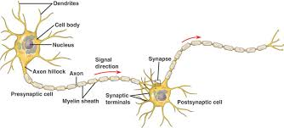

Slide 10
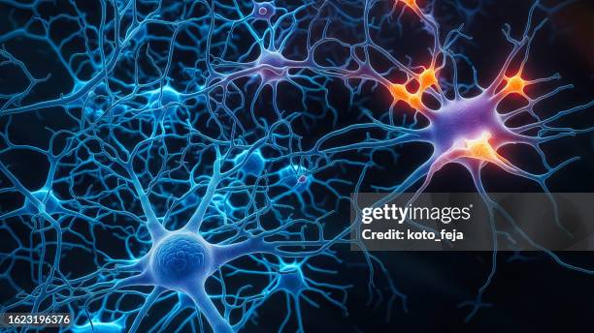

Slide 11
Types of Neurons (Structural Classification)
1. Unipolar Neurons
Single process
Rare in humans (mainly in embryos)

Slide 12
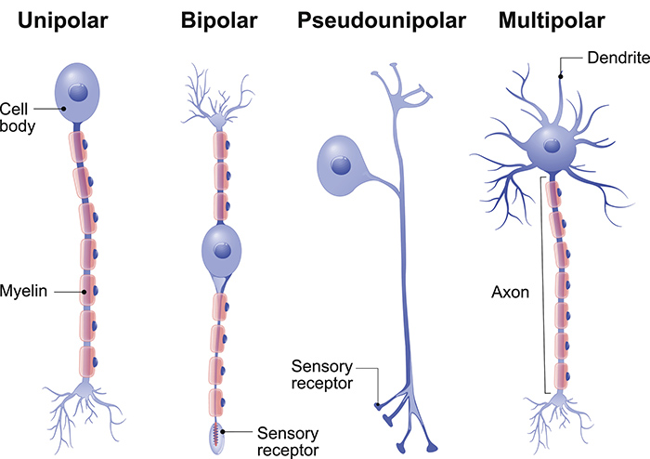

Slide 13
Continued
2. Bipolar Neurons
One axon and one dendrite
Found in:
  Retina of eye
  Olfactory epithelium
Example:
Used in special senses like vision and smell.

Slide 15
Continued
3. Multipolar Neurons
One axon and many dendrites
Most common type
Found in:
  Brain
  Spinal cord
Example:
Motor neurons controlling muscles.

Slide 17
Types of Neurons (Functional Classification)
1. Sensory (Afferent) Neurons
Carry impulses from receptors to CNS
Example:
Pain sensation from skin to brain.

Slide 18
Continued
2. Motor (Efferent) Neurons
Carry impulses from CNS to muscles/glands
Example:
Brain sending signal to move your hand.

Slide 19
Continued
3. Interneurons (Association Neurons)
Connect sensory and motor neurons
Found only in CNS
Example:
Decision-making neurons in brain.

Slide 20
GREY MATTER
Definition
Grey matter is nervous tissue consisting mainly of:
  Neuron cell bodies
  Dendrites
  Non-myelinated axons
  Neuroglia

Slide 21
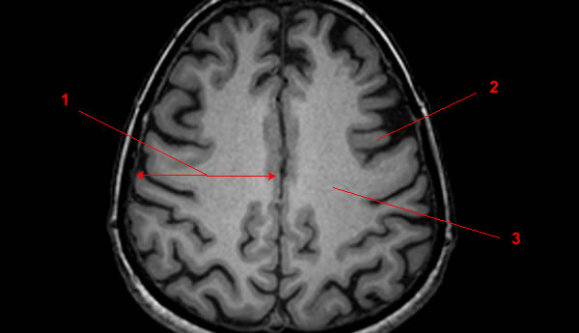

Slide 22
Location of Grey Matter
In Brain
Forms:
  Cerebral cortex
  Cerebellar cortex
Also present as deep nuclei
Example:
Outer layer of brain (cortex) is grey matter.

Slide 23
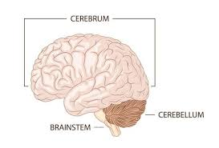

Slide 24
Continued
In Spinal Cord
Located centrally
H-shaped or butterfly-shaped

Slide 25
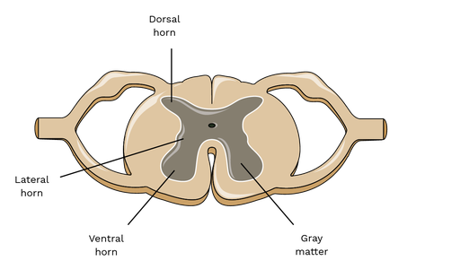

Slide 26
Function of Grey Matter
Responsible for:
  Processing information
  Thinking
  Memory
  Decision making
Example:
Solving a math problem uses grey matter.

Slide 27
Why Grey in Color?
Due to:
  Absence of myelin
  Presence of neuron cell bodies

Slide 28
WHITE MATTER
Definition
White matter consists mainly of:
  Myelinated axons
  Very few neuron cell bodies

Slide 29
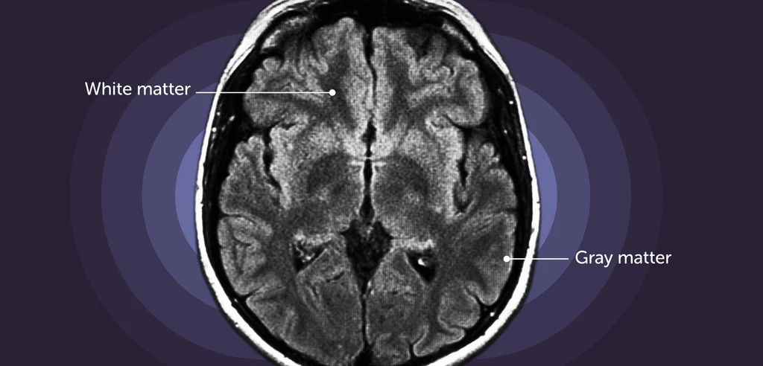

Slide 30
Location of White Matter
In Brain
Located deep to grey matter
Forms:
  Tracts
  Pathways
In Spinal Cord
Located peripherally
Surrounds grey matter

Slide 31
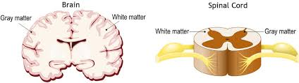

Slide 32
Function of White Matter
Responsible for:
  Transmission of impulses
  Communication between different brain regions
Example:
Sending message from brain to foot muscles.

Slide 33
Why White in Color?
Due to:
  Myelin sheath (rich in fat)

Slide 34
DIFFERENCES BETWEEN GREY & WHITE MATTER
Grey Matter | White Matter
Cell bodies present | Myelinated axons present
Grey in color | White due to myelin
Processing center | Conduction pathways
Cortex of brain | Inner part of brain

Slide 35
Clinical Note
Damage to grey matter → loss of thinking or memory
Damage to white matter → loss of coordination or signal transmission
Example:
Multiple sclerosis affects white matter due to myelin damage.

Slide 36
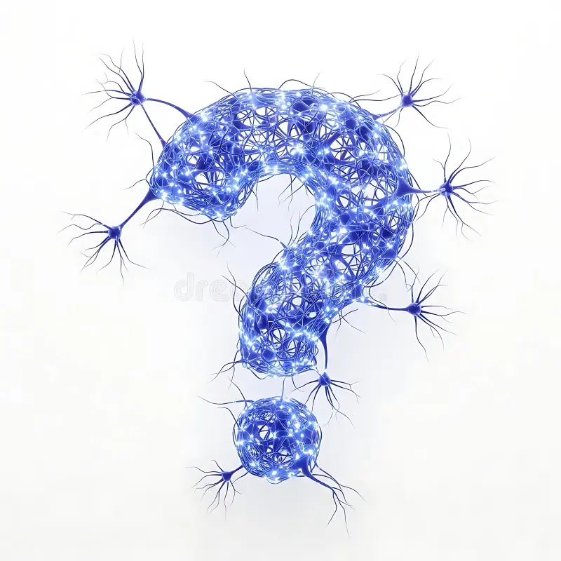

Slide 37


