Slide 1

Phrases
Functional English | BS & DPT
Hafsa Rasheed

Slide 2
What Is a Phrase?
A phrase is a group of related words that:
has meaning
works as one unit
does NOT contain a subject and a finite verb
Therefore: A phrase ≠ a sentence

Slide 3
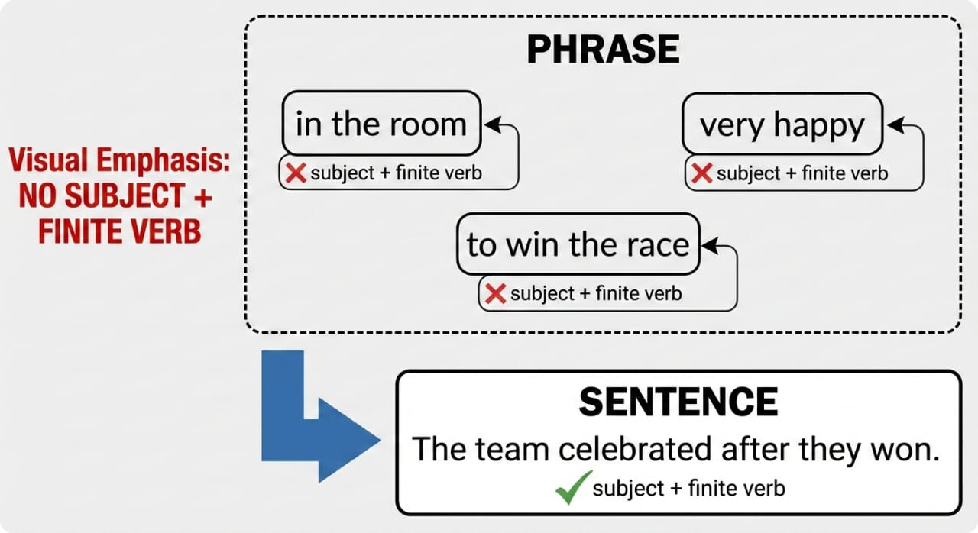
Etymology of ‘Phrase’
Greek: phrasis → expression / way of speaking
Latin: phrasis
Old French → English
📌 Meaning evolution:
Phrase = a meaningful expression

Slide 4
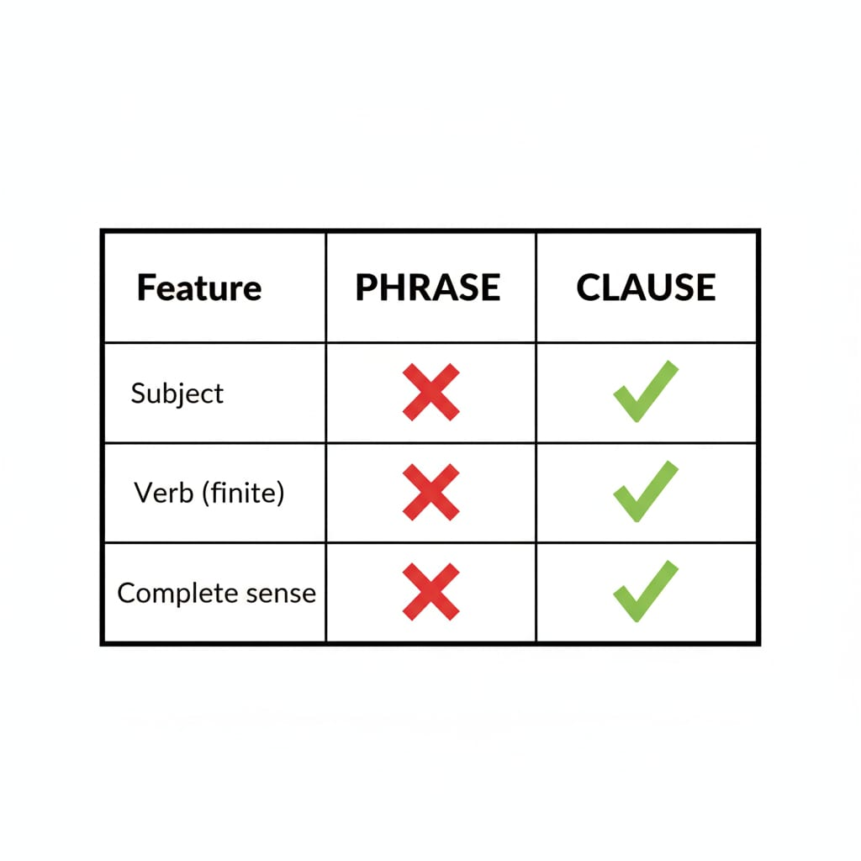
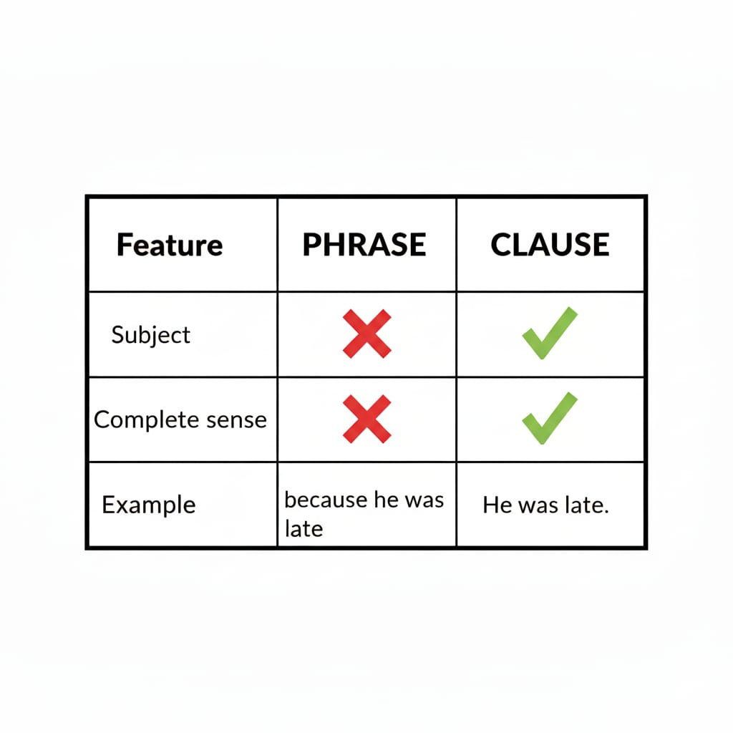
Phrase vs Clause

Slide 5
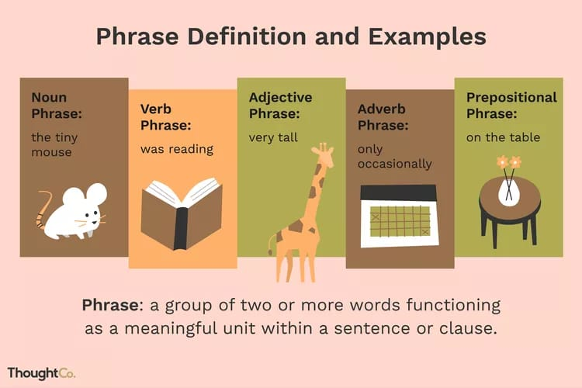
Basic Types of Phrases

Slide 6
Noun Phrase
Definition: A phrase that functions as a noun.
Structure: (Determiner) + (Adjective) + Noun
Examples:
a boy
the tall building
my best friend
Sentence: The tall building collapsed.

Slide 7
Verb Phrase
Definition: Main verb + auxiliary/helping verbs
Examples:
is going
has been reading
will have completed
Sentence: She has been studying hard.

Slide 8
Adjective Phrase
Definition: Describes a noun.
Structure: (Adverb) + Adjective
Examples:
very happy
extremely difficult
Sentence: She is very intelligent.

Slide 9
Adverb Phrase
Definition: Modifies a verb, adjective, or adverb.
Examples:
very quickly
quite silently
Sentence: He spoke very softly.

Slide 10
Prepositional Phrase
Structure: Preposition + Object
Examples:
in the room
on the table
according to rules
Sentence: The keys are on the table.

Slide 11
Infinitive Phrases
Definition: Starts with to + base verb
Examples:
to become a doctor
to win the race
Sentence: He wants to become a pilot.

Slide 12
Gerund Phrase
Definition: Verb + ing working as a noun, with its modifiers.
Examples:
reading books
playing cricket
Sentence: Reading books improves knowledge.

Slide 13
Uses of Gerund Phrases
As SUBJECT
Swimming daily keeps you fit.
2. As OBJECT of a verb
(verbs: enjoy, avoid, suggest, finish, deny)
He enjoys playing cricket.
3. As OBJECT of a preposition
Rule: preposition → verb + ing
He is fond of reading poetry.

Slide 14
Participle Phrase
Definition: Phrase beginning with:
present participle (-ing)
past participle (V3)
Works as an adjective.
Examples: Running fast, he won the race.
Exhausted by work, she slept early.
Describes the nearest noun

Slide 15
Absolute Phrase
Definition:
Noun + participle
No finite verb
Grammatically independent
Examples:
The weather being fine, we went out.
He sat quietly, his eyes fixed on the door.

Slide 16
Uses of Absolute Phrases
Showing cause: The match having ended, the crowd left.
Showing time: Dinner finished, they went home.
Adding background detail: She stood silent, her face pale.
Formal & literary writing

Slide 17


