Slide 1

Measurements of Attitude
BS-MLT
1ST SEMESTER
Ms. Shehwar Saeed

Slide 2
Measurement of Attitudes
Attitudes are typically measured through:
Self-Report Scales
These are questionnaires that ask people to report their feelings and beliefs about various attitude objects
Likert scales ask respondents to rate their agreement with various statements
e.g., “I enjoy exercising: strongly agree, agree, neutral, disagree, strongly disagree”

Slide 3
Measurement of Attitudes
Implicit Association Test (IAT)
An assessment intended to detect subconscious associations between mental representations of objects (concepts) in memory.
This test measures implicit attitudes by analyzing the speed with which individuals associate certain objects or ideas with positive or negative concepts.
based on the idea that people can hold unconscious attitudes that may not align with their explicit beliefs.

Slide 4
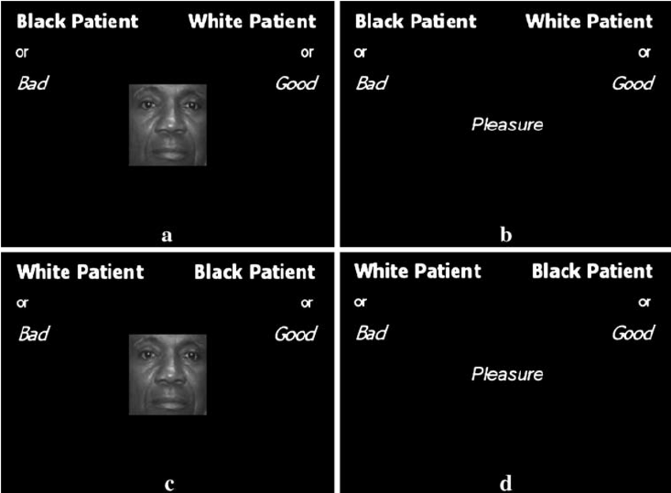
Implicit Association Test (IAT)

Slide 5
Cont…
Behavioral Observations
Behavioral Observations: Sometimes, researchers measure attitudes indirectly by observing people’s behavior

Slide 6
Conclusion
The nature and structure of attitudes in social psychology provide crucial insights into how people think, feel, and act in social situations.
Understanding the components of attitudes, how they are formed, and how they can change is key for predicting behaviors and influencing social change

Slide 7

Any Question?

Slide 8


