Slide 1

ANATOMY
THE UPPER LIMB
DPT
1ST SEMESTER
DR DANISH

Slide 2
Radius
General Features:
The radius is the lateral bone of the forearm (anatomical position).
Extends from the elbow joint proximally to the wrist joint distally.
Plays a major role in pronation and supination by rotating around the ulna.

Slide 3
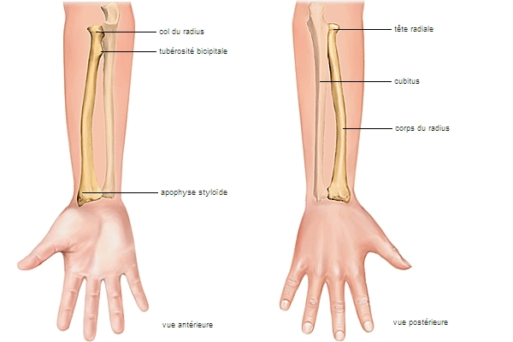

Slide 4
Continued
Proximally articulates with:
  Capitulum of humerus
  Radial notch of ulna
Distally articulates with:
  Scaphoid and lunate bones
  Head of ulna at the distal radioulnar joint

Slide 5
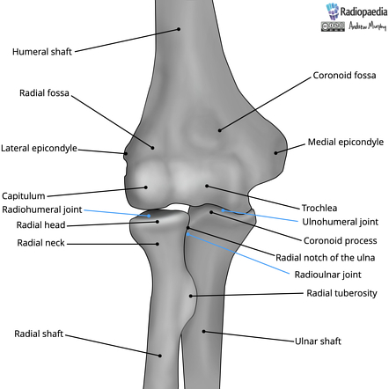
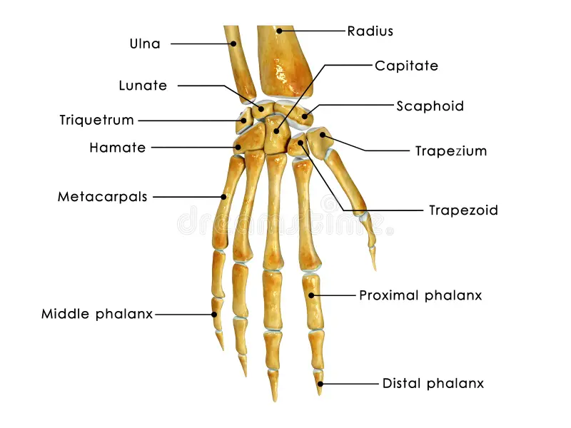

Slide 6
Parts of the Radius
A. Head of Radius
Disc-shaped, expanded proximal end.
Superior surface:
  Shallow concavity for articulation with the capitulum of humerus.
Peripheral surface:
  Articulates with the radial notch of ulna.
Stabilized by the annular ligament.

Slide 7
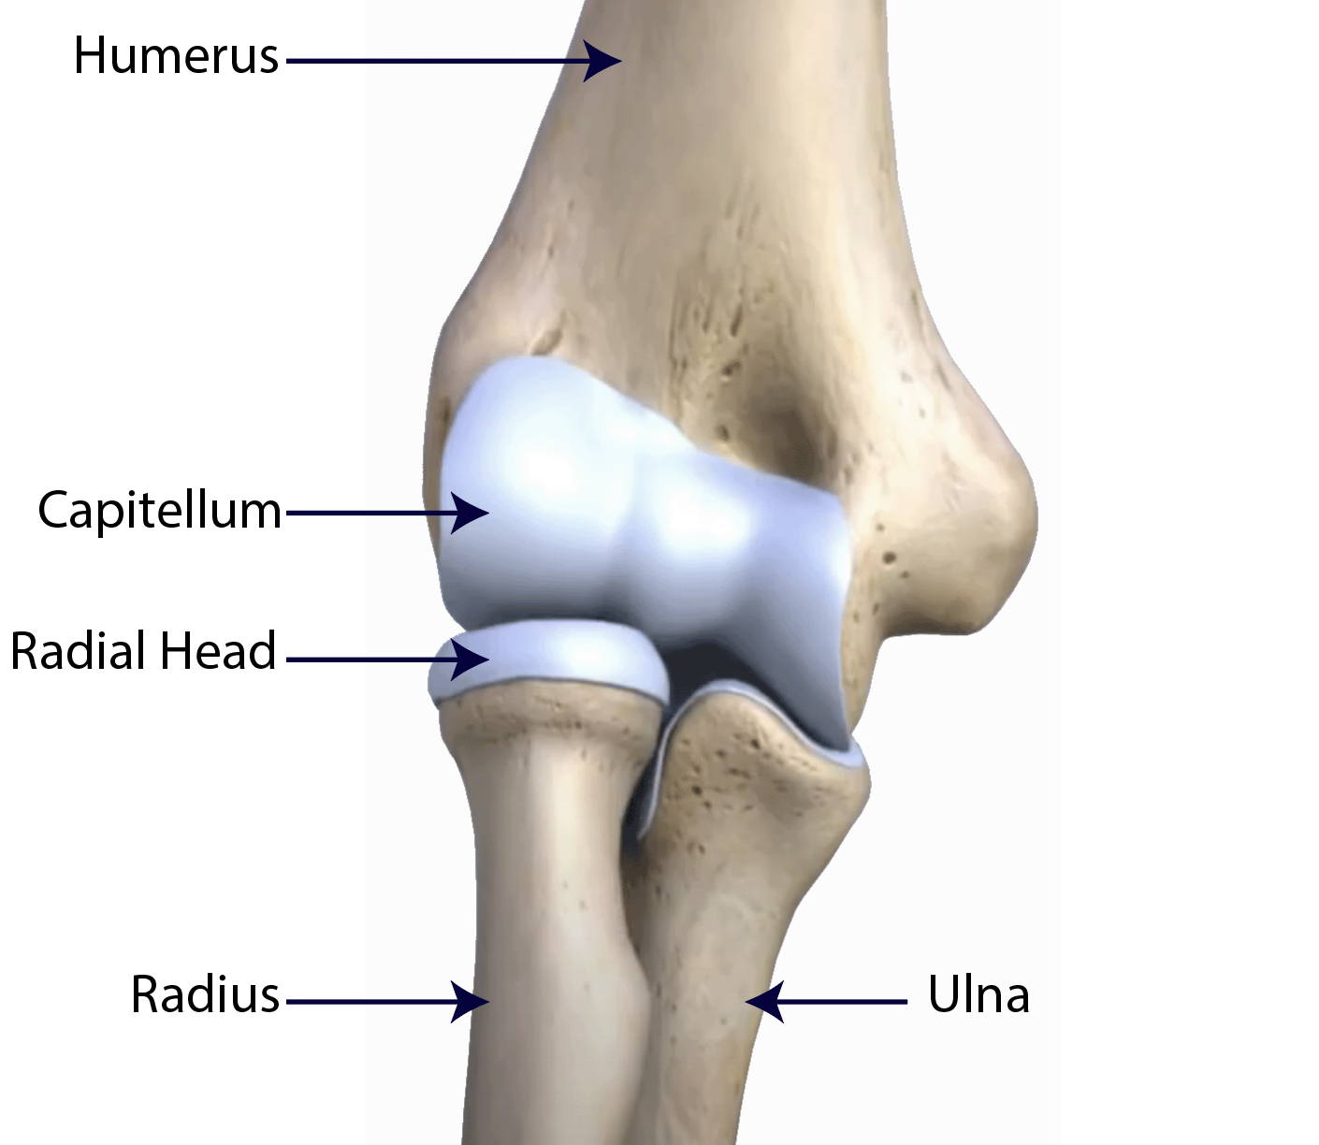

Slide 8
Continued
B. Neck of Radius
Narrow constricted region immediately distal to the head.
Common site of fractures, especially in children.

Slide 9
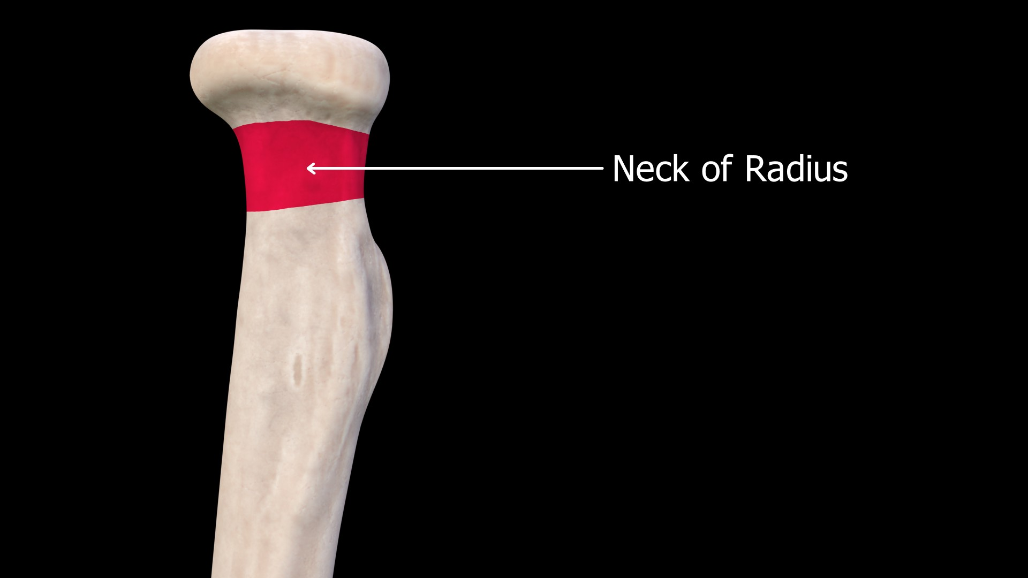

Slide 10
Continued
C. Radial Tuberosity
Roughened prominence on the anteromedial aspect, distal to the neck.
Insertion site of biceps brachii muscle.
Important for powerful forearm flexion and supination.

Slide 11
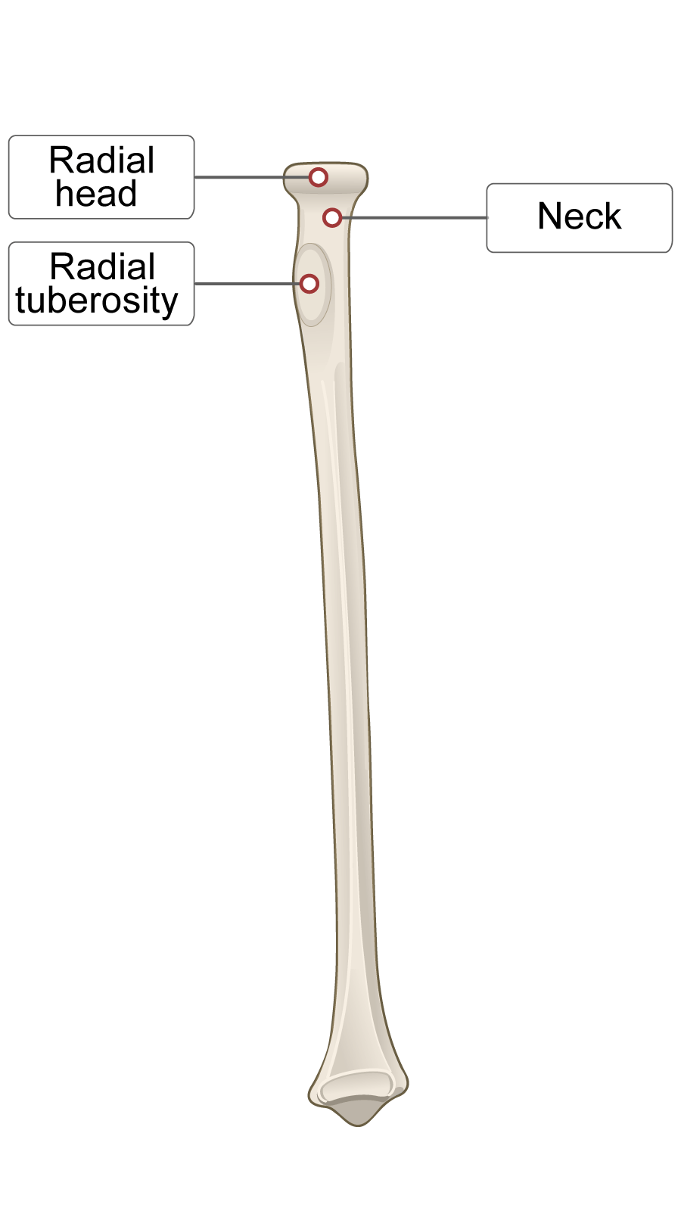

Slide 12
Continued
D. Shaft (Body) of Radius
Elongated midportion of the bone.
Interosseous border (medial border):
  Sharp crest for attachment of the interosseous membrane.
Provides attachment for several muscles:
  Pronator teres
  Flexor digitorum superficialis
  Flexor pollicis longus
  Supinator

Slide 13
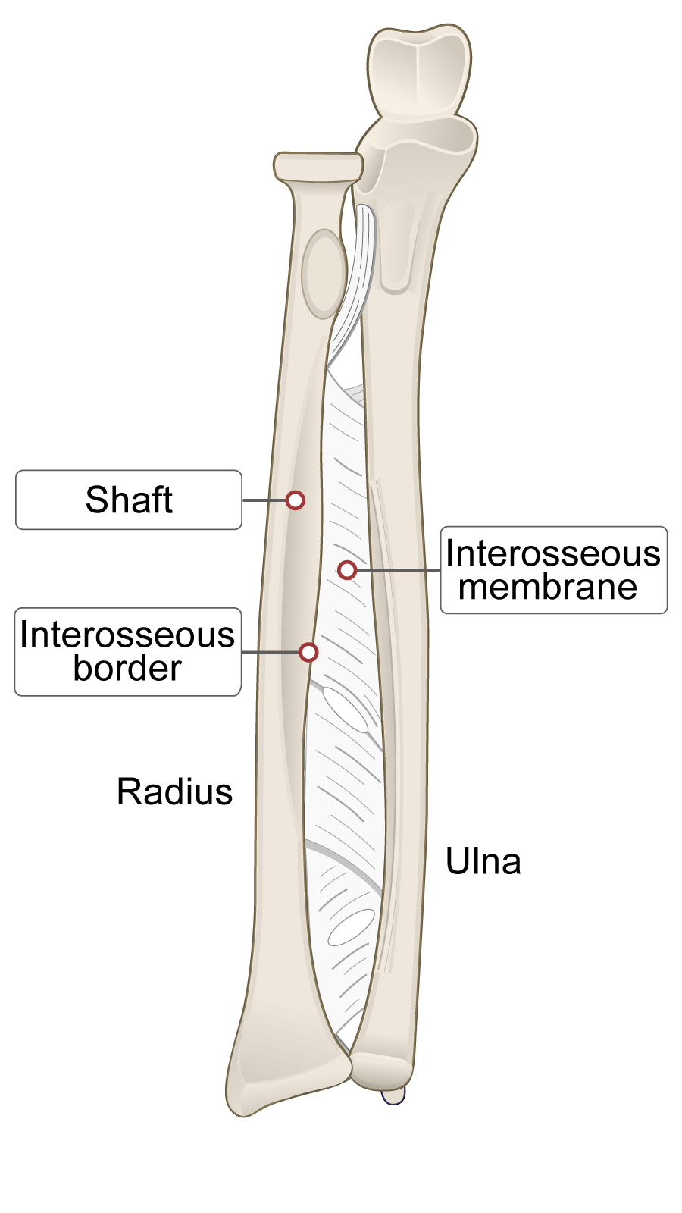

Slide 14
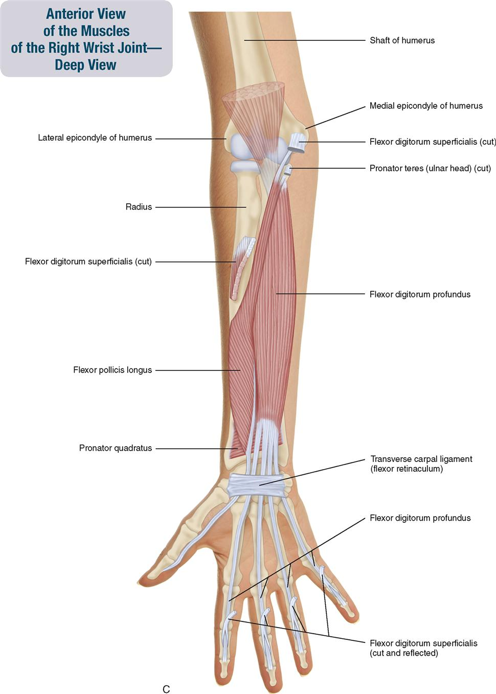

Slide 15
Continued
E. Distal End of Radius
Broad and expanded.
Carpal articular surface:
  Lateral facet → scaphoid
  Medial facet → lunate

Slide 16
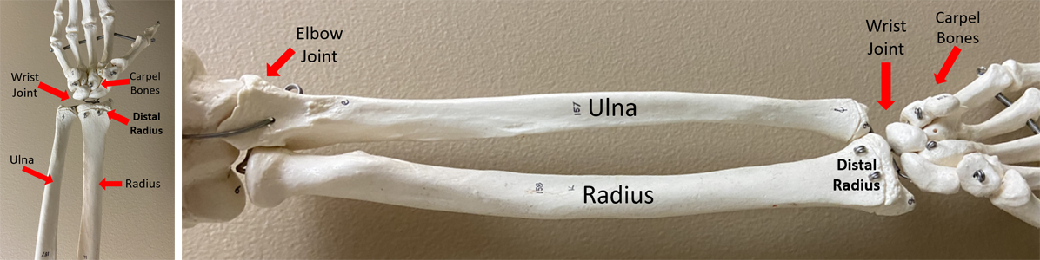

Slide 17
Continued
Ulnar notch:
  Articulates with the head of the ulna.
Styloid process:
  Lateral projection
  Attachment for ligaments of the wrist.
Dorsal tubercle (Lister’s tubercle):
  Acts as a pulley for extensor pollicis longus tendon.

Slide 18
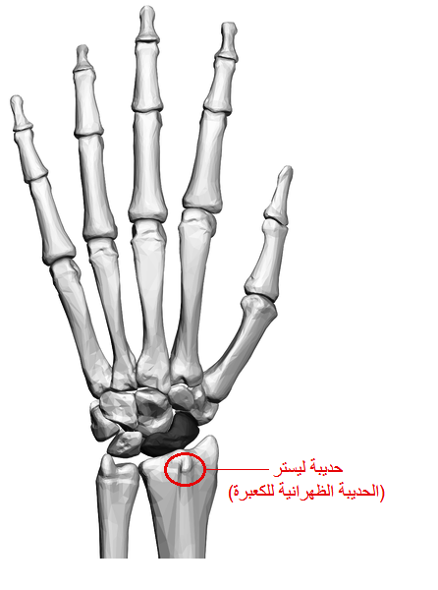

Slide 19


Slide 20


