Slide 1

BASIC MEDICAL SCIENCE
FSC MEDICAL TECHNOLOGIES I
DR DANISH

Slide 2
CIRCULATORY SYSTEM
Cardiovascular System
Also called blood-vascular system
Consists of:
  Heart – muscular pumping organ
  Blood vessels:
    Arteries
    Veins
    Capillaries

Slide 3
STRUCTURE OF THE HEART
External Features of the Heart:
Lies obliquely in the middle mediastinum
Located mostly posterior to the sternum
Externally described by:
  Borders
  Surfaces

Slide 4
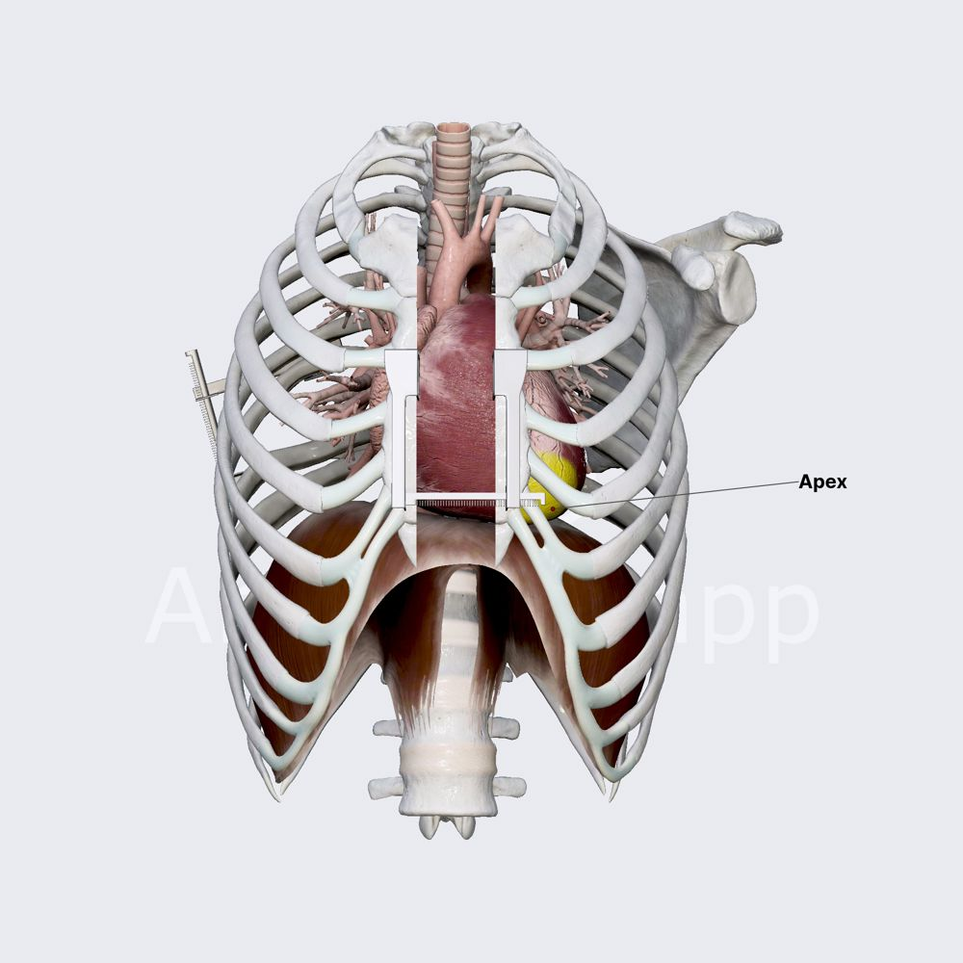

Slide 5
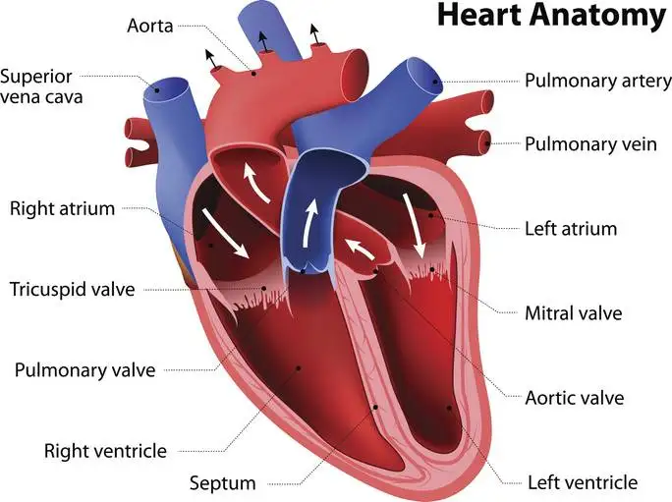

Slide 6
BORDERS OF THE HEART
Right border: Formed by right atrium
Left border: Mainly formed by left ventricle

Slide 7
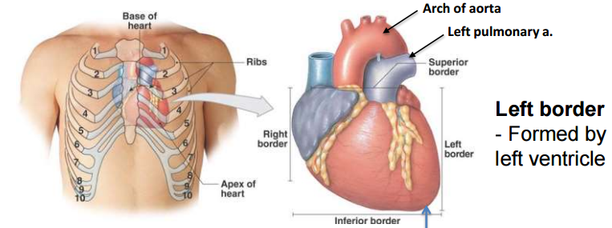

Slide 9
Continued
Apex:
  Tip of the left ventricle
  Located in left 5th intercostal space
Superior border:
  Formed by right & left auricles
  Plus conus arteriosus of right ventricle
Inferior border:
  Lies on the diaphragm
  Mostly formed by right ventricle

Slide 10


Slide 12
SURFACES OF THE HEART
Anterior (sternocostal) surface:
  Mainly formed by right ventricle
Posterior surface:
  Mainly formed by left atrium
Diaphragmatic surface:
  Mainly formed by left ventricle

Slide 14
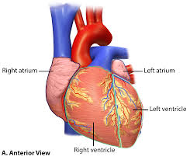

Slide 15
SULCI OF THE HEART
There are three main sulci:
  Coronary sulcus
  Anterior interventricular sulcus
  Posterior interventricular sulcus
Functions:
  Contain major vessels
  Contain epicardial fat

Slide 16
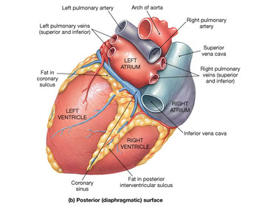

Slide 17
AUSCULTATION AREAS OF THE HEART
Aortic area: Right 2nd intercostal space
Pulmonic area: Left 2nd intercostal space
Erb’s area: Left 3rd intercostal space
Tricuspid area: Left 4th or 5th intercostal space
Mitral area (apex): Left 5th intercostal space

Slide 18
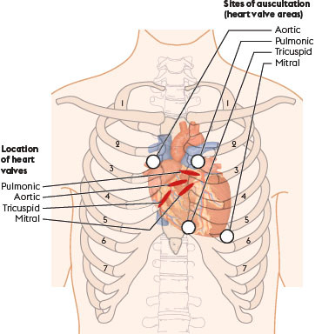

Slide 20
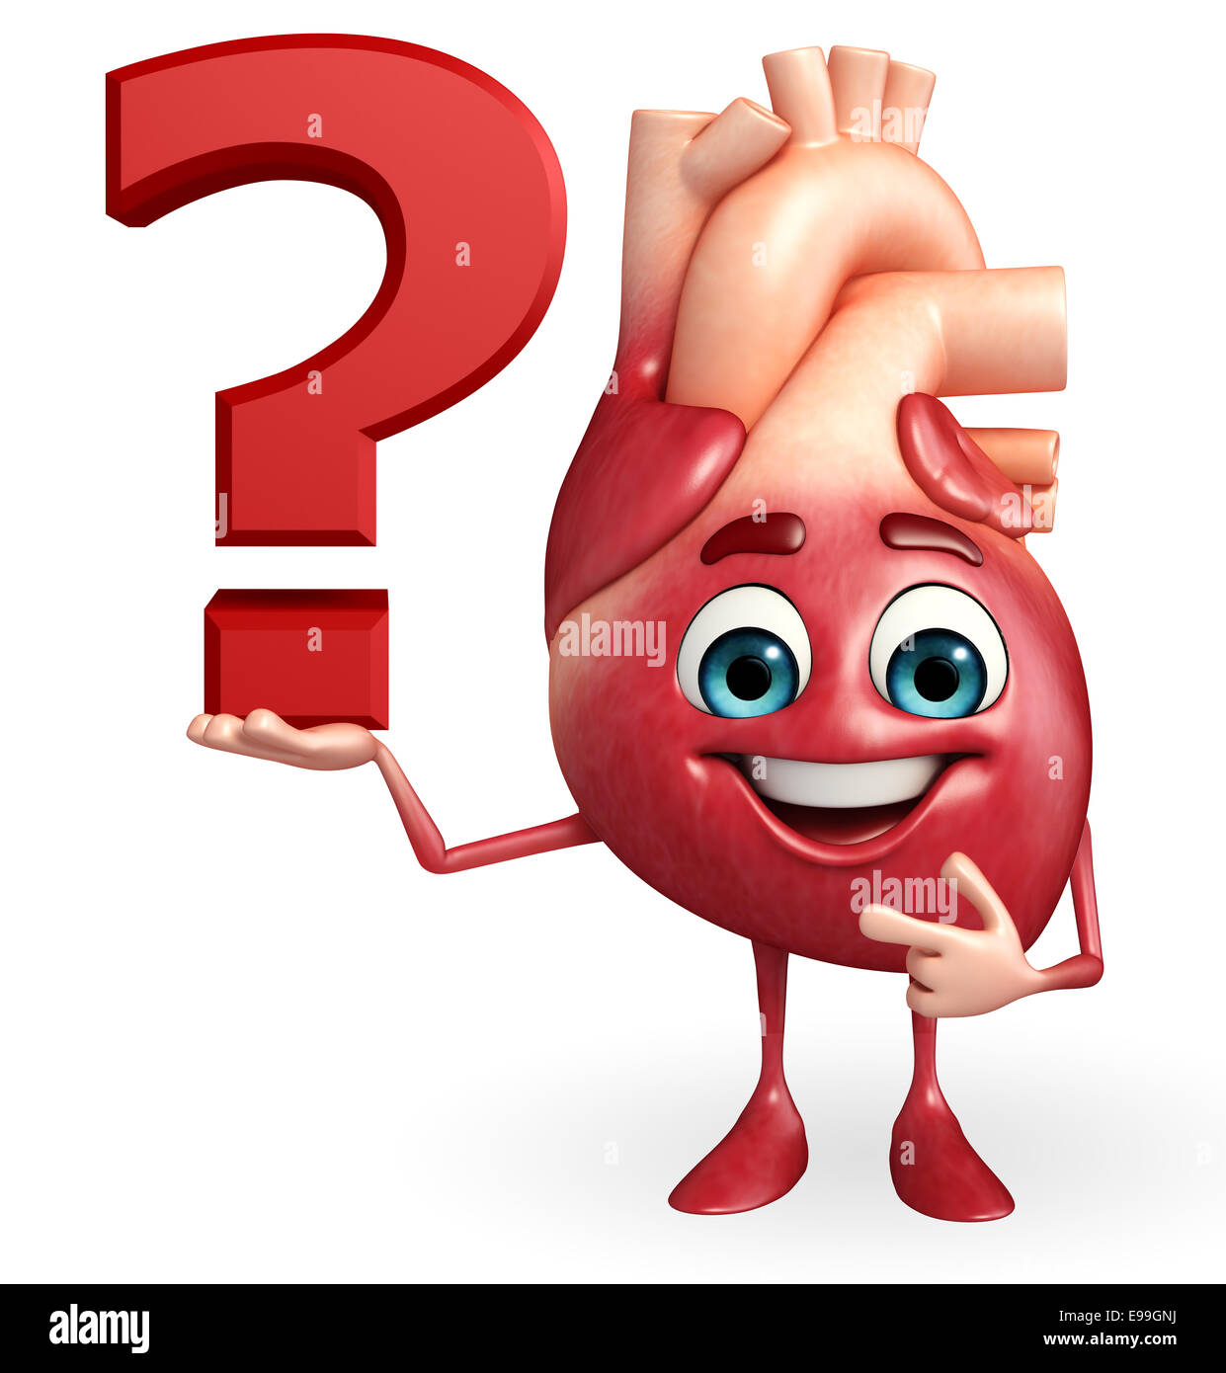

Slide 21


