Slide 1

BASIC MEDICAL SCIENCE
FSC MEDICAL TECHNOLOGIES I
DR DANISH

Slide 2
Ureters
Structure:
The ureters are muscular tubes that originate from the renal pelvis of each kidney.
They extend downward through the abdomen and pelvis.
Connect the kidneys to the urinary bladder.

Slide 3
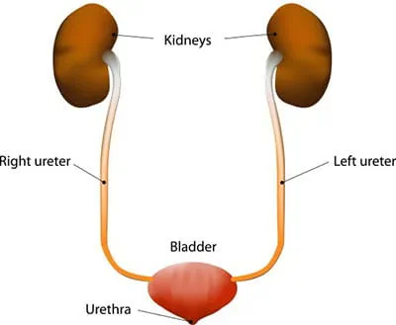

Slide 4
Structure of Ureter Walls
The walls of the ureters consist of three layers.
Each ureter is approximately 25–30 centimeters in length and 3–4 millimeters in diameter.

Slide 5
Continued
Mucosa: innermost layer lined with transitional epithelium.
Muscularis: middle layer of smooth muscle fibers that undergo peristaltic contractions to push urine toward the bladder.
Adventitia: outer connective tissue layer that anchors the ureters in place.

Slide 6
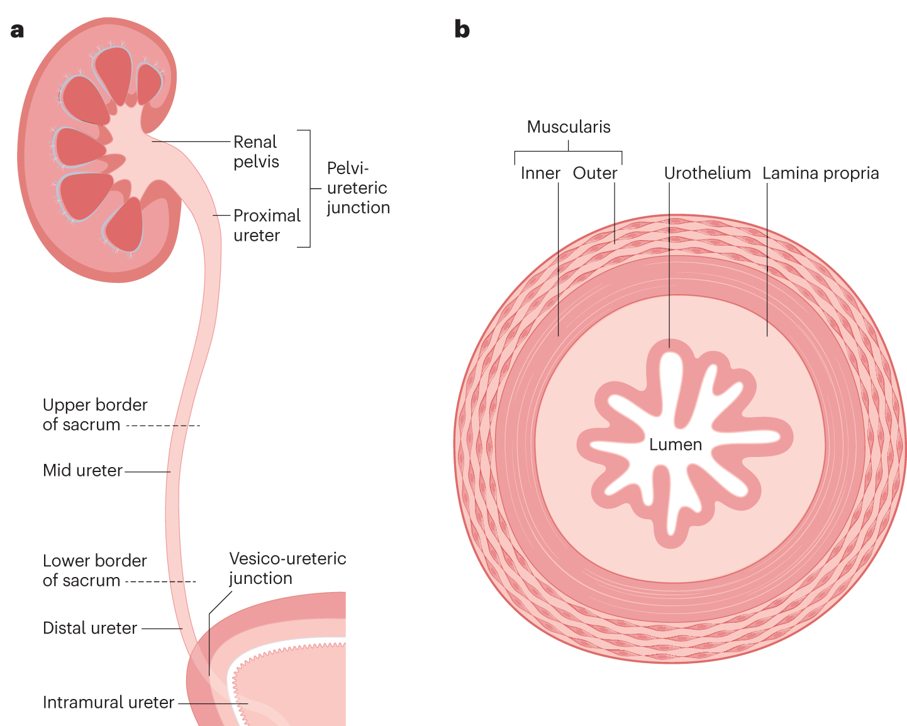

Slide 7
Function of the Ureters
Primary function: transport urine from the kidneys to the urinary bladder.
Peristaltic contractions of smooth muscle in the ureter walls propel urine downward, even against gravity.
Ureters contain valves that prevent backflow of urine from the bladder into the ureters.

Slide 8
Blood Supply & Innervation
Blood supply: branches of the renal, gonadal, and common iliac arteries.
Innervation: primarily autonomic (sympathetic & parasympathetic nerve fibers) regulating smooth muscle contraction and relaxation.

Slide 9
Difference Between Right & Left Kidneys
Both are retroperitoneal organs on either side of the vertebral column.

Slide 10
Anatomy of Right vs. Left Kidneys
Location: Right kidney sits slightly lower than the left due to the liver.
Shape & Size: Right kidney is often slightly smaller & more rounded because of the space occupied by the liver.
Left kidney is typically longer and narrower than the right.

Slide 11
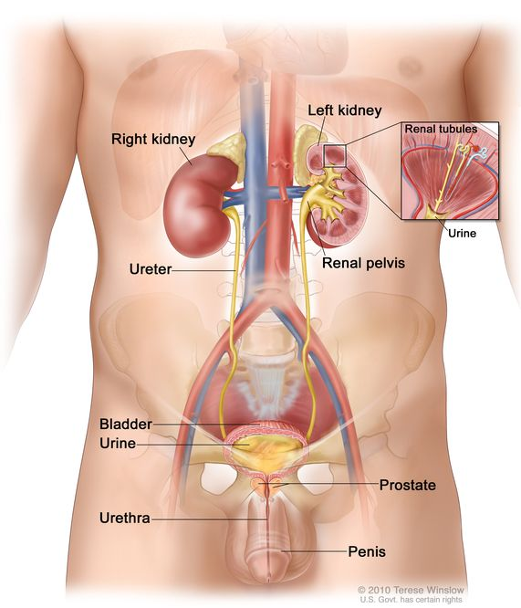

Slide 12
Position of Structures
Right kidney is positioned lower due to the large right lobe of the liver.
Left kidney is located slightly higher and more medial compared to the right kidney

Slide 13
Vasculature Anatomy
The right renal artery arises directly from the abdominal aorta; the left renal artery arises at a slightly higher level.
The right renal vein is shorter and straighter than the left renal vein, which is longer.
The left renal vein often receives the left gonadal vein before draining into the inferior vena cava.

Slide 14
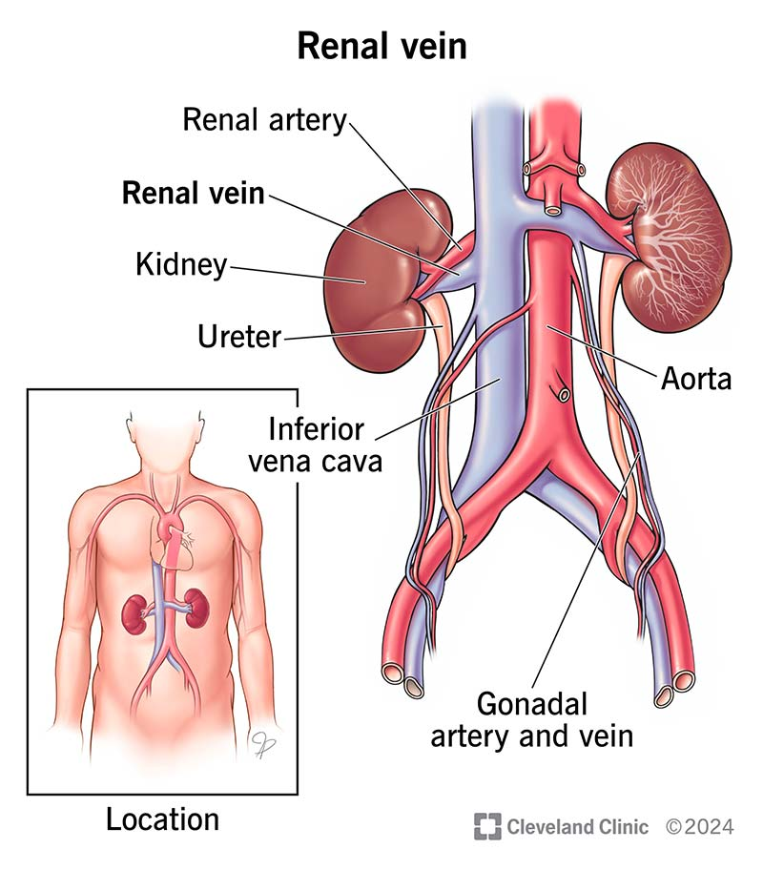

Slide 15
Adrenal Glands
Both kidneys are associated with adrenal glands (also called suprarenal glands).
The right adrenal gland is usually pyramidal in shape; the left adrenal gland is more crescent‑shaped.

Slide 17
Ureters
Each ureter carries urine from its kidney to the urinary bladder.
The right ureter is typically shorter than the left ureter because of the position of the right kidney.

Slide 19
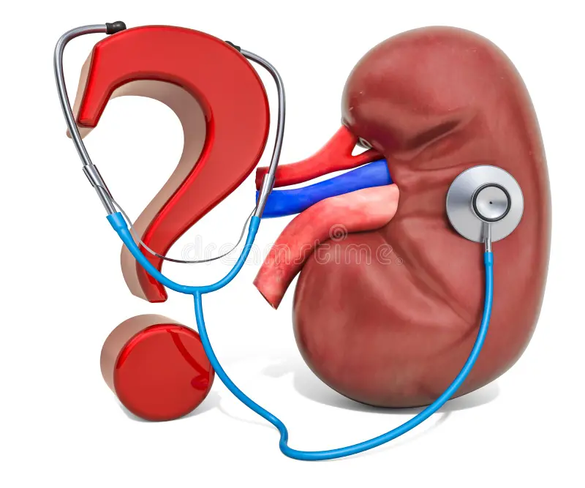

Slide 20


