Slide 1

Surgical Diathermy
ADNAN RAMZAN
FSC(OT)
DOCTORS INSTITUTE OF MEDICAL SCIENCE

Slide 2
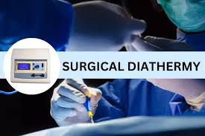

Slide 3
Surgical Diathermy
Surgical diathermy is a modern surgical technique.
It is used in operation theatres.
It works by using high frequency electric current.
The current produces controlled heat.
Heat is used to cut tissues.
It also helps in coagulation of blood.
Bleeding during surgery is reduced.
It improves surgical efficiency.

Slide 4
Definition
Diathermy comes from Greek roots: "dia" (through) and "therma" (heat), literally meaning "heating through,"
It converts electrical energy into heat energy.
The heat acts on body tissues.
It allows precise tissue cutting.
It helps in sealing blood vessels.
It minimizes blood loss.

Slide 5
History of Surgical Diathermy
Surgical diathermy was developed in early 20th century.
William T. Bovie contributed to its development.
It was first used in brain surgery.
Initially equipment was very basic.
Technology improved over time.
Modern units are computerized.
Safety features were added.
Now it is widely used worldwide.

Slide 6
Principle of Diathermy
It works on Joule heating principle.
High frequency current passes through tissue.
Tissue resistance produces heat.
The heat causes tissue cutting.
It also causes protein coagulation.
Controlled energy is applied.
Proper settings are essential.
Notes:
Joule's heating effect, or resistive heating, is when electrical energy converts to thermal energy as current flows through a conductor, causing resistance and electron-atom collisions that generate heat, described by the formula H=I2RTcap H equals cap I squared cap R cap T
𝐻=𝐼2𝑅𝑇
, where heat (H) depends on current (I), resistance (R), and time (T). It's the principle behind toasters and electric heaters but also a loss in power lines, and it's used in devices like fuses.

Slide 7
Types of Surgical Diathermy
There are mainly two types of diathermy.
Monopolar diathermy is commonly used.
Bipolar diathermy is safer for delicate surgery.
Both use high frequency current.
They differ in electrode arrangement.
Selection depends on surgery type.
Each has advantages.
Each has limitations.

Slide 8
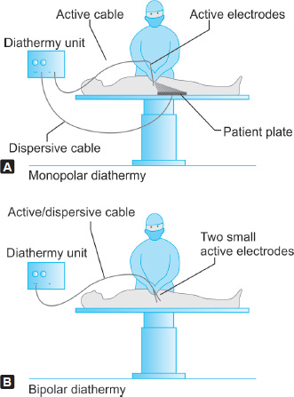
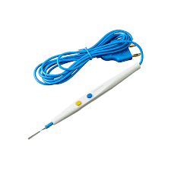
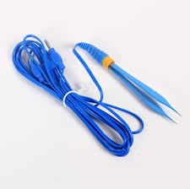

Slide 9
Monopolar Diathermy
Monopolar diathermy uses one active electrode.
Current passes through patient body.
Return electrode is placed on patient.
It is used for cutting.
It is used for coagulation.
Careful placement is needed.
Risk of burns exists.

Slide 10
Bipolar Diathermy
Bipolar diathermy uses two electrodes.
Both electrodes are part of forceps.
Current passes only between tips.
No return plate is required.
It is safer than monopolar.
Used in microsurgery.
Used in neurosurgery.
Less tissue damage occurs.

Slide 11
Components of Diathermy Unit
A diathermy unit has many components.
It includes electrosurgical generator.
Active electrode is present.
Patient return electrode is used.
Foot switch or hand switch is included.
Cables connect all parts.
Each part has specific function.

Slide 12
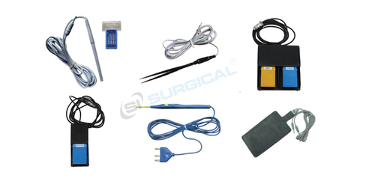

Slide 13
Electrosurgical Generator
It is the main unit of diathermy.
It generates high frequency current.
Power output can be adjusted.
Different modes are available.
It converts electrical supply.
Safety alarms are present.
Modern generators are digital.

Slide 14
Active Electrode
Active electrode delivers current to tissue.
It may be knife shaped.
It may be needle shaped.
It is held by surgeon.
It concentrates energy at tip.
It produces cutting effect.
Damage can occur if faulty.

Slide 15
Patient Return Electrode
It is also called grounding pad.
It completes electrical circuit.
It is attached to patient skin.
Large surface area is used.
It prevents burns.
Proper placement is essential.
Contact must be firm.

Slide 16
Cables and Accessories
Cables carry current safely.
They connect generator and electrodes.
Insulation prevents shock.
Foot switch controls activation.
Hand switch may be used.
Regular inspection is needed.
Damaged cables are dangerous.

Slide 17
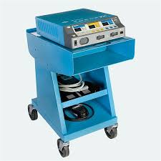
Working Mechanism
Current flows from generator.
It passes through active electrode.
It enters patient tissue.
Heat is generated in tissue.
Effect depends on mode selected.
Current returns via pad.
Circuit is completed.
Proper grounding is essential.

Slide 18
Cutting Mode
Cutting mode produces continuous current.
It causes rapid tissue heating.
Cells vaporize quickly.
Clean incision is produced.
Minimal coagulation occurs.
Used for skin incision.
Used for deep tissue cutting.
Skill is required.

Slide 19
Coagulation Mode
Coagulation mode produces interrupted current.
It causes slower heating.
Blood vessels are sealed.
Bleeding is controlled.
Used for hemostasis.
Less cutting effect.
Prevents blood loss.

Slide 20
Blend Mode
Blend mode is combination of modes.
It provides cutting and coagulation.
Degree of blend can be adjusted.
It is commonly used.
Tissue damage is reduced.
Surgeon preference matters.
Proper setting is required.

Slide 21
Uses of Surgical Diathermy
It is used in general surgery.
It is used in gynecology.
It is used in neurosurgery.
It is used in ENT surgery.
It is used in plastic surgery.
It controls bleeding.
It shortens surgery time.
It improves outcomes.

Slide 22
Advantages of Diathermy
It reduces blood loss.
It provides clear surgical field.
It saves operating time.
It allows precise cutting.
It reduces need for sutures.
It improves healing.
It is widely available.

Slide 23
Disadvantages of Diathermy
It can cause burns.
Electrical shock may occur.
Smoke is produced.
Equipment is costly.
Requires trained staff.
Improper use is dangerous.
Maintenance is required.

Slide 24
Safety Precautions
Proper training is essential.
Equipment must be checked.
Correct power settings used.
Grounding pad properly placed.
Remove metal objects.
Monitor patient closely.
Follow OT protocols.

Slide 25
Burn Hazards
Burns may occur at pad site.
Poor contact causes burns.
High power increases risk.
Wet skin is dangerous.
Hair should be removed.
Pad should be flat.
Check skin regularly.
Report burns immediately.

Slide 26
Electrical Hazards
Faulty cables cause shock.
Improper grounding is risky.
Equipment damage increases danger.
Staff must be alert.
Regular inspection required.
Follow safety guidelines.
Emergency measures ready.

Slide 27
Care of Equipment
Equipment should be cleaned.
After each surgery care needed.
Cables should be checked.
Electrodes cleaned properly.
Store in dry place.
Avoid physical damage.
Follow manufacturer guidelines.
Report faults early.

Slide 28
Role of OT Technician
Prepare diathermy unit.
Check power settings.
Ensure proper grounding.
Assist surgeon during use.
Monitor equipment function.
Ensure patient safety.
Handle accessories.
Maintain records.

Slide 29
Preparation Before Use
Check electrical supply.
Inspect all connections.
Select correct mode.
Set power level.
Place return electrode.
Ensure patient skin prep.
Test unit before surgery.
Follow checklist.

Slide 30
Care During Surgery
Monitor power settings.
Observe patient response.
Avoid prolonged activation.
Watch for burns.
Ensure sterile handling.
Maintain clear field.
Communicate issues.

Slide 31
Care After Surgery
Switch off equipment.
Disconnect electrodes safely.
Inspect patient skin.
Clean accessories.
Store equipment properly.
Report any issues.
Document usage.
Prepare for next case.

Slide 32
Maintenance of Diathermy
Regular servicing is required.
Calibration ensures accuracy.
Replace damaged parts.
Test safety features.
Maintain service record.
Follow maintenance schedule.
Ensures long life.

Slide 33
Conclusion
Surgical diathermy is essential OT tool.
It improves surgical efficiency.
It controls bleeding effectively.
It requires proper handling.
Safety precautions are vital.
Training reduces risks.
Proper use ensures patient safety.

Slide 34


