Slide 1

BASIC MEDICAL SCIENCE
FSC MEDICAL TECHNOLOGIES I
DR DANISH

Slide 2
Urinary Bladder
Overview:
Hollow muscular organ
Located in pelvis.
Posterior to the pubic symphysis.
Anterior to the rectum in males and uterus or vagina in females

Slide 3
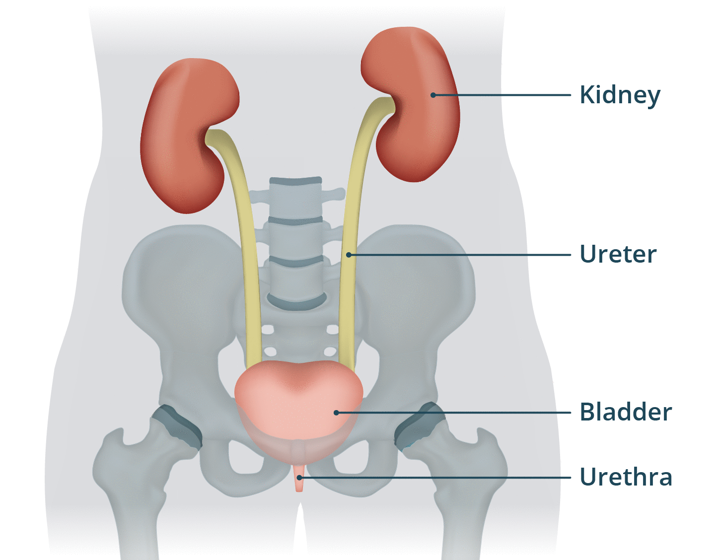

Slide 4
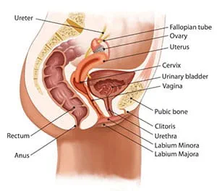

Slide 5
Structure
Composed of smooth muscle tissue called the detrusor muscle
Detrusor muscle contracts to expel urine during urination (micturition)

Slide 6
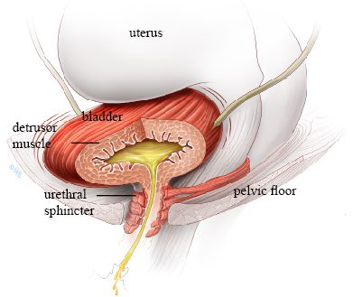

Slide 7
Shape and Size
Shape and size vary depending on bladder distension
Empty bladder: pear-shaped
Full bladder: becomes spherical
Capacity in adults: approximately 300–500 mL

Slide 8
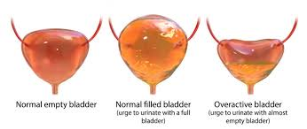

Slide 9
Walls of the Urinary Bladder
Mucosa
  Innermost layer
  Lined with transitional epithelium
  Allows stretching to accommodate urine
Submucosa
  Contains blood vessels, nerves, and lymphatics

Slide 10
Continued
Muscularis
  Smooth muscle fibers forming the detrusor muscle
Serosa
  Outermost layer
  Covers the superior surface of the bladder

Slide 11
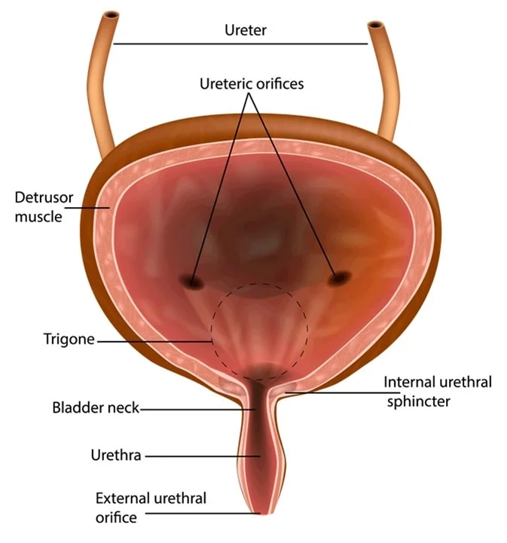

Slide 12
Trigone
Triangular-shaped area within the bladder
Defined by:
  Two ureteric openings
  One urethral opening
Lined with smooth muscle
Functions as a funnel directing urine into the urethra during urination

Slide 13
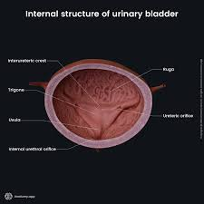

Slide 14
Ureteral Orifices
Openings in the trigone where ureters enter the bladder
Ureters
  Muscular tubes
  Transport urine from kidneys to bladder

Slide 16
Urethral Orifice
Opening of the urethra
Located at the apex of the trigone
Surrounded by a sphincter muscle
Controls flow of urine from bladder to urethra

Slide 18
Blood Supply
Supplied by branches of the internal iliac arteries
  Superior vesical artery
  Inferior vesical artery
Venous drainage via vesical veins
Vesical veins drain into internal iliac veins

Slide 19
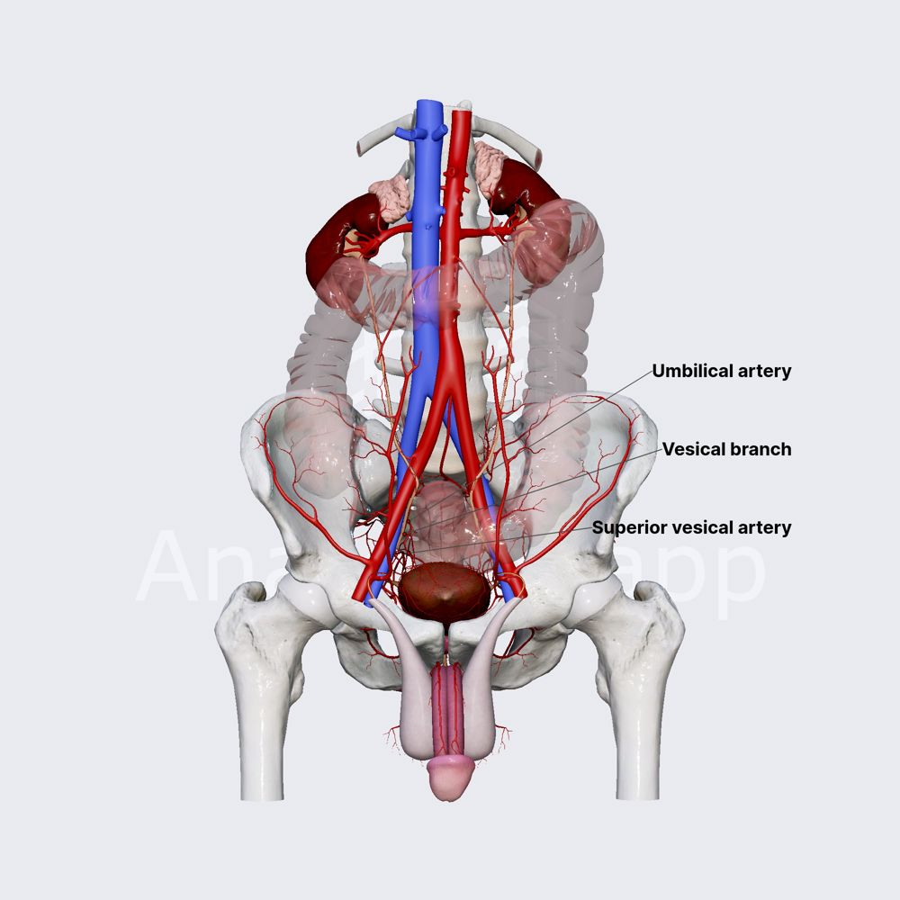

Slide 20
Innervation
Controlled by the autonomic nervous system
Parasympathetic fibers (pelvic splanchnic nerves)
  Stimulate bladder contraction (micturition)
Sympathetic fibers (hypogastric nerves)
  Inhibit bladder contraction

Slide 21


Slide 22


