Slide 1
Physiology
BS Medical Technologies
Awais Hamza

Slide 2
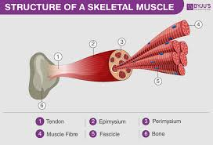
Physiological Anatomy of Muscles & Their Types
Muscle = 40–50% of body weight
Specialized for contraction & force generation
Functions:
Movement
Posture
Stabilization of joints
Heat production (thermogenesis)

Slide 3
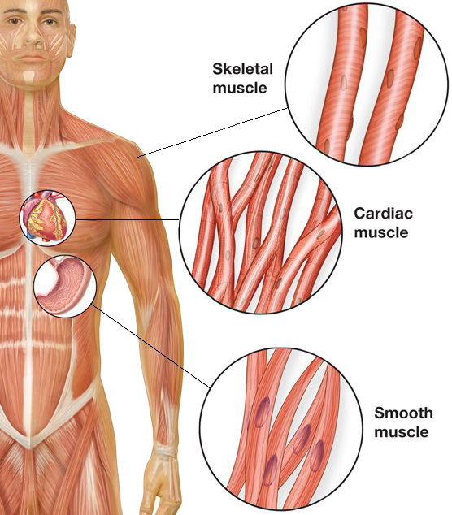
Classification of Muscle Tissue
Skeletal Muscle
  Striated,Voluntary
Cardiac Muscle
  Striated, Involuntary
Smooth Muscle
  Non-striated,Involuntary

Slide 4
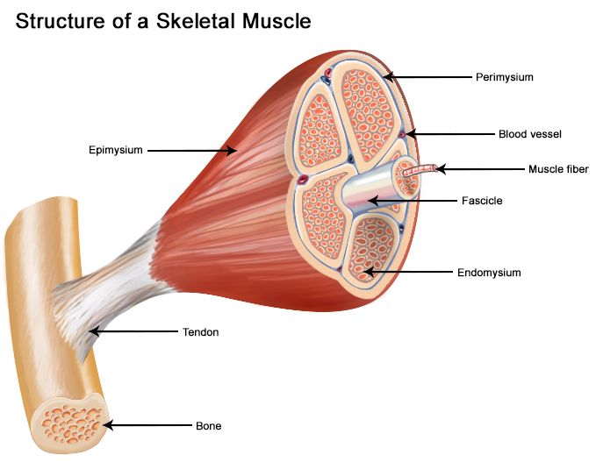
SKELETAL MUSCLE
Attached to bones via tendons
Long, cylindrical, multinucleated fibers
Striated appearance due to organized myofilaments
Controlled by somatic nervous system

Slide 5
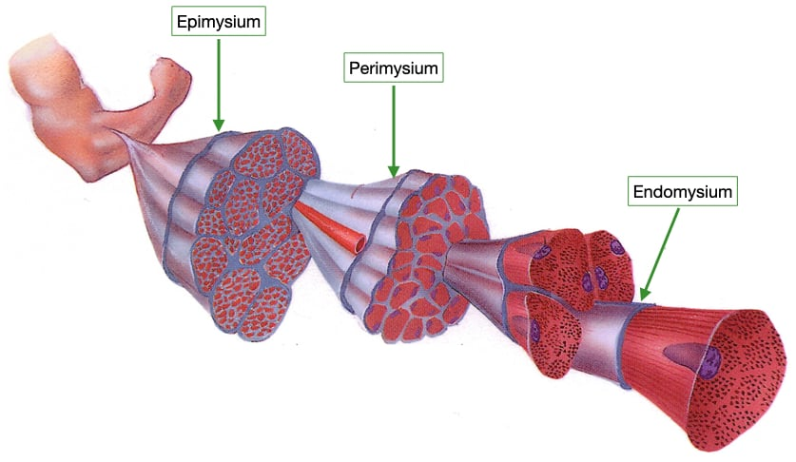
Connective Tissue Layers
Epimysium — surrounds whole muscle,Perimysium — surrounds fascicles, Endomysium — surrounds each muscle fiber

Slide 6
Structure of a Muscle Fiber
Each muscle fiber (cell) contains:
Sarcolemma — cell membrane
Sarcoplasm — cytoplasm
Myofibrils (hundreds per cell)
Sarcoplasmic reticulum (SR) — Ca²⁺ storage
T-tubules — conduct action potential deep into fiber

Slide 7
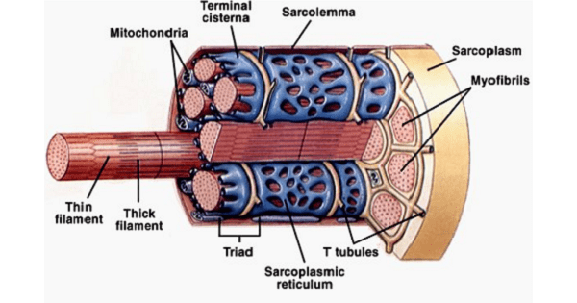

Slide 8
Sarcomere (Functional Unit)
Extends from Z-line to Z-line
Contractile proteins:
  Actin (thin filament)
  Myosin (thick filament)
Supporting proteins:
  Titin — elasticity
  Nebulin, α-actinin

Slide 9
Bands of Sarcomere
A-band: length of myosin
I-band: actin only
H-zone: myosin only
M-line: middle line
Z-line: end boundary
Striations arise from alternating thick & thin filaments.

Slide 10
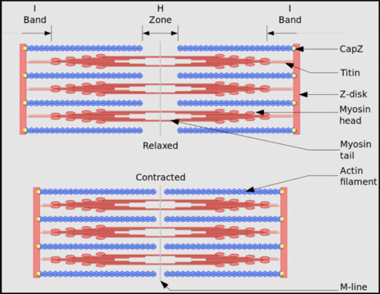

Slide 11
Types of Skeletal Muscle Fibers
Type I — Slow Oxidative
Red color (myoglobin), High endurance
ATP from oxidative phosphorylation
Type IIa — Fast Oxidative-Glycolytic
Intermediate fatigue resistance
Type IIb/IIx — Fast Glycolytic
Powerful, fast, fatigues easily, Low myoglobin

Slide 12
COMPARISON OF MUSCLE TYPES
Feature | Skeletal | Cardiac | Smooth
Striations | Yes | Yes | No
Control | Voluntary | Involuntary | Involuntary
Nuclei | Multi | Single | Single
Shape | Long cylindrical | Branched | Spindle
Regeneration | Poor | Very poor | Good
T-tubules | Present | Present | Absent
SR | Well developed | Moderate | Poor

Slide 13
Functional Differences
Skeletal → Fast, powerful, fatigable
Cardiac → Rhythmic, continuous, non-fatigable
Smooth → Slow, sustained, energy-efficient

Slide 14
FUNCTIONAL CHARACTERISTICS OF SKELETAL MUSCLE
Voluntary, rapid movement
Controlled by somatic nervous system
Precise + powerful contractions

Slide 15
Functional Characteristics
1. Excitability
Responds to motor neuron stimulation
Neurotransmitter: Acetylcholine (ACh)
Generates end plate potential → action potential
2. Conductivity
Action potential spreads along sarcolemma & T-tubules
Allows simultaneous contraction of entire fiber

Slide 16
Functional Characteristics
3. Contractility
Uses Sliding Filament Mechanism
High force generation due to:
  Dense packing of myofibrils
  Organized sarcomeres
4. Elasticity & Extensibility
Can stretch and return to original length
Role of titin, connective tissue layers

Slide 17
FUNCTIONAL CHARACTERISTICS OF CARDIAC MUSCLE
Involuntary
Found only in the heart
Contracts rhythmically and continuously for life

Slide 18
Functional Characteristics
1. Automaticity (Autorhythmicity)
Generates its own impulses
Due to pacemaker cells (SA node)
No external nerve needed to initiate contraction
2. Conductivity
Impulse spreads through gap junctions
Entire myocardium can behave as functional syncytium

Slide 19
Functional Characteristics
3. Rhythmicity
Constant, rhythmic contractions
Maintained by intrinsic pacemaker activity
4. Contractility
Strong, long-lasting contractions
Calcium from:
  Sarcoplasmic reticulum
  Extracellular fluid (via voltage-gated Ca²⁺ channels)

Slide 20
Functional Characteristics
Long Refractory Period
200–300 ms
Prevents tetany → heart cannot cramp
Ensures filling and pumping cycles remain coordinated
High Fatigue Resistance
Abundant mitochondria
Continuous oxygen supply
Relies mainly on aerobic metabolism

Slide 21
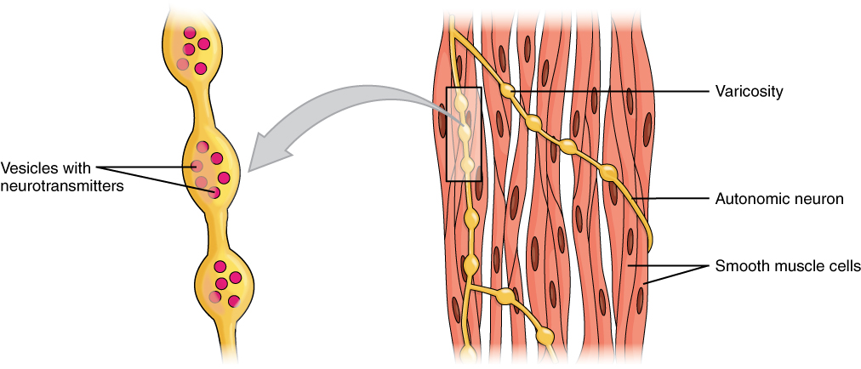
FUNCTIONAL CHARACTERISTICS OF SMOOTH MUSCLE
Involuntary
Found in blood vessels, bronchi, GI tract, uterus, bladder
Slow but sustained contractions
Highly energy-efficient

Slide 22
Functional Characteristics
1. Excitability
Can be stimulated by:
  Autonomic nerves, Hormones
  Stretch, Local chemicals
  Pacemaker cells (in GI)
2. Conductivity
Single-unit smooth muscle linked by gap junctions
Allows slow wave propagation

Slide 23
Functional Characteristics
3. Contractility
Uses actin-myosin, but:
  No sarcomeres
  Dense bodies + diagonal arrangement
Long-lasting, powerful “corkscrew” contraction
4. Low Fatigue
Maintains contraction for hours (“latch mechanism”)
Very low ATP requirement

Slide 24
Events of Muscle Contraction & Relaxation
Muscle contraction occurs when an action potential from a motor neuron triggers a sequence of events that lead to:
Calcium release
Actin–myosin interaction
Sarcomere shortening
Relaxation occurs when:
Calcium is pumped back
Actin–myosin cross-bridges stop forming

Slide 25
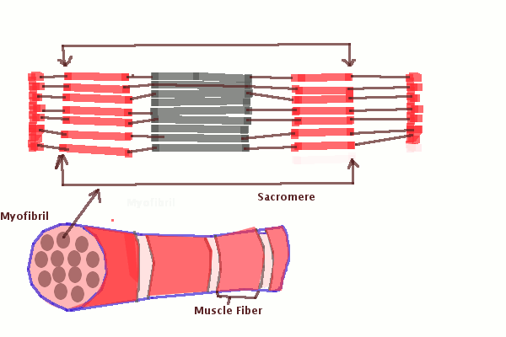

Slide 26
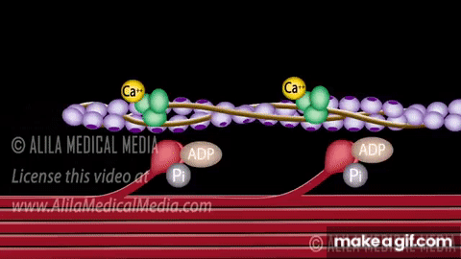

Slide 27
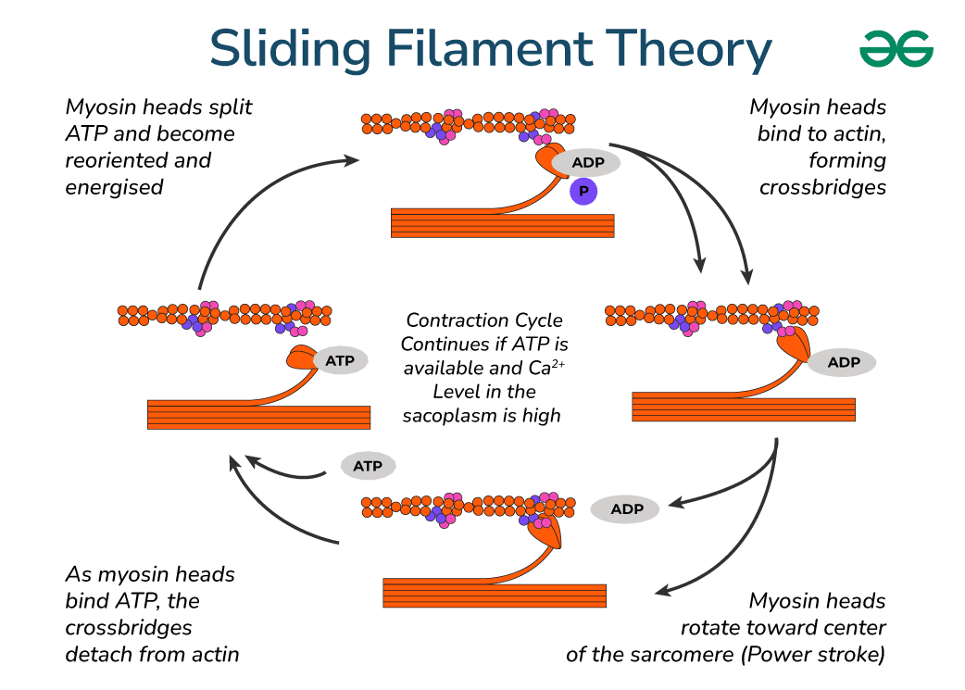

Slide 28
Steps of Muscle Contraction
Nerve action potential arrives at neuromuscular junction (NMJ)
Release of acetylcholine (ACh)
Activation of muscle fiber (end plate potential → AP)
Action potential spreads along sarcolemma and T-tubules
Ca²⁺ release from sarcoplasmic reticulum (SR)
Cross-bridge formation between actin & myosin
Power stroke → contraction (shortening)
Ca²⁺ reuptake → relaxation

Slide 29
Step 1: Arrival of Action Potential at NMJ
AP reaches axon terminal of motor neuron
Opens voltage-gated Ca²⁺ channels
Ca²⁺ influx triggers exocytosis of ACh vesicles

Slide 30
Step 2: Release of ACh in Synaptic Cleft
ACh diffuses across synaptic cleft
Binds to ACh nicotinic receptors on motor end plate
Opens ligand-gated Na⁺ channels
Na⁺ influx → end plate potential (EPP)

Slide 31
Step 3: Generation of Action Potential in Muscle Fiber
If EPP reaches threshold → muscle AP generated
AP travels along sarcolemma
Moves into fiber through T-tubules

Slide 32
Step 4: Excitation–Contraction Coupling
AP reaches T-tubules
Activates dihydropyridine receptors (DHPR)
DHPR mechanically opens ryanodine receptors (RyR) on SR
Massive Ca²⁺ release into sarcoplasm
This links electrical signal → mechanical contraction.

Slide 33
Step 5: Ca²⁺ Binds Troponin
Ca²⁺ binds troponin C
Causes tropomyosin to move away from actin binding sites
Exposes myosin-binding sites on actin
Enables cross-bridge formation

Slide 34
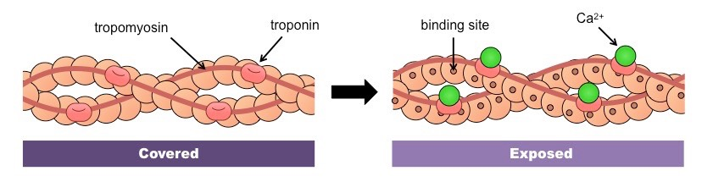

Slide 35
Step 6: Cross-Bridge Cycle (Contraction Mechanism)
1. Cross-bridge formation
Myosin head (with ADP + Pi) binds to actin.
2. Power stroke
Pi is released, Myosin head pivots → pulls actin inward
Sarcomere shortens
3. Detachment
ATP binds to myosin head, Myosin releases actin

Slide 36
Step 6: Cross-Bridge Cycle (Contraction Mechanism)
4. Re-cocking
ATP hydrolyzes → ADP + Pi
Myosin head resets → ready for next cycle
Cycle repeats as long as Ca²⁺ and ATP are available.

Slide 37
Step 7: Sarcomere Shortening
During contraction:
I-band shortens
H-zone disappears
A-band remains same
Z-lines move closer
Overall → muscle fiber contracts (shortens)

Slide 38
Muscle Relaxation (Full Sequence)
Relaxation begins when motor neuron stops firing.
1. ACh Removal
Acetylcholinesterase (AChE) breaks down ACh
No more EPP
Muscle AP stops
2. Ca²⁺ Reuptake
Ca²⁺ pumped back into SR by SERCA pumps (active transport)

Slide 39
Muscle Relaxation (Full Sequence)
3. Troponin–Tropomyosin Reset
Without Ca²⁺ → troponin releases Ca²⁺
Tropomyosin re-covers actin binding sites
Myosin can no longer bind actin
4. Cross-bridges cease
No interaction → no tension
5. Muscle Returns to Rest Length
Due to elasticity and opposing muscle groups

Slide 40
What is the Neuromuscular Junction?
The NMJ is a specialized synapse between:
A motor neuron
A skeletal muscle fiber
Its function:
Convert electrical signal (nerve AP) into
Chemical signal (ACh), then into
Electrical signal in muscle → contraction
This process is called excitation of the muscle.

Slide 41
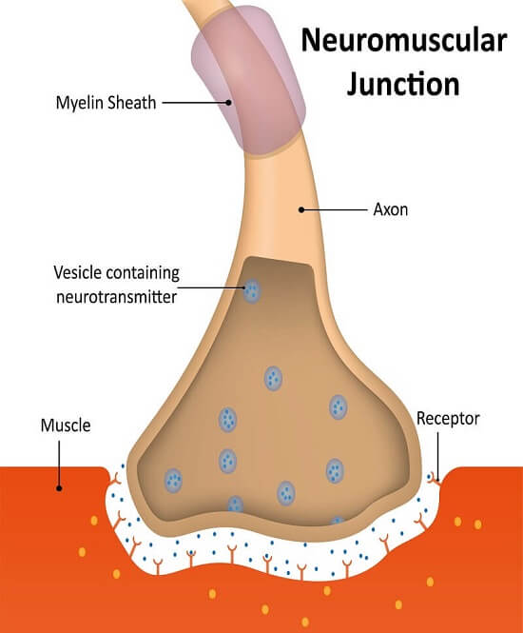
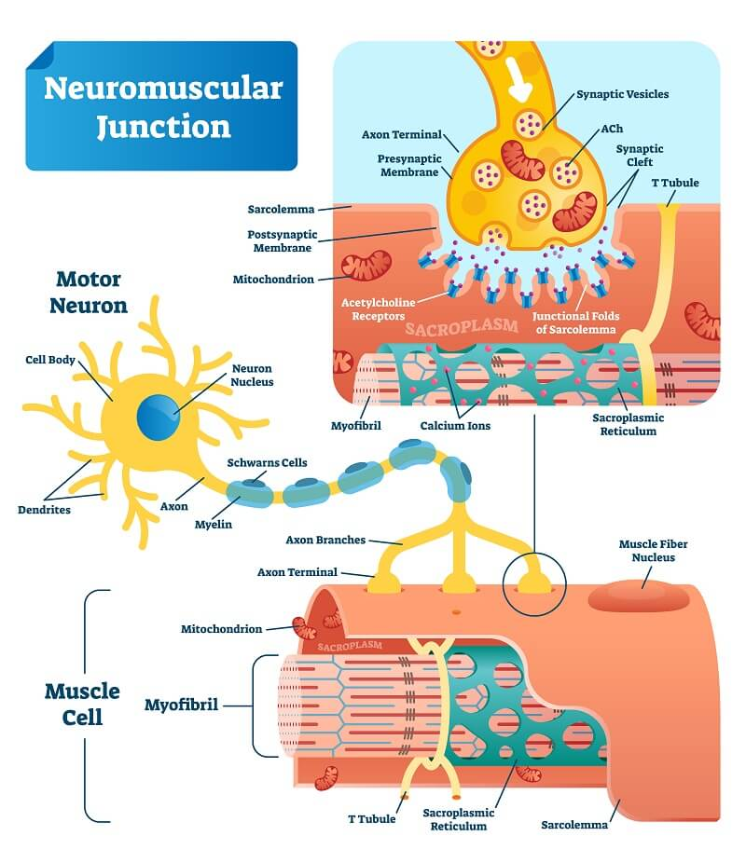

Slide 42
Components of the NMJ
1. Presynaptic Terminal (Motor Neuron Ending)
Synaptic vesicles containing acetylcholine (ACh), Voltage-gated Ca²⁺ channels
2. Synaptic Cleft
Space between nerve & muscle, Contains acetylcholinesterase (AChE)
3. Postsynaptic Membrane (Motor End Plate)
Folded membrane with nicotinic ACh receptors: Ligand-gated ion channels (allow Na⁺ in)

Slide 43
Step-by-Step Events at the NMJ
1. Arrival of action potential at motor neuron terminal
Depolarization opens voltage-gated Ca²⁺ channels
2. Ca²⁺ influx
Ca²⁺ enters presynaptic terminal
3. ACh release
ACh vesicles fuse with the membrane
ACh is exocytosed into synaptic cleft

Slide 44
Step-by-Step Events at the NMJ
4. ACh binds to receptor
ACh binds nicotinic ACh receptors on motor end plate
Opens ligand-gated Na⁺ channels
5. End Plate Potential (EPP)
Na⁺ influx causes local depolarization
If threshold reached → muscle action potential

Slide 45
Generation of Muscle Action Potential
EPP causes voltage-gated Na⁺ channels to open
Action potential spreads over sarcolemma
Travels deep into fiber via T-tubules
Leads to Ca²⁺ release → contraction

Slide 46
Removal of ACh (Termination)
After signal transmission:
AChE breaks down ACh into acetate + choline
Choline is taken back into presynaptic neuron
Prevents continuous stimulation of muscle
This ensures one nerve impulse → one contraction.

Slide 47
Properties of the NMJ
1. One-way Transmission
Motor neuron → muscle (never reversed)
2. High Safety Margin
Large amount of ACh released → ensures contraction every time
3. No summation
EPP is graded, but muscle action potential is all-or-none

Slide 48
Aerobic vs Anaerobic Muscle Contraction
Muscle fibers generate ATP through two major systems:
Aerobic metabolism (with oxygen)
Anaerobic metabolism (without oxygen)
Both systems operate during exercise but dominate under different conditions.

Slide 49
Aerobic Muscle Contraction
Muscle contraction supported by oxygen-dependent ATP production in mitochondria.
Uses oxidative phosphorylation
Relies on fatty acids, glucose, and pyruvate, Occurs in mitochondria
Produces large ATP amounts (36–38 molecules per glucose), Slow but sustained contractions
Dominant in endurance activities, Produces CO₂ + H₂O (no lactic acid)

Slide 50
Anaerobic Muscle Contraction
Contraction supported by ATP production without oxygen, Uses anaerobic glycolysis
Glucose → pyruvate → lactic acid
Occurs in cytosol, Small ATP yield (2 molecules per glucose), Fast but short-duration contractions, Rapid fatigue due to lactic acid buildup
Fiber Type:
Type II (Fast-twitch fibers)
Low myoglobin, fewer mitochondria, Powerful, rapid, but easily fatigued

Slide 51
Differences Table
Feature | Aerobic Contraction | Anaerobic Contraction
Oxygen required | Yes | No
ATP yield | High (36–38 ATP) | Low (2 ATP)
Speed | Slow | Fast
Fatigue | Low | High
Main products | CO₂ + H₂O | Lactic acid
Duration | Long (endurance) | Short bursts
Fibers | Type I | Type II
Mitochondria | Many | Few
Efficiency | Very efficient | Less efficient

Slide 52
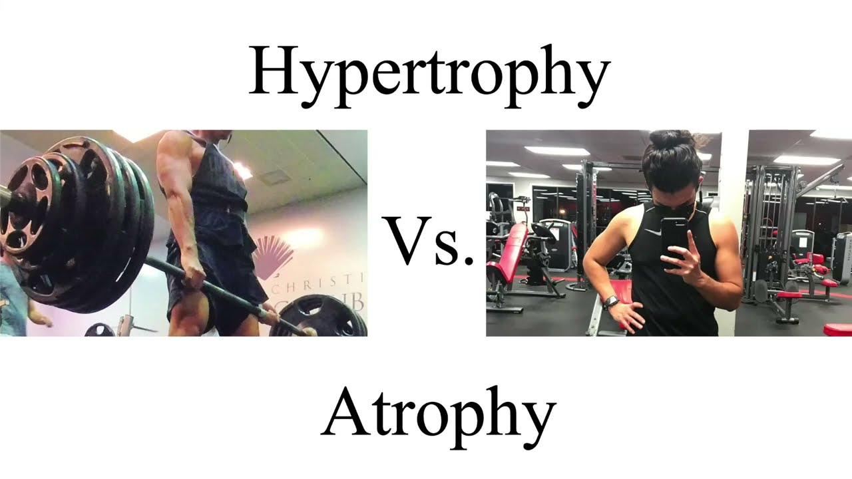

Slide 53
Muscle Hypertrophy
Increase in size of a muscle due to enlargement of individual muscle fibers (not an increase in fiber number).
Causes:
Resistance training (weight lifting), Increased workload
Hormonal influences:
  Testosterone, Growth hormone, IGF-1
Increased nerve stimulation, High-protein diet

Slide 54
Physiological Changes
Increased myofibrils
Increased sarcomeres
More actin & myosin
Increased glycogen storage
Increased mitochondria in oxidative training
Greater strength and force production

Slide 55
Muscle Atrophy
Decrease in muscle size due to loss of myofibrils and reduction in metabolic activity.
Causes: Lack of physical activity
Immobilization (fracture, cast, bed rest)
Denervation (nerve injury), Aging (sarcopenia)
Chronic diseases (cachexia), Malnutrition
Space travel (zero gravity)

Slide 56
Physiological Changes
Reduced myofibril number
Decreased protein synthesis
Increased protein degradation (via proteasomes)
Smaller muscle fibers
Weakness, decreased endurance

Slide 57
Feature | Hypertrophy | Atrophy
Muscle size | Increases | Decreases
Fiber number | Same | Same
Fiber diameter | Increases | Decreases
Protein synthesis | ↑ Increased | ↓ Decreased
Protein breakdown | Normal or ↓ | ↑ Increased
Strength | Increases | Decreases
Causes | Training, hormones | Disuse, denervation, aging
Reversibility | Yes | Yes (early stages), partial in chronic

