Slide 1

Spinal Cord
BS-PSY
1ST SEMESTER
Ms. Shehwar Saeed

Slide 2
Structure of Spinal Cord
Long, conical structure as thick as human little finger
Protected by vertebral column
Composed of 24 individual vertebrae of
Cervical (neck)
Thoracic (chest)
Lumber (lower back)
Sacral & coccygeal (pelvic region)

Slide 3
Structure of Spinal Cord
Spinal cord passes through a hole in each of the vertebrae (Spinal Foramens)
Spinal cord is only about two third as long as the vertebral column rest of the space filled with the mass of spinal roots
  Composing of cauda aquina
Caudal block
Small bundles of fibers emerge from each side of SC in two straight lines along dorsolateral and ventrolateral faces

Slide 4
Structure of Spinal Cord
Groups of these bundles fused together and formed 31 paired sets of dorsal roots and ventral roots
Dorsal and ventral roots fused together as they passed through the intervertebral foramens and become spinal nerves

Slide 5
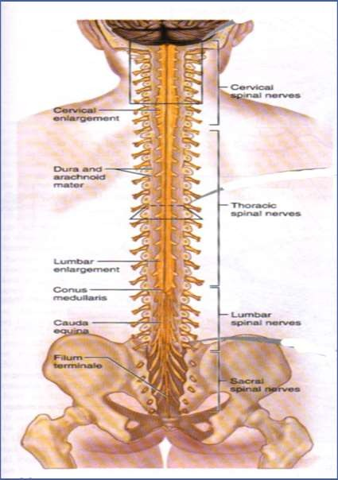
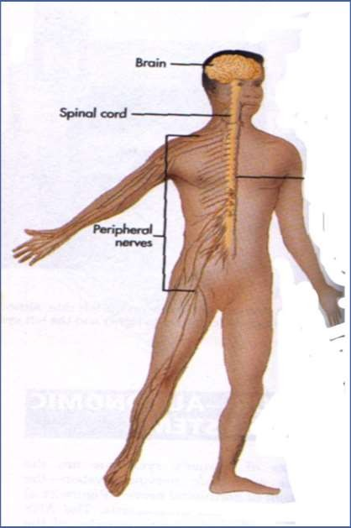

Slide 6
Functions of spinal cord
Distribute motor fibers to the effector organs of the body (glands and muscles)
Collect somatosensory information to be passed on to the brain are smooth muscle, cardiac muscle and glands that respond to nerve impulses from the central nervous system without conscious thought.
They are part of the automatic, or involuntary, nervous system, along with receptors, afferent nerves and efferent nerves.

Slide 7
Functions of spinal cord
Electrical communication. Electrical currents travel up and down the spinal cord, sending signals which allow different segments of the body to communicate with the brain.
While a person walks, a collection of muscle groups in the legs are constantly contracting.
  This central walking pattern generator in the spinal cord are made up of neurons which send signals to the muscles in the legs, making them extend or contract, and produce the alternating movements which occur when a person walks.

Slide 8
O Reflexes. Reflexes are involuntary responses resulting from stimuli involving the brain, spinal cord, and nerves of the peripheral nervous system.

Slide 9

Any Question?

Slide 10


