Slide 1

ANATOMY
BS RIT,MLT,OTT
1ST SEMESTER
DR DANISH

Slide 2
Lymph Vascular System
Definition:
The lymph vascular system is a unidirectional drainage system.
It collects excess tissue fluid (lymph) and returns it to the venous circulation.
It is closely related to the immune system.

Slide 3
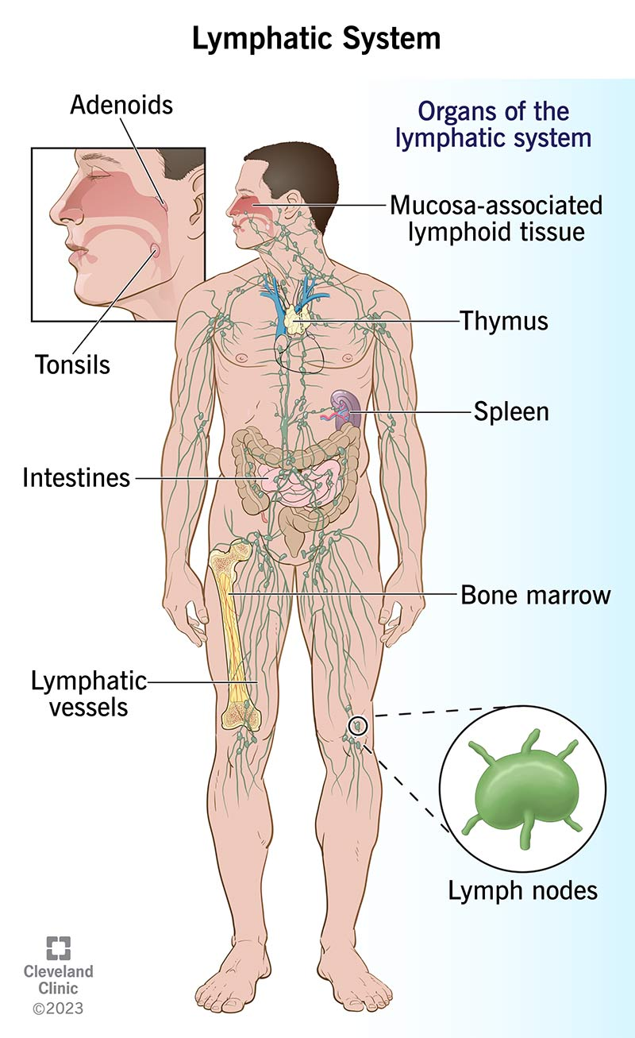

Slide 4
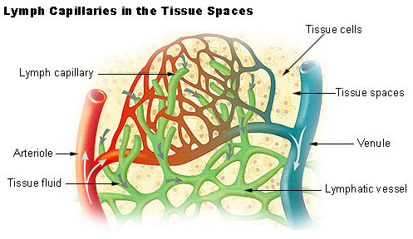

Slide 5
Functions
Drains excess interstitial fluid and plasma proteins.
Maintains fluid and electrolyte balance.
Absorbs fats and fat-soluble vitamins from the intestine.
Provides immune defense by producing and transporting lymphocytes.
Acts as a pathway for spread of infections and malignant cells.

Slide 6
Components of Lymphatic System
Lymph
Lymph capillaries
Lymph vessels
Lymph nodes
Lymphatic organs

Slide 7
Lymph
Clear, pale yellow fluid formed from tissue fluid.
Rich in lymphocytes.
Intestinal lymph (chyle) contains emulsified fats, giving a milky appearance.

Slide 8
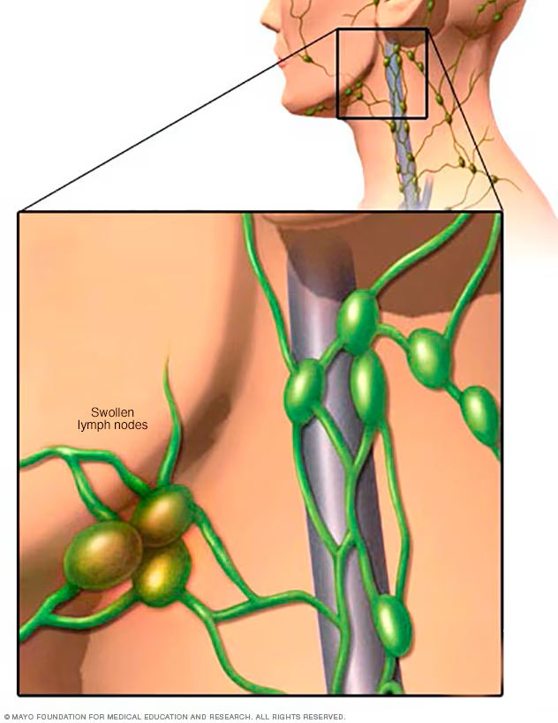

Slide 9
Lymph Capillaries
Blind-ended microscopic vessels.
Lined by a single layer of endothelial cells.
Highly permeable to proteins and large particles.
Absent in CNS, bone marrow, cartilage, cornea, and epidermis.

Slide 10
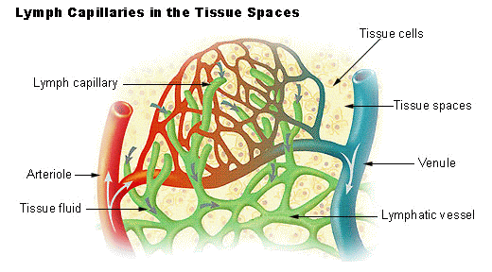

Slide 11
Lymph Vessels
Formed by union of lymph capillaries.
Structurally similar to veins but thinner walls.
Contain numerous valves to prevent backflow.
Lymph is moved by muscle contraction, arterial pulsation, and respiratory movements.

Slide 12
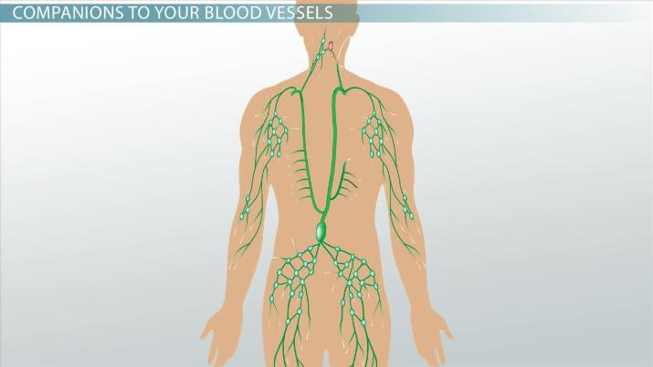

Slide 13
Lymph Nodes
Small, oval or bean-shaped structures.
Located along lymph vessels.
Act as biological filters.
Contain lymphocytes and macrophages.
Common groups: cervical, axillary, inguinal, mesenteric.

Slide 14
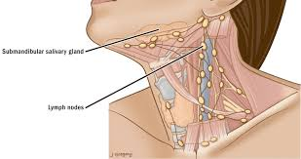

Slide 15
Lymphatic Organs
Spleen: filters blood and destroys old RBCs.
Thymus: maturation of T-lymphocytes.
Tonsils: local immune defense.
Peyer’s patches: immunity in intestine.

Slide 16


Slide 17


