Slide 1
Statistics
DPT
Awais Hamza

Slide 2
What Is an “Average”?
Average = A single value representing an entire dataset
Used for → Comparison • Decision-making • Trend analysis
Common types:
Mean
Median
Mode
Geometric Mean
Harmonic Mean
Weighted Average

Slide 3
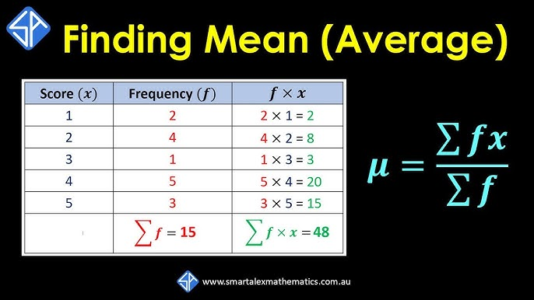

Slide 4
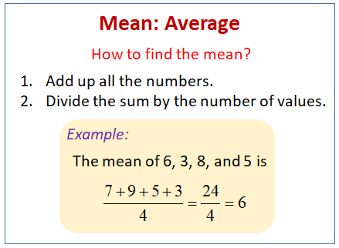

Slide 5
Arithmetic Mean
Properties:
Sensitive to extreme values
Best for symmetrical distributions
Additive

Slide 6
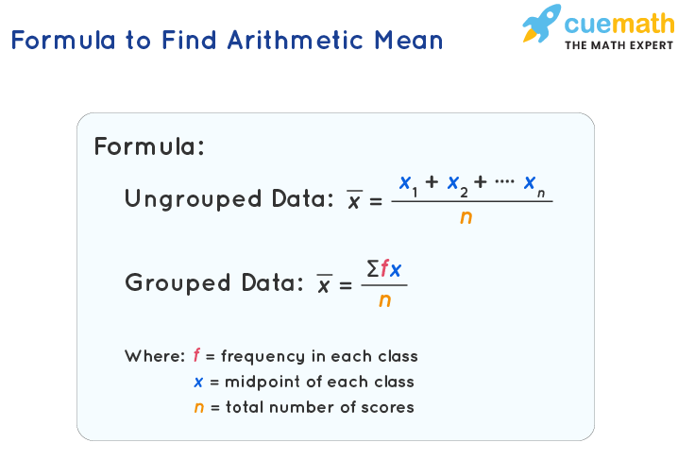

Slide 7
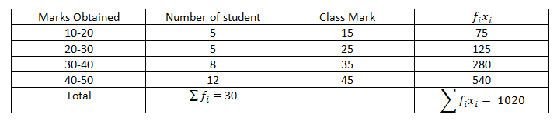

Slide 8
Questions
The daily temperatures recorded for a week (°C):
21, 24, 26, 28, 27, 25, 22
Find the mean temperature.
The heights (cm) of 6 plants are:
12, 15, 11, 18, 14, 16
Calculate the average height.
A teacher records the test scores of 8 students:
56, 72, 64, 80, 76, 68, 60, 84
Find the arithmetic mean.

Slide 9
Median
Median = Middle value after arranging data
Properties:
Not affected by outliers
Best for skewed data
Splits data into two equal parts
Example: 2, 4, 7, 9, 12 → Median = 7

Slide 10
Questions
Find the median of:
3, 9, 5, 8, 7, 6, 10
The weights (kg) of 9 people are:
52, 60, 58, 55, 62, 57, 59, 53, 61
Calculate the median.
The following data represents weekly pocket money (Rs.):
100, 150, 120, 180, 200, 160, 140
Find the median.

Slide 11
Mode
Mode = Most frequently occurring value
Types:
Unimodal (one mode), Bimodal
Multimodal, No mode
Best for: Categorical data, Distributions with peaks

Slide 12
Questions
Find the mode of:
4, 6, 3, 6, 8, 6, 5
Determine the mode of the following numbers:
12, 15, 11, 15, 14
Find the modal value:
20, 22, 22, 25, 27, 22, 30
Find the mode:
5, 8, 9, 8, 7, 6, 8
Identify the mode:
100, 95, 90, 100, 85, 95, 90, 100

Slide 13
Mode Questions
Find the mode of the following data:
10, 9, 11, 10, 12, 10, 13, 11
The number of cars sold in 10 days:
5, 7, 6, 7, 8, 7, 5, 6, 7, 8
Find the mode.
For the following dataset, calculate the mode:
45, 50, 45, 60, 55, 50, 45, 55

Slide 14
Geometric Mean (GM)
The Geometric Mean (GM) is the nth root of the product of n positive numbers.It is used when values are multiplicative, growth-based, or change over time.
Used for:
Growth rates
Ratios
Percent changes
Financial returns

Slide 15
When is Geometric Mean Used?
GM is ideal when:
✔ Data involves ratios or rates
Examples: growth rate, interest rate, inflation, population growth.
✔ Multiplicative changes occur
Values multiply, not add.
✔ Values vary greatly
GM reduces the effect of extremely large values.

Slide 16
Properties of Geometric Mean
GM is always less than or equal to AM
Geometric Mean < Arithmetic Mean
GM is appropriate only for positive values
Because you cannot take log or even roots of negative values.
Multiplying each observation by a constant k multiplies GM by the same constant.
GM is affected by every value, just like the arithmetic mean.
GM is the best measure for growth and compounding.

Slide 17
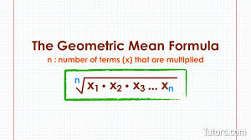

Slide 18
Questions
Find the geometric mean of:
4 and 16
Compute the GM of:
2 and 18
Find the geometric mean:
5 and 20

Slide 19
Questions
Find the geometric mean of:
2, 8, 32
Compute the GM of the three numbers:
4, 16, 64
Find the GM of the dataset:
1, 3, 9, 27

Slide 20
