Slide 1

ANATOMY
BS RIT,OTT,MLT
1ST SEMESTER
DR DANISH

Slide 2
Circulatory Routes
The human body has three major circulatory routes:
  Systemic circulation
  Pulmonary circulation
  Coronary circulation
Together, they ensure continuous transport of oxygen, nutrients, hormones, and waste materials throughout the body.

Slide 3
Systemic Circulation
Largest and most extensive circulatory route.
Function: Delivers oxygen-rich blood from the left ventricle to all body tissues (except the lungs) and returns deoxygenated blood to the heart.

Slide 4
Continued
Pathway:
  Begins at the left ventricle.
  Blood is pumped into the aorta, the body’s main artery.
  Aorta sends branches to the upper body (via superior vena cava) and lower body (via inferior vena cava).
  Oxygen exchange occurs in the capillary beds of organs and tissues.
  Deoxygenated blood returns to the right atrium via the:
    Superior vena cava (from upper limbs, head, neck, thoracic region)
    Inferior vena cava (from abdomen, pelvis, lower limbs)
Ensures supply of oxygen and nutrients to every organ system.

Slide 5
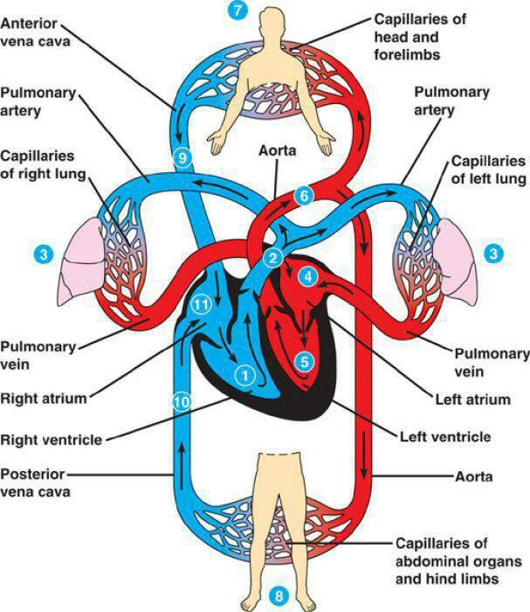

Slide 6
Pulmonary Circulation
Transports deoxygenated blood from the heart to the lungs and returns oxygenated blood back to the heart.
Pathway:
Begins in the right ventricle.
Blood enters the pulmonary trunk, which divides into:
  Right pulmonary artery → right lung
  Left pulmonary artery → left lung

Slide 7
Continued
  In the lungs, blood flows through pulmonary capillaries, where:
    Carbon dioxide is removed
    Oxygen is absorbed
  Oxygenated blood drains into four pulmonary veins (two from each lung).
  Returns to the left atrium.
Entire cycle takes about 4–8 seconds.
Essential for gas exchange and maintaining oxygen supply to the body.

Slide 8
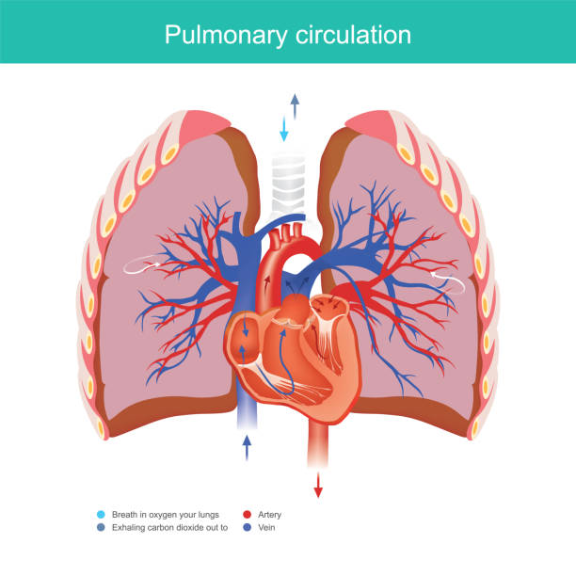

Slide 9
Coronary Circulation
Supplies blood to the heart muscle itself, ensuring it receives oxygen and nutrients.
Coronary arteries:
  Originate from the arch of the aorta.
  Usually two main arteries:
    Right coronary artery
    Left coronary artery

Slide 10
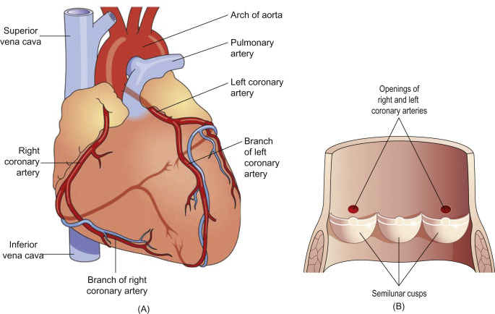

Slide 11
Venous drainage routes
Coronary sinus
  Collects most of the venous blood from the heart wall.
  Drains into the right atrium.
  Accounts for about 66% of cardiac venous return.
Anterior cardiac veins
  Usually 2–3 small veins.
  Drain directly into the right atrium, not through the coronary sinus.

Slide 13
Continued
Venae cordis minimae:
Small venous channels
Begin in the wall of heart end directly into its chambers
Mainly in right atrium & right ventricle

Slide 14
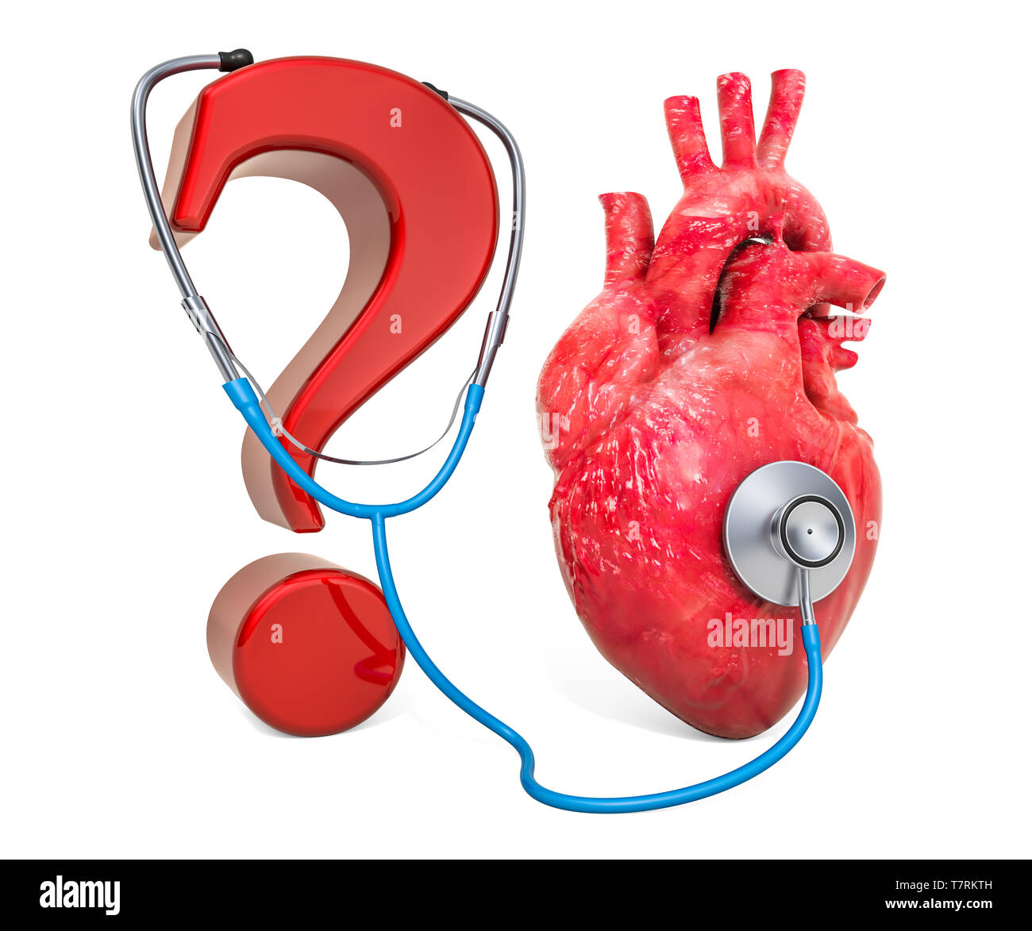

Slide 15


