Slide 1

PHYSIOTHERAPY TECHNIQUES I
FSC PT I
DR DANISH

Slide 2
Ulnar Nerve Injury
Definition:
Injury or compression of the ulnar nerve, which runs from the brachial plexus down the arm into the hand
Common sites of injury: cubital tunnel (elbow), Guyon’s canal (wrist)
Leads to sensory and motor dysfunction in the ring & little fingers and intrinsic hand muscles

Slide 3
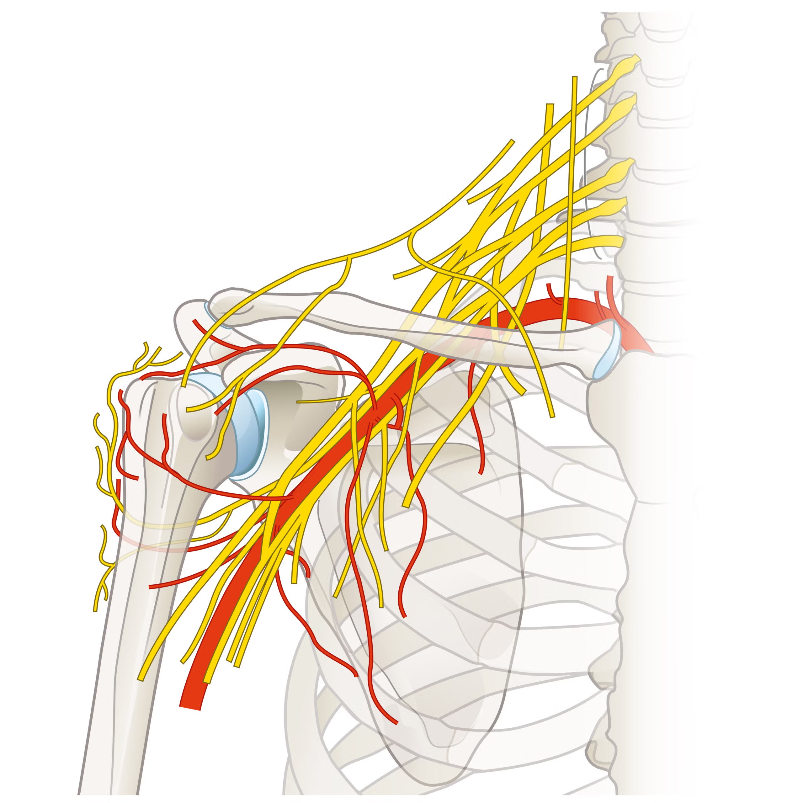

Slide 4
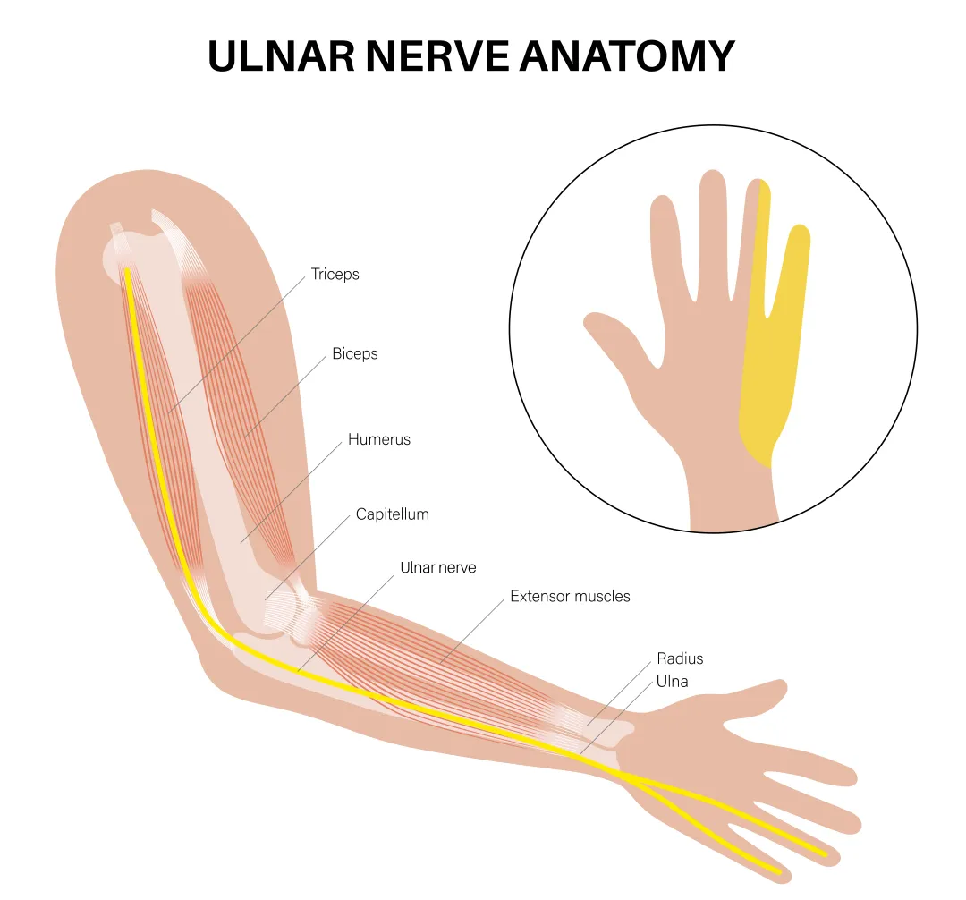

Slide 5
Symptoms of Ulnar Nerve Injury
Symptoms of Ulnar Nerve Injury
Numbness & tingling in the ring and little fingers
Weak grip strength
Claw hand deformity (hyperextension at MCP, flexion at IP joints of 4th & 5th digits)
Muscle wasting in the hand, especially the interossei and hypothenar muscles

Slide 6
CONTINUED
Difficulty with:
  Finger spread / adduction
  Precision grip
  Pinch movements
Pain or aching on the inside of the elbow or wrist (depending on site of injury)

Slide 7
Causes of Ulnar Nerve Injury
Compression at the elbow (Cubital tunnel syndrome)
Compression at the wrist (Guyon's canal syndrome)
Trauma:
  Fractures of the humerus, elbow, wrist
  Direct blow to the medial elbow

Slide 8
CONTINUED
Prolonged elbow flexion (sleeping with elbows bent, phone use)
Repetitive strain from occupational or athletic activities
Inflammation or swelling around the nerve
Diabetes and other neuropathy-related disorders
Iatrogenic injury during elbow or wrist surgery

Slide 9
Treatment of Ulnar Nerve Palsy
Conservative Management
Activity modification (avoid prolonged elbow flexion / pressure)
Splinting:
  Night elbow splint at 30–45° flexion
  Wrist splint for Guyon's canal compression
NSAIDs for pain and inflammation

Slide 10
CONTINUED
Physiotherapy:
  Nerve-gliding exercises
  Strengthening of intrinsic hand muscles
  Posture correction
Ergonomic adjustments for work and daily activities

Slide 11
CONTINUED
Medical / Surgical Management
Steroid injections (select cases)
Surgical decompression:
  Cubital tunnel release
  Medial epicondylectomy
  Anterior transposition of the ulnar nerve
Surgery for Guyon's canal release
Post-surgical physiotherapy to restore function

Slide 12
Common Peroneal Nerve Injury
Definition:
Injury to the nerve that wraps around the fibular neck and controls foot dorsiflexion, eversion, and toe extension.

Slide 13
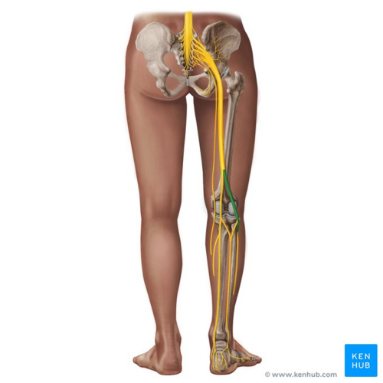

Slide 14
Causes
Trauma around the knee (fibular head fracture, knee dislocation)
Compression from tight casts/braces or frequent leg crossing
Prolonged squatting or kneeling
Surgical complications (especially knee surgery)
Rapid or severe weight loss reducing soft-tissue protection

Slide 15
Symptoms
Foot drop (cannot lift foot upward)
Weak foot eversion and toe extension
Sensory loss or tingling on lateral leg and dorsum of foot
Steppage gait
Pain or burning sensation along the nerve pathway

Slide 16
Treatment
Remove external pressure or tight dressings
Physical therapy for strengthening and gait training
Ankle–foot orthosis (AFO) for foot drop
Pain control (NSAIDs, neuropathic medications)
Surgical decompression if entrapment
Nerve repair or grafting if lacerated
Tendon transfer for chronic, non-recovering foot dr

Slide 17


Slide 18


