Slide 1

Central Nervous System
BS-PSY
1ST SEMESTER
Ms. Shehwar Saeed

Slide 2
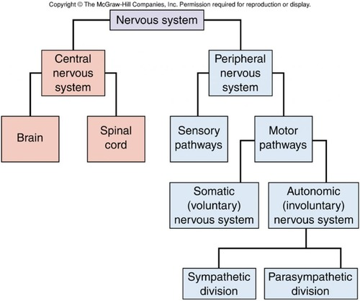

Slide 3
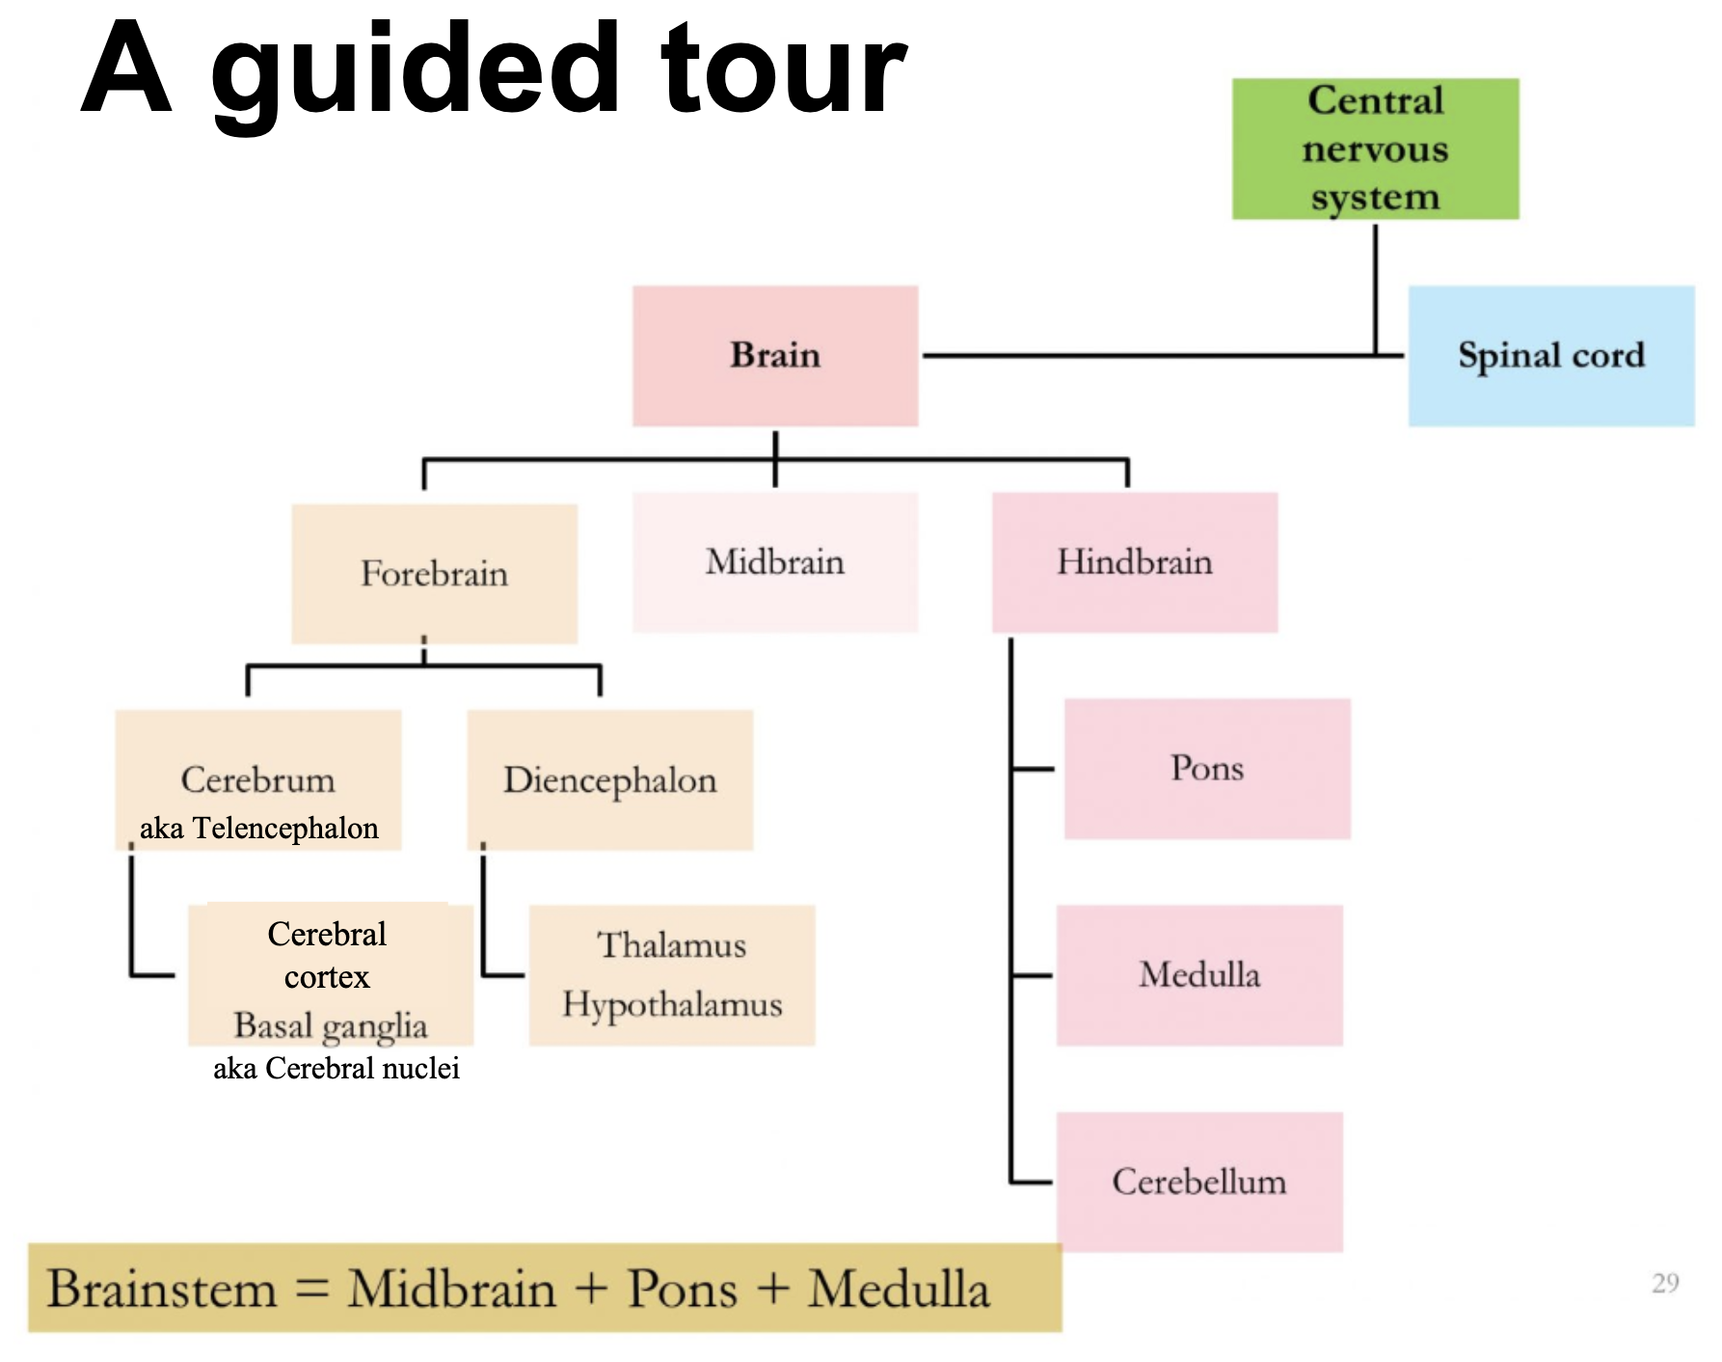
Central Nervous System
Brain
  Forebrain
  Midbrain‘
  Hindbrain

Slide 4
Forebrain
largest and most complex region of the brain, encompassing a variety of structures, including the thalamus, hypothalamus, limbic system, and cerebrum.
The Thalamus: A Relay Station
The Hypothalamus: A Regulator of Biological Needs
  hypo means “under,”
  control the autonomic nervous system

Slide 5
Forebrain
  link between the brain and the endocrine system
  regulation of basic biological drives and processes
The Limbic System
  located roughly along the border between the cerebral cortex and deeper sub cortical areas.
  hippocampus, the amygdala -memory formation, emotion, motivation

Slide 6
Forebrain
The Cerebrum: The Center of Complex Thought-Outer layer cerebral Cortex
  Right and Left Hemispheres
  Corpus Callosum
  cerebral hemisphere is divided into four parts called lobes

Slide 7
Forebrain
The occipital lobe, at the back of the head
The parietal lobe is forward of the occipital lobe
The temporal lobe (meaning “near the temples”)
, the frontal lobe, the largest lobe in the human brain.

Slide 8
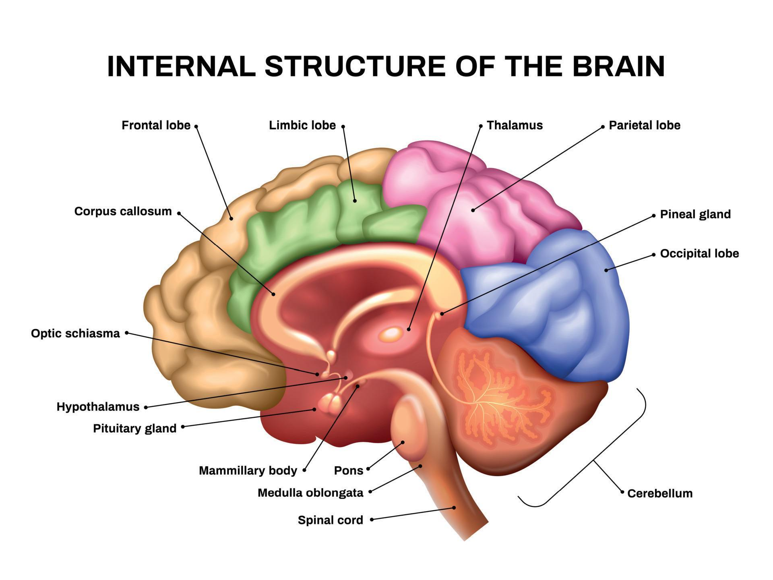

Slide 9
Midbrain
Located at the central core of the brainstem
Running through both the hindbrain and the midbrain is the reticular formation
regulation of sleep and arousal

Slide 10
Hindbrain
The hindbrain includes the cerebellum and two structures found in the lower part of the brainstem: the medulla and the pons.
Medulla -attaches to the spinal cord, controls largely unconscious but vital functions
Pons-pons (literally “bridge”) includes a bridge of fibers that connects the brainstem with the cerebellum.
It involved with sleep and arousal

Slide 11
Hindbrain
Cerebellum-(literally “little brain”) is a relatively large and deeply folded structure
coordination of movement and to the sense of equilibrium, or physical balance

Slide 12
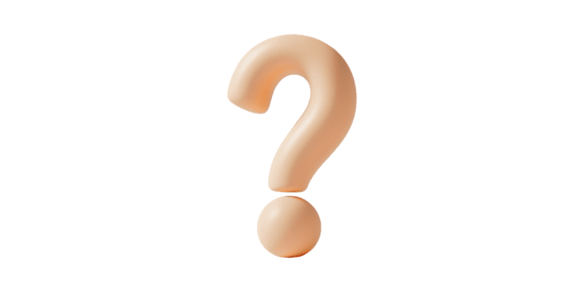
Any Question?

Slide 13


