Slide 1

Influences on Aggression
BS-MLT
1ST SEMESTER
Ms. Shehwar Saeed

Slide 2
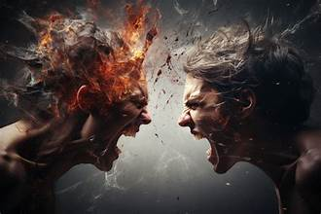
Influences on Aggression
interaction of
  Biological Elements.
  Situational Factors,
  Personal Characteristics

Slide 3
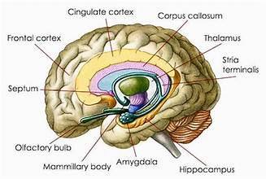
Biological Influences
Genetics: A predisposition for aggression can be partially inherited.
Brain Structure and Neurotransmitters:
  Amygdala and prefrontal cortex
  Serotonin and dopamine

Slide 4
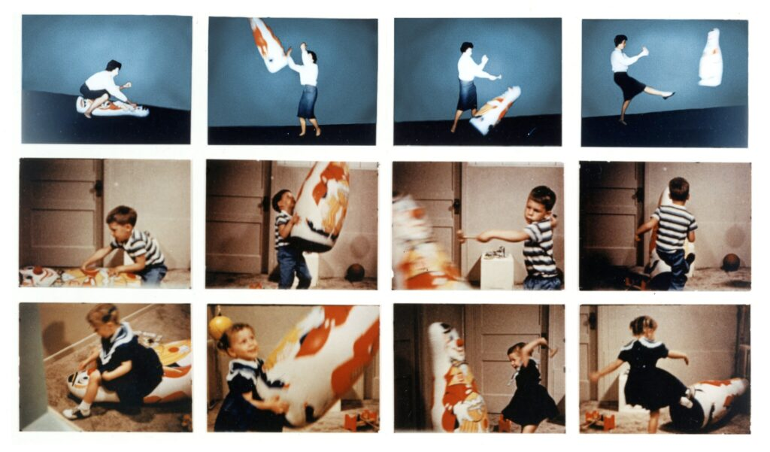
Situational and Environmental Influences
Frustration and Provocation
Social Learning and Media
  Bobo doll experiment
  Mass media
Environmental Discomfort
  Unpleasant environmental conditions

Slide 5
Situational and Environmental Influences
Weapon Effect
  Presence of Aggressive Cues
Social Exclusion
  Experiencing social rejection or ostracism can lead to feelings of injustice and lower self-esteem

Slide 6

Personal and Individual Influences
Personality Traits
  Impulsivity
  Neuroticism
  narcissism
Gender
Hostile Cognitive Biases
Substance Use

Slide 7

Any Question?

Slide 8


