Slide 1

Neuron: Structure and Functions
BS PSYCHOLOGY
1ST SEMESTER
Ms. Shehwar Saeed

Slide 2
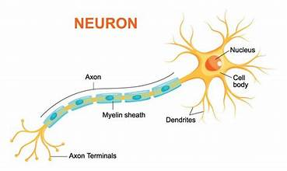
Agenda
Structure of Neuron
Functions of Neuron
Neural Communication
  Communication between neuron
  Threshold
  Action Potential
  Postsynaptic Potential

Slide 3
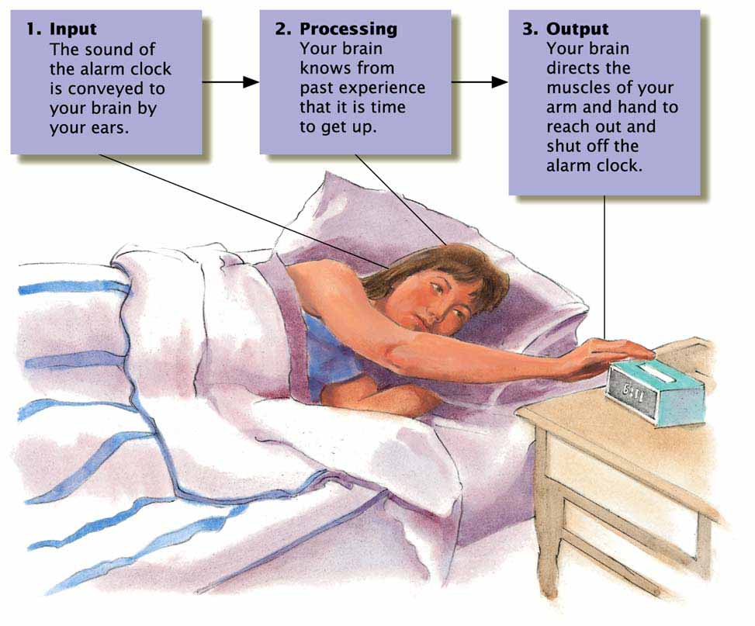
Three Functions of the Nervous System
The nervous system’s three main functions are to receiver information (input), integrate that information with past experiences (processing), and guide actions (output).

Slide 4
Neurons
Fundamental unit of the nervous system – nerve cell
  Dendrite
    The branching extensions of a neuron that receive messages and conduct impulses toward the cell body
  Axon
    the extension of a neuron, ending in branching terminal fibers, through which messages are sent to other neurons or to muscles or glands

Slide 5
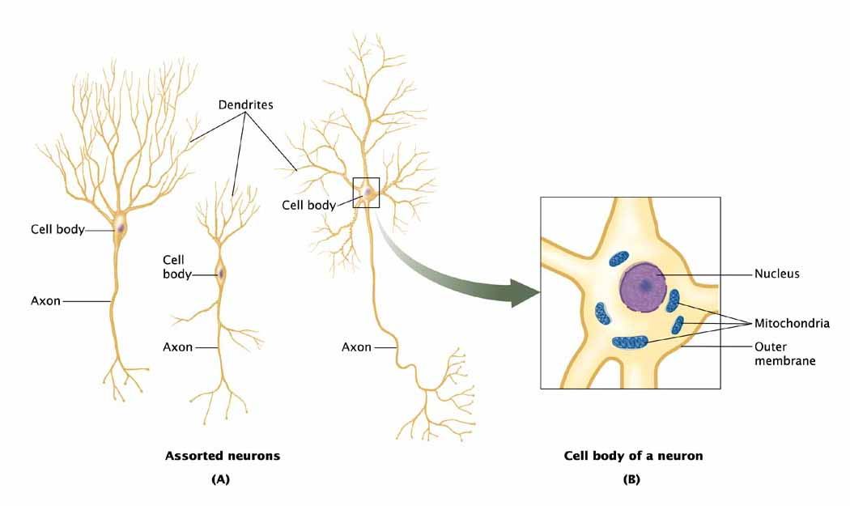

Slide 6
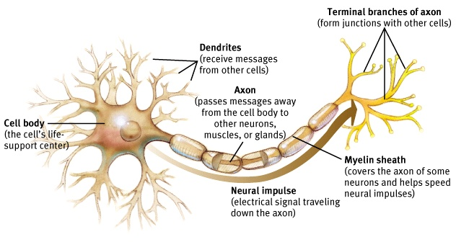
Neurons
Myelin
  A fatty substance that wraps around some axons and increases the speed of action potentials
Terminal Buttons
  are the small, bulbous structures at the ends of a neuron's axon that transmit signals to other neurons by releasing chemical messengers called neurotransmitters.

Slide 7
Neural Communication
A neurons cell membrane is a semipermeable barrier – molecules that pass through carry either a positive or negative charge
Polarized cell membrane – when the cell pumps positively charged molecules out through its membrane, making the inside more negative than the outside
Some positively charged molecules are able to pass through openings called channels, located along axons and dendrites as act as “gates

Slide 8
Action Potential
A wave of electrochemical changes traveling down an axon when a neuron becomes depolarized
  Changes in the environment around the cell can depolarize part of its membrane, causing the gates to open and allowing positively charged molecules to rush in
  The sequence continues, creating a wave of changes in electrochemical potential that spreads down the axon
Threshold –
  the level of stimulation required to trigger a neural impulse

Slide 9
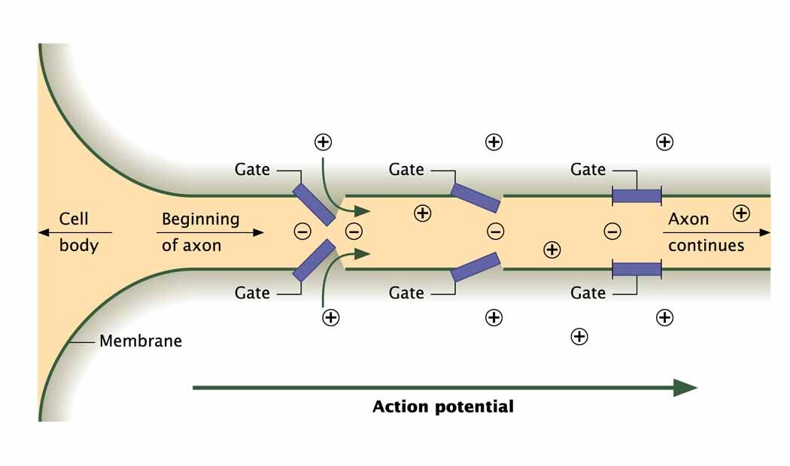
The Beginning of an Action Potential

Slide 10
Neural Communication
Synapse
  junction between the axon tip of the sending neuron and the dendrite or cell body of the receiving neuron
Neurotransmitters
  chemical messengers that assists in the transfer of signals from one neuron to another
  when released by the sending neuron, neuro-transmitters travel across the synapse and bind to receptor sites on the receiving neuron, thereby influencing whether it will generate a neural impulse
  Receptors – site on the surface of a cell that allows only one type of neurotransmitter to fit into it

Slide 11
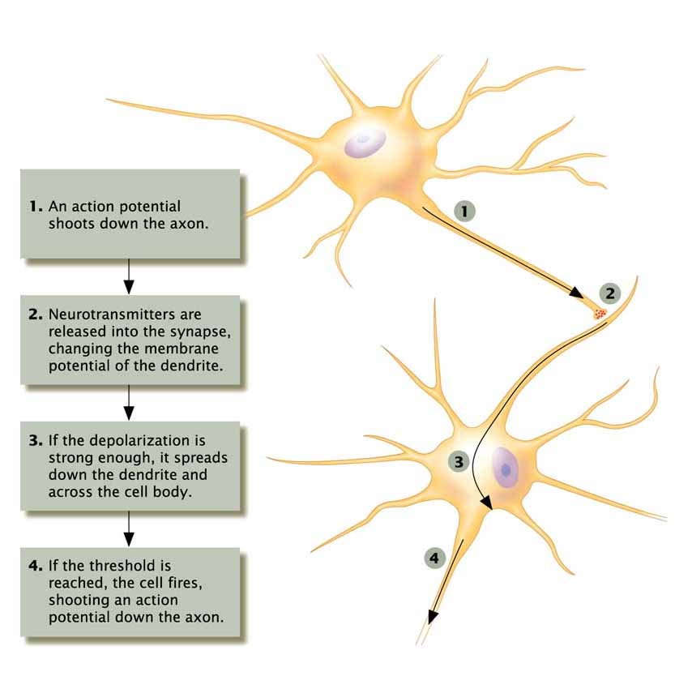
Communication Between Neurons

Slide 12
Postsynaptic Potential
The change that takes place in the membrane potential of the postsynaptic cell (a neuron that has received stimulation from another neuron)
  Excitatory Postsynaptic Potential – the polarization of the neuron’s membrane, making the cell more likely to fire an action potential
  Inhibitory Postsynaptic Potential – the hyperpolarization of the neuron’s membrane, making a cell less likely to fire an action potential

Slide 13

Any Question?

Slide 14


