Slide 1

ANATOMY
BS RIT,MLT,OTT
1ST SEMESTER
DR DANISH

Slide 2
Anastomosis of Blood Vessels
Introduction:
The term anastomosis refers to a connection between two blood vessels.
It forms a network that allows blood to take an alternate route if one pathway is blocked.
It maintains continuous blood flow to tissues and prevents ischemia.
Anastomoses can occur between arteries, between veins, or between arteries and veins.

Slide 3
Types of Anastomoses
A. Arterial Anastomosis
B. Arteriovenous Anastomosis (A-V Shunts)
C. Venous Anastomosis

Slide 4
A. Arterial Anastomosis
A. Arterial Anastomosis
A direct or indirect connection between two arteries.
Provides collateral circulation—a natural backup system for blood supply.
Ensures tissues receive blood even if one arterial branch is obstructed.
Common in regions where constant blood flow is essential (e.g., limbs, joints).

Slide 5
CONTINUED
Can be:
  True anastomosis – actual joining of two arterial branches.
  Potential anastomosis – terminal branches come close but do not join; may develop collateral flow if needed.

Slide 6
Examples of Arterial Anastomosis
Around joints (e.g., scapular anastomosis around the shoulder).
Gastric arteries along the lesser and greater curvatures of the stomach.
Arterial arcades in the intestines.

Slide 7
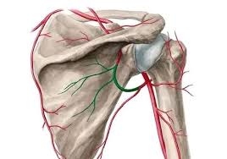

Slide 8
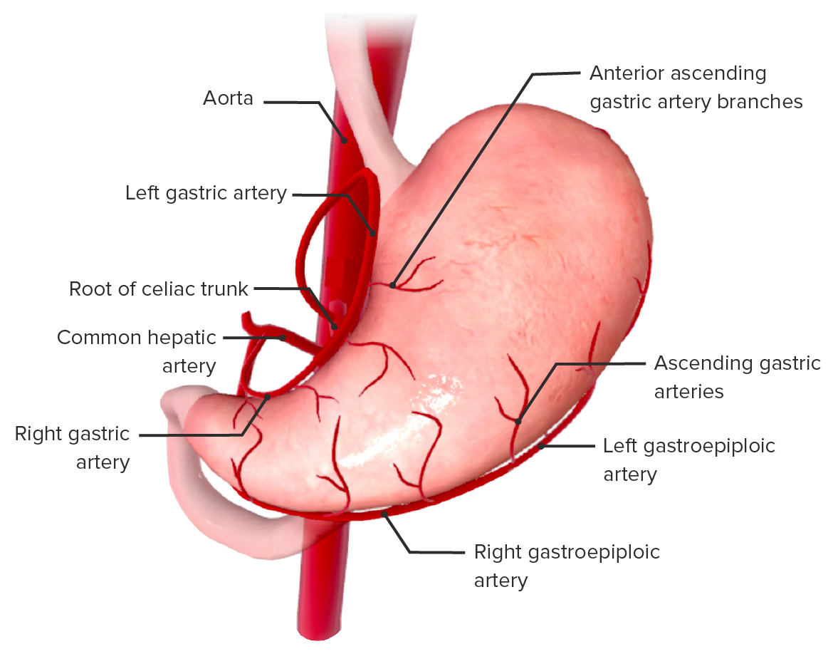

Slide 9
B. Arteriovenous Anastomosis (A-V Shunts)
A direct connection between an artery and a vein without passing through capillaries.
Allows blood to bypass capillary beds.
Regulates blood flow, temperature, and local circulation.
Controlled by smooth muscle or specialized sphincters.
Abundant in skin of digits, ears, and nose—helps conserve heat in cold environments.

Slide 10
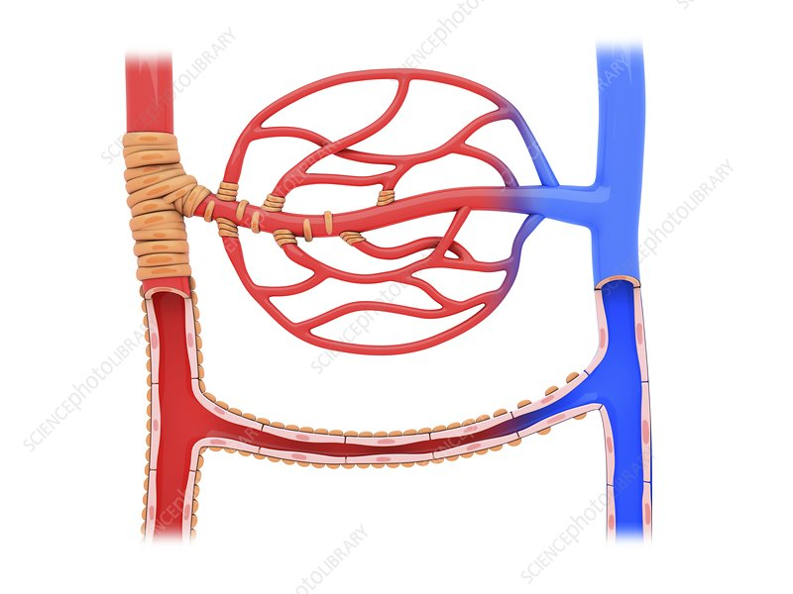

Slide 11
Functions of Arteriovenous Anastomosis
Thermoregulation
  Opens in cold: reduces heat loss by diverting blood away from the skin.
  Closes in heat: increases blood flow to skin for heat dissipation.
Blood pressure control—by altering peripheral resistance.
Rapid redistribution of blood during emergencies.

Slide 12
Venous Anastomosis (Brief Overview)
Connections between veins.
More common and extensive than arterial anastomosis.
Assist in venous return and provide multiple drainage pathways.
Example: veins of the scalp, limbs, and portal–systemic venous connections.

Slide 13
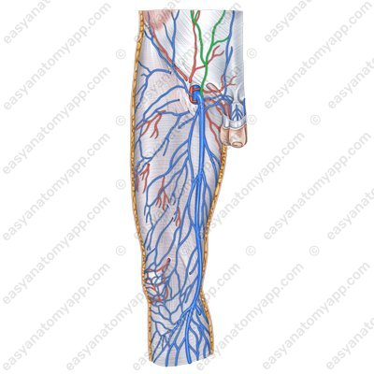

Slide 14
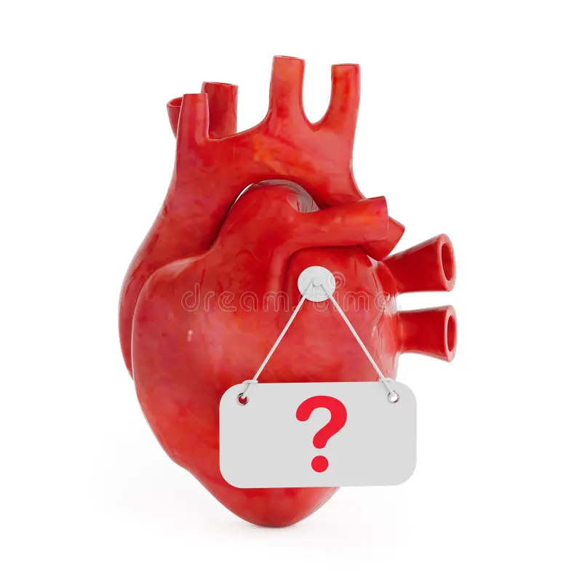

Slide 15


