Slide 1
Cardiac Event Monitor
ADNAN RAMZAN
FSC(OT)

Slide 2
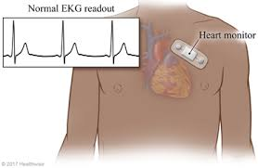
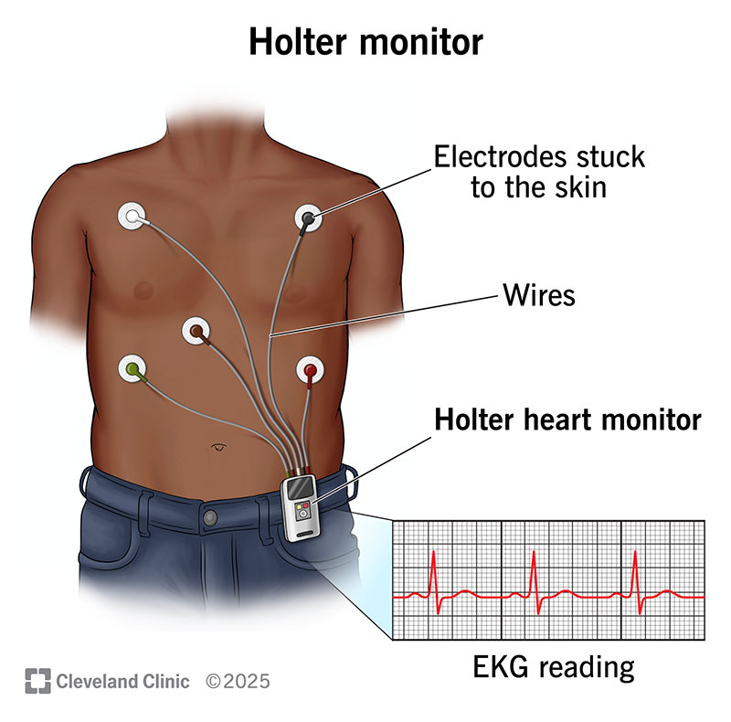

Slide 3
Cardiac Event Monitor
Small wearable device to record heart rhythm over time
Detects abnormal rhythms that don’t happen daily
Works like ECG but for long-term monitoring
Battery-powered and portable
Notes:
a standard cardiac monitor (like a Holter) records continuously (24/7) for a short period (days), while a cardiac event monitor is worn longer (weeks) but only records when you press a button or it detects an issue, capturing specific symptomatic episodes rather than constant data

Slide 4
Types of Cardiac Event Monitors
Patch Recorder
patch recorder (or cardiac patch monitor) is a small, adhesive, wireless device worn on the chest to continuously record your heart's electrical activity (ECG) for days or weeks
worn for up to 2 weeks
Symptom Event Monitor – activated by patient when symptoms start
Loop Memory Monitor – records before & after events
Implanted Loop Recorder – under the skin for years
Notes:
implantable loop recorder (ILR) is a small device that a healthcare provider places in your chest, just beneath the skin. It monitors your heart rate and rhythm and records anything that's abnormal. Most stay implanted for up to three years, but it may come out sooner if your provider gets the information they need.
insert or fix (tissue or an artificial object) in a person's body, especially by surgery.

Slide 5
When is It Used?
Symptoms that happen rarely
Irregular heartbeats not seen in hospital
To diagnose hidden cardiac issues
To monitor heart over weeks/months

Slide 6
Reasons for Use
Fainting, chest pain, dizziness
Palpitations After heart attack or stroke
Risk of arrhythmia
Notes:
Heart palpitations (pal-pih-TAY-shuns) are feelings of having a fast-beating
(fainting)fast onset, short duration, and spontaneous recovery
irregularities in the heartbeat,

Slide 7
Cardiac Event Monitor vs Holter Monitor
Feature | Holter Monitor | Event Monitor
Duration | 24–48 hours | Weeks to months
Recording | Continuous | Only during symptoms
Use | Frequent symptoms | Rare symptoms

Slide 8
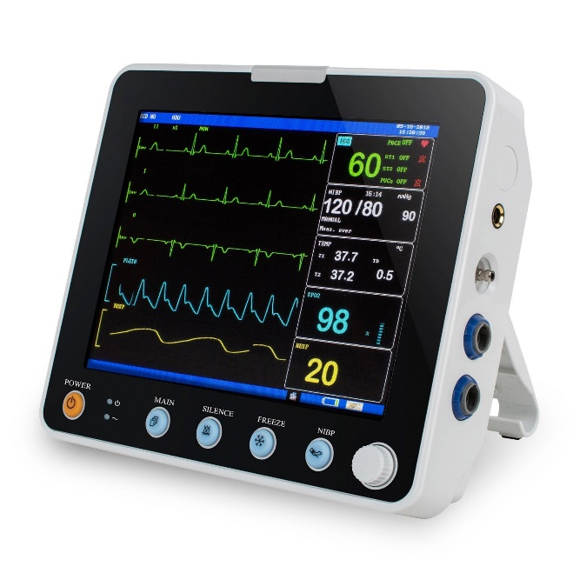
What is a Cardiac Monitor?
Bedside monitor showing heart’s electrical activity
Used in hospitals (ICU, OT, ER)
Provides continuous real-time readings

Slide 9
Purpose of Cardiac Monitor
Shows ECG waves continuously
Measures oxygen saturation & blood pressure
Alerts staff if readings become abnormal
Helps emergency detection and treatment

Slide 10
Components
Monitor screen
ECG cables & electrodes
Pulse oximeter probe
Blood pressure cuff

Slide 11
Additional Easy Points
Improves patient safety
Helps doctors make quick decisions
Reduces hospital stay & complications
Patient-friendly, safe and painless

Slide 12
Cardiac Event Monitor
Device used to record heart rhythms for a long duration
Helps diagnose irregular heartbeat conditions
Used in OPD / home settings

Slide 13
How it Works
Sensors placed on chest
Detect and record heart’s electrical signals
Data sent to doctor by phone or computer
Doctor checks for abnormal heart rhythm

Slide 14
What to Expect During Use
Sticky strips (electrodes) attached to chest
Painless and safe
You can bathe but may need to change patches
May need to press a button when symptoms occur

Slide 15
What Results Show
Detects:
Tachycardia → fast heart rate
Bradycardia → slow heart rate
Atrial fibrillation
Atrial flutter
Helps doctor plan treatment
Notes:
Atrial flutter –organize manner
Atrial fib-------chaotic manner

Slide 16
Do’s & Don’ts (Safety Precautions)
Keep monitor away from:
Electric blankets, razors
Mobile phones & magnets
Microwave ovens
Metal detectors

Slide 17
Advantages of Cardiac Event Monitor
Helps detect hidden heart rhythm problems
Continuous monitoring at home
No hospital stay required
Cost-effective diagnosis method

Slide 18
What is a Defibrillator?
A medical device used to treat life-threatening cardiac arrhythmias
Conditions: Ventricular fibrillation & Pulseless ventricular tachycardia
Delivers an electric shock to heart muscles
Restores normal heart rhythm and conduction
Life-saving emergency equipment

Slide 19
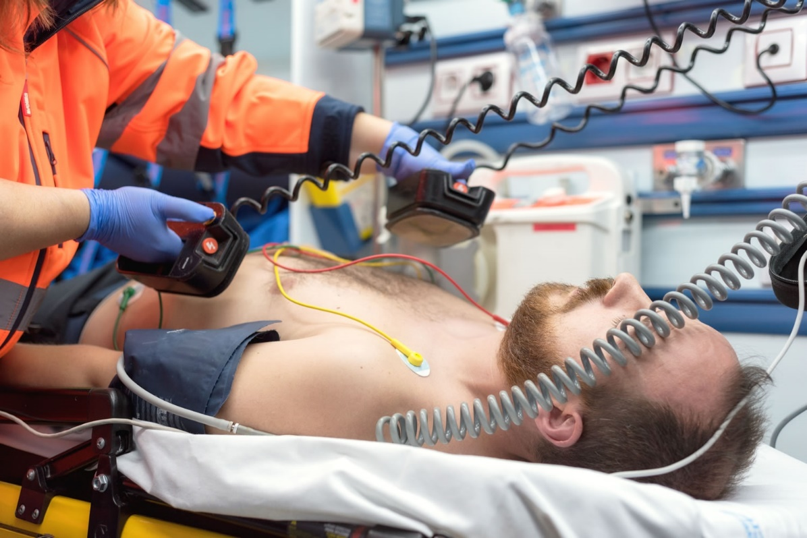

Slide 20
How Defibrillation Works
Detects abnormal heart rhythm
Delivers controlled electrical shock
Heart momentarily stops to reset rhythm
Normal heartbeat restarts after shock

Slide 21
Types of Defibrillators
External Defibrillators
Transvenous Defibrillators
Implantable Defibrillator (ICD)
AED – Automated External Defibrillator

Slide 22
Uses of Defibrillator
Cardiac arrest
Severe arrhythmias
Emergency OT and ICU care
During heart surgeries

Slide 23
What is a Defibrillator?
A medical device that gives an electric shock to the heart
Used to correct abnormal heart rhythms
Helps restart the heart during an emergency
Treats ventricular tachycardia and ventricular fibrillation
Brings heartbeat back to normal rhythm

Slide 25
Why It Is Needed
Can save life during sudden cardiac arrest
Restores proper heart pumping
Shock corrects dangerous arrhythmias
Works together with CPR for better results

Slide 26
Who Can Use It?
Doctors, nurses, trained first-aid responders
Public can use Automated External Defibrillator (AED)
Simple instructions guide the user
High-risk patients may need personal devices

Slide 27
Automated External Defibrillator (AED)
Easy to use with voice and visual instructions
Common in public places like malls and airports
Detects heart rhythm automatically
Delivers shock only if needed

Slide 28
Defibrillators for Personal Use
Used by people at high risk of heart failure
Device is small and portable
Shock may feel like a kick, but is lifesaving
Always available during emergency

Slide 29
Wearable Defibrillator
Worn like a vest under clothes
Sensors monitor heart continuously
Sends shock if abnormal rhythm detected
Temporary protection for risky heart patients

Slide 30
Implantable Cardioverter Defibrillator (ICD)
A small device placed inside the body
Works like a watchdog for the heart
Gives shock automatically when needed
Stays active 24/7 to prevent cardiac death

Slide 31
How Defibrillators Work
Electrodes placed on chest
Device checks heart rhythm
Shock stops abnormal electrical signals
Allows heart to restart normally

Slide 32
Using an AED
Check response and breathing
Call emergency help
Attach AED pads to chest as shown
Stand clear while shock is given
Follow AED voice commands

Slide 33
CPR With Defibrillator
CPR gives temporary blood flow
AED restarts the heart rhythm
Best when used together immediately
Every minute delay reduces survival chances

Slide 34
Where AEDs Are Found
Hospitals and ambulances
Schools, malls, airports, gyms
Public places for emergency help
Some homes of heart-risk patients

Slide 35
Safety Tips
Keep pads attached properly
Do not touch patient during shock
Avoid using near water or metal surfaces
Follow AED instructions carefully

Slide 36


